Slide 1
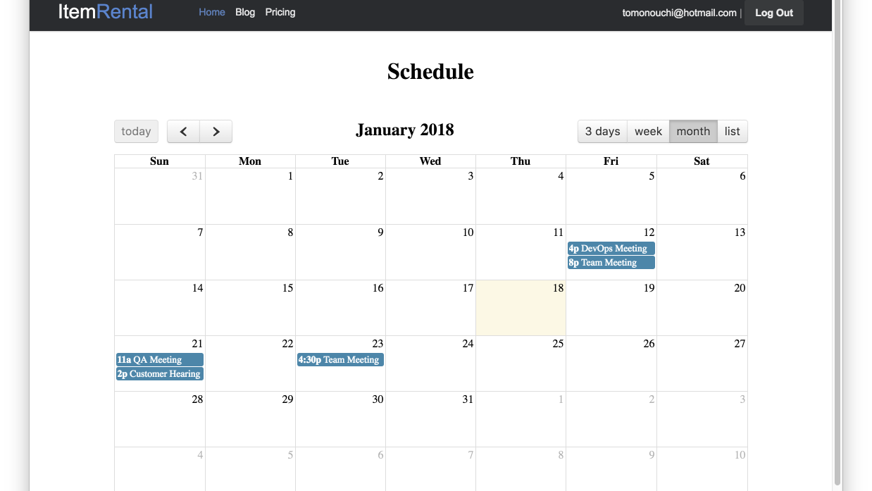

Team Meeting
Edit
Date
Jan 12 2018 (Mon) 2:00pm – 4:00pm
Location
19F Meeting Room A
Description
I entered this seed event into the database using Mongo shell.
Members
Tomohiro Sato
Kohey Sakamoto
Suguru Ihara
Yuichiro Kita
Junya Murakami
Visibility
Public

Slide 2

Team Meeting
Save
Date
Jan 12 2018 (Mon) 2:00pm – 4:00pm
Location
19F Meeting Room A
Description
I entered this seed event into the database using Mongo shell.
Members
Tomohiro Sato
Kohey Sakamoto
Suguru Ihara
Yuichiro Kita
Junya Murakami
Visibility
Public

