Slide 2
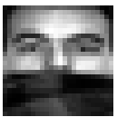
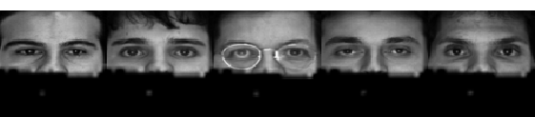
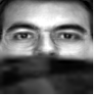


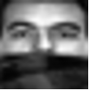
LR Input
HR Training Images
HR Output
α₁
α₂
α₃
α_{N}
Identification of Corrupted Pixels
LR Training Images
Interpolated Corrupted Pixels
Sparse Representation Based Image SR

Slide 3
LR Input
HR Training Images
HR Output
α₁
α₂
α₃
α_{N}
Identification of Corrupted Pixels
LR Training Images
Interpolated Corrupted Pixels
Sparse Representation Based Image SR
Notes:
modified

Slide 4

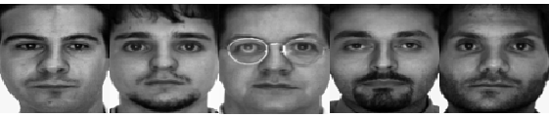
Position-patch Based Face Hallucination
LR Input
Traditional HR Output
Clean Training Images
Interpolated Image
Synthesis
Mask Learning
Our HR Output

Slide 5

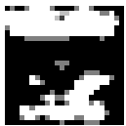
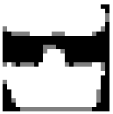

τ is too small
τ is too large
Reconstruct Error
τ
Target value of τ
(a) (b) (c) (d)
(too many pixels
are dropped)
(the reserved region still contains occlusions)
(Input)

Slide 6
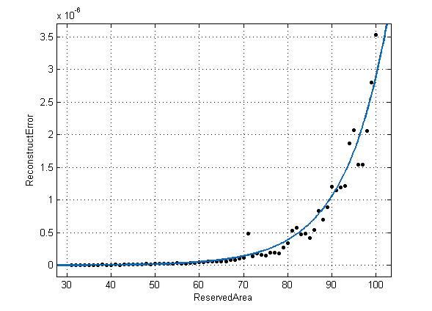
Reconstruct Error
τ(%)

Slide 7
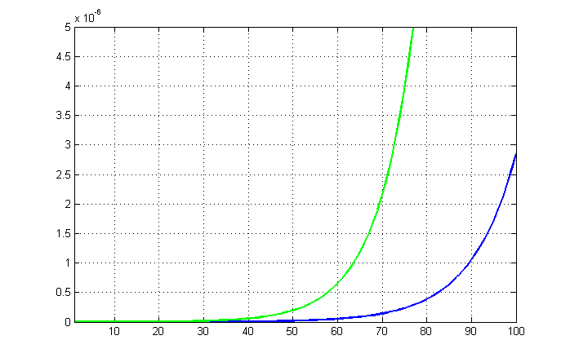
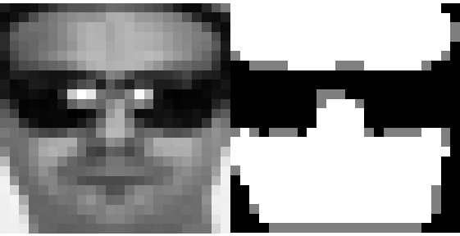
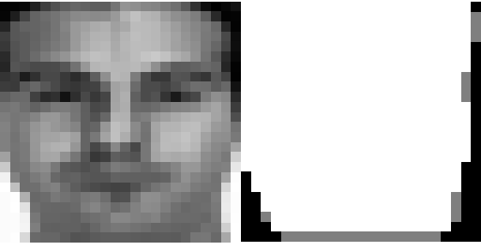
Reconstruct Error
τ(%)
(a) (b)

Slide 8
Table 1
Part A | Bicubic | Jung’s | Our
PSNR | 23.8445 | 24.7172 | 24.9705
SSIM | 0.8050 | 0.7781 | 0.8288
Part B | Bicubic | Jung’s | Our
PSNR | 25.6739 | 27.0004 | 27.2819
SSIM | 0.8559 | 0.8683 | 0.8830

Slide 9
Table 2
Method | LR_RSC | HR_Bicubic_RSC | HR_Jung_RSC | HR_Our_RSC
Recognition Rate | 85.50% | 80.33% | 83.50% | 88.50%

Slide 10
(a)
(b)
(c)
(d)

Slide 11
(a)
(b)
(c)
(d)
(a)

Slide 14
Experiment(視覺上)
Whole Image | Bicubic | Jung | Our | HR
Neutral | Class 1 Images
Sun glasses
Scarf
… | Class 2 Images
MaskedImage | Bicubic | Jung | Our | HR
Neutral | Class 1 Images
Sun glasses
Scarf
… | Class 2 Images

