Slide 1
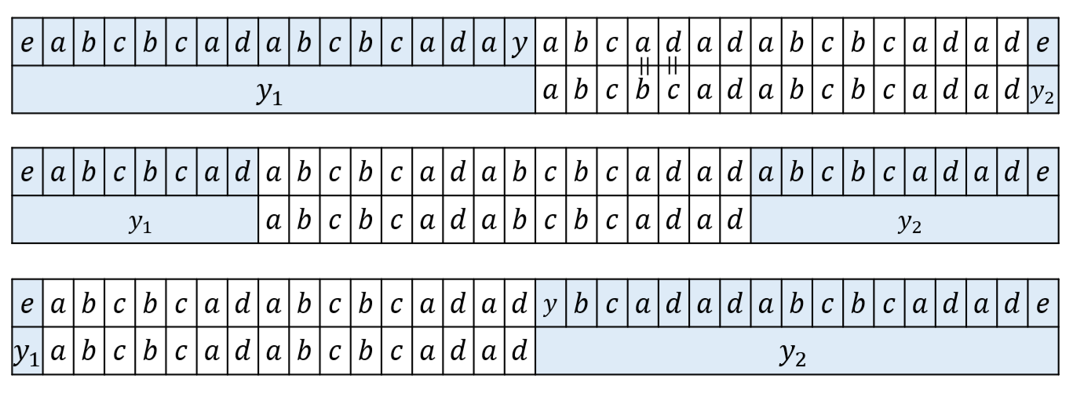



$$p\left\{x≔ya\right\}=$$
$$p\left\{x≔bc\right\}=$$
$$p\left\{x≔dy\right\}=$$

