Slide 1


KAVACH
TRAIN COLLISION AVOIDANCE SYSTEM
Toms Jiji Varghese
Narayanan Nampoothiry V
M.Tech Electronic Systems Engineering(2023-2025)

Slide 2
Sl. No. | Parameter | Mechanism | Remarks
1 | Network protocol | Modified UDP | Retransmission till ACK is received
2 | Typical latency | Train to Server to train | 6 to 12ms (including encryption and decryption time at server)
3 |  | Train to Server | 2-3ms
3 | Security features | Encryption | Base64-encoded 44-byte key
4 | Authentication method | Custom Challenge-Response AUTH Protocol | Both way handshake using challenge-response mechanism at start
5 | Error detection | CRC | Modulo operation with standard polynomial
6 | Error correction | Not applicable/needed | Retransmission
7 | Network statistics | Monitored | Client monitors based on RTT and informs server
8 | Fail-Safe | Declare a section RED Call for manual intervention | In case of no communication from a train, that particular section will be declared unsafe. Server redundancy, common database, Server-2 will take over in case of non-reception of health sync message
9 | Database ruggedness | Encryption and Authentication | Only data from specific trains are accepted to the database

Slide 3
KEY FEATURES
Efficient and reliable communication
Error detection
Cryptographic implementations
2-way authenticated
Strong algorithm
Efficient DBMS
Scalable architecture
Low latency
Fail-Safe
Feedback for network improvement
And many more…

Slide 4
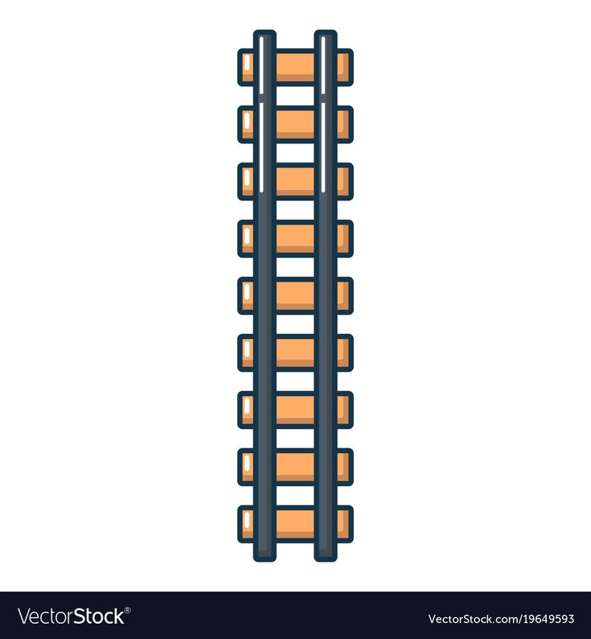
Architecture
Two RFIDs at entry and two at exit
RF IDs separated by fixed distance
RFID tag

Slide 5
Data stored in RFID tag
In-between stations
Bit number | 0-13 | 14-27 | 28-33 | 34 | 35 | 36
Data | Station 1 code | Station 2 code | Distance | differentiation between loop line and main line | Loop Line identification | Track direction
Description | Smaller of the station codes | Larger of the station codes | Distance from station 1 (in Km) | 0 -> Main Line (ignore bit 35) 1 -> Loop Line | 1 -> Up loop Line 0 -> Down loop Line | 1 -> Up Track 0 -> Down Track
Entry of station before the platform
Bit number | 0-13 | 14-27 | 28 | 29-34
Data | Station 1 code | Station 1 code | Branch or Platfrom | Identification of each branch
Description | Station code of the station | Station code of the station | 0 -> Not reached Platform | Used to uniquely identify each branching of the track. There will be 2 RFIDs at each branching, one in the branch and one in the main line
At platform
Bit number | 0-13 | 14-27 | 28 | 29-33 | 34
Data | Station 1 code | Station 1 code | Branch or Platfrom | Identification of each platform | Platform Entry/Exit identification
Description | Station code of the station | Station code of the station (if in parking lot the 0x00) | 1 -> Reached Platform | Unique identification of each platform according to platform number | 0 -> Inner RFIDs 1 -> Outer RFIDs

Slide 6
Data send to Server
Field | Explanation | Bits
WOD | Week of the day | 20
Train No. | Train number | 16
Station_1 | Station code | 14
Station_2 | Station code | 14
Platform | At a platform? (Y/N) | 1
Platform_ID | Platform number | 5
Entry | At platform entry? (Y/N) | 1
Branch ID |  | 6
Distance | Distance from a reference station | 6
Loop_line | Loop line? (Y/N) | 1
Track/Loop_line_ID | Up/Down | 1
Track_Direction | Towards station 1 or 2 | 1
TX_time |  | 20
Speed | From Odometer/GPS | 8
Stop | Whether Stopped? (Y/N) | 1
Direction | To Station1 or Station2 | 1
RTT | From previous transactions | 10
Total |  | 126

Slide 7
Database at Server
Field | Explanation | Bits
Received time | Server timestamp
WOD | Week of Day | 20
Train No. | Train number | 16
Station_1 | Station code | 14
Station_2 | Station code | 14
At Station | Y/N | 1
Platform | At a platform? (Y/N) | 1
Platform_ID | Platform number | 1
Entry | At platform entry? (Y/N) | 1
Branch ID |  | 6
Distance | Distance from a reference station | 6
Loop_line | Loopline? (Y/N) | 1
Track/Loop_line_ID | Up/Down | 1
Track_Direction | Towards station 1 or 2 | 1

Slide 8
Database at Server (Continuation)
Field | Explanation | Bits
TX_time |  | 1
Speed | From Odometer/GPS | 8
Stop | Whether Stopped? (Y/N) | 1
Direction |  | 1
RTT | From previous transactions | 10
IP | Obtained at Authentication
Port | Obtained at Authentication

Slide 9
Flow diagram at Server (Action thread)
Train number matches?
WAIT
State
Packet arrives
NO
WAIT
State
YES
Chance of collision
Challenge
Update Database
NO
NO
Decrypt
YES
YES
Send STOP message to train(s)
Challenge response

Slide 10
Flow diagram at client (Transmission thread)
RFID data arrives
Pattern matches?
WAIT
State
NO
WAIT
State
YES
Send via modified UDP protocol
Encrypt
Form packet
ACK received within the RTO
YES
Update RTT
NO

Slide 11
Flow diagram at client (Boot up thread)
ACK received within the RTO
Boot-up complete
Sent Challenge to server
YES
Connection established
NO

Slide 12
Flow diagram at client (Receiver thread)
WAIT
State
Message from server arrives
Decrypt
STOP message
Immediate STOP and inform the server
YES
NO
Challenge message
Send Challenge response
YES
NO
WAIT
State

Slide 13
Improved Fail-Safe algorithm for future…
Server-1
Server-2
Server-3
Moderator

Slide 14
THANK YOU..

Slide 15
Case 1 : Authentication
AUTHENTICATION : TRUE & FALSE
Case 2 : Head-On
Sl .No. | Train 1 | Train 2
Station 1 | Same
Station 2 | Same
Direction | 1 | 0
Distance | A | B
Track | Same
Decision will be taken based on the distance between trains (A-B)

Slide 16
Case 3 : Moving away
No Action
Case 4 : Following
Sl .No. | Train 1 | Train 2
Station 1 | Same
Station 2 | Same
Direction | 1 | 1
Distance | A | B
Track | Same
Speed | ≠0 | ≠0
If the distance between trains (A-B) is less than the threshold, STOP will be issued to the train behind

