Slide 1

Customer Analysis
Tom Ruge

Slide 2

Beginning of our journey
Your Data:
  - Purchase channels
  - Customer Data
  - Product spending
  - Promotion campaigns

Slide 3

What you will get!
Primary Goal:
  - Segmentation of customer groups
Ancillary objectives:
  - Unique insights into your company
  - Better use of companies resources
→ Business more profitable

Slide 4
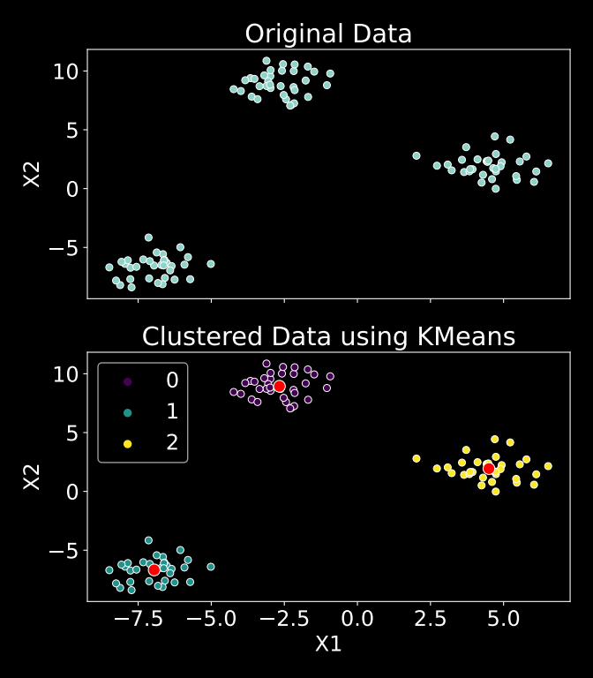
Method: Clustering
- Clustering finds groups of properties in the data.
→ Identifying groups of
customers

Slide 5
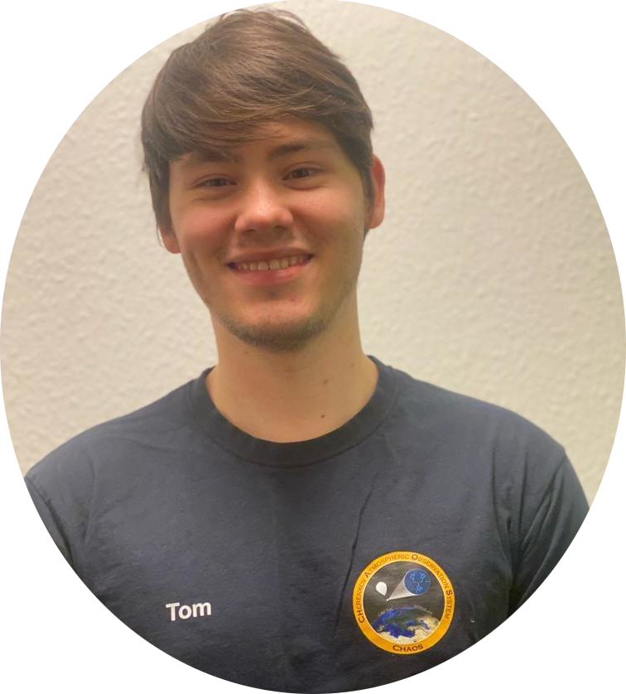
Let us make the world a better place to be a customer
TickleTech Consulting
Tom Ruge
(+69)973 648648
tomson@smtp.org

