Slide 1
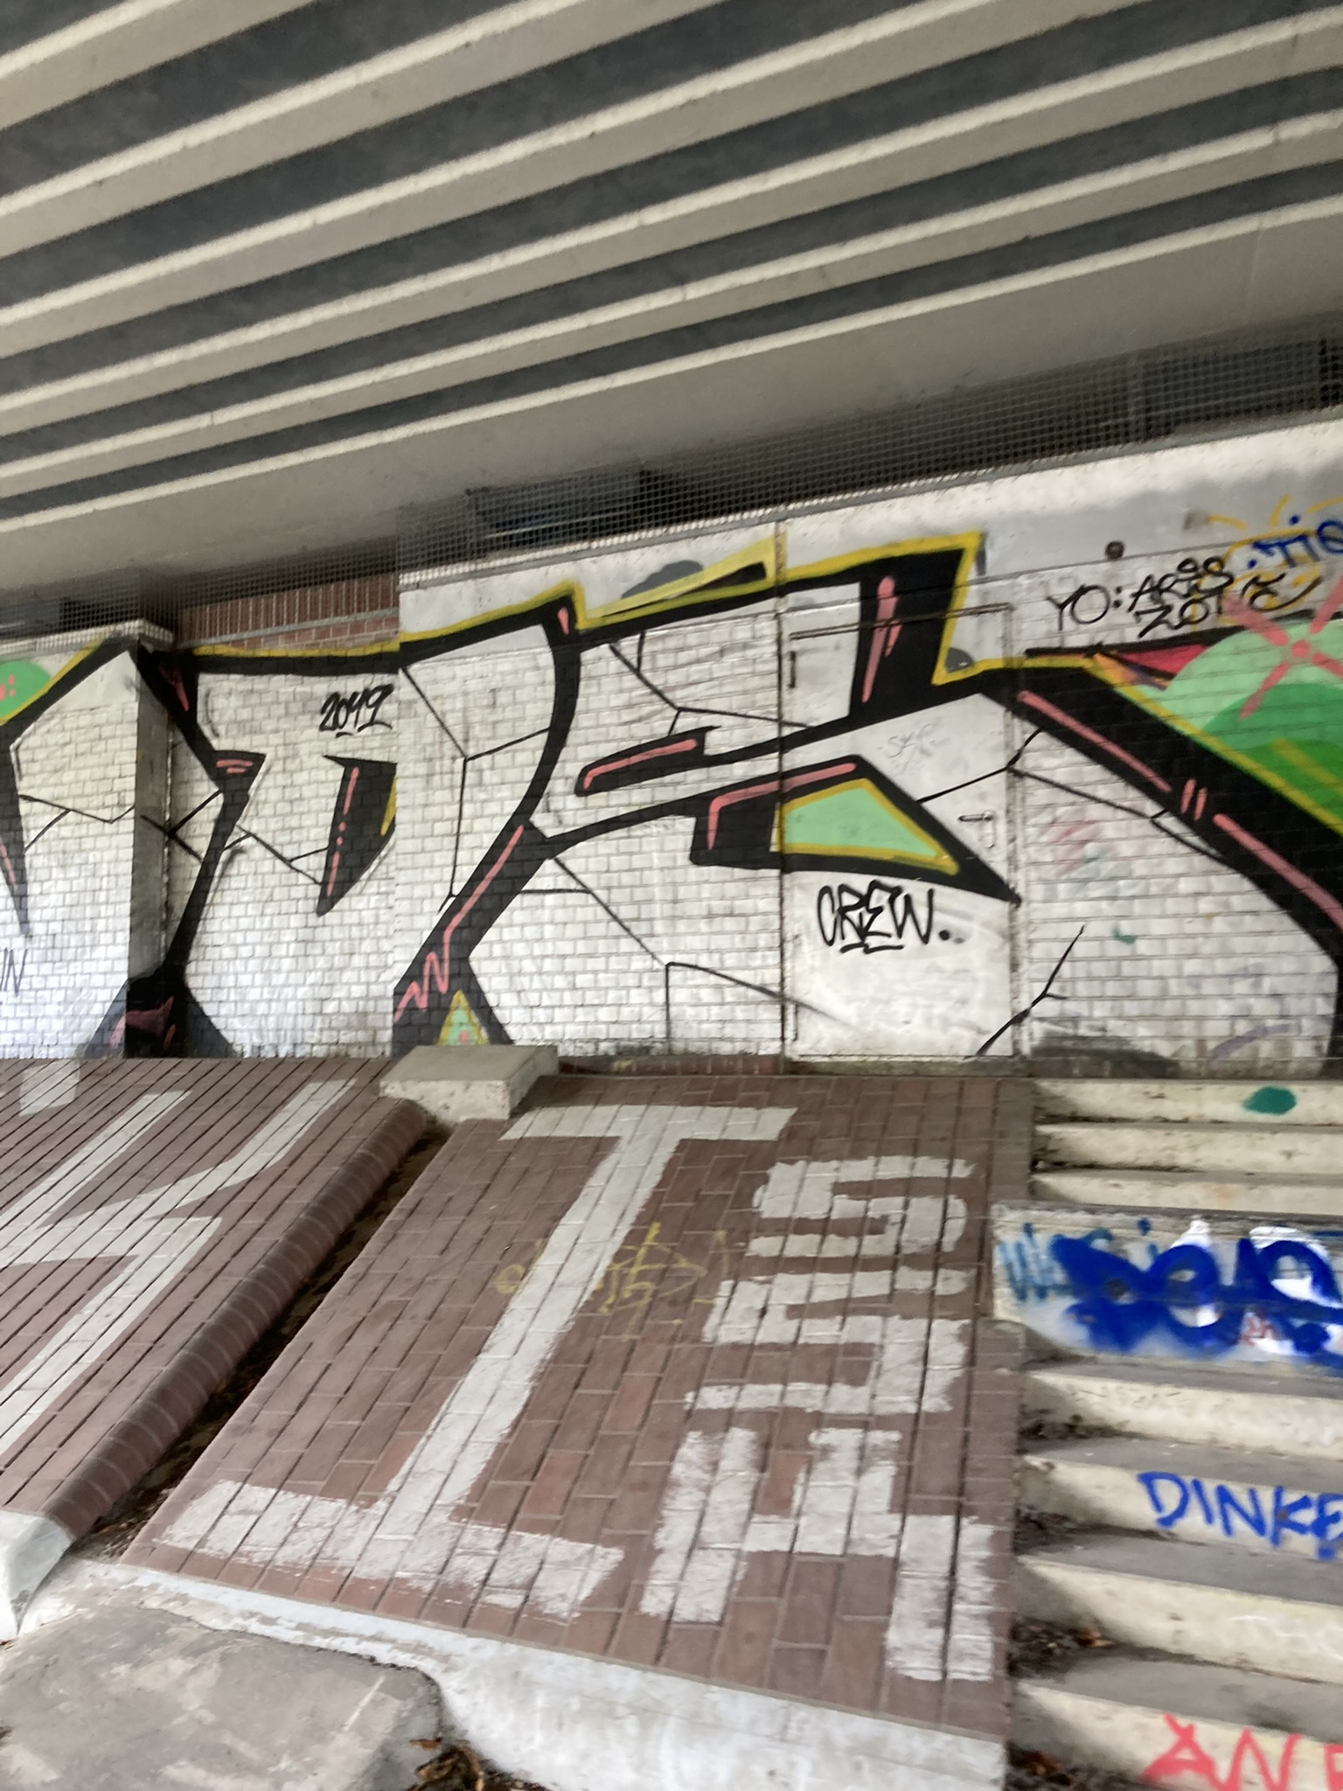
Visual Graffiti Detector(VGD)
For Hamburg Urban City
(The story is fictional!)
Tom Ruge
24.10.24

Slide 2


Problem: So Far
Hamburg City Camera System
More personnel needed for graffiti detection
Graffiti inspections are not conducted frequently
Quality of life decreases due to unremoved graffiti
Manual Checking of Graffiti

Slide 3
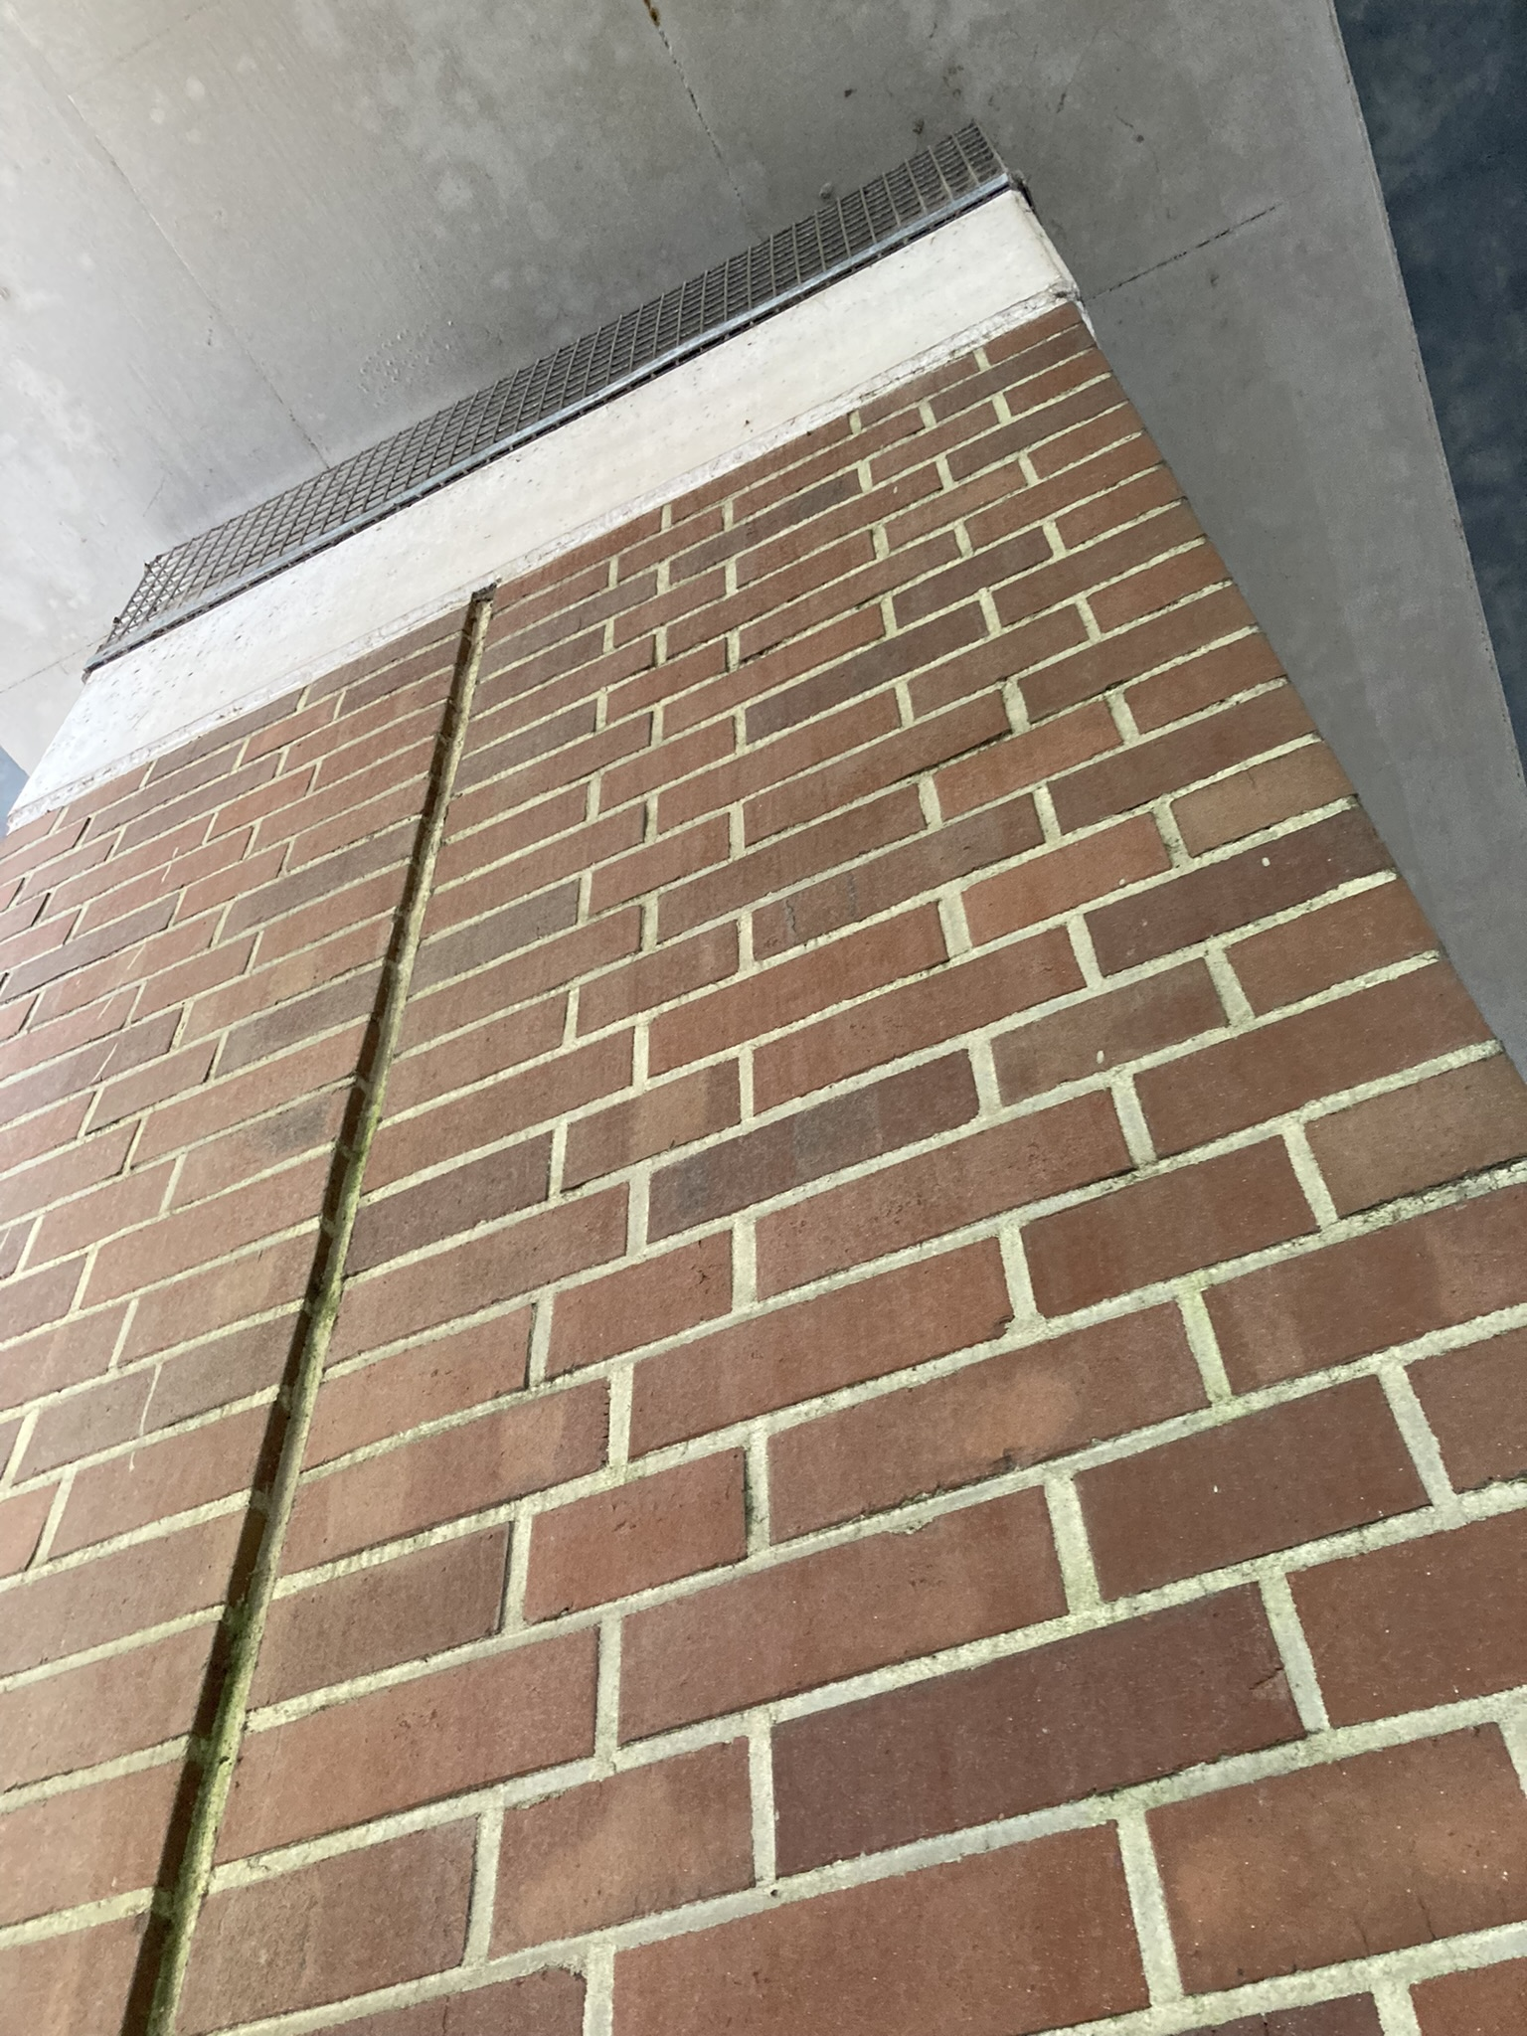
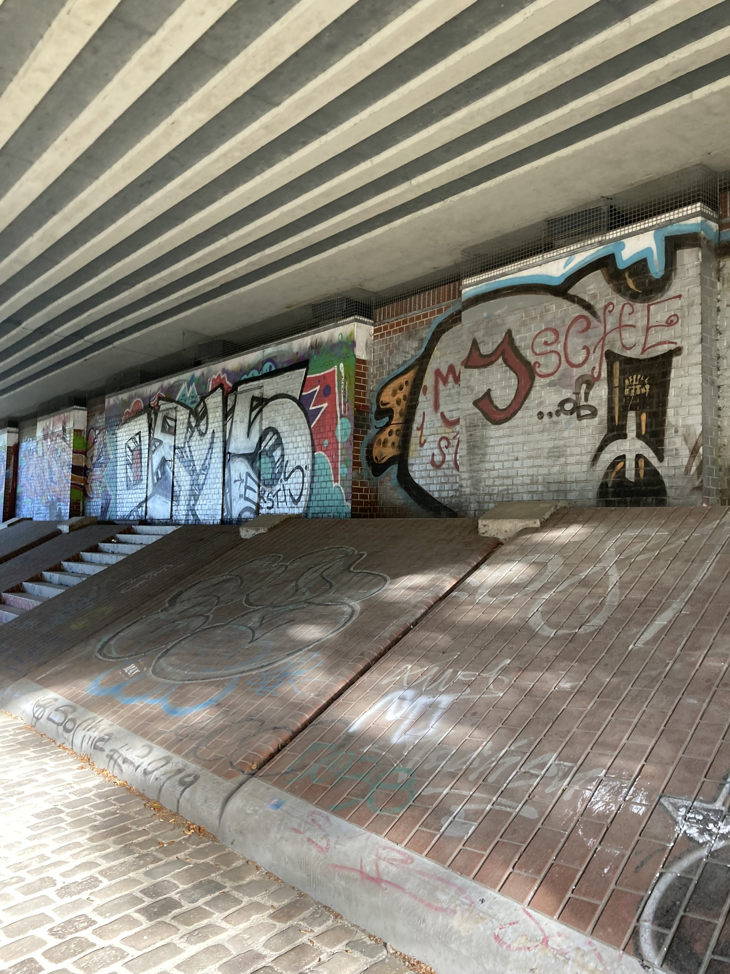
Solution: Visual Graffiti Detector
Is Graffiti
High Priority for Cleanup
Deep Learning Model(State of the Art)
Graffiti checking around the clock
No personnel required
Metric for priority
More effective city maintenance
Data already aquired
No Graffiti

Slide 4
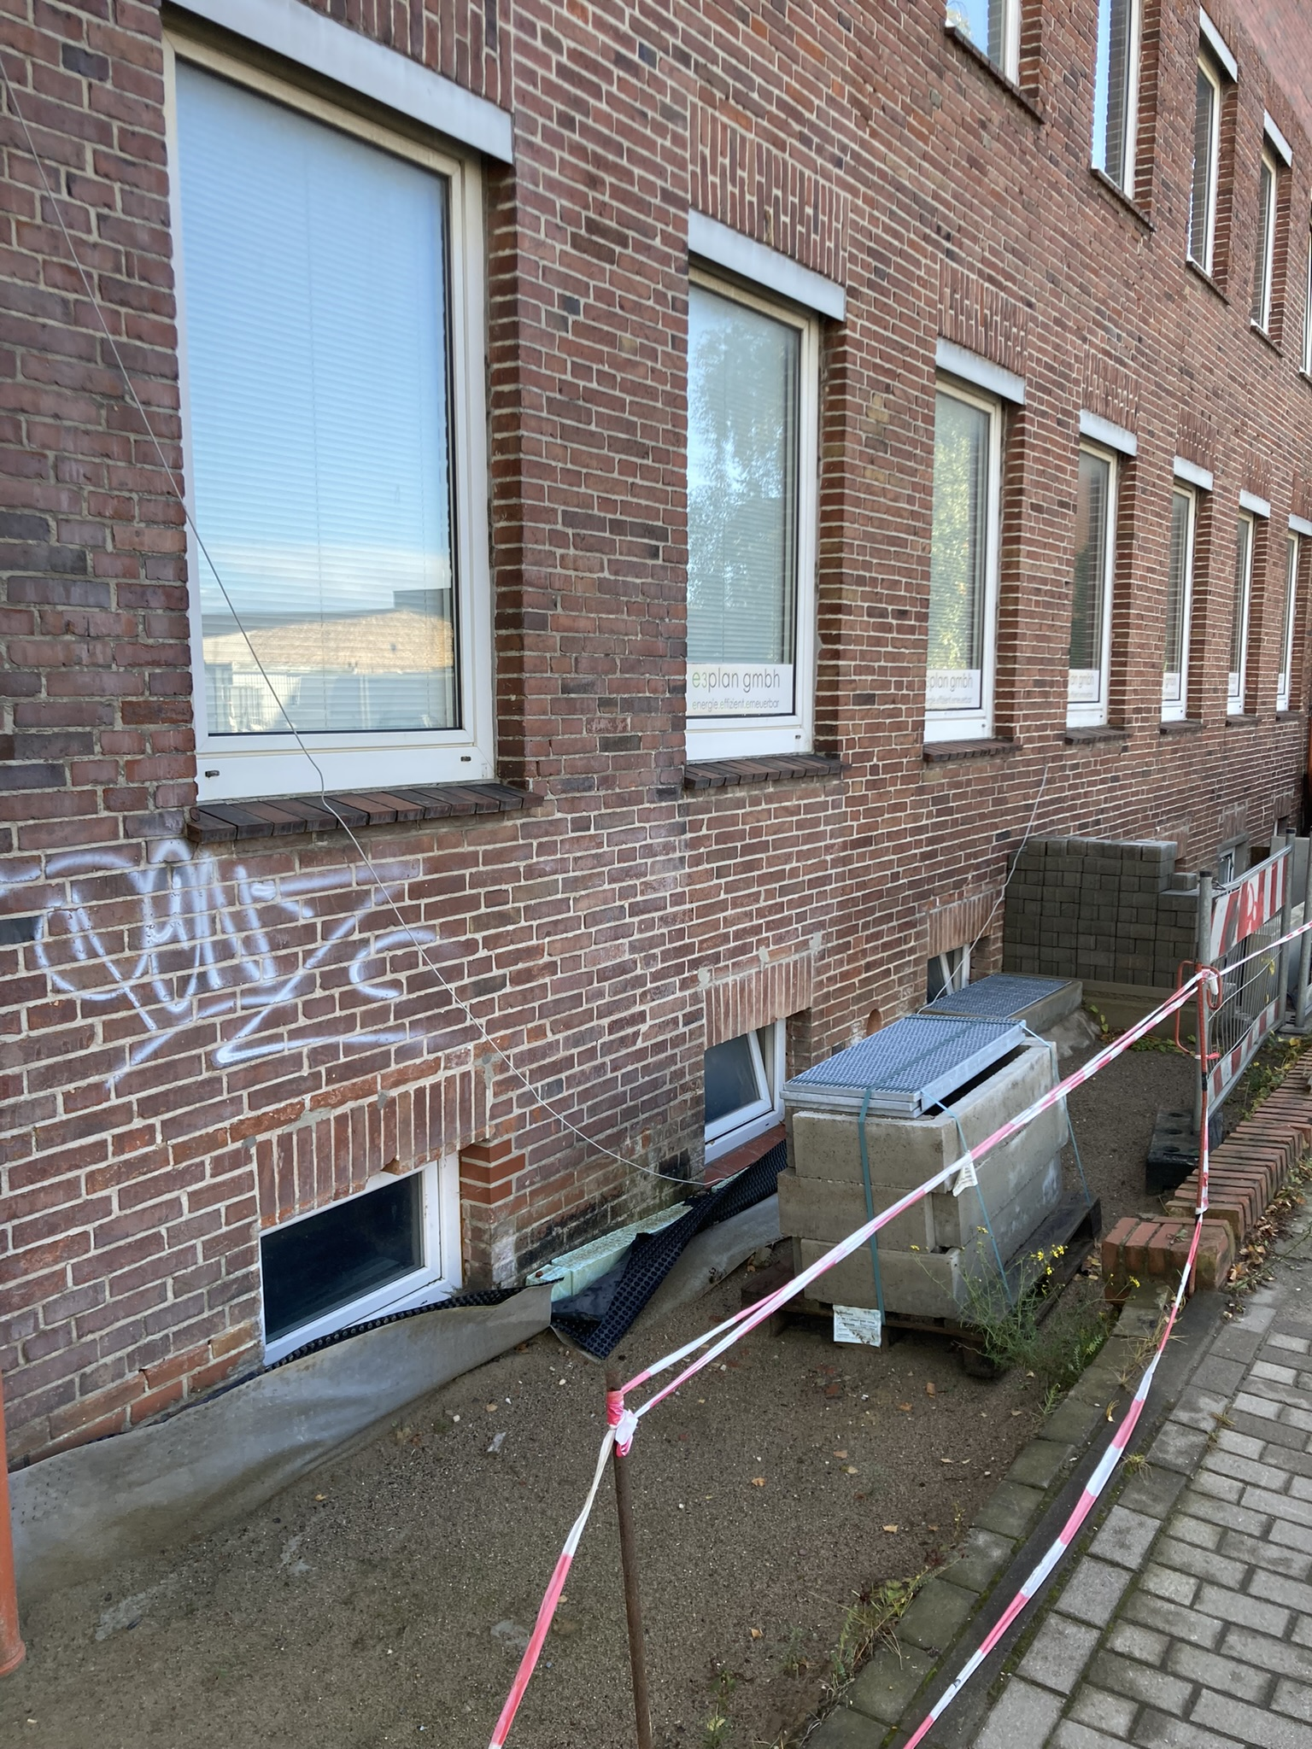
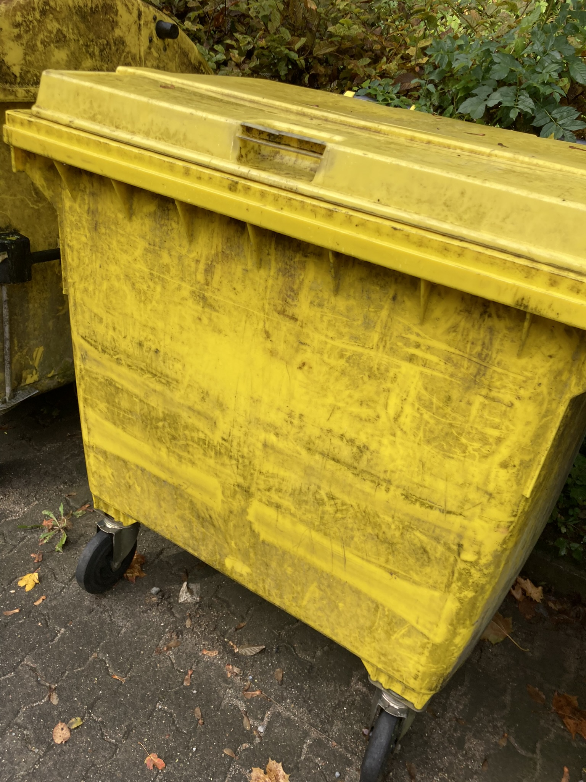
VGD: Available Data
387 non graffiti pictures
Diverse → real world data
496 graffiti pictures
Diverse → real world data

Slide 5
Benefits for City Hamburg
Improved Urban Aesthetics
Increased Property Values
Enhanced Public Safety
Deterrence of Vandalism
Better Resource Allocation
Suport for Tourism
A Happy City!

Slide 6

Contact Information
Tom Ruge
tom01@gmail.com
(+49) 1231 1241213

