Slide 1

Physical Activity Classification
Tom Ruge
tom.ruge@me.com
Januar 8, 2023

Slide 2

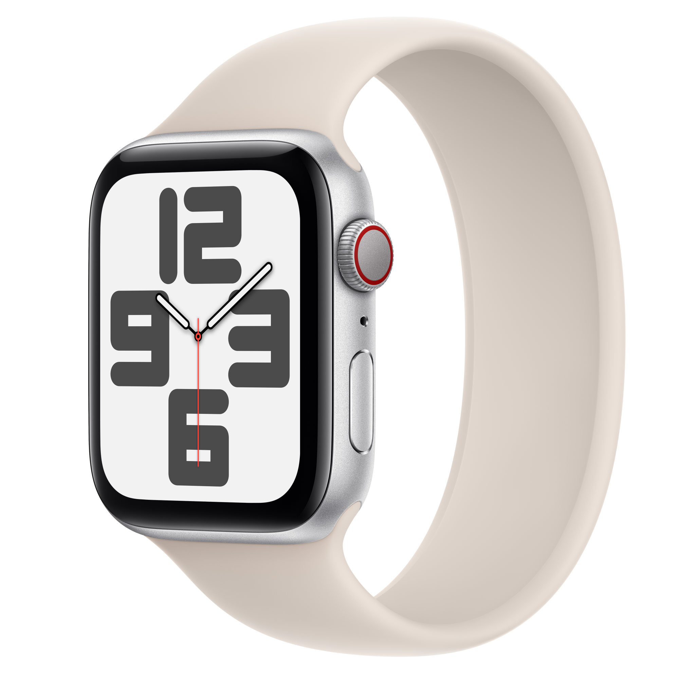

Why and where?

Slide 3
Literature
Webpage:
  Dataset with 6 different activities
  Accelerometer and gyroscopic data from smart phone available
  With simple 2 Layer neural network 89% Accuracy could be archieved
  With LSTM a acccuracy of 91 could be reached.
Kaggle Notebook:
  Same Dataset
  Achieved a 99% Accuracy but testing is not realistic
  All other Kaggle notebooks had the same flaw.

Slide 4
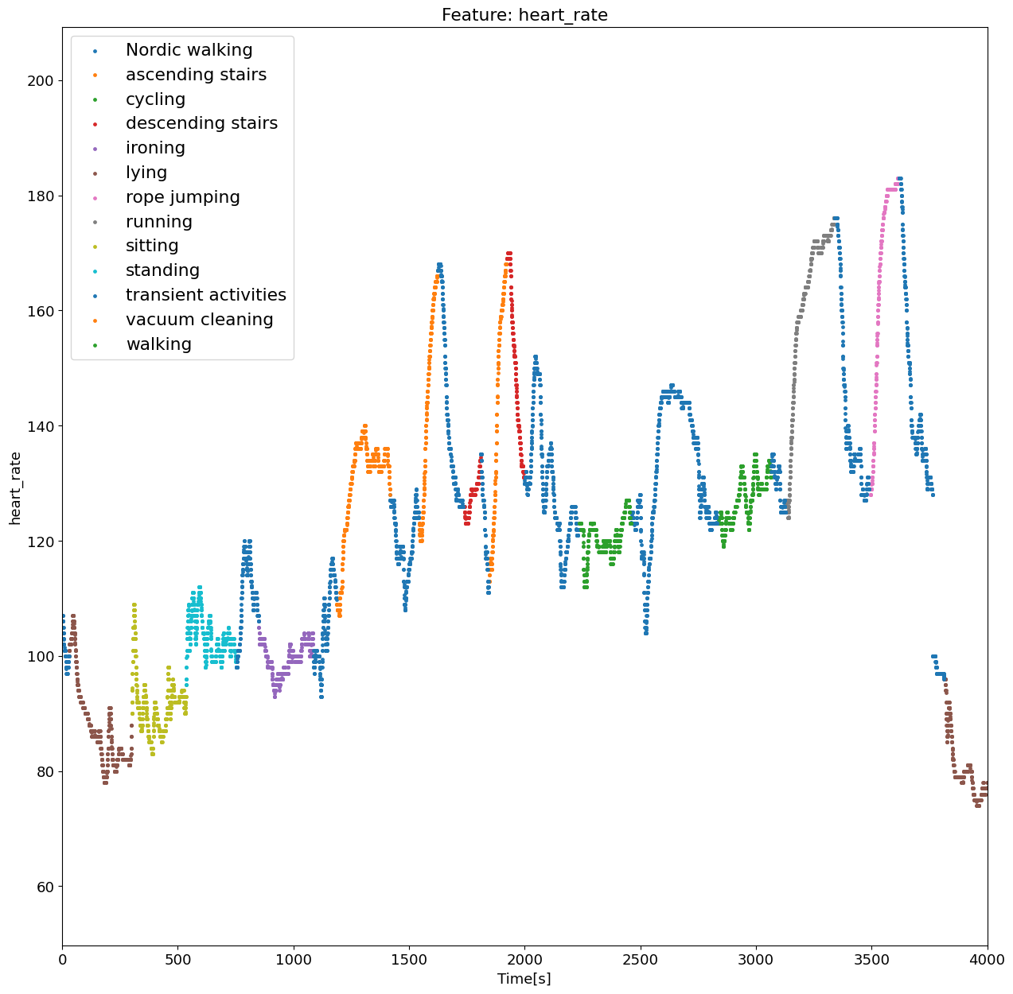
Dataset Characteristics
Dataset:
  From Kaggle
  31 Features(heartbeat, accelerometer, gyroscope, …)
  13 labels(walking, lying, transient activities, etc …)
  Data measured by 8 different people
  Around 2 million rows

Slide 5
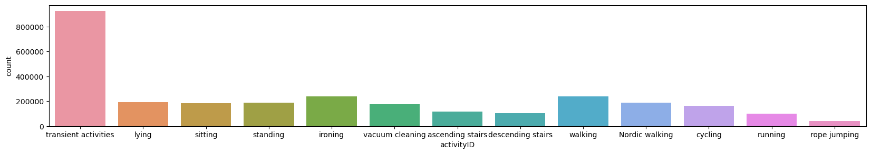
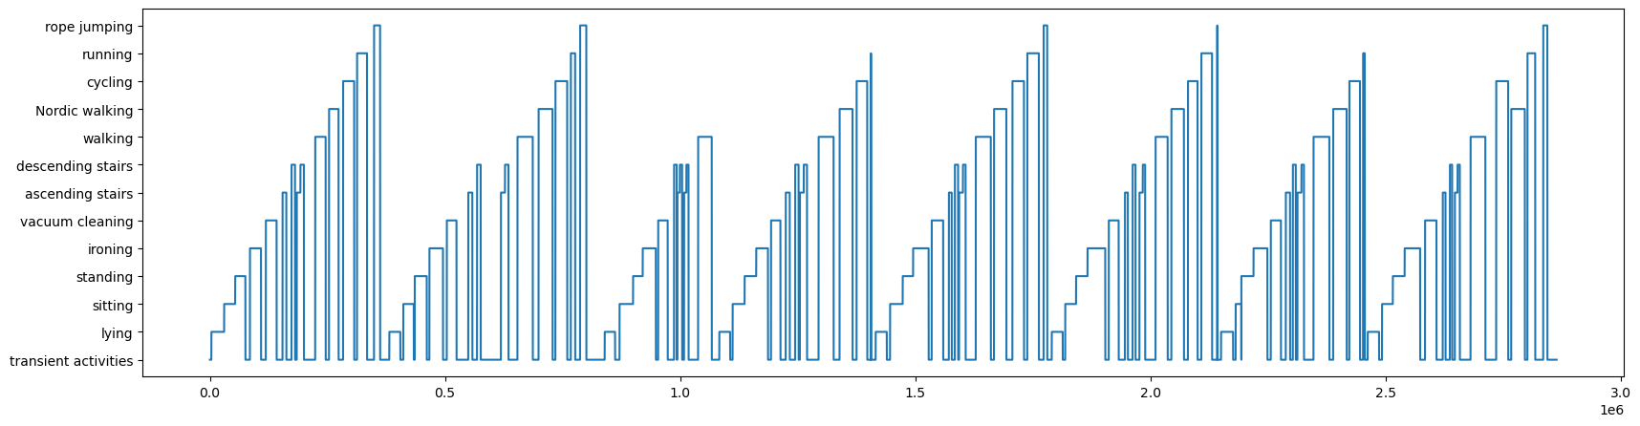
Possible Biases

Slide 6
Testing scenario
Problem:
  Random train validation split not realistic
  → train validation split between people
  → itterate over dataset with 1 person test and 7 train.

Slide 7

Baseline Model
→ Average accuracy of 49% and std of 11%.
Test_PeopleID_mask: 6
Accuracy: 0.63
Test_PeopleID_mask: 5
Accuracy: 0.33

Slide 8
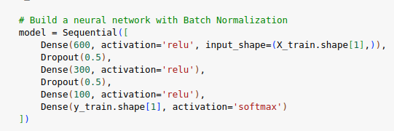
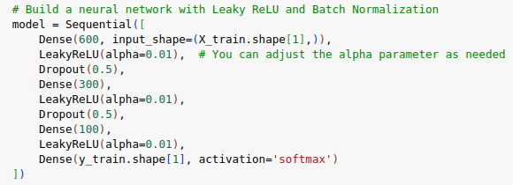
Model 1 with Simple NN
Relu:
Average accuracy: around 71%
Standard deviation accuracy: aroubd 13%
Leaky Relu:
Average accuracy: around 71%
Standard deviation accuracy: aroubd 13%

Slide 9
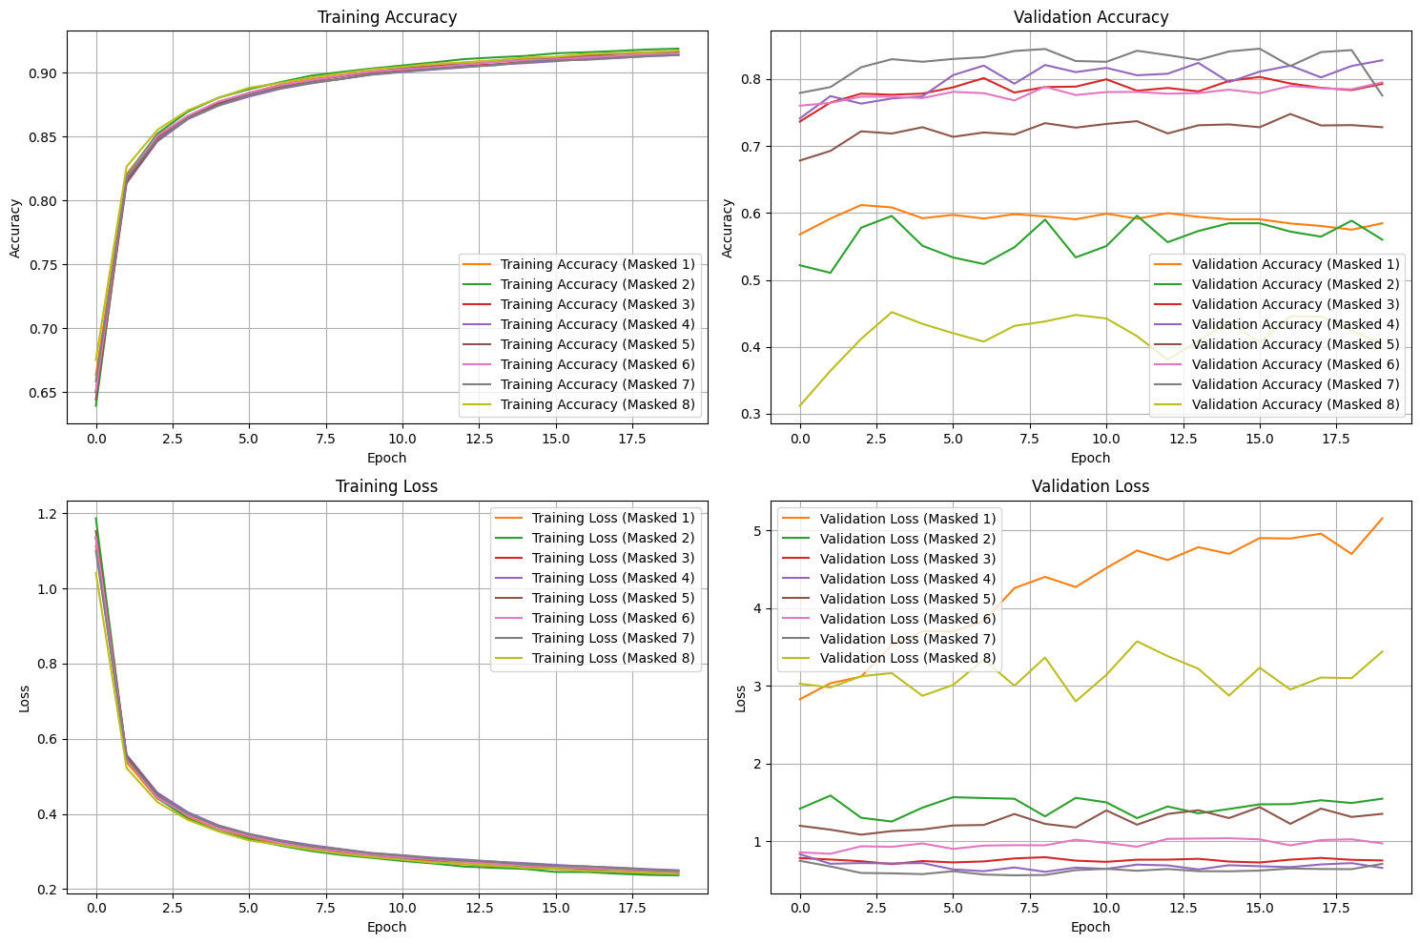
Model 1

Slide 10
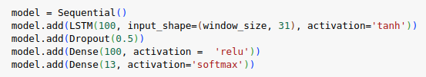

Model 2 with LSTM
- window size 100 → 5s worth
- batch size 100 because data has big variation
average accuracy: 57%
standart dviation: 18%

Slide 11
Results
- Both neural nets performed at least 20% better then the logistical regression.
- The first model performed with an accuracy around 71%
  - Activations ReLu and Leaky ReLU perfromed the same
- The LSTM performed even better!
  - changing units from LSTM did not change much. Maybe overfitting

Slide 12
Side Results

Slide 13
Challenges and Errors
- Random Undersampling results in slightly different accuracys→ making 5 runs and taking the avg from the avg
- Running time, especially for LSTM
- kinda… everything

Slide 14
Conclusion and Outlook
Conclusion:
- As expected LSTM performed better then simple neural net better then logistic regression.
Outlook:
- Better investigation of Hyperparameters
- validation not on undersampled dataset
- average the classifications to improve accuracy.

Slide 15

Questions, Comments?

Slide 16
Side Results

