Slide 1



PRU221m
Report project
Group 3:
Nguyễn Bình Dương
Bùi Đức Minh
Lê Mạnh Hùng
Quách Văn Trung
Nguyễn Thị Hiền Lương

Slide 2
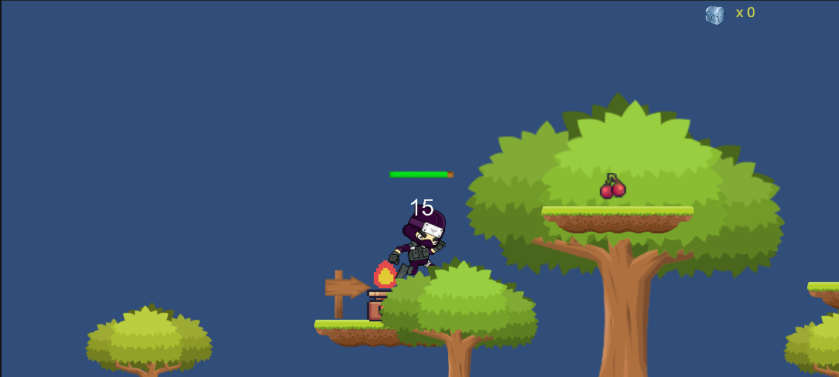
Collect Fruit to heal and upgrade power

Slide 3
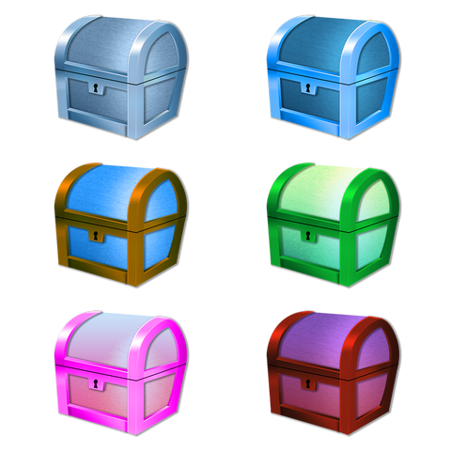
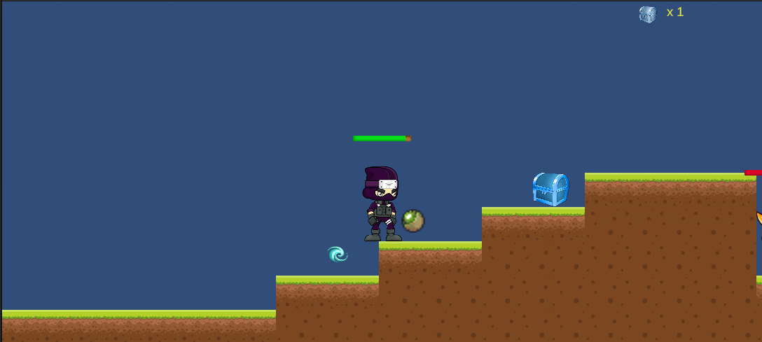
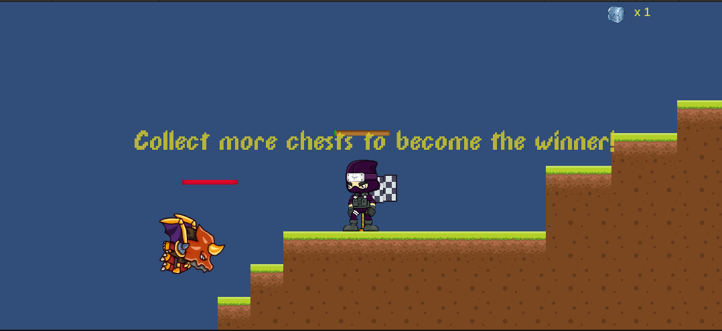
Collect enough treasure chest to pass level

Slide 4

Character classes in the game

Slide 5
Player
Player is unique in the game, so it will be tagged with a unique tag "Player".
Enermys:
there are different types of enermy and they all deal different damage

Slide 6
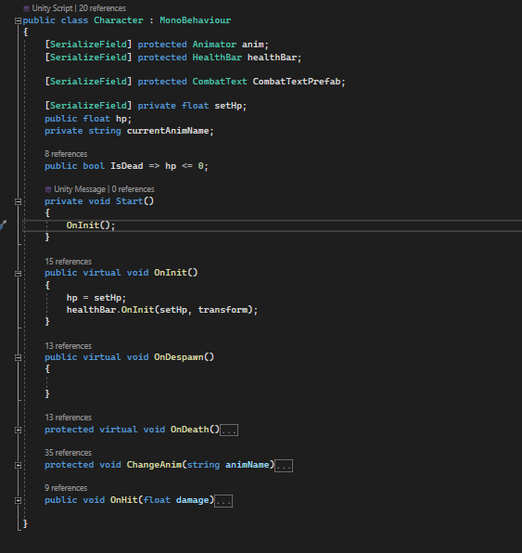
Player and Enermy both share the same base class: Character

Slide 7
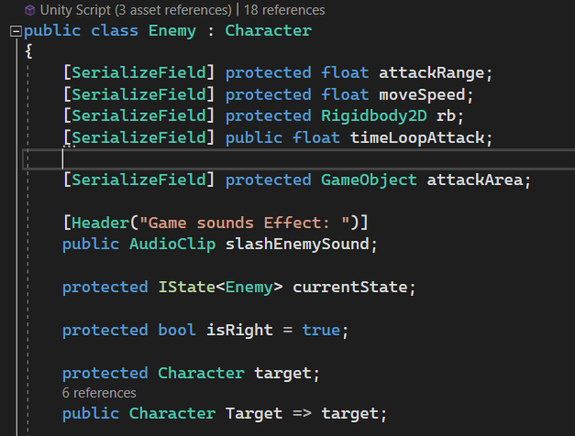
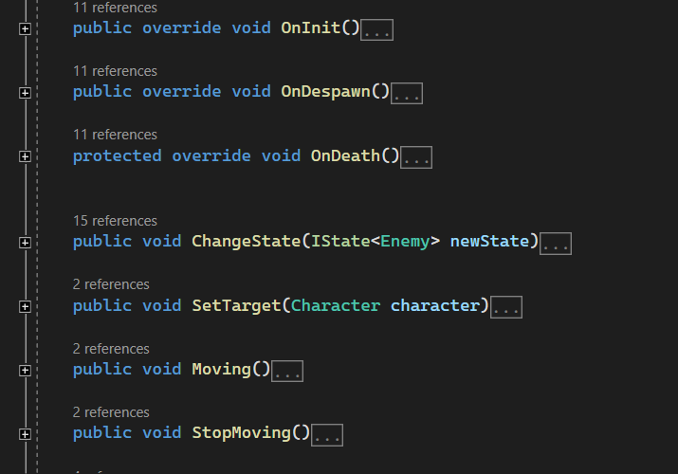
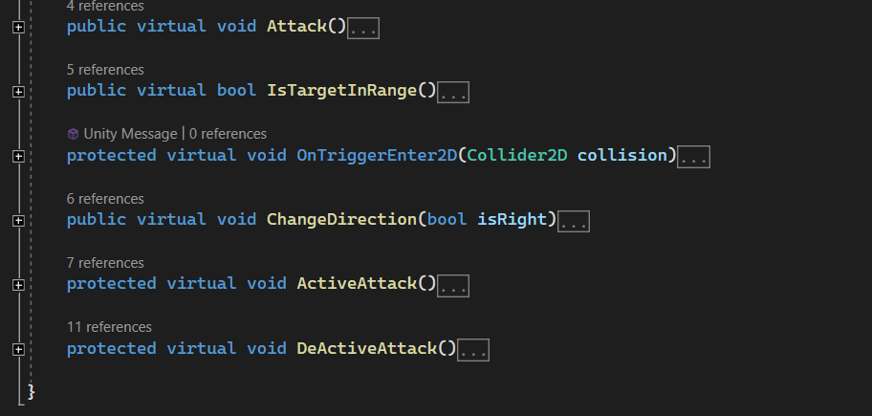
Enermys has its own base class, which inherits from this Chacracter class

Slide 8
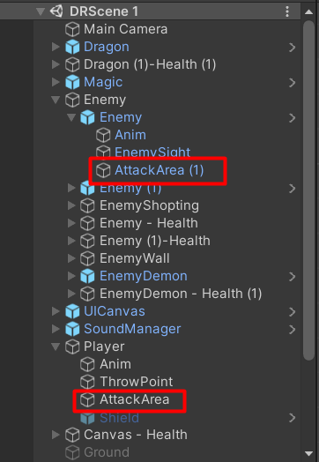
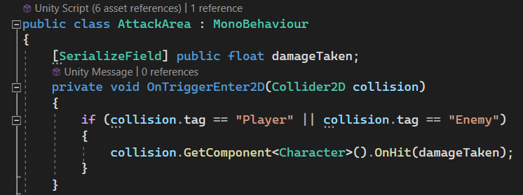
OnHit(): When player or player is in attack range, and there is collision between colliders, in onTriggerEnter2D event, onHit() is called => player/enerny will subtract hp

Slide 9
Design Pattern

Slide 10
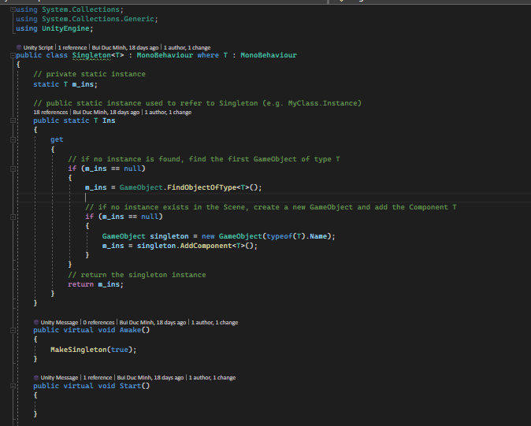
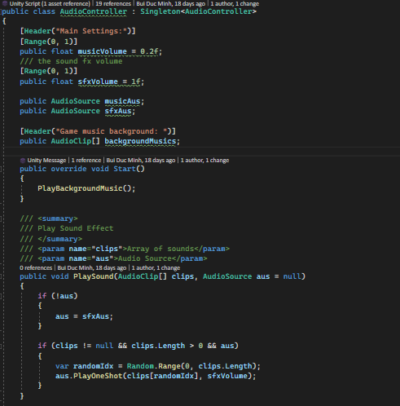

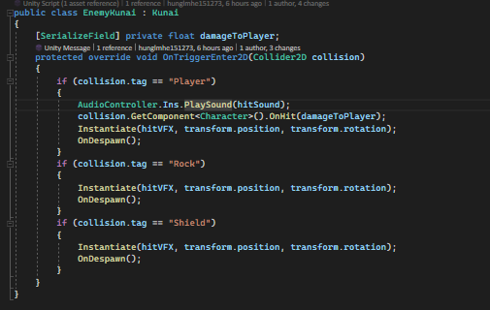
Singleton
Contain a class generic of singleton design pattern
Implement base class to apply Singleton Pattern

Slide 11
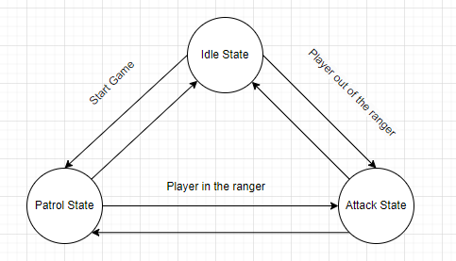
2. State Pattern
Using 3 states (Idle, Patrol, Attack for enemy)
State change depends on the player's movement

Slide 12
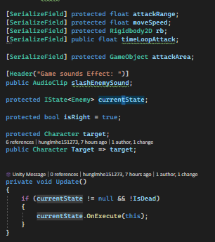
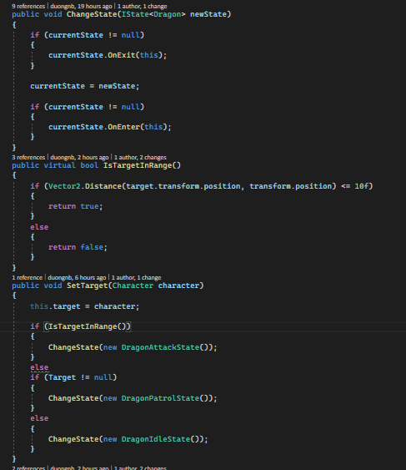
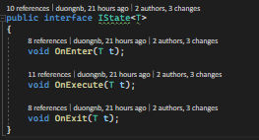
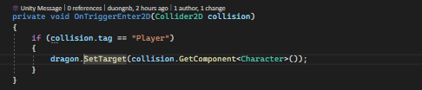
State Pattern Explain
Execute State
Change State
State Interface

Slide 13
Demo

Slide 14
Thanks for listening

