Slide 1


Slide 2
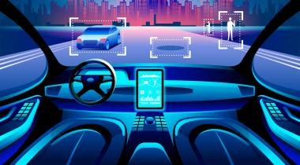

Slide 3

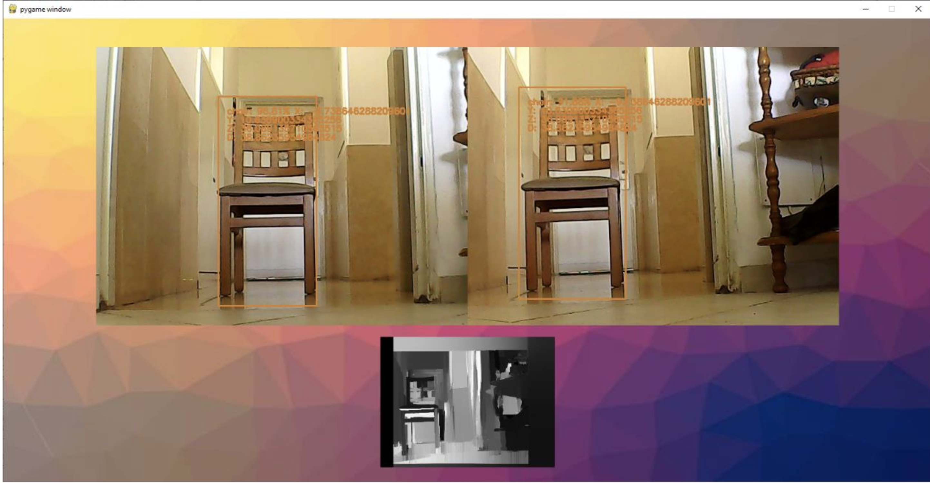
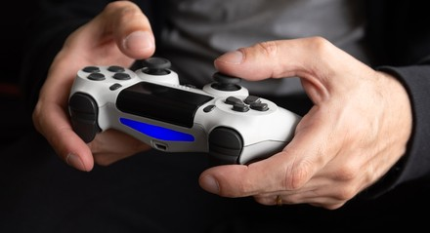
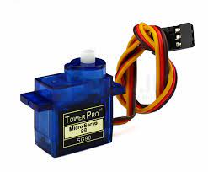
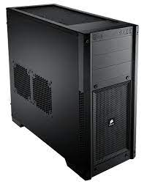
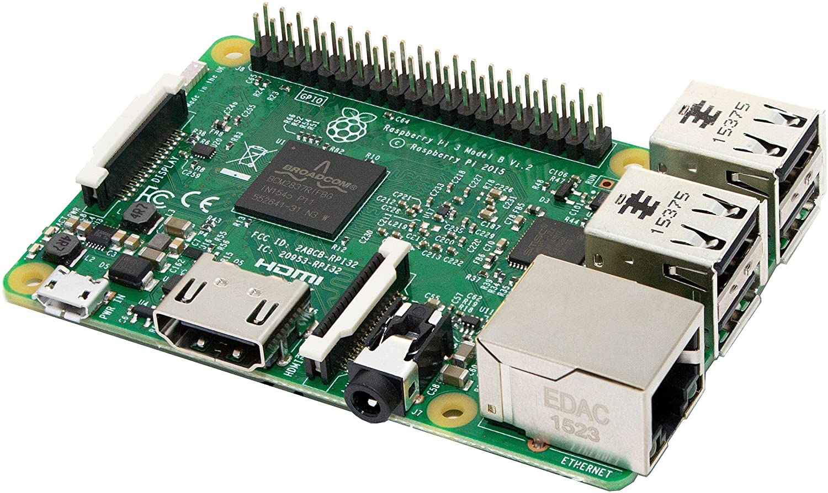

Electronic Signals
Video Output
Object Detection
Object Comparison
Distance Calculation
Depth Map Generation
Bluetooth
UDP Live Video Streaming
PICommunication Protocol – Control Wheels and camera gyroscope
Electronic Signals

