Slide 1
PemGo
.

Slide 2
AIMS
1. To Eradicate the problem of students email glitch.
To generate a more reliable student email.

Slide 3
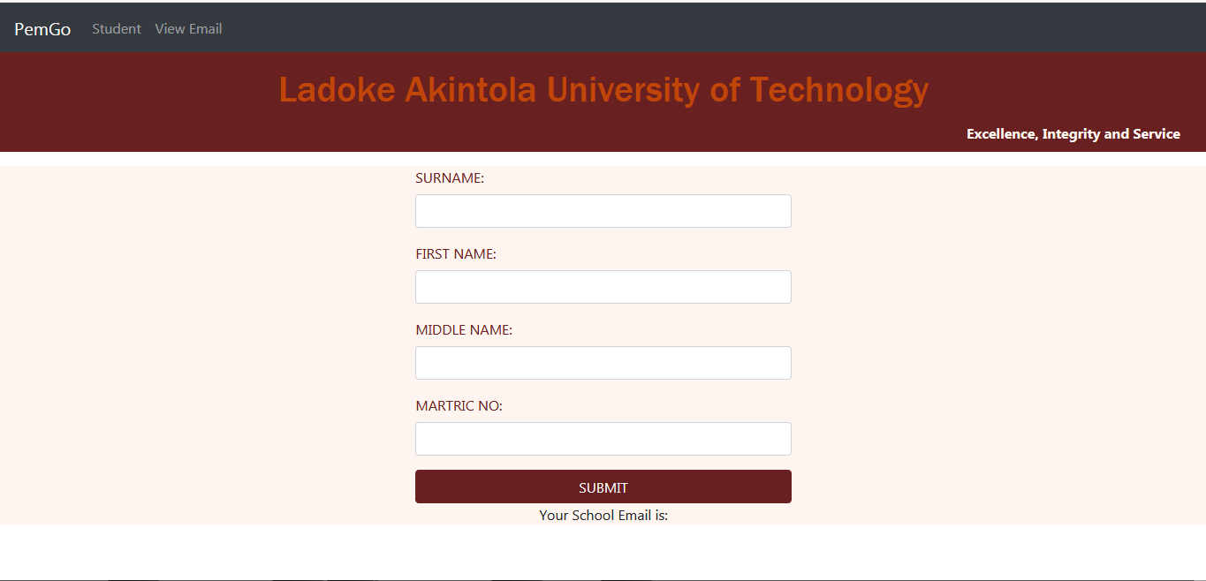
User Interface

Slide 4
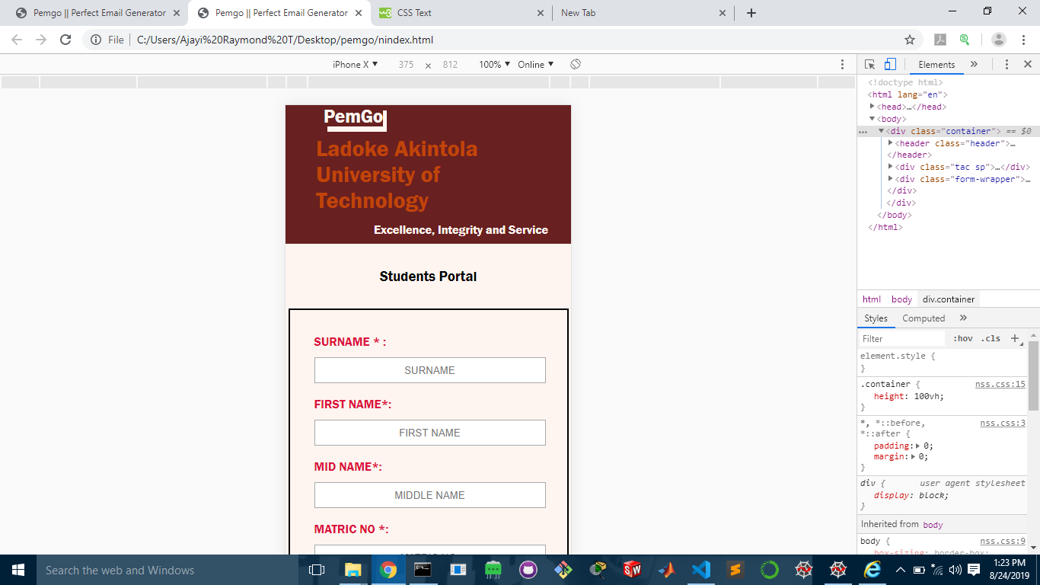
Responsiveness

