Slide 1
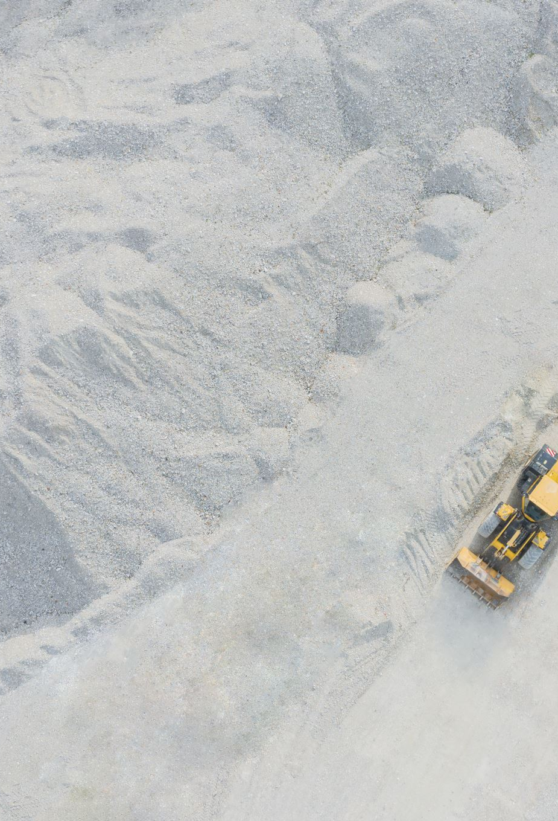
Predictive Maintenance
Ton Nattapan

Slide 2
Objective
Predict the life expectancy of machine components and the operational hours of the machine to be used in scheduled maintenance

Slide 3
Dataset
Sources
Dataset context
Sources: https://www.kaggle.com/datasets/arnabbiswas1/microsoft-azure-predictive-maintenance
Machine conditions and usage: The operating conditions of a machine e.g. data collected from sensors.
Failure history: The failure history of a machine or component within the machine.
Maintenance history: The repair history of a machine, e.g. error codes, previous maintenance activities or component replacements.
Machine features: The features of a machine, e.g. engine size, make and model, location.

Slide 4
DatASETs
Telemetry Time Series Data (PdM_telemetry.csv)
Error (PdM_errors.csv)
Maintenance (PdM_maint.csv)
Failures (PdM_failures.csv)
Metadata of Machines (PdM_Machines.csv)

Slide 5
Feature engineering
Use telemetry dataframe to calculate machine operating hours for each day
Preparing dataframe to calculate life expectancy of components
Create a new dataframe of date vs age of the machine

Slide 6
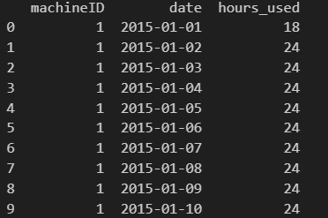
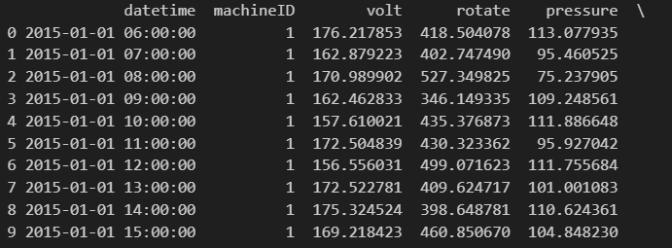
Feature engineering - Use telemetry dataframe to calculate machine working hours for each day
Machine working hours, used in work hours prediction
Telemetry

Slide 7
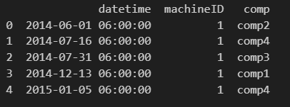
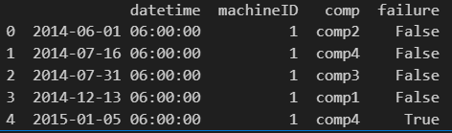
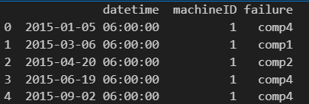
Feature engineering - Merging and comparing dF ‘maint’ and ‘failure’ to create ‘maint_flagged’
Replaced component
Label failure component
Failure component

Slide 8
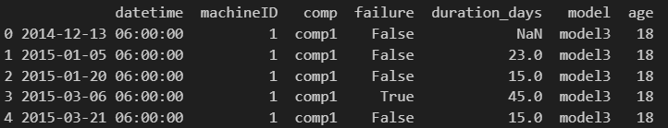
Feature engineering - Add 'model' and 'age' column in df 'machine' to df 'machine_flagged'
Label failure component
Dataframe to be used in component life expectancy prediction

Slide 9
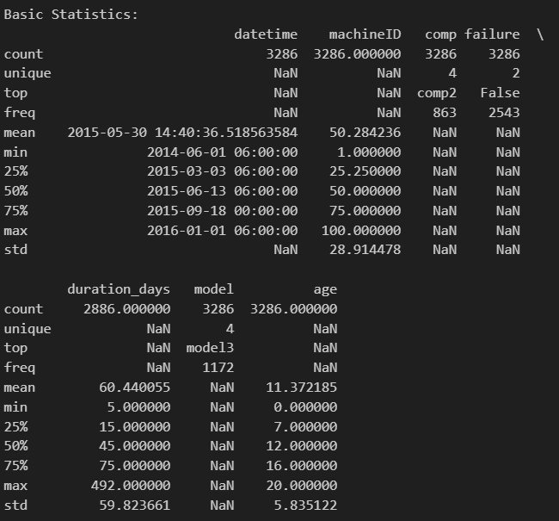
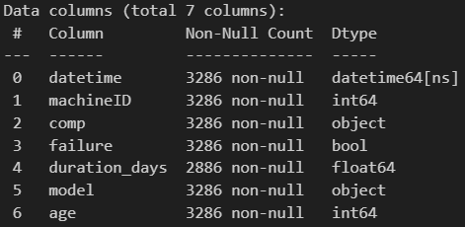
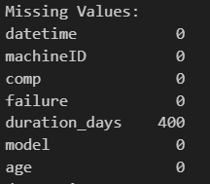
EDA – Basic Stats

Slide 10
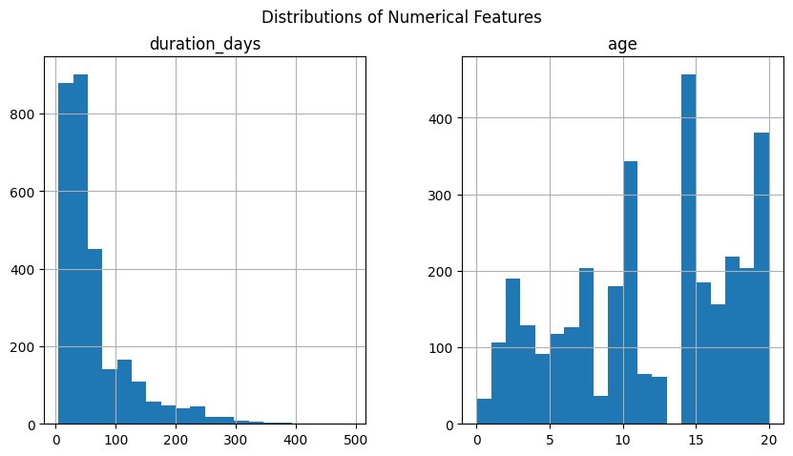
EDA - Distribution of numerical features

Slide 11
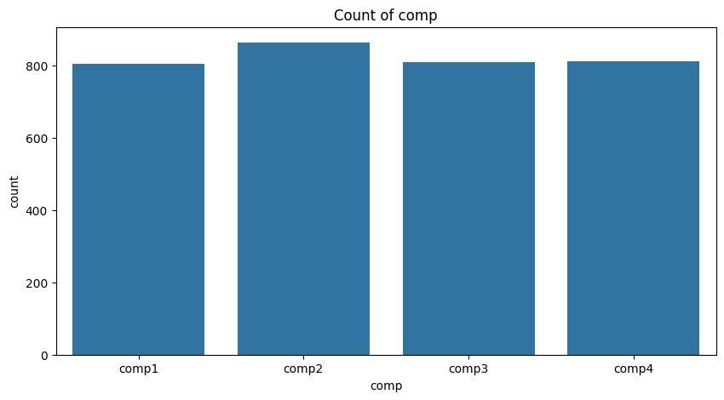
EDA - count of components

Slide 12
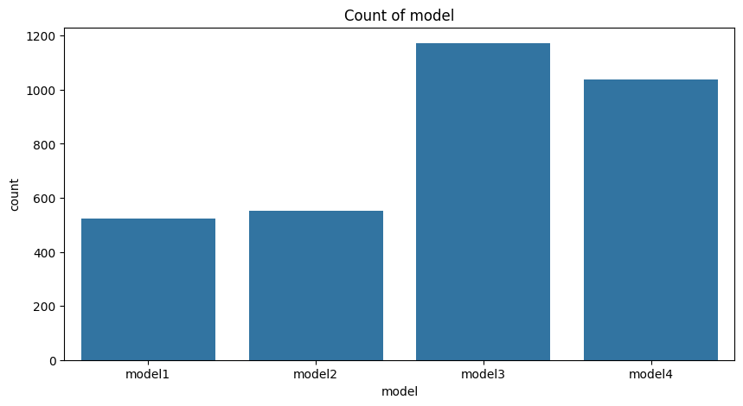
EDA - count of model
Is there relationship between failure and model?

Slide 13
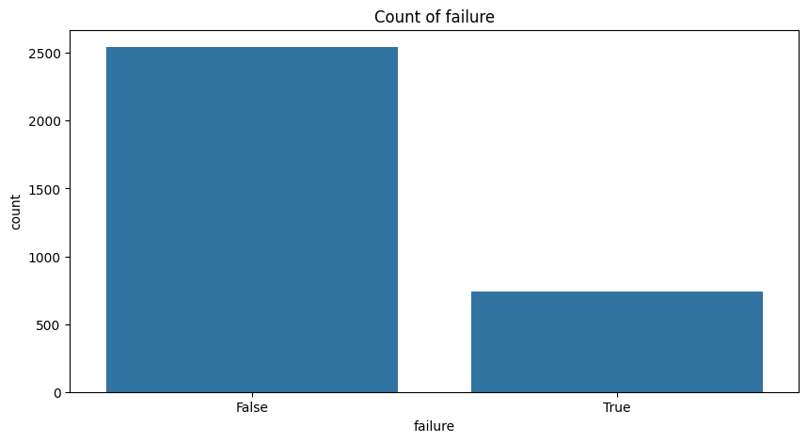
EDA - count of failure

Slide 14
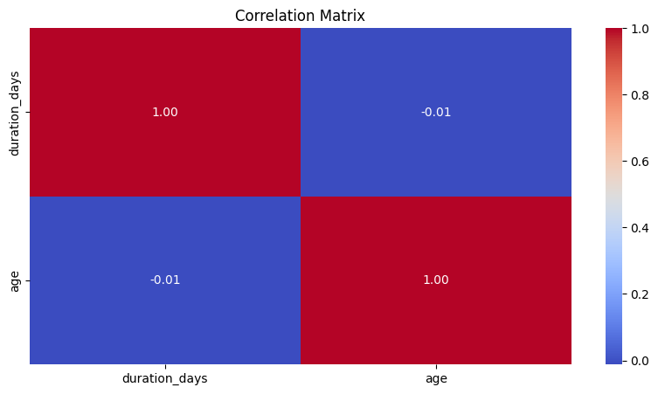
EDA - correlation between duration_days and age
There is no relation between duration_days and age.

Slide 15
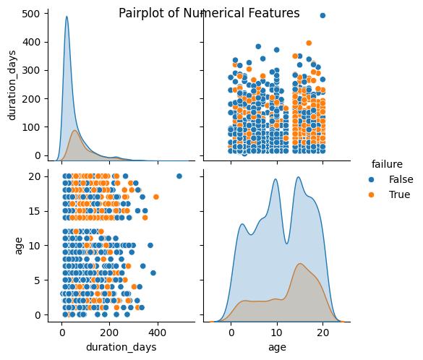
EDA - Pairplot of age and duration_days

Slide 16
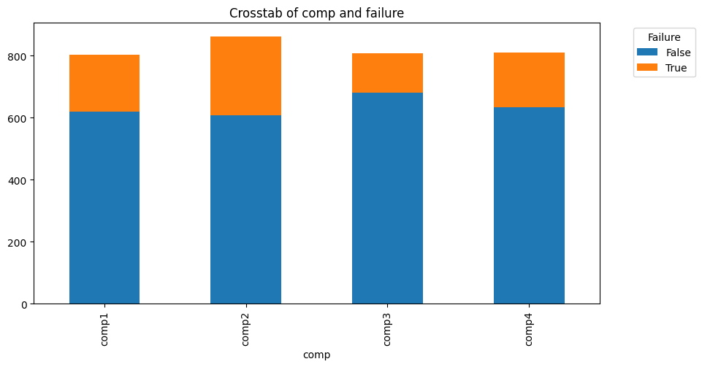
EDA - Relationship between failure and components

Slide 17
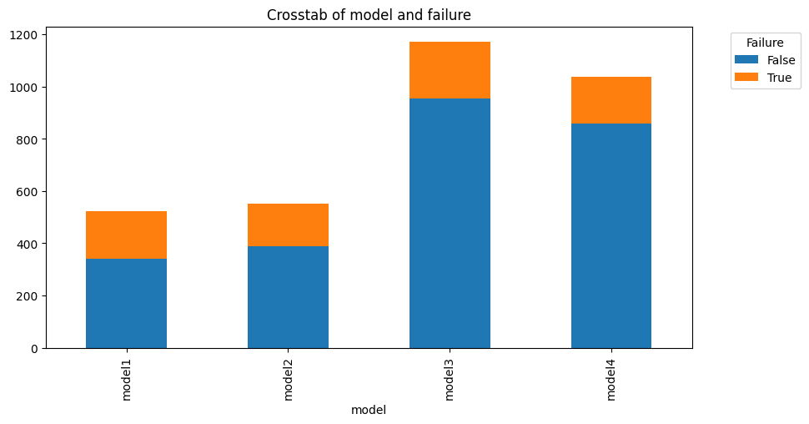
EDA - Relationship between failure and machine model
Is there relationship failure and model?

Slide 18
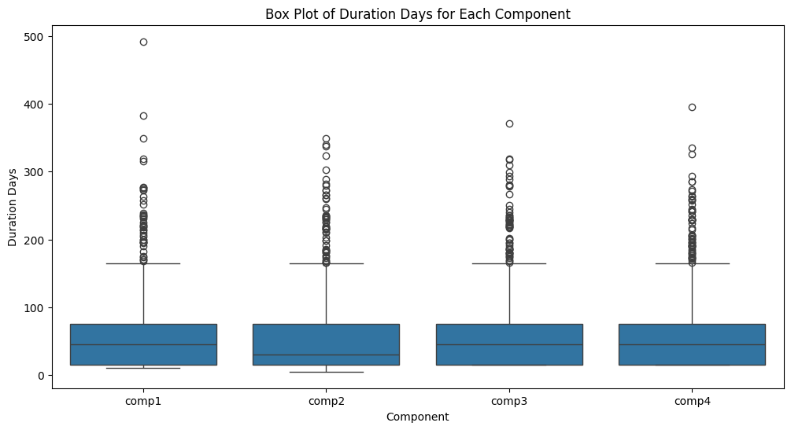
EDA - Box Plot of Duration Days for Each Model

Slide 19
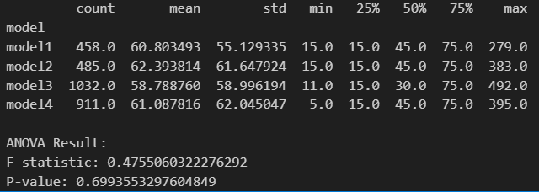
EDA - ANOVA to test if there is relationship between ‘model’ and ‘failure’
Interpretation:
This p-value is much higher than the common significance threshold (0.05)
There is no significant relationship between 'model' and 'duration_days’.
The different model categories do not have statistically different means for duration_days.

Slide 20
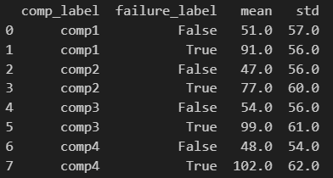
Prediction - Mean and standard deviation of 'duration_days' (unable to find relattionship among features)
Interpretation:
The mean duration is higher when there is a failure compared to when there is no failure. This suggests that components tend to last longer before failing, possibly indicating that failures occur less frequently but after longer usage periods. Alternatively, it might imply that replacements due to failures are delayed compared to scheduled maintenance, leading to higher mean durations.
The standard deviation values are high across all components and for both failure and non-failure cases. This suggests a significant variability in the duration of components, indicating that the time until maintenance or failure can vary widely. Therefore, using the mean alone as a predictor might not be reliable, and other statistical measures or models might be needed to account for the high variability.

Slide 21
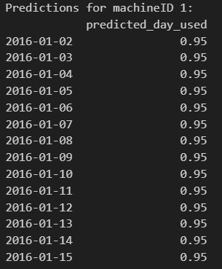
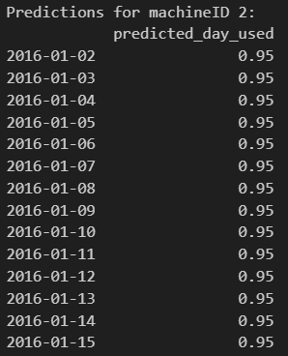
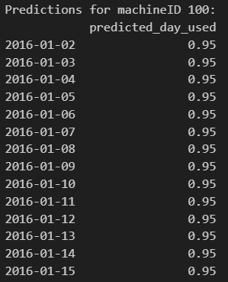
Prediction - 14 days moving average prediction of 'day_used’ for Each Machine
…

