Slide 1
MARSH
FP&A Financial Review
Latin America Region | Full-Year 2024
Executive Steering Committee Presentation

Slide 2
Executive Summary
MARSH
Full-year 2024 financial performance at a glance
$2.12B
315K
26,472
136
Total Revenue (USD)
Total Transactions
Unique Clients
Countries Served
KEY HIGHLIGHTS
▸ Revenue concentration: top 10% of clients (2,647 accounts) generate 48.1% of total revenue — high dependency on key accounts.
▸ Geographic breadth spans 136 countries across 137 currencies, yet top 3 countries alone account for 3% of global revenue.
▸ Latin America contributes 17.5% of global revenue (20,962 clients across 23 countries).
▸ COMPLIANCE ALERT: 1,355 clients flagged for Q4 2024 exposure to restricted jurisdictions — immediate review required.
Marsh FP&A | 2024 Financial Review | CONFIDENTIAL
2 / 9

Slide 3
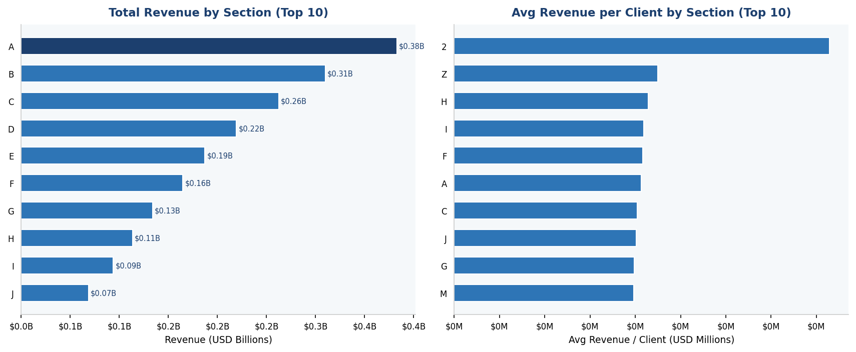
Market Section Analysis — Revenue by Section
MARSH
Q1: Starting digit of each client code = Market Section. Are there differences in expected revenue by section?
YES — sections differ significantly. Section "A" leads with $0.38B total (18.0% of global revenue).
Revenue per client varies 15.9× between highest and lowest productivity sections — raw volume understates section quality.
Section "2" earns $0.2M per client on average vs. $0.0M for section "3".
* 22 total market sections identified across 26,472 clients
Marsh FP&A | 2024 Financial Review | CONFIDENTIAL
3 / 9

Slide 4
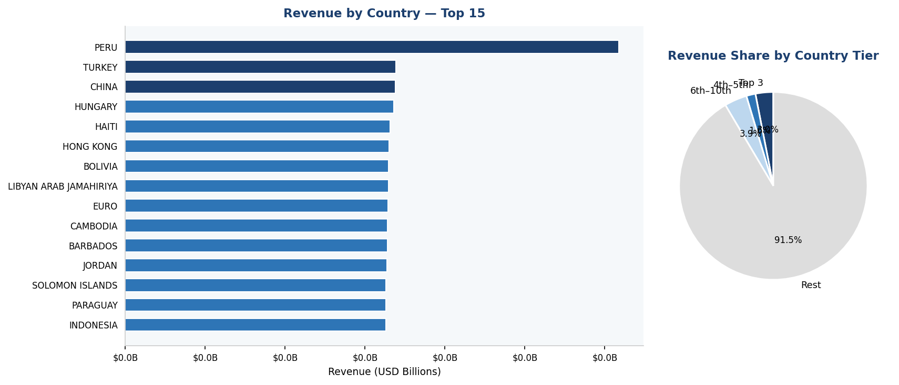
Geographic Revenue Distribution
MARSH
Q2: Is revenue affected by geography? — Yes, strongly. A handful of countries dominate global revenue.
YES — geography drives revenue. Top 3 countries account for 3% of global revenue.
Top 10 countries represent 9% of revenue out of 136 total countries — extreme concentration.
Peru alone = 1.5% of global revenue ($0.03B). Single-country risk must be assessed.
* Navy bars = top 3 countries
Marsh FP&A | 2024 Financial Review | CONFIDENTIAL
4 / 9

Slide 5
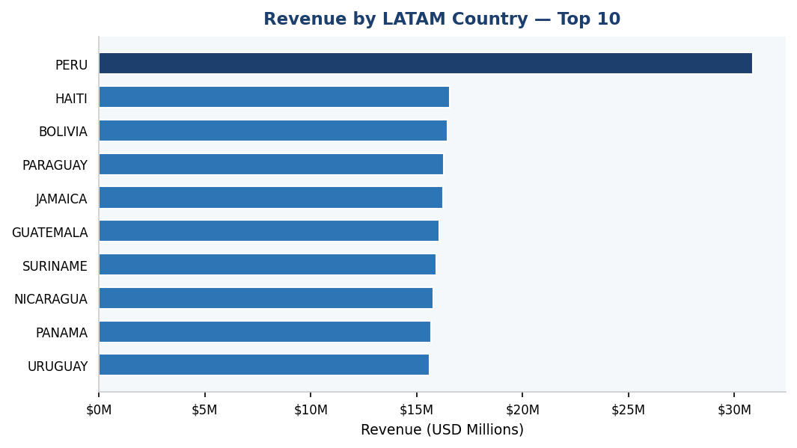
Latin America — Regional Deep Dive
MARSH
LATAM contributes 17.5% of global revenue across 23 countries and 20,962 clients
$0.37B
17.5%
20,962
23
LATAM Revenue
Global Share
LATAM Clients
Countries
Peru leads LATAM with $31M in revenue.
Top 2 LATAM countries hold 13% of regional revenue — a balanced regional growth strategy is recommended.
TOP 5 MARKET SECTIONS IN LATAM
Section A
$66M
Section B
$55M
Section C
$46M
Section D
$39M
Section E
$33M
Marsh FP&A | 2024 Financial Review | CONFIDENTIAL
5 / 9

Slide 6
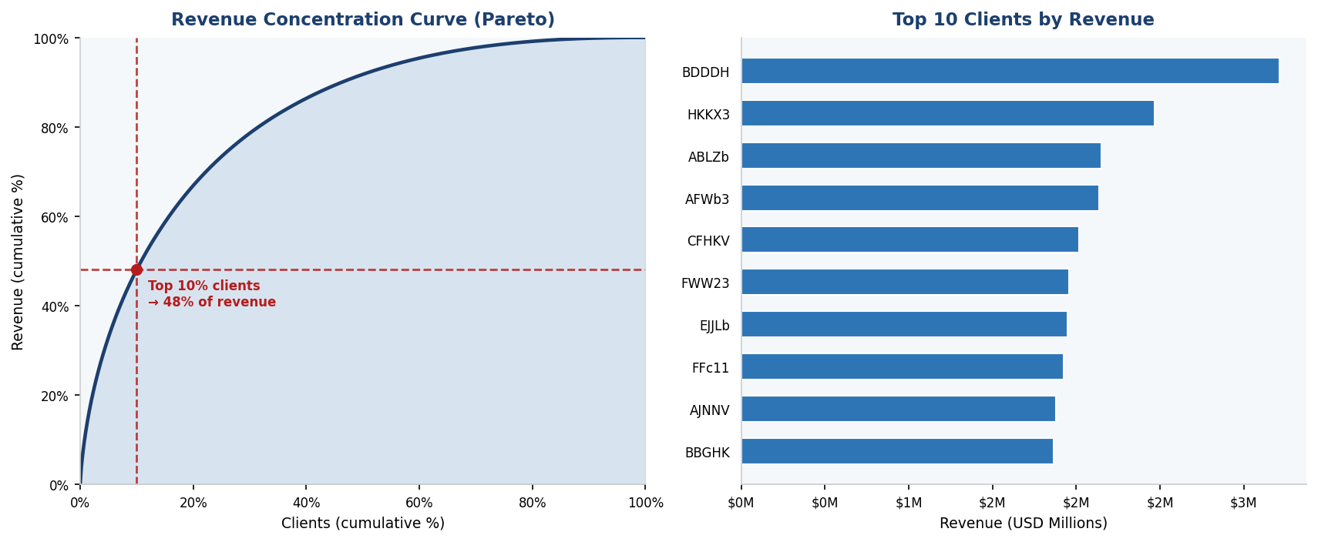
Client Revenue Concentration — Pareto Analysis
MARSH
Original Insight: A small fraction of clients generates the vast majority of revenue
Top 1% of clients (264 accounts) generate 12.0% of total revenue.
Top 10% (2,647 clients) → 48% of revenue. Remaining 23,825 clients → only 52%.
Recommendation: implement tiered account management. Protect key accounts; develop retention and growth playbooks for the top tier.
Long-tail opportunity: 23,825 clients generating only 52% of revenue represent upside if average ticket is grown.
Marsh FP&A | 2024 Financial Review | CONFIDENTIAL
6 / 9

Slide 7
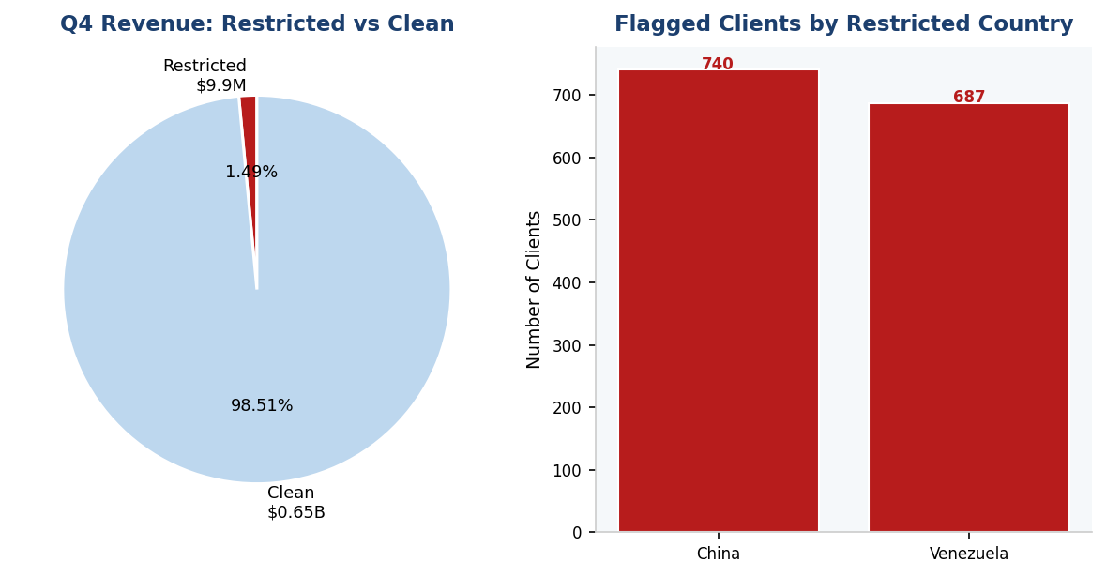
Compliance Risk Dashboard
MARSH
Q4 2024 — Exposure to Restricted Jurisdictions (Russia · Cuba · China · Venezuela)
⚠ ALERT: 1,355 clients had transactions with restricted jurisdictions in Q4 2024, representing $9.9M (1.49% of Q4 revenue)
Country
Flagged Clients
Revenue (USD)
China
740
$5.5M
Venezuela
687
$4.4M
ACTION: Immediate compliance review required for all flagged accounts.
Marsh FP&A | 2024 Financial Review | CONFIDENTIAL
7 / 9

Slide 8
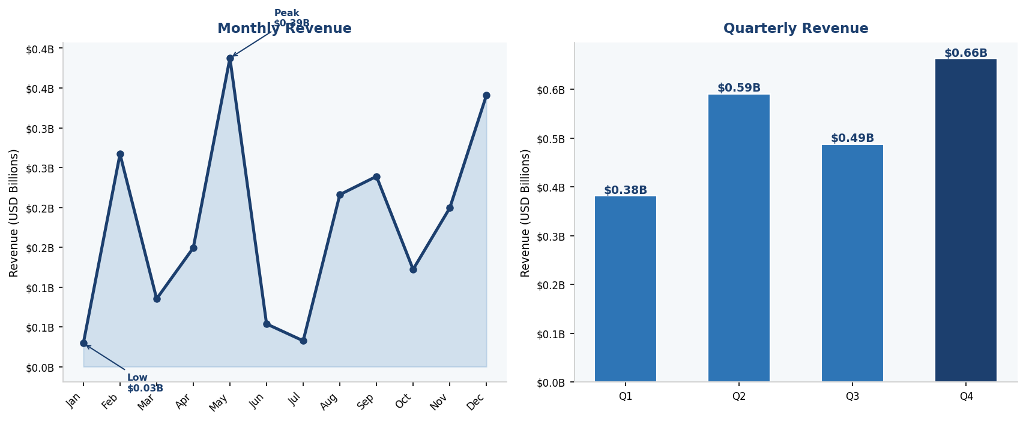
Revenue Trend & Seasonality
MARSH
2024 monthly and quarterly revenue — identifying peaks and troughs
Q4 is the strongest quarter: $0.66B.
Q1 is the weakest: $0.38B — 73% below peak quarter.
Consider front-loading pipeline activity in historically low quarters to smooth annual performance and reduce Q4 pressure.
Marsh FP&A | 2024 Financial Review | CONFIDENTIAL
8 / 9

Slide 9
Key Findings & Strategic Recommendations
MARSH
Summary of analytical insights and proposed actions
MARKET SECTIONS
Revenue differs significantly by section. Section "A" leads in volume (18.0% of global), but revenue per client varies 15.9× across sections. Prioritise investment in high-productivity sections.
GEOGRAPHIC CONCENTRATION
Geography strongly affects revenue. Top 3 countries = 3% of revenue. Diversification into mid-tier countries would reduce single-market dependency and unlock growth potential.
CLIENT PARETO
Top 10% of clients (2,647 accounts) drive 48% of revenue. Implement tiered account management. Long-tail of 23,825 clients represents untapped revenue upside.
LATIN AMERICA
LATAM = 17.5% of global revenue. Top 2 LATAM countries hold 13% of regional revenue — growth opportunity in underpenetrated markets. LATAM sections mirror global trends.
COMPLIANCE RISK
1,355 clients had Q4 2024 exposure to restricted jurisdictions ($9.9M = 1.49% of Q4 revenue). Immediate compliance review and enhanced monitoring protocols required.
Marsh FP&A | 2024 Financial Review | CONFIDENTIAL
9 / 9

