Slide 1

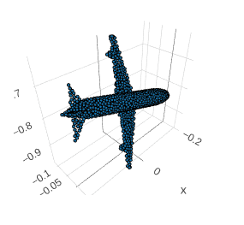

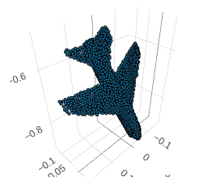

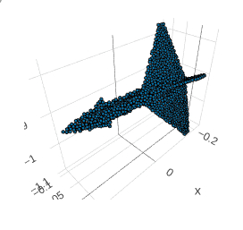

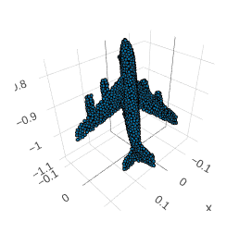
From Pixel to Mesh
Project of RecVis18 - M2 MVA
Tong ZHAO
Oscar CLIVIO

Slide 2
Content
Project Goal
Pixel2Mesh
Experiment
Conclusion
Found around the house!

Slide 3
Project Goals

Slide 4
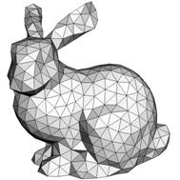
Project Goals
Topic : from a single RGB view of a 3D object, reconstruct its 3D representation.
Preferred 3D representation : meshes —— easier to deform, model shape details.
The model we used: Pixel2Mesh introduced in Pixel2Mesh: Generating 3D Mesh Models from Single RGB Images, Wang et al, EECV, 2018
Our goals :
Entirely reimplement the model in PyTorch √
Reproduce its results on 1 class ×
Test different regularization methods and play with different parameters √
Improve net structure √

Slide 5
Pixel2Mesh

Slide 6

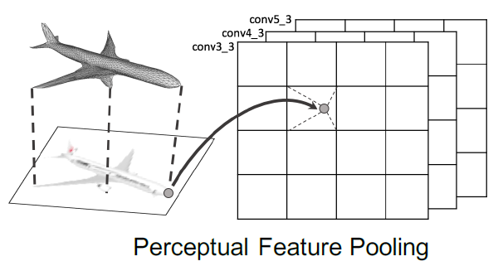
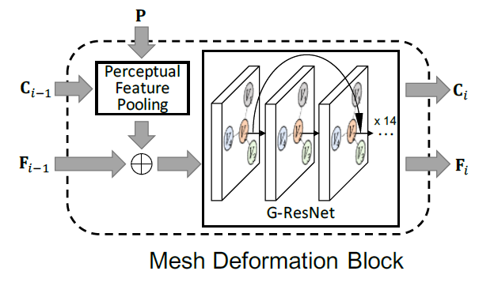
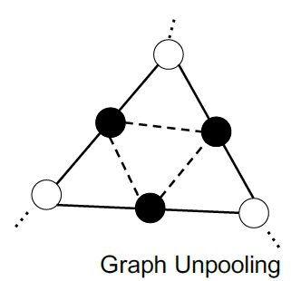
Mesh representation and main modules
Mesh = Graph : vertices, edges, and features for each vertex.
Main ideas :
Progressively deform an original mesh (eg ellipsoid)
Introduce more and more points in the mesh
Modules:
Graph Convolutional Networks (GCN).
Perceptual feature pooling Layer :
Mesh Deformation Block : 14 GCNs with
shortcut connections (G-ResNet)
Graph Unpooling Layer : create vertices and edges.

Slide 7
2D VGG-16 Network
3D Graph-ResNet
2 * Conv2 (3 x 3) : 224 -> 224
Graph Projection : 3 -> 963
Conv2 (3 x 3) : 224 -> 112
Graph Conv : 963 -> 192
2 * Conv2 (3 x 3) : 112 -> 112
13 * Graph Res Conv : 192 -> 192
cat
Conv2 (3 x 3) : 112 -> 56
Graph Projection : 3 -> 963
Graph Unpooling : Add vertices
2 * Conv2 (3 x 3) : 56 -> 56
Conv2 (3 x 3) : 56 -> 28
Graph Conv : 1155 -> 192
13 * Graph Res Conv : 192 -> 192
2 * Conv2 (3 x 3) : 28 -> 28
cat
Conv2 (5 x 5) : 28 -> 14
Graph Projection : 3 -> 963
Graph Unpooling : Add vertices
2 * Conv2 (3 x 3) : 14 -> 14
Graph Conv : 1155 -> 192
Conv2 (5 x 5) : 14 -> 7
13 * Graph Res Conv : 192 -> 192
2 * Conv2 (3 x 3) : 7 -> 7
Graph Conv : 192 -> 3

Slide 8
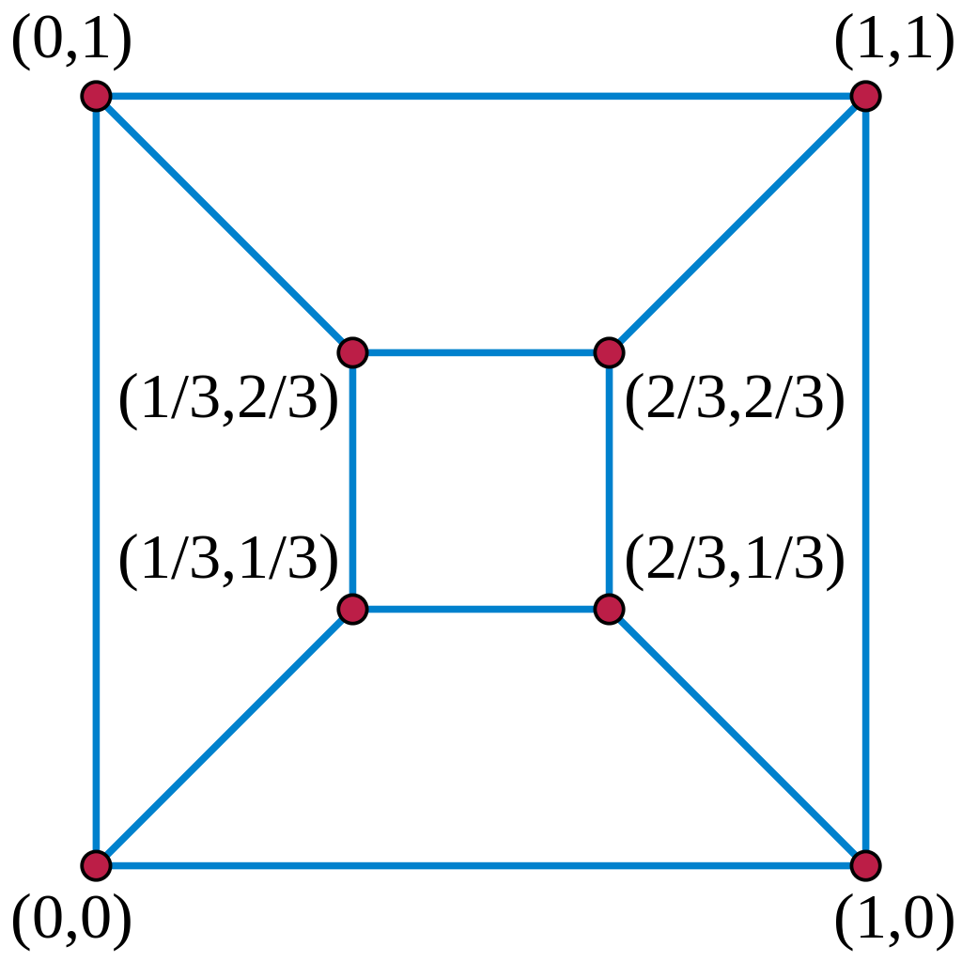
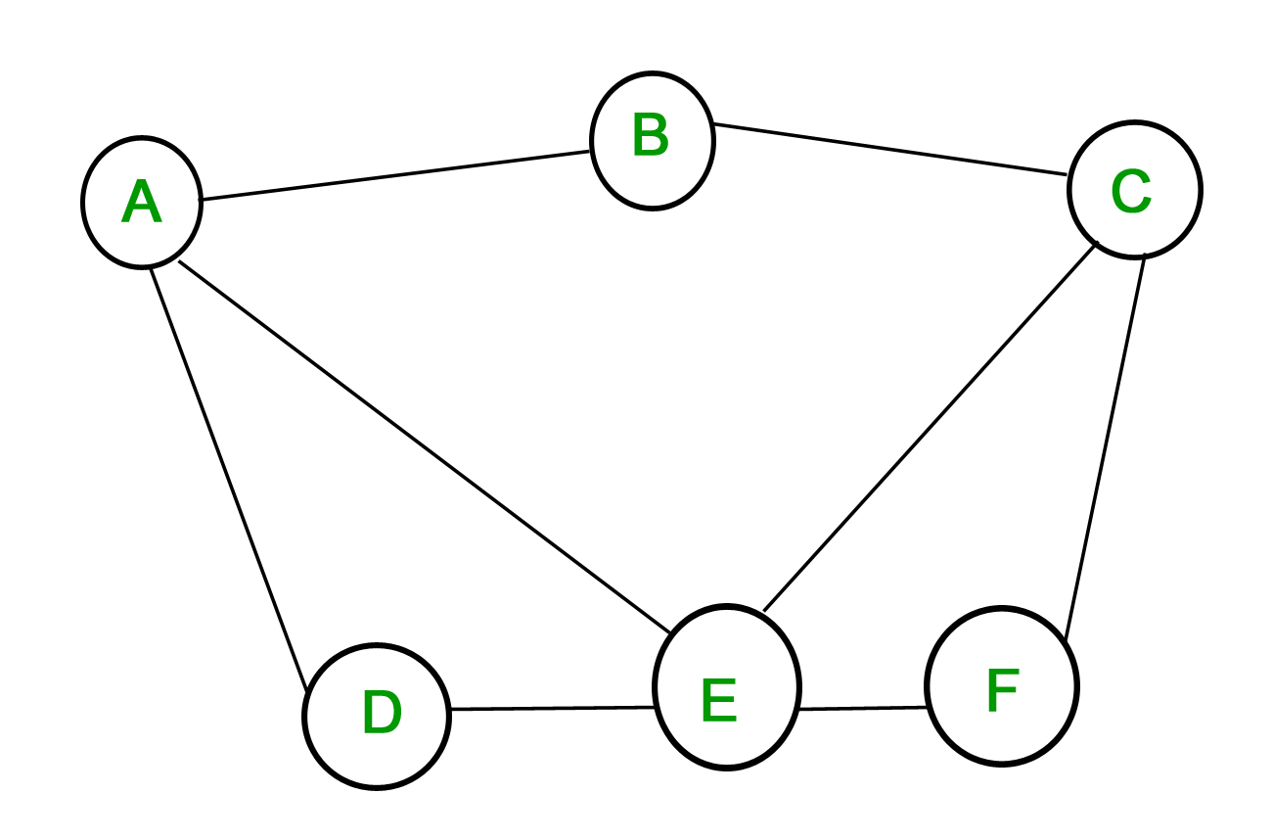
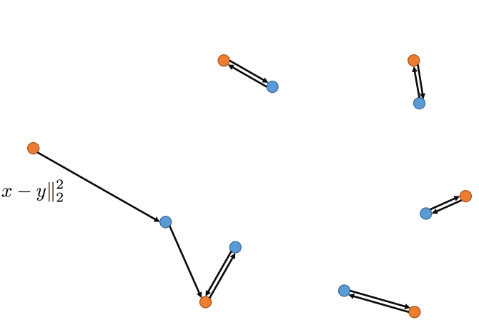
Loss Design
Chamfer Loss: Measure the discrepancy between two point clouds. It does not guarantee any connectivity of the graph.
Tutte Laplacian Loss: Prevent the vertices from moving too freely after a deformation block.
Edge Length Loss: Penalize long edges in the mesh by minimizing its L2 norm.
No loss has direct relation with 2D VGG net!

Slide 9
AutoEncoder-based 2D Net
Motivation: A warm start for 2D image feature, provide strong features to the 3D GNN.
Loss :
Binary cross entropy - approach the distribution
L1 loss - avoid blurry reconstructed image
Structure: All-convolutional U-net
Strategy:
first epoch, we minimize the image loss and the mesh loss
After then, we minimize only the mesh loss.

Slide 10
Experiments

Slide 11

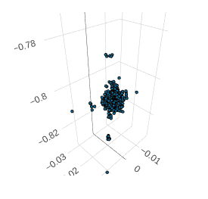
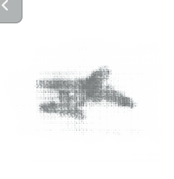
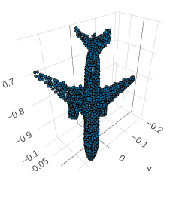
An Example
Input 2D Image | Output 3D Point Cloud | Output 2D Image | 3D GroundTruth

Slide 12
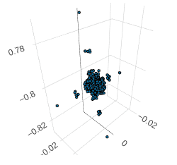
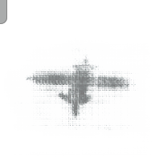
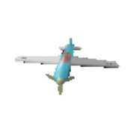
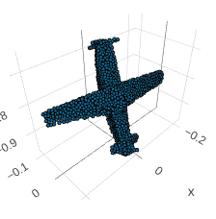
An Example
Input 2D Image | Output 3D Point Cloud | Output 2D Image | 3D GroundTruth

Slide 13


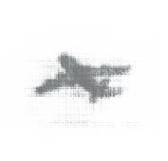
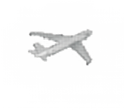
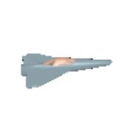
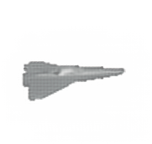
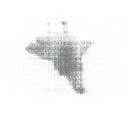

Detail 1 - Influence of 3D GCN on 2D CNN
The auto-encoder can reconstruct a high-quality image in a few (~2000) iterations. But the 3D GCN leads the network to focus on the general shape instead of details.
With Image Loss
Without Image Loss

Slide 14
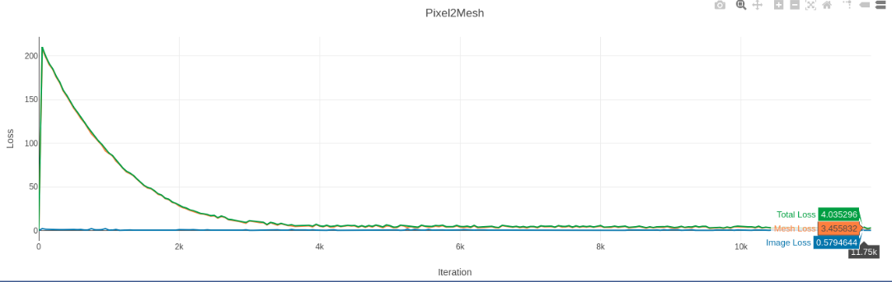
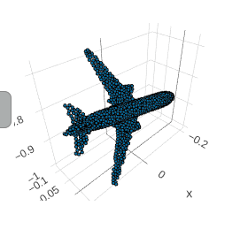
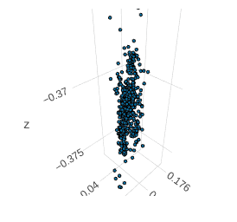
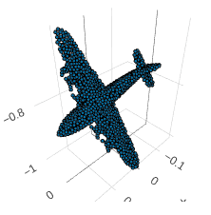
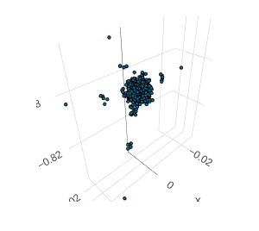
Detail 2 - Where is the weird result from?
√ The network structure: the output shape in each layer is consistent.
√ Image loss: the reconstructed image is satisfactory
√ Chamfer loss: the network learned through the training process the camera intrinsic matrix

Slide 15
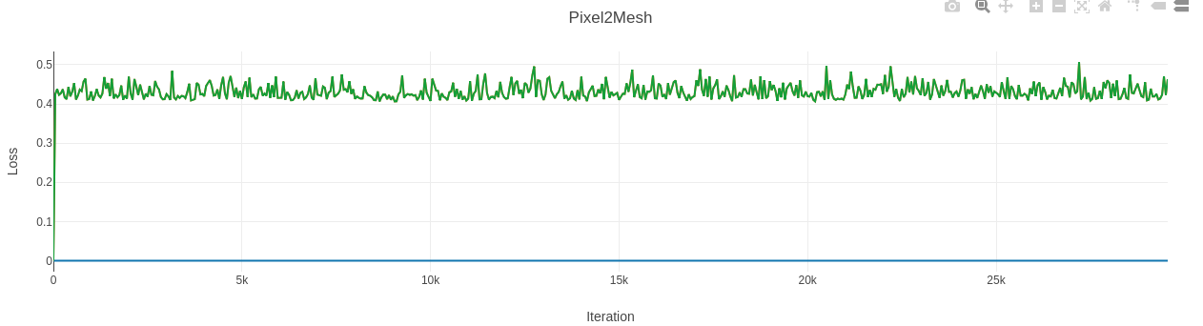
Detail 2 - Where is the weird result from?
× Laplacian loss & Edge length loss: function ‘index_select’ is used in both functions. Its gradient goes wrong when there are repeated indices.
https://github.com/pytorch/pytorch/issues/3644 & https://github.com/pytorch/pytorch/issues/5159
× Batch size is 1: the graph projection layer only works when batch size is 1, which makes the network easily get stuck in a local minimum.

Slide 16
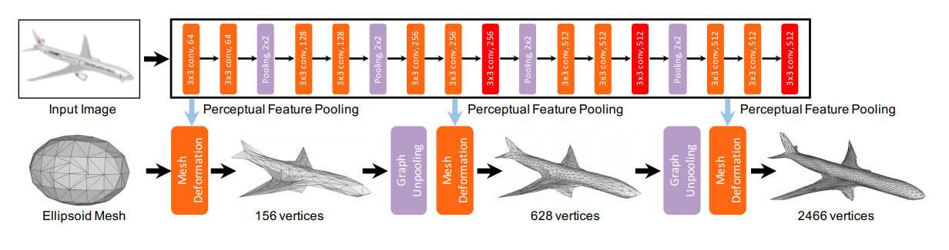
Detail 2 - Where is the weird result from?
× Overuse of 2D image features: all 3 graph projection layers use the same image features.

Slide 17
Conclusion

Slide 18

Conclusion
Pixel2Mesh is a complicated network based on 2D CNN and 3D GCN.
Additional image reconstruction task accelerates the convergence of the model
Further tests need to be done to reproduce its performance on TensorFlow
Code available at: https://github.com/Tong-ZHAO/Pixel2Mesh-Pytorch

Slide 19
References
[1] Wang, N., Zhang, Y., Li, Z., Fu, Y., Liu, W. and Jiang, Y.G., 2018. Pixel2Mesh: Generating 3D Mesh Models from Single RGB Images. arXiv preprint arXiv:1804.01654.
[2] Groueix, T., Fisher, M., Kim, V.G., Russell, B.C. and Aubry, M., 2018. AtlasNet: A Papier-M\^ ach\'e Approach to Learning 3D Surface Generation. arXiv preprint arXiv:1802.05384.
[3] Kipf, T.N. and Welling, M., 2016. Semi-supervised classification with graph convolutional networks. arXiv preprint arXiv:1609.02907.

Slide 20
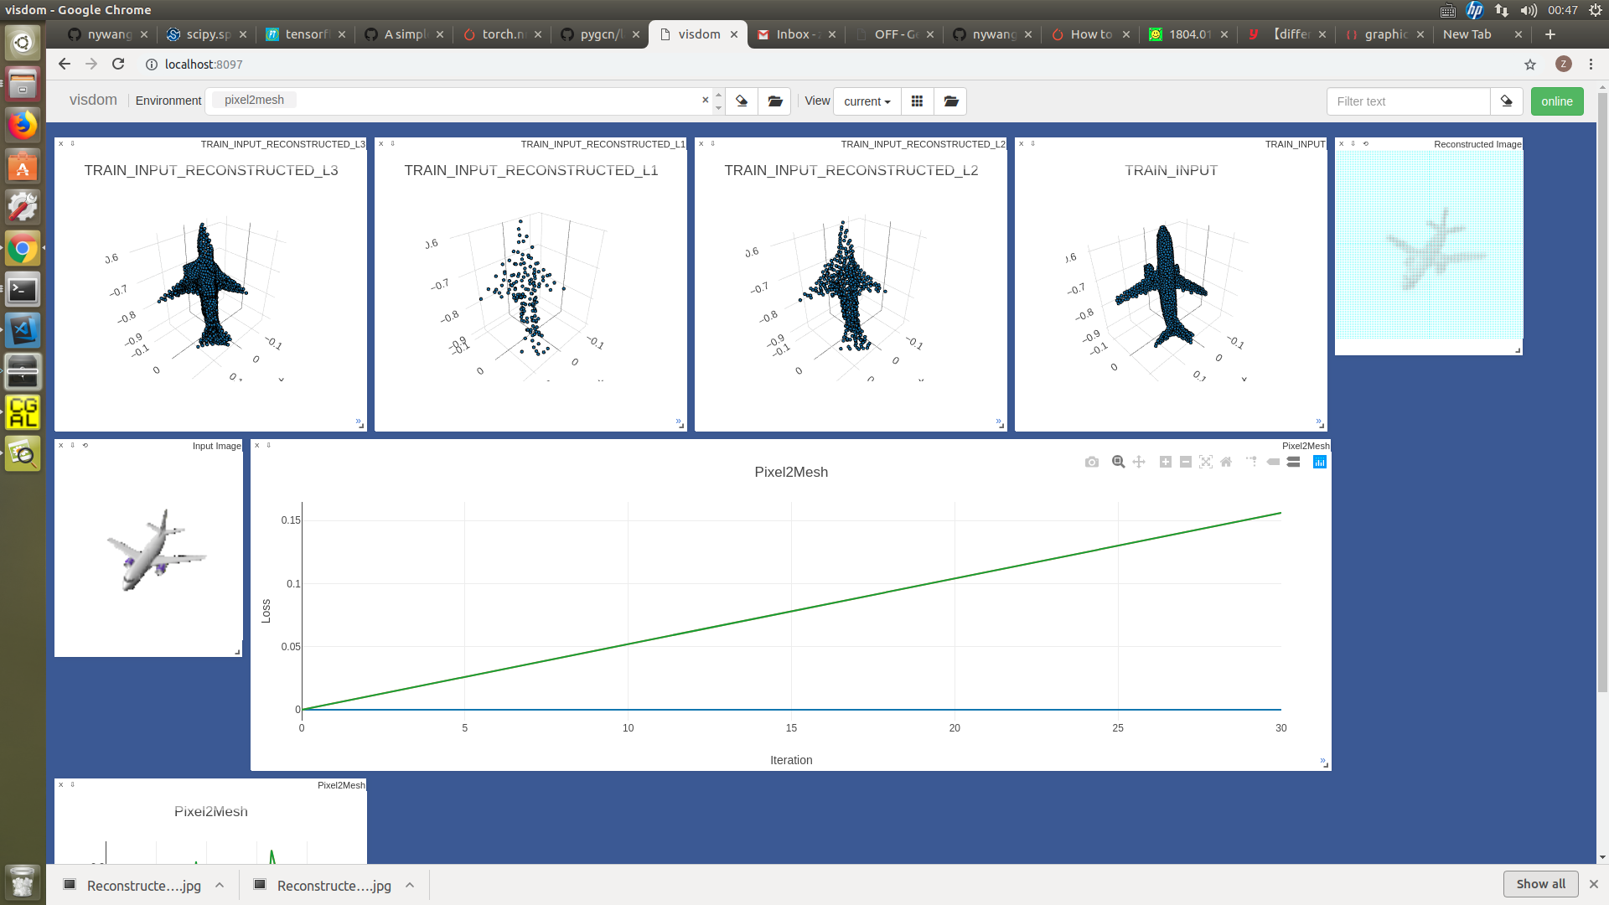
2D Encoder
2D Decoder
Feature Maps
3D GCN

