Slide 1
From GO To Draughts
Haozhe SUN & Tong ZHAO
M2 MVA RL

Slide 2
Contents
Algorithm Review
Game Design
Experiment
Conclusion

Slide 3
Algorithm Review

Slide 4
ResNet-Based CNN
Game State
Input: game state (8x3x3 tensor)
1 convolution block + several residual blocks
Every block:
Convolution layers with 3x3 kernel
Batch normalization
Relu
Value head
Convolution layers + fc layers
Outputs a scalar real value
Policy head
Convolution layers + fc layers
Outputs a real-valued vector (8*8*4)
Convolution Block
Residual Block
...
Residual Block
Value Head
Policy Head
Value ([-1, 1])
Policy (vector)

Slide 5
MCTS
Node:
State Node: contains all information of the current game state
Action Node: represent the action going from its parent state node to its child state node
State Node
Parent (1 Action Node)
Children (N Action Nodes)
Game Map (np.array)
Movable Pieces (np.array)
Player (int)
GameOver (bool)
Action Node
Parent (1 State Node)
Child (1 State Node)
Action (tuple)
Piece Coordinate (np.array)
Stats (N, W, Q, P)

Slide 6
MCTS
Basic Operations:
Selection: Choose the following action
Deterministic Strategy: choose the node whose N is largest
Probabilistic Strategy: 𝜋 ~ N^{1/τ}
Expansion: Initialize all possible moves with
N = W = Q = 0
P = prior_{CNN}
Evaluation: A complete process going from the root to a GameOver State
Backpropagation
N = N + 1, W = W + v, Q = W / N

Slide 7
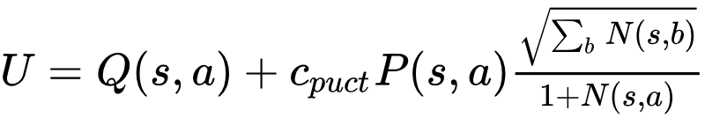
MCTS
Simulation
Polynomial Upper Confidence Trees (PUCT)
Exploration - Exploitation Strategy: Choose the child whose U is largest
Large c_{puct} : encourage exploration
Small c_{puct} : encourage exploitation

Slide 8
ResNet
MCTS
Game State
Convolution Block
Residual Block
N W
P Q
...
Residual Block
Value Head
Policy Head
Value ([-1, 1])
Policy (vector)

Slide 9
Joint Training
Three components executed asynchronously in parallel
Self-play:
Creating dataset
Using the best neural network so far
Optimization of neural network:
Training neural network
Sampling batches from recent self-play games
Cross-entropy : policy
Mean squared error : value
Evaluator:
Update the best neural network so far
Update only if the new neural network is stronger according to results of competition

Slide 10
Game Design

Slide 11
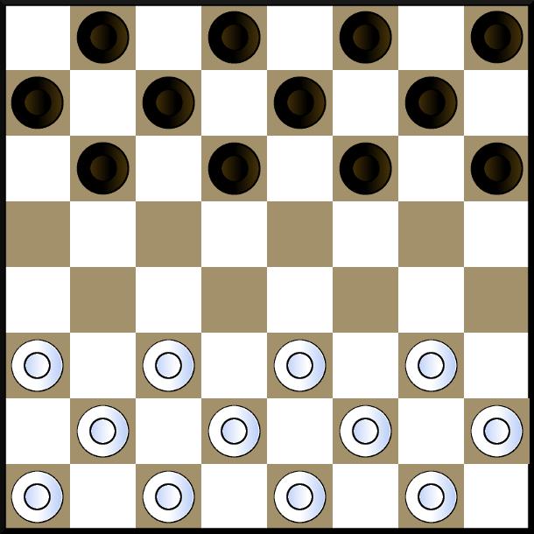
Game Rule - English Draughts
Move:
Single Move: Move forward diagonally to an unoccupied square
Jump: Eat an opponent’s piece which lies on the adjacent square. Multiple jumps are possible and mandatory
King:
Once the piece reaches opponent’s border, it becomes a king and can move both forward and backward
Game Over:
No piece left on the board
No possible moves

Slide 12
Game State
0 : No pieces
1 : White piece
-1 : Black piece
Game Map
Piece Map
0 : No pieces / Unmovable pieces
1 : Movable pieces
Player Map
All 1s if white
All -1s if black
8 x 8 x 3

Slide 13
Game Policy
The entries are all between 0 and 1, which represents the probability the piece choose the direction {NorthWest, NorthEast, Southwest, SouthEast}.
The MCTS filters all moves and keeps only legal moves.
8 x 8 x 4

Slide 14
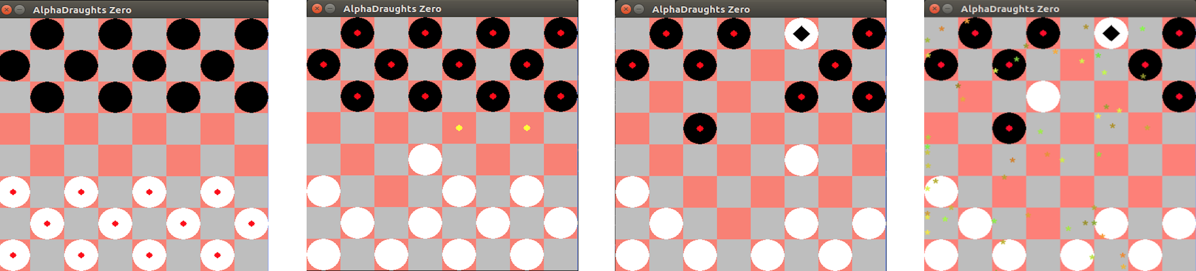
Graphical User Interface (GUI)
(a) Game Board
(b) Possible Moves
(c) King
(d) Animation

Slide 15
Experiment

Slide 16
Training
Param | Value | Param | Value
CPU | Intel E3-1231 v3 | Learning Rate | 0.01
GPU | Nvidia GTX 1070 | Self Play Time | 10
Training Time | 3 days | Number of Epochs per Iteration | 50
Simulation Per Time | 20 | c_{puct} | 0.1

Slide 17
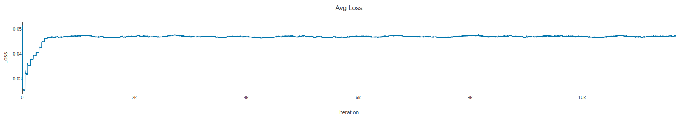
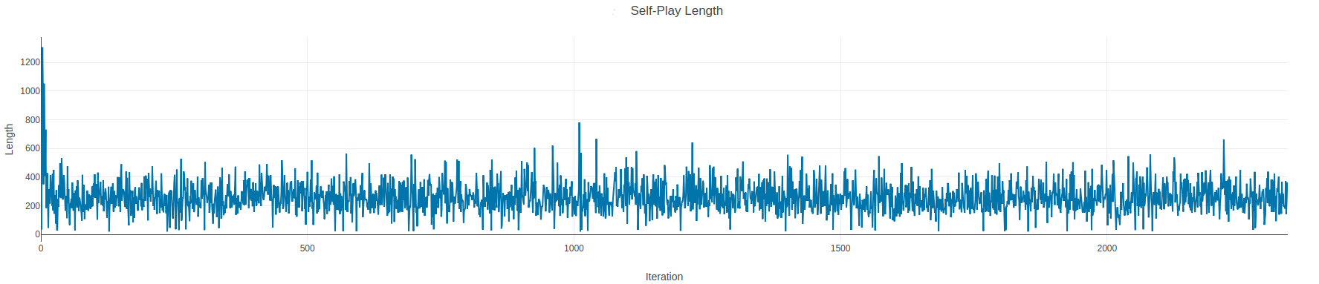
Training

Slide 18
DEMO TIME ~

Slide 19
Conclusion

Slide 20
Conclusion
AlphaGo Zero is a efficient yet time-consuming reinforcement learning algorithm for games with complete information
Parameter selection is not obvious
The time of simulation is crucial to get a good model
https://github.com/Tong-ZHAO/AlphaDraughts-Zero
Thank You!

