Slide 1
Automatic Annotation Synchronizing with Textual
Description for Visualization
Chufan Lai, Zhixian Lin, Ruike Jiang, Yun Han, Can Liu, Xiaoru Yuan
Proceedings of the 2020 CHI Conference on Human Factors in Computing Systems

Slide 2

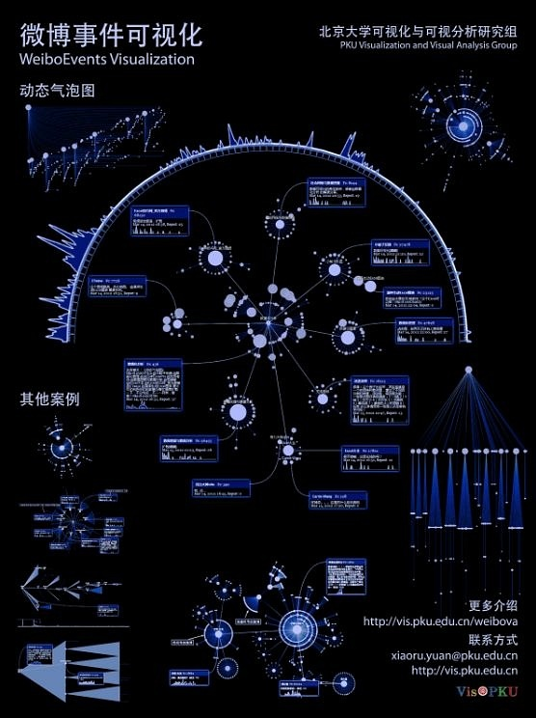
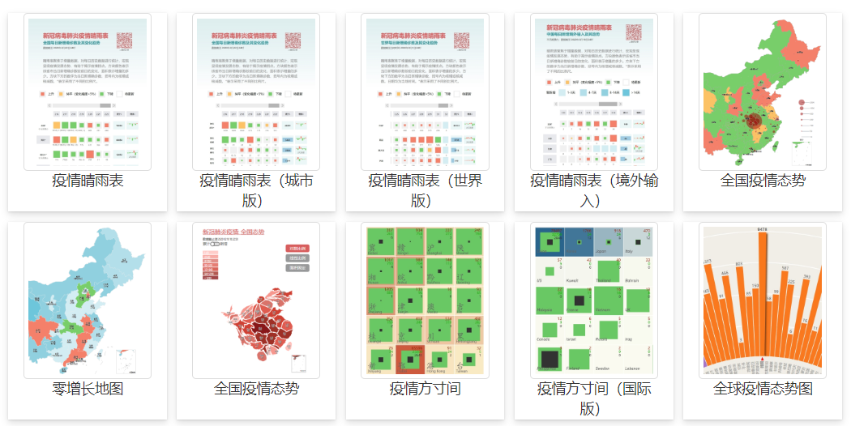


Xiaoru Yuan, Department of Intelligent Science and Technology, Peking University.
PKU Visualization and Visual Analytics Group
Information Visualization, Computer Graphics, Interaction Design, High-dimensional data visualization
IEEE Visualization, IEEE Trans on Visualization and Computer Graphics, EuroVis
Chufan Lai, Department of Intelligent Science and Technology, Peking University.
PKU Visualization and Visual Analytics Group.
Zhixian Lin, Department of Intelligent Science and Technology, Peking University.
PKU Visualization and Visual Analytics Group.

Slide 3



Ruike Jiang, Department of Intelligent Science and Technology, Peking University.
PKU Visualization and Visual Analytics Group.
Yun Han, Department of Intelligent Science and Technology, Peking University.
PKU Visualization and Visual Analytics Group.
Can Liu, Department of Intelligent Science and Technology,Peking University.
PKU Visualization and Visual Analytics Group.

Slide 4
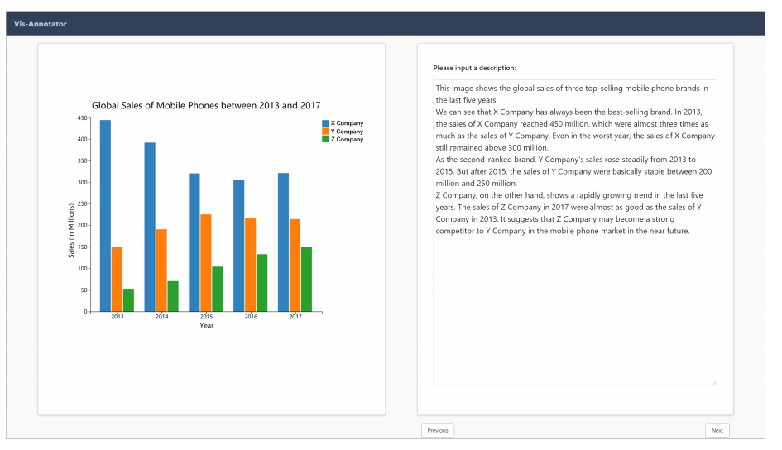
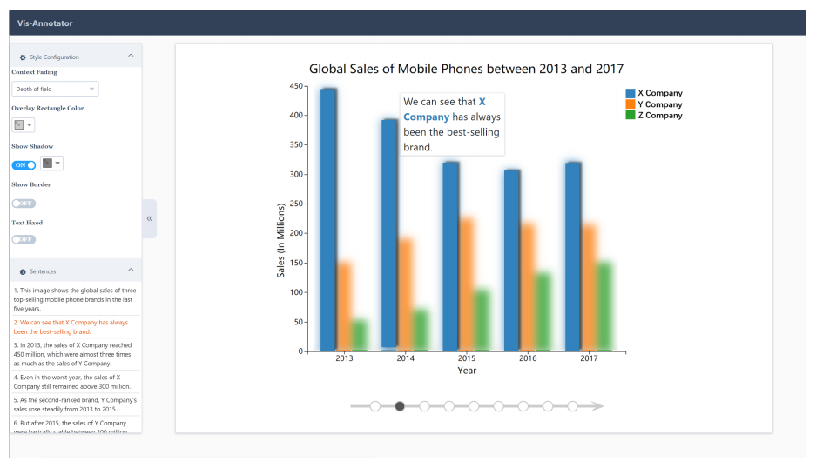
Vis-Annotator
(a) Upload
(b) Fine-Tune
https://www.youtube.com/watch?v=9SkGmdW4y-o https://vimeo.com/361162531

Slide 5
Motivation
• As the visualization becomes more complicated, it becomes boring and time-consuming for audiences to understand descriptions of a visualization.
• Due to limited short-term memory, the audiences must frequently switch between the description and the image.
• Automatic annotation can free the presenter's work.

Slide 6
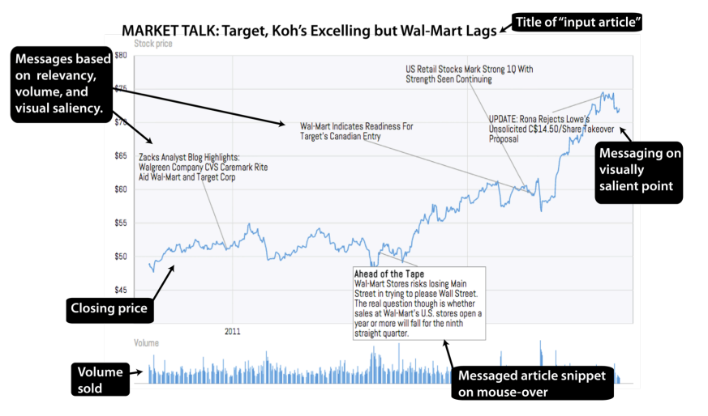
Related Work
• Annotation Assisted Story-telling
• Automatically Generating Annotations
Observational / Data-driven Annotations, Automate Additive Annotations
• Extracting Information from Visualizations
Reverse Engineering of Visualization: Data / Auxiliary Entity Extraction
• Natural Language Interface
Generating visualizations and triggering interactions with an existing visualization.

Slide 7
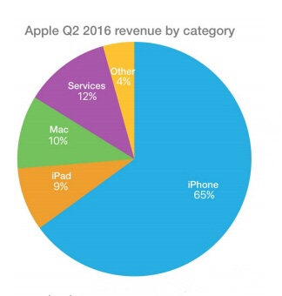
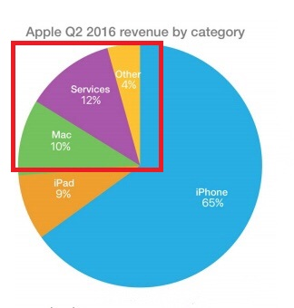
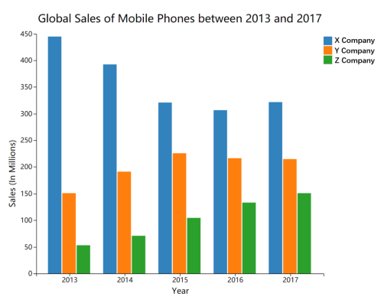
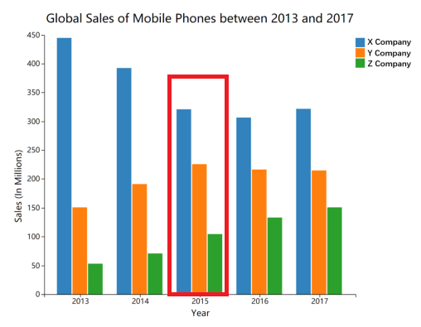
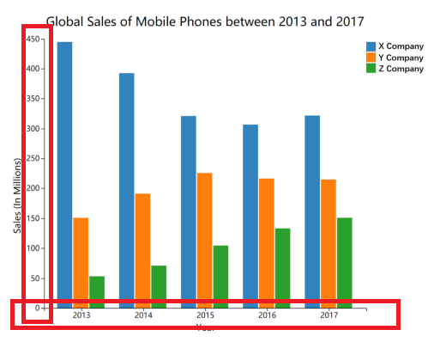
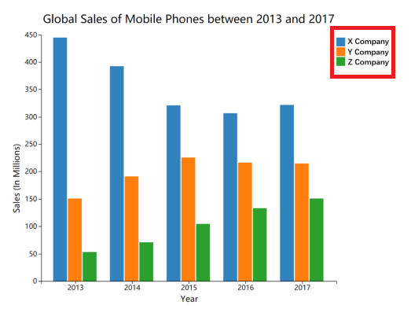
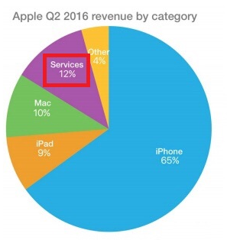
Data Entity: rectangles, circles, and sectors
Auxiliary Entity: axes, legneds, and data labels

Slide 8
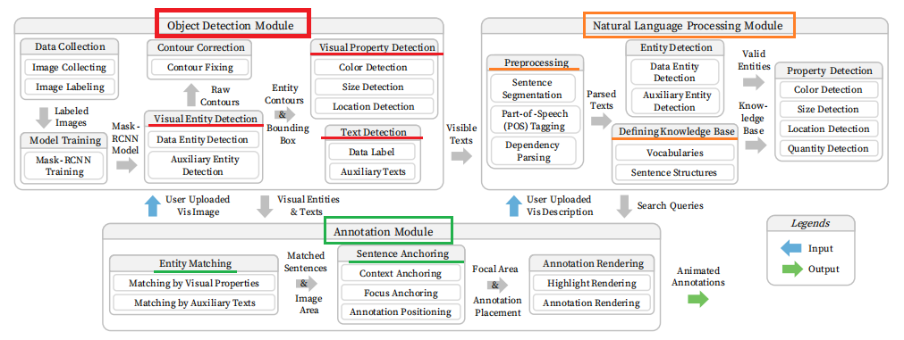
Three Major Modules

Slide 9
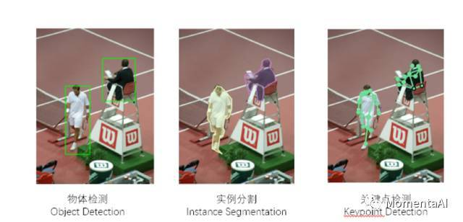
Object Detection Module(OD)
• Visual Entity Detection
Mask R-CNN

Slide 10

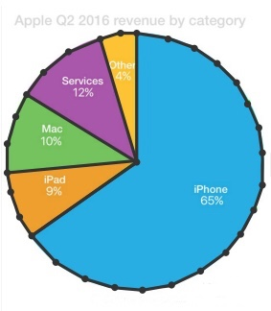
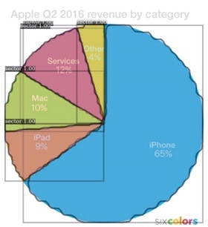
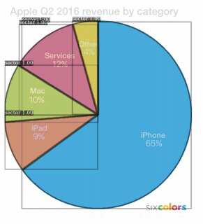
Object Detection Module(OD)
• Visual Entity Detection
208 bar charts, 161 pie charts and 100 scatterplots
rectangle, circle, sector, axes, and color legends
Corpus Collecting
Image Labeling
Model Training
Contour Correction

Slide 11
Object Detection Module(OD)
• Visual Property Detection
Color Detection
Size Detection
Location Detection
HSV color space ——> 11 colors( • • • • • •...... )
area, X-range, and Y-range
the position of centroid

Slide 12
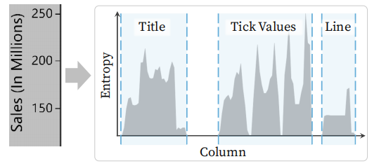
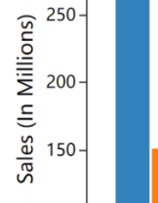
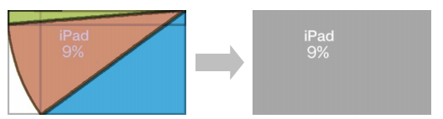
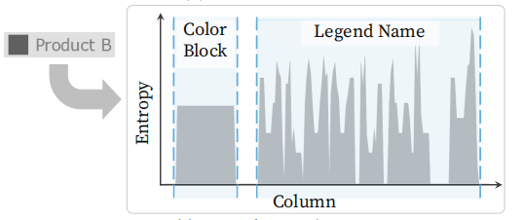

Object Detection Module(OD)
• Text Detection(Tesseract-OCR)
Data Lables
Axes
Legends

Slide 13
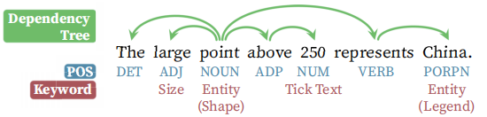
Natural Language Processing Module(NLP)
• Processing(SpaCy)

Slide 14
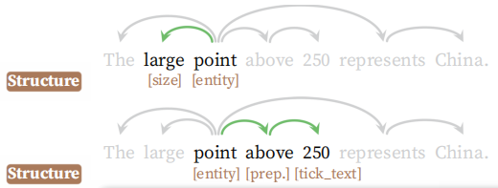
Natural Language Processing Module(NLP)
• Defining Knowledge Base
standard vocabulary, synonyms vocabulary, structure library
(a)
"the red point"
"the point in red"
(b)

Slide 15
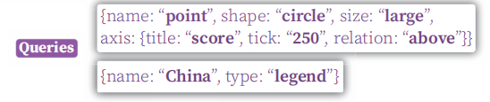
Natural Language Processing Module(NLP)
• Entity Detection

Slide 16
Natural Language Processing Module(NLP)
• Property Detection
colors
size
location
“red”, “orange”, “brown”, “yellow”....
“large”, “small”, “long”....
“middle”, “top”, “bottom”....

Slide 17
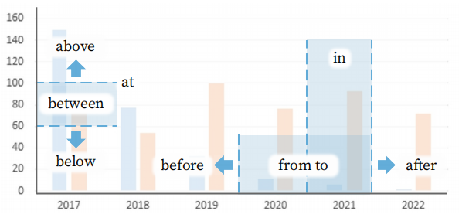
Annotation
• Entity Matching( shape, a data label, or a legend name(NLP) )
Matching by Visual Properties
(Color / Size / Location Matching)
“sector”
xx 75%
Matching by Auxiliary Texts
(Data labels / Legend / Axis Matching)
"below 2014" (numerical) vs. "before 2014" (ordinal)

Slide 18
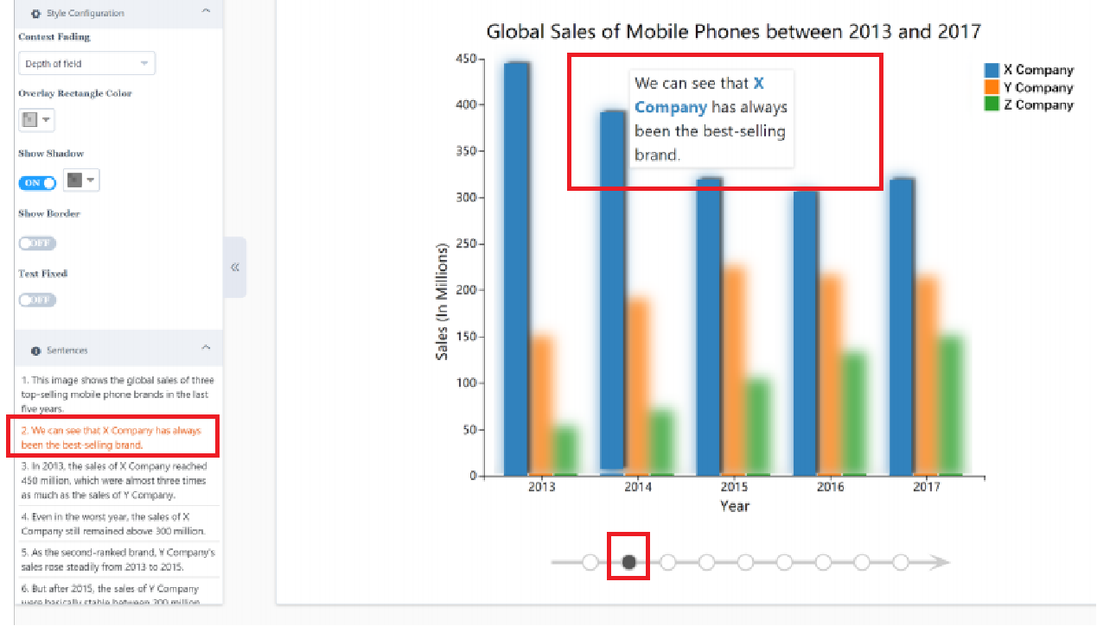
Annotation
• Sentence Anchoring (collision detection)
• Annotation Rendering

Slide 19
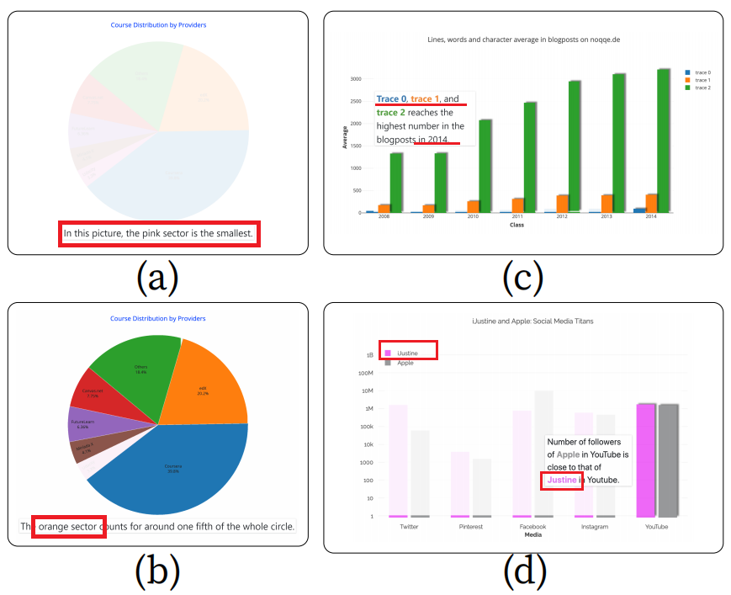
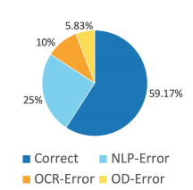
Evaluation
• OD-Error: unrecognized data entities
• OCR-Error: wrongly identified texts
• NLP-Error:
(1) grammar errors
(2) unstable nature of the language model
( "the car on the left" and "the point on the left" )

Slide 20
Pros
1.Automatic annotation is a new research perspective and cut-in point.
2.There is not much knowledge in other fields.
3.Point out the reason of automatic annotation error.
Cons
Automatic annotation has limitations in more complex visualizations.

Slide 21
Thanks!

