Slide 1
The Disparity of Telemedicine Adoption During the COVID-19 Pandemic
The World of mHealth
S25
Ling Tong, PhD
Research Fellow, University of Wisconsin Milwaukee
Twitter: @Ling968
#CIC23

Slide 2


Disclosure
The study was supported by the National Center for Advancing Translational Sciences, National Institutes of Health, Award Number 2UL1TR001436.

Slide 3
Learning Objectives
After participating in this session, the learner should be better able to:
Understand the digital divide
Learn the gap between in-person and telemedicine care
Examine healthcare disparity from a social determinant standpoint

Slide 4
Introduction
Telemedicine adoption rises under COVID-19 Pandemic.
Telemedicine benefits:
Lower Cost
Efficiency, no need to visit in person
Does it really work for all populations?

Slide 5
Overall Utilization Rate
Telemedicine
The numbers are calculated combined with the U.S. Census bureau combined with the Clinical Translational Science Institute of Southeastern Wisconsin using 2020 – 2022 data.
Three forms of healthcare include in-person care, telemedical care, and patient phone or message. Patients receiving both telemedicine and in-person care were categorized as
telemedicine visits for the purposes of this analysis, regardless of the order of visits. Patients with both telemedicine and phone/message visits are counted as telemedicine visits;
Similarly, patients with in-person and phone/message visits are counted as in-person visits.

Slide 6
Question
What factors affect Telemedicine adoption?
How to improve the care coverage?
Patient Disparity:
Racial minority
Non-English speakers
Older adults
Living far from Hospital
Non-insurers
Patient of lower income

Slide 7
Hypothesis
Patients who are older are less likely to use telemedicine services
Patients who are not insured
Patient with lower income …..
Patient living in rural area ….
Patient who do not speak English…

Slide 8
Data Source
Retrospective cohort study, association analysis
Froedtert hospital, Wisconsin
Clinical Translational Science Institute, WI
Time range: March 2020 – March 2022
2.3M patients
Measurement: Odds ratio patient with characteristics X are more/less likely to utilize telemedicine services during pandemic

Slide 9
Social determinant factors
Social and Economic Factors | Data Source
Sex | Electronic Health Records
Race | Electronic Health Records
Age | Electronic Health Records
Ethnicity | Electronic Health Records
Insurance Status | Electronic Health Records
Language (English/Non-English) | Electronic Health Records
Area Deprivation Index | U.S. Census Bureau data
Rural-Urban Continuum Codes | U.S. Census Bureau data

Slide 10
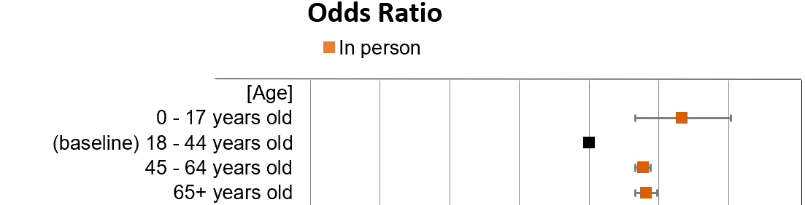
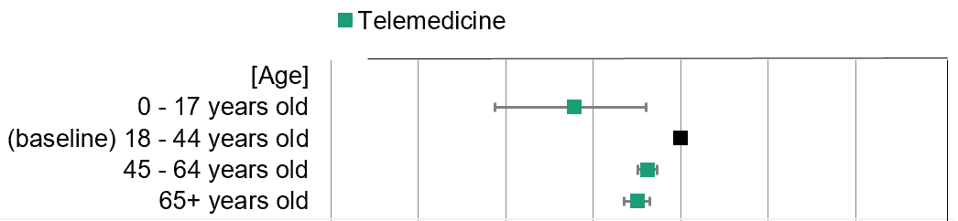
Age
Older adults had more
In-person visits
Older adults had less telemedical visits
Less
More
Utilization

Slide 11


Language
Less
More utilization
Odds Ratio
Patients who don’t speak English are underserved population
(Telemedicine may not address their care needs
Due to Non-English speakers. )

Slide 12

Rural-urban Continuum Code
Patients in rural area go to hospital
less frequently. (0.89x)
Less
Non-metropolitan residents have more phone calls (1.26x)
More
utilization

Slide 13
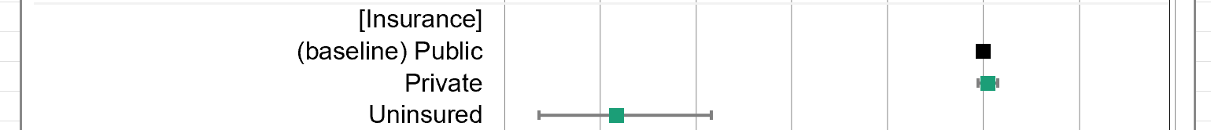
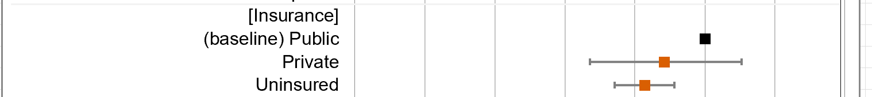
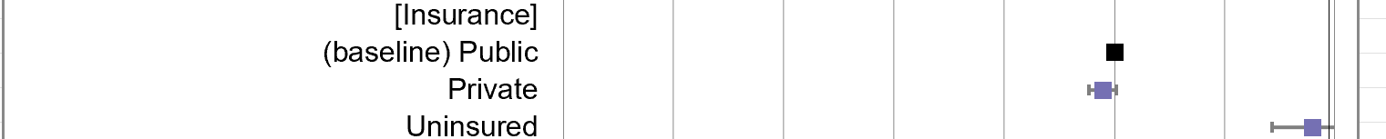

Insurance Type
More
utilization
Less
Uninsured patients use 3.7 times more on
calling/messaging for healthcare needs

Slide 14
Telemedicine Utilization Gap
Telemedicine exacerbated disparities in:
People who do not speak English (with a 0.30 odds ratio compared to baseline)
Older age (65y/o+, 0.89x)
Rural residences (0.89x)
Uninsured (0.07x)

Slide 15
Telemedicine Utilization Gap
Telemedicine exacerbated disparities in:
Coverage remains low (~21%)
National average is 30%~40% on first month, then move to 5 - 10% hereafter
Phone and in-person care are major forms (60-70%)
Telemedicine cannot fully cover/replace in-person care

Slide 16
Reason of Limited Telemedicine Adoption?
Treatment & diagnosis impossible via telemedicine
Many treatment options are not possible via telemedicine
Physical therapy,
inpatient examinations,
lab test
More…
Suggestion
Focus online consultation services
Convenient, cost-effective
Can have more specialties involved when needed
Less technological barriors

Slide 17
Changes?
Tech:
Provide accessible platform for older adults
Use video remote interpreting technology:
Financial Support
Availability of free digital devices and internet
Partnership with community organizations
Clarify the role of telemedicine
Only use for initial consultations
Encourage in-person visit hereafter

Slide 18
Conclusion
Telemedicine: an under-used service have potentials and gaps
Minority socioeconomic groups: Unequal utilization
Systematic guideline is needed.

Slide 19
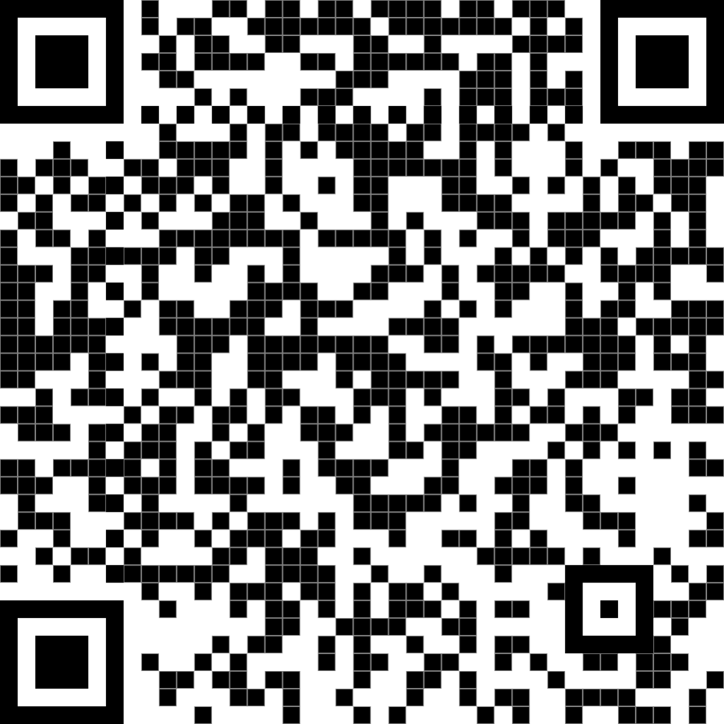
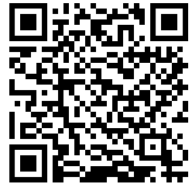
Thank you!
Email me at: ltong@uwm.edu
Download the slides
Download the paper

