Slide 1
INFO-B 585 Biomedical Analytics Microsoft Excel
Guest Teaching Demonstration – Ling Tong
Notes:
Greetings

Slide 2

Ling Tong Lecturer, University of Wisconsin, Milwaukee

Slide 3


Theory
Practice

Slide 4

Study Objectives:
Biomedical Analytics

Slide 5
Introduction

Slide 6

Microsoft Excel

Slide 7

Why Excel?

Slide 8

Easy to use
File easy to transfer
Installed everywhere
Can load large data
Work in cross departments

Slide 9







Multiple Data type
Applies to multiple Scenario
E.g. Bank
Electronic health records
Statistical Analysis
Travel Expenses report
(number)
(scientific)
(fraction)

Slide 10
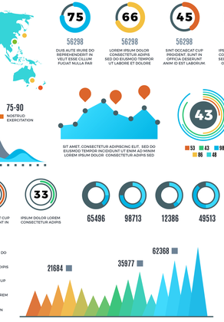
Data Visualization
Built-in charting and analyzing tools
Example: Dashboard

Slide 11
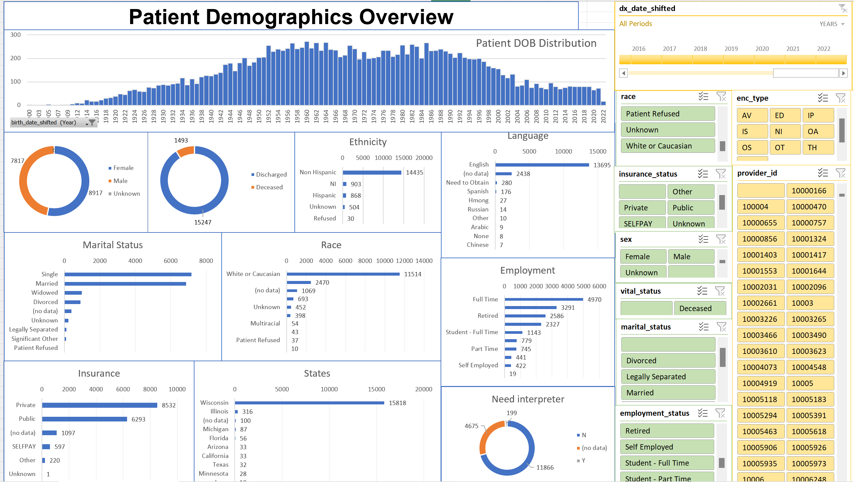

Slide 12
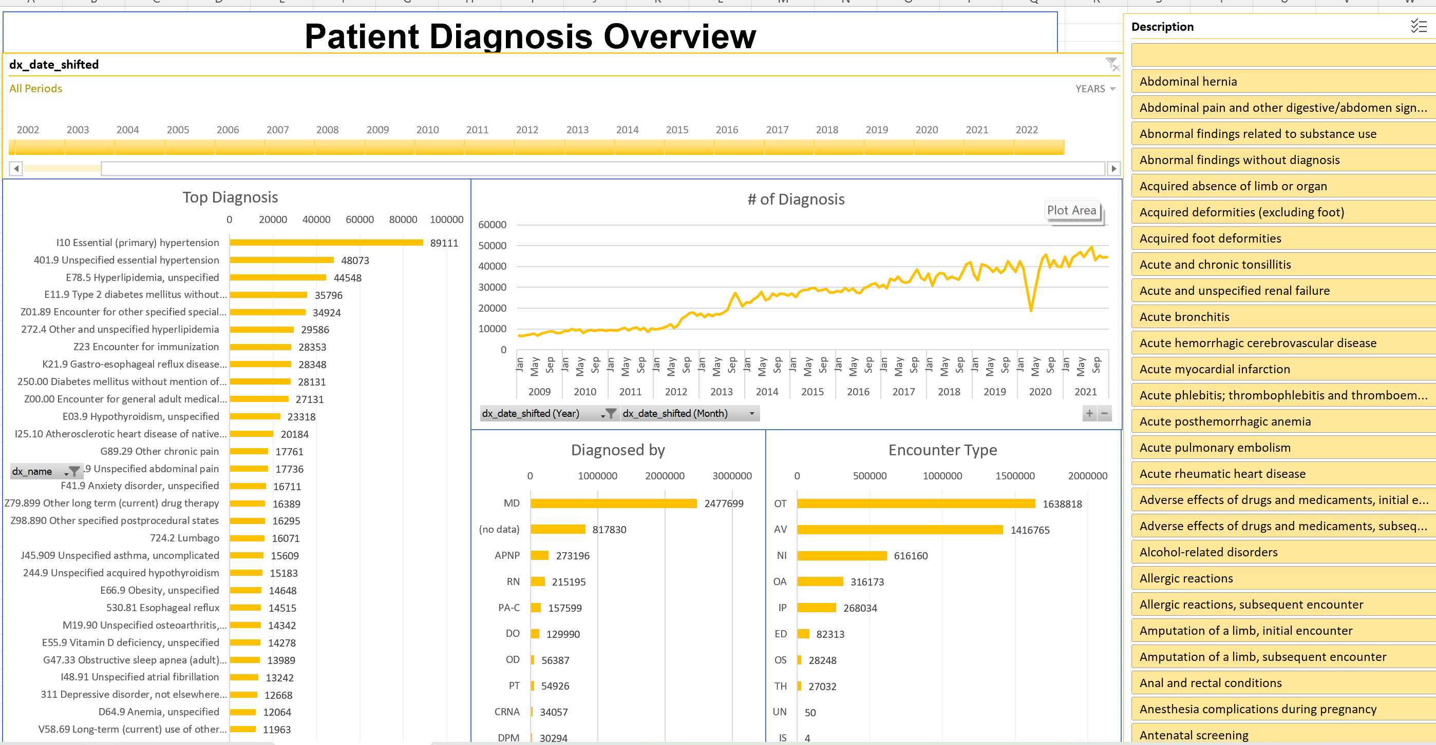

Slide 13




File integration
Integrate into data analysis tools
Flexibility

Slide 14



Microsoft Excel Essential skills
Data Visualization
Application
Data Analysis
Toolbox
Spreadsheet

Slide 15
Spreadsheet
Describing Data:
Data entry
Formatting
Editing
Searching
Sorting
Filtering

Slide 16
Data Visualization Application
Create Data Summary
Creating Charts
Describing and Presenting Charts
Interpret chart results

Slide 17
Data Analysis Toolbox
Support the real problems
Improve efficiency, reduce errors
Enhance healthcare outcome, etc

Slide 18


Descriptive vs Summative
Descriptive: Search for some [Data] you need
Summative: Look for valuable [Insights]

Slide 19

A Computer Search in

Slide 20

Search Function

Slide 21
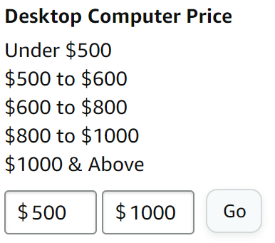

How to Narrow down?
Filter

Slide 22
After we applied filter…

Slide 23
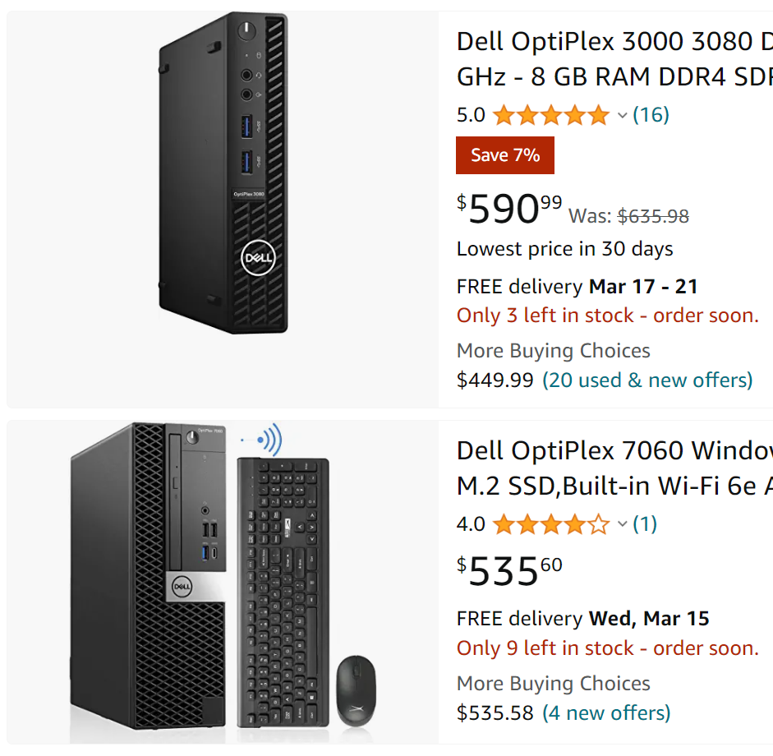
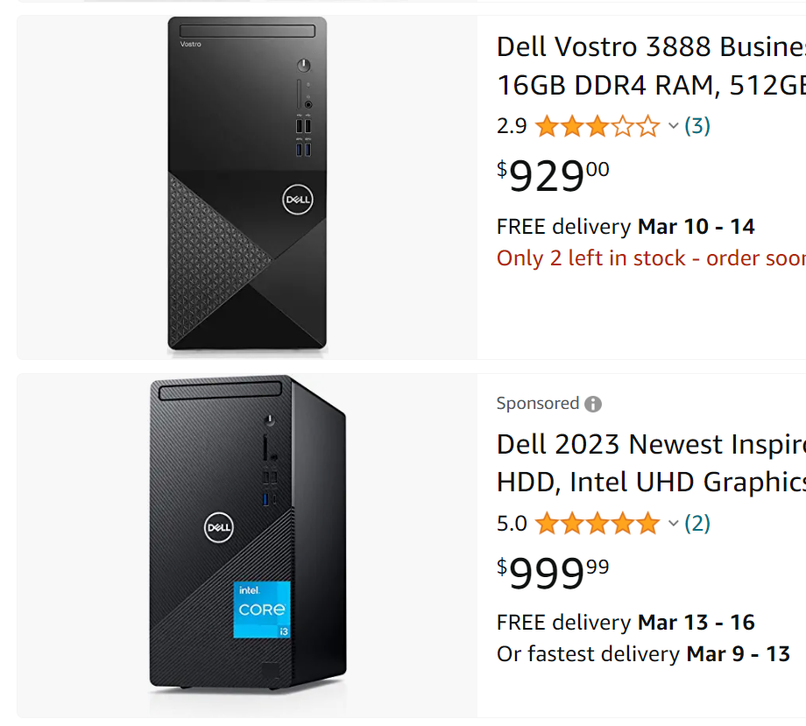

Slide 24

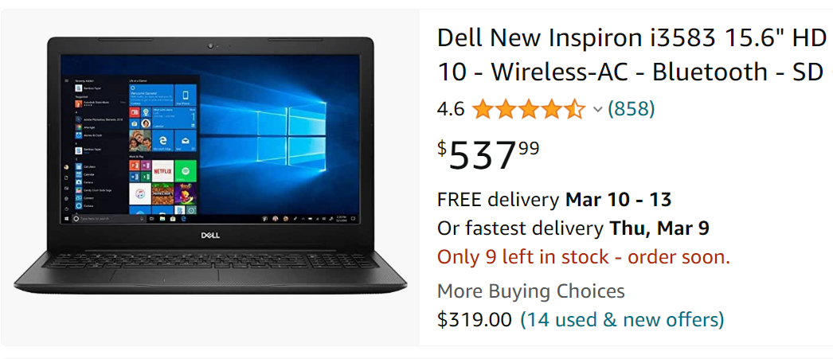
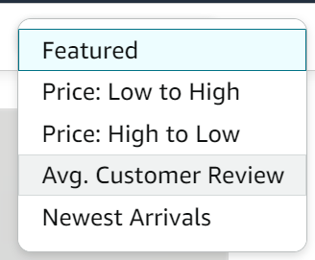
Many of them have not enough reviews
Sort by Reviews

Slide 25
Search for a product
Search
Keyword
Dell Desktop
Filter
Price
Sort
Review
Best first
$500-$1,000

Slide 26
Search in a employee database
Search
Last Name
Filter
Department
Sort
Alphabetical order
Health informatics
Last name

Slide 27
Summary – Descriptive Search
Descriptive parts:
Finding something you need
Excel is providing a toolbox to facilitate your search
Descriptive: Search for some [Data] you need

Slide 28
Before placing the order…
What else do you need to check?
Review
Price history

Slide 29
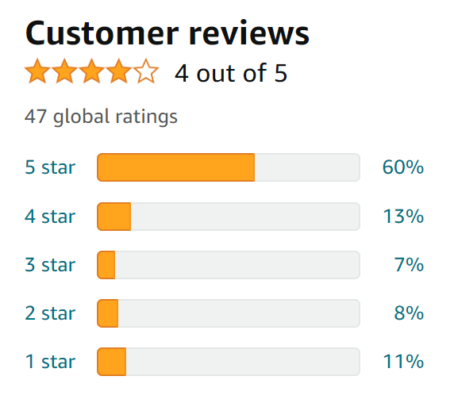
Review
Ratings | percentage
5 star | 60%
4 star | 13%
3 star | 7%
2 star | 8%
1 star | 11%
Summative Table

Slide 30
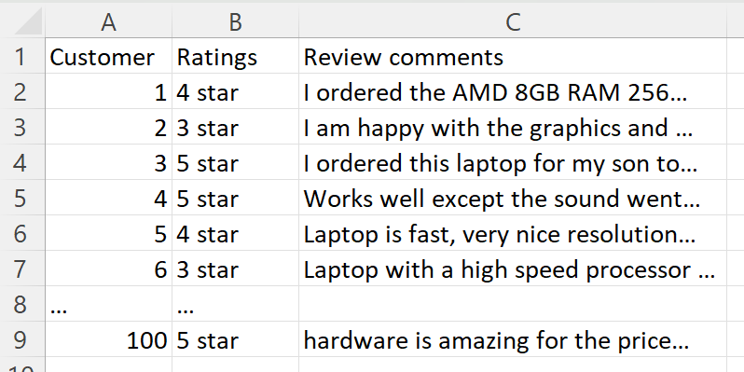
Ratings | percentage
5 star | 60%
4 star | 13%
3 star | 7%
2 star | 8%
1 star | 11%
Summative Table
Descriptive Spreadsheet

Slide 31
Customer reviews
The [average] ratings for all independent customers
Summarized data
Combined with multiple descriptive records
Why we use this: Easy to evaluate the products quality

Slide 32
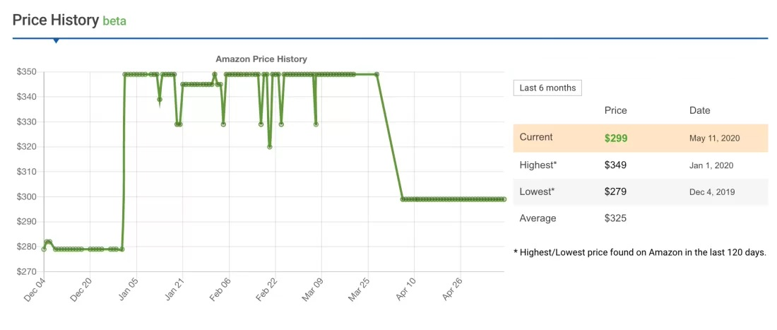
Price History

Slide 33
Price History
The chart shows product prices and changes in a line chart
Summarized data
Combined with multiple records
Why we use this: Buy the product at lower price

Slide 34
How to make these charts?
Microsoft Excel
Pivot table vs Chart maker

Slide 35
How do we translate then in Healthcare industry?
Assignment – In-class example
Scenario: Data analysis from a employee ratings report
What conclusions you’ll be able to make?

