Slide 1
The Disparity of Telemedicine Adoption During the COVID-19 Pandemic
Ling Tong, PhD
Department of Health Informatics and Administration
University of Wisconsin-Milwaukee
Notes:
Good Morning.
It’s very nice to visit the University of Houston.
I really appreciate the opportunity to share you with my research studies.
I hope you could learn from my projects, and most importantly, bring the knowledge to your expertise.
It would also be important to bring the topic into your clinical practice.
We’re talking about the Disparity, and the Telemedicine.

Slide 2
Speaker Background
B.S. in Computer Science
Ph.D. in Biomedical and Health Informatics
7-year research experience
Medical College of Wisconsin
University of Wisconsin Milwaukee
4-year teaching experience
Data Science in Medicine
Notes:
My Name is Ling Tong. I will get a PhD degree on May 20th.
My education begins with a computer science bachelor degree.
I learned how to program, process data, design computer software in my bachelor education.
I found I was interested in Healthcare data analysis.
Therefore, since 2017, I began my PhD program in University of Wisconsin Milwaukee.
In this program, I learned all of the skills for the data processing.
I also had a lot of chance to work on research projects in Medical college of Wisconsin.
I also have four years of teaching experience. I have a group of undergraduate students, and I share my knowledge and thoughts in my specialized area.

Slide 3
Research Expertise
Data analysis
Technology
Analysis for a better care
Innovation for a better care
Retrospective cohort analysis
AI & Health Informatics
Public Health population studies
Data Science in Medicine
Notes:
My expertise mainly lies on the two parts.
The technology and data analysis. The goal of the two expertise is the same, to create a better care from an analytic view.

Slide 4
Technology - AI-based Predictive Algorithms
AI achieves great performance in healthcare field
Predicting diagnosis, long-term survival, prognosis, etc.
A lot more projects to go
My Previous experience in Machine learning & Clinical decision support
Predicting adverse events using clinical trials[1]
Using images to detect bone cancer [2], and breast cancer [3]
Senior adult falls diagnosis [4]
Evaluating health news quality in AI [5]
The potential for artificial intelligence in healthcare
Notes:
I learned from Dr King, this position will have a role on a grant.
The grant involves training predictive algorithms from the data.
I have a rich experience using technologies to complete such algorithms

Slide 5
Health Care Analysis
Analysis for a better care
Improve healthcare outcome
Finding healthcare gaps
Population study, socioeconomic study, cohort analysis.
Notes:
The second part is Healthcare Data analysis.
Specifically, I have experience in population study, socioeconomic study, and retrospective cohort analysis.
If you have some research ideas to share with me, I would really glad to know your thoughts.

Slide 6
The Disparity of Telemedicine Adoption During the COVID-19 Pandemic
Introduction
Methods
Results
Discussion
Future Work
Grant opportunities
Conclusion
Notes:
Let’s begin today’s research topic.
I will begin with an introduction and problems
and present my solutions and discuss the future probability how to address the issue.
Also, In the final part I will expand my view and shows my study’s possible directions.

Slide 7
Introduction
COVID-19 health care outcomes
Telemedicine Services
Introduction
Methods
Results
Discussion
Future work
Grant opportunities
Conclusion
Notes:
The telemedicine have become a normal thing in clinical practice.
Telemedicine lets the health care provider care for patients without an in-person office visit.
Under the context of online working, online shopping, and online banking – Everything is getting online.
So, using telemedicine is basically an option.
However, healthcare is a bit different from other online services: One big factors is, does it work for every populations?
Let’s go back and look at a few charts of the COVID-19 healthcare outcomes.

Slide 8
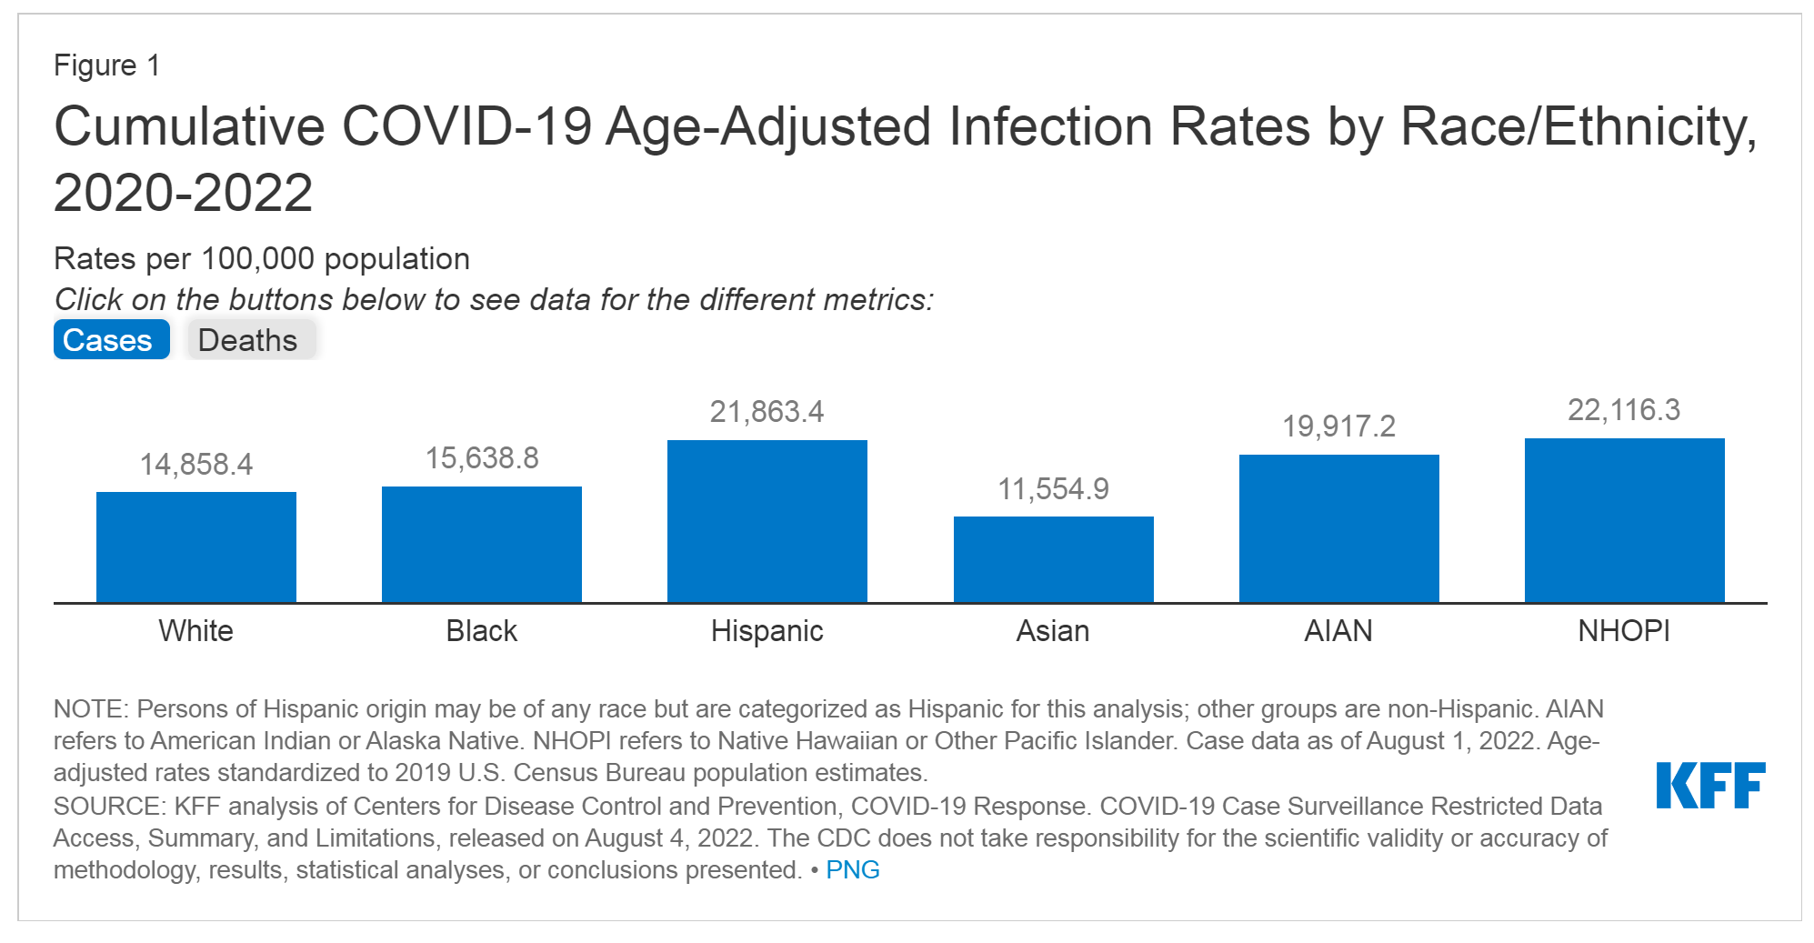
COVID-19 Infection varies by race
Hispanic, Black and other racial minorities had the highest infection rates
Introduction
Methods
Results
Discussion
Future work
Grant opportunities
Conclusion
Notes:
Here in this chart, I showed the infection rates for each racial group.
When we look at the numbers, the infection rate is higher black, Hispanic, and American Indian and Alaska Native, and Native Hawaiian or other pacific islanders.
That shows, racial minorities had the highest infection rates.

Slide 9
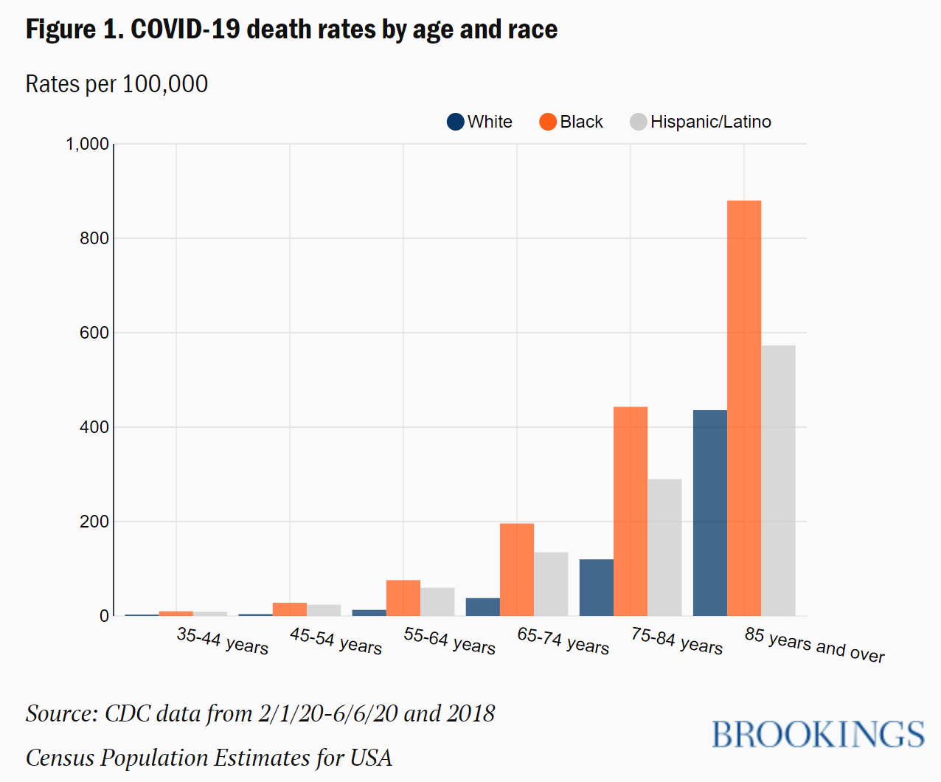
Death Rates
The pandemic impacts racial minorities
The healthcare disparity in different races
Introduction
Methods
Results
Discussion
Future work
Grant opportunities
Conclusion
Notes:
How about the death rates?
When we look at the CDC data, it’s also shown the black and Hispanic people have a higher death rates,
Sometimes for the older age groups, its close to two times difference in death rates.
Therefore, based on these results, our community is showing an unequal healthcare outcomes for the major racial groups
And racial minorities.

Slide 10
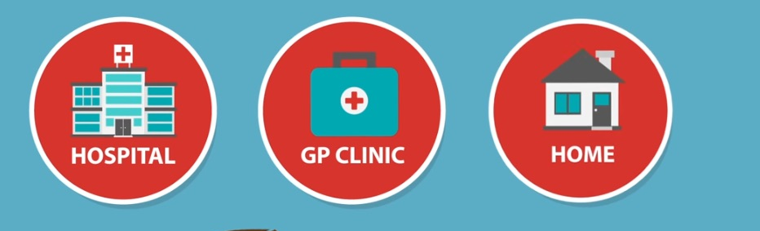
Telemedicine
Telemedicine rises under COVID-19 Pandemic.
Telemedicine’s benefits.
Telemedicine was designed to expand the care.
Does it really work for all populations?
10
Introduction
Introduction
Methods
Results
Discussion
Future work
Grant opportunities
Conclusion
Notes:
When we think about the telemedicine, it is always positive.
For example, it can reduce the COVID-19 transmission, it can reduce the transportation cost, and make healthcare more accessible.
But is that really true for all populations? Such as for the patient of low income and racial minorities?
No study have ever talk about this problems, So we decided to take a closer look about this problem.

Slide 11
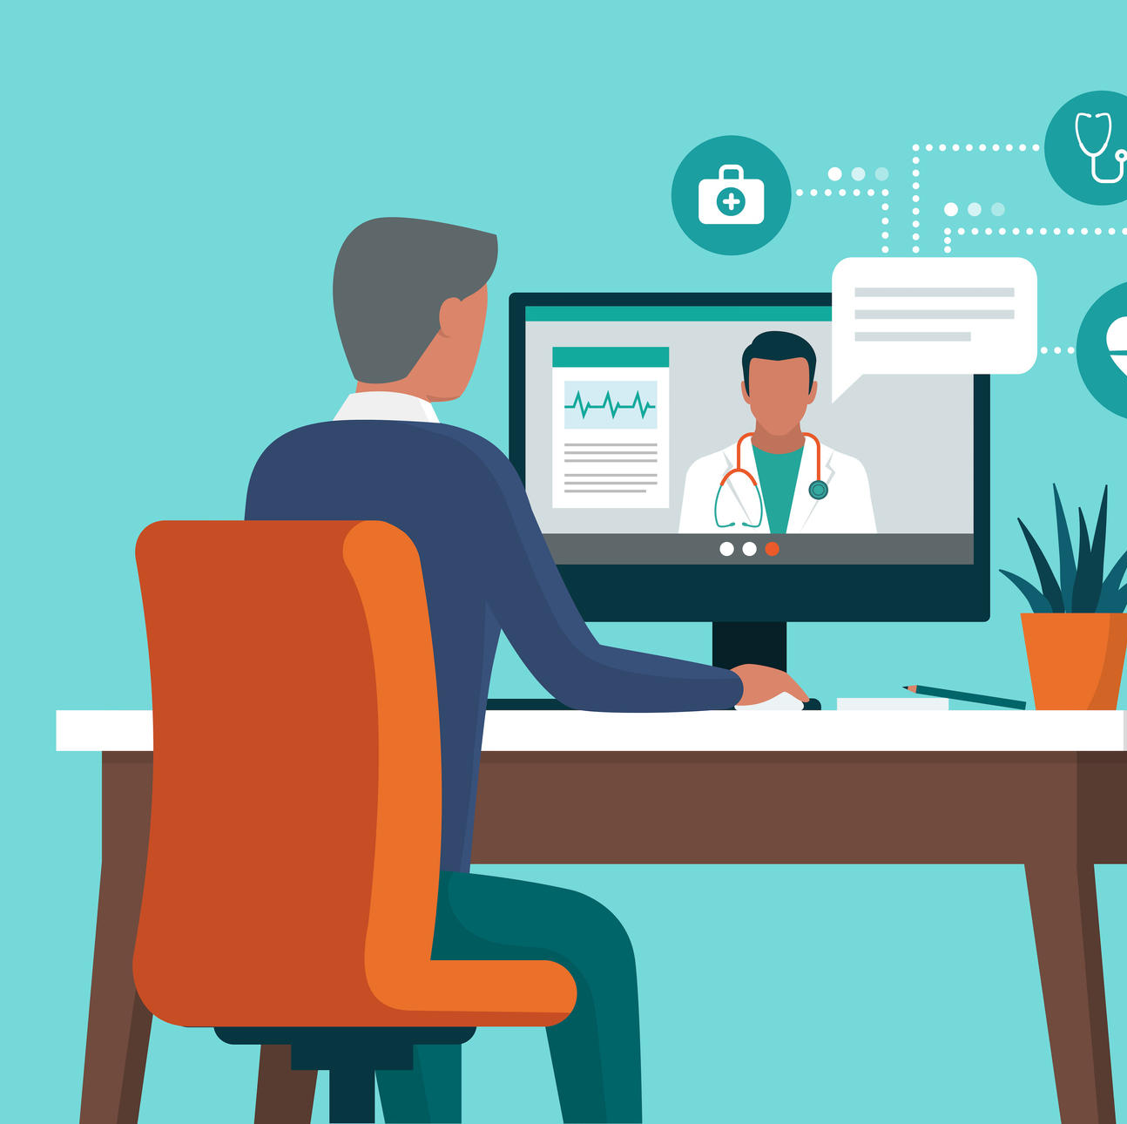
Current Gaps
Unequal telemedicine adoption
The digital divide
Measurement of disparity
11
Introduction
Methods
Results
Discussion
Future work
Grant opportunities
Conclusion
Notes:
In fact, in my research groups, a few of physicians has come up with the questions:
The majority group of patients in virtual care is young adults.
Many senior age patients do not use the services so often, and have a much lower utilizations.
It causes a problem in telemedicine use – some special group of people cannot benefit as much as from the expansion.
We call it digital divide – that means some people do not enjoy the new technology and new forms due to some reasons.
In Academia, there is currently a way to measure the ‘disparity’.

Slide 12
Study Goal
Discover underserved populations
Provide Evidences of healthcare disparities
Promote equal access to telemedical care
12
Introduction
Methods
Results
Discussion
Future work
Grant opportunities
Conclusion
Notes:
To answer these questions, I designed this study and aim to achieve three study goals.
First, I will use methodologies to discover which is underserved populations.
Secondly, I will provide the evidence and define a measurement of disparities.
Finally, according to the underserved group, I will create special strategies to promote the equal access to telemedical care.

Slide 13

Methods
How to systematically find the gap of telemedicine services?
Introduction
Methods
Results
Discussion
Future work
Grant opportunities
Conclusion
Notes:
Therefore, I need to show the disparity – and how we can show the underserved populations?
It’s time to making hypothesis.

Slide 14
Hypotheses
Patients who are older are less likely to use telemedicine services
Patients who are not insured
Patient with lower income …..
Patient living in rural area ….
Patient who do not speak English…
Notes:
The hypotheses comes from the physician’s experience --
Patients who are older are less likely to use telemedicine services,
Other possible factors are insurance, income, rural residence, and different language…
Obviously, if I want to demonstrate these are the factors, we need to collect these patient variables first.

Slide 15
Methods: Data Source
Retrospective cohort study
Froedtert hospital, Wisconsin
Clinical Translational Science Institute
2.3M patients
Time range: March 2020 – March 2022
Methods
Introduction
Methods
Results
Discussion
Future work
Grant opportunities
Conclusion
Notes:
A good beginning to make hypothesis is firstly look at those patient variables.
Therefore, I firstly collected data and define the study type:
It is a retrospective cohort study, and I collected the data from my research center, and included about 2.3 million patients.
That patient is the total number of patients the clinical center have served in the past two years.

Slide 16
Social and Economic Factors
Social and Economic Factors | Data Source
Sex | Electronic Health Records
Race | Electronic Health Records
Age | Electronic Health Records
Ethnicity | Electronic Health Records
Insurance Status | Electronic Health Records
Language (English/Non-English) | Electronic Health Records
Area Deprivation Index | U.S. Census Bureau data
Rural-Urban Continuum Codes | U.S. Census Bureau data
Introduction
Methods
Results
Discussion
Future work
Grant opportunities
Conclusion
Notes:
Apparently, I need to collect the social and economic factors.
So, these are the factors needed to find the gaps.
We have Sex, Race, age, ethnicity, insurance status, and Language for each patients.
In addition to that, patient’s income and address violates the privacy compliance – so I replaced these factors in two other variables.
They are called Area Deprivation Index and rural-urban continuum codes.

Slide 17




Area Deprivation Index
Evaluate socioeconomic status in community
0 - 100
ADI
+
+
+
=
Income
Education
Employment
Housing
Notes:
An are deprivation index is a mix of factors, from 0 to 100, evaluate the socioeconomic status in a community.
It includes a community’s income, education, employment and housing as a factor and finally give a overall socioeconomic score. Which we used to evaluate the patient’s socioeconomic status.

Slide 18

Rural-Urban Continuum Codes
A community classification (Metropolitan / Non-metropolitan)
vs
Rural area
Urban area
Notes:
Another variable is Rural Urban continuum codes. It is a community classification, to identify an area is in rural area, or in an urban area.
Therefore, we also included this in our study.

Slide 19
Measurement of disparity
Odds Ratio

Slide 20
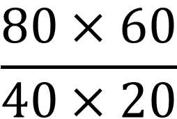
Odds Ratio
A measurement of association
Often used in clinical trials
E.g., Can evaluate the efficacy of a new drug.
Outcome
 | Success | Fail
Control | 40 | 60
Treatment | 80 | 20
$$\frac{80×60}{40×20}$$
Predictor
Odds Ratio =
= 6.0
Treatment group is 6 times compared to the control group
Introduction
Methods
Results
Discussion
Future work
Grant opportunities
Conclusion
Notes:
Here comes the key questions: How to measure the gap?
We borrow the odds ratio to measure the disparity in our study
It is a statistical measurement -- that quantifies the events and interventions.
It is often used in clinical trials and association studies – so we can evaluate the efficacy of medicine.
For example, we can evaluate a new drug in a clinical trial.
If the result is in this table – showing the drug of a control group and treatment group, and find the success and fail rate of a treatment.
We can calculate the odds ratio in the formula.
It means for patients in the treatment group, the odds of treatment is 6 times compared to the control group.

Slide 21


Apply Odds Ratio to Telemedicine
Outcome
Forest Plot
(simulated data) | Telemedicine | No Telemedicine
Female | 47 | 53
Male | 52 | 48
Predictor
Less
$$Odds Ratio=\frac{47×48}{52×53}=0.82$$
More utilization
The odds of Female residents choosing Telemedicine is 0.82x
Compared to male residents
Notes:
We can also borrow this idea to our study in telemedicine. The table can be designed in this way.
Let me give you a simulated example:
Let’s assume the number of male patients who use telemedicine, and do not use telemedicine, are 47 and 53,
And the number of Female is 52 and 48.
Which we can shows the gap in odds ratio numbers
Therefore, the odds of female choosing Telemedicine is 0.82 times.
In the forest plot, we can show it as an easy to read way.

Slide 22

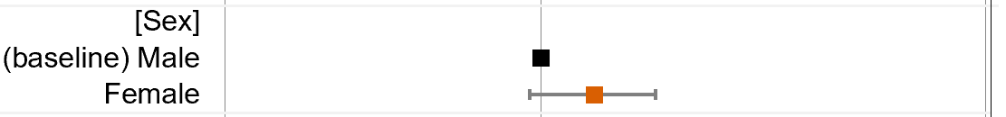
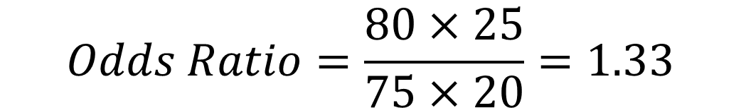
Apply Odds Ratio to In-person
Outcome
Forest Plot
(simulated data) | In-person visit | No in-person visit
Female | 80 | 20
Male | 75 | 25
Predictor
More
Utilization
Less
$$Odds Ratio=\frac{80×25}{75×20}=1.33$$
The odds of Female residents choosing in-person visit is 1.33x
Compared to male residents
Notes:
Similarly, we can check the in-person visit and non- in-person visit in the same way.
Assume the number of male patients who visit in-person , and do not visit in-person, are 75 and 25,
And the number of Female is 80 and 20.
Which we can shows the gap in odds ratio numbers
Therefore, the odds of female choose in-person visit is 1.33 times.

Slide 23
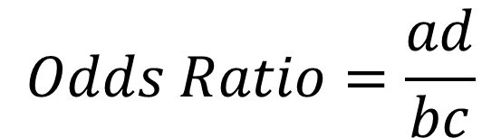
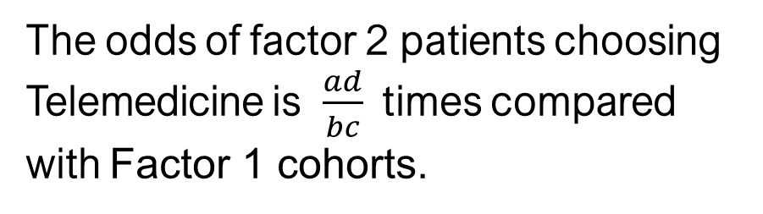
Creating Hypothesis
Hypothesis:
Patients of Factor X are less likely to use telemedicine services
Outcome
 | Telemedicine | No Telemedicine
Socioeconomic Factor 1 | a | b
Socioeconomic Factor 2 | c | d
Predictor
$$Odds Ratio=\frac{ad}{bc}$$
The odds of factor 2 patients choosing Telemedicine is $\frac{ad}{bc}$ times compared with Factor 1 cohorts.
Notes:
Therefore, we create a formal statement of the hypothesis, and apply our hypothesis in this way:
Patients of Factor X are less likely to use telemedicine services
Then, let’s summarize the numbers in this small table,
So we can calculate the odds ratio and give an exact number.

Slide 24
Results: The Disparity of Telemedicine Utilization
Introduction
Methods
Results
Discussion
Future work
Grant opportunities
Conclusion
Notes:
Here we show the utilization results in Southeast Wisconsin.

Slide 25
Overall Utilization Rate
Telemedicine
The numbers are calculated combined with the U.S. Census bureau combined with the Clinical Translational Science Institute of Southeastern Wisconsin using 2020 – 2022 data.
Three forms of healthcare include in-person care, telemedical care, and patient phone or message. Patients receiving both telemedicine and in-person care were categorized as
telemedicine visits for the purposes of this analysis, regardless of the order of visits. Patients with both telemedicine and phone/message visits are counted as telemedicine visits;
Similarly, patients with in-person and phone/message visits are counted as in-person visits.
Introduction
Methods
Results
Discussion
Future work
Grant opportunities
Conclusion
Notes:
First, is the utilization of utilization. It means 21% of local people have tried the telemedicine before.
Compared with in-person, telephone utilization, the overall use rate is a much lower.

Slide 26
Age
18-44 years old
15.8%
18-44 years old
17.9%
In-person visit
Telemedicine
>65 years old
48.6%
>65 years old
45.8%
45 - 64 years old
36.1%
45 - 64 years old
35.8%
Introduction
Methods
Results
Discussion
Future work
Grant opportunities
Conclusion
Notes:
Among people who used telemedicine, 45% are older than 65 years old. This is less than the average in hospital data.

Slide 27
Race
14.0%,
African American/Black
3.1%,
Other minorities
4.6 %,
Other minorities
11.8%,
African American/Black
Telemedicine
In-person visit
81.4%, White
83.4%, White
Introduction
Methods
Results
Discussion
Future work
Grant opportunities
Conclusion
Notes:
When we a looking closer in race, about 81.4% are white, and 14.0% are African American or black, and 4.6% are minorities.

Slide 28
Insurance
1.1%, Uninsured
4.0 %, Uninsured
52.7%
Public
Insurance
Telemedicine
In-person visit
46.2%,
Private
Insurance
50.7%,
Public Insurance
45.3%,
Private Insurance
Introduction
Methods
Results
Discussion
Future work
Grant opportunities
Conclusion
Notes:
In terms of insurance for those who use telemedicine, about 50.7% reported public insurance, and 45.3% reported private insurance. Also, 4.0% percent of people is uninsured.

Slide 29
Language
0.4%
Require Interpreter
~4% require interpreter
Telemedicine
In-person visit
Introduction
Methods
Results
Discussion
Future work
Grant opportunities
Conclusion
Notes:
During the telemedicine visits, 96.5% communicates in English, and only 0.4% requires a interpreter

Slide 30
Rural/Urban gaps
9.5%
Rural Area
8.7%
Rural Area
Telemedicine
In-person visit
91.3%
City Area
90.5%
City Area
Introduction
Methods
Results
Discussion
Future work
Grant opportunities
Conclusion
Notes:
Also, there is a large body of patients living In city area using telemedicine, only 9.5% patients connected from rural area

Slide 31
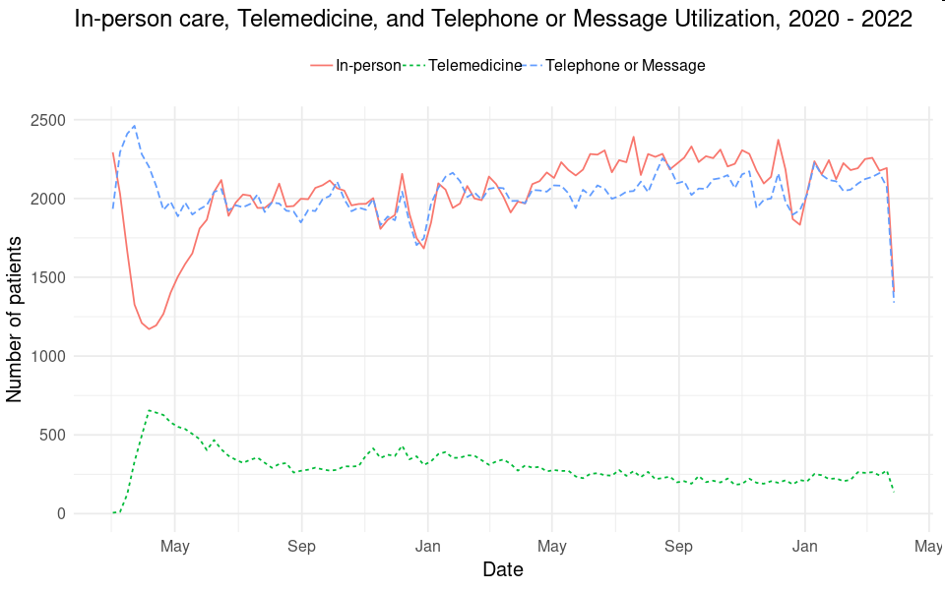
Weekly Utilization
2020
2021
2022
Results
Introduction
Methods
Results
Discussion
Future work
Grant opportunities
Conclusion
Notes:
In terms of the time changes, we can see the utilization rises quickly a 2020 may. However, it declined quickly to about half of all-time high, and then becomes a stable tools for people. Mean while, the other two utilization is much higher, and keeps active all the time. The only drop of in-person visits is during March 2020.

Slide 32
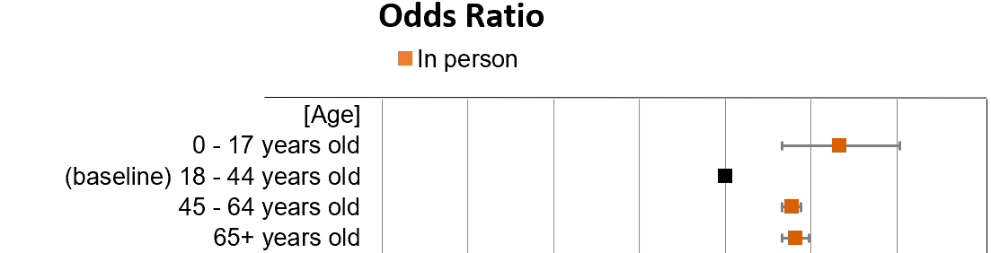
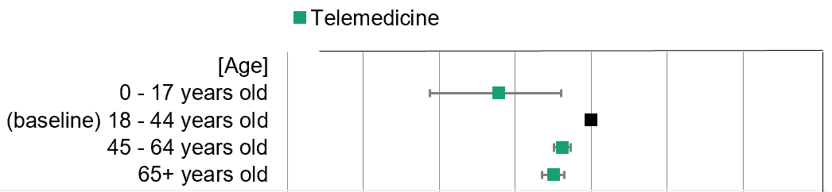
By Age, utilization
More
utilization
Less
65+ years old group are 0.71x (95% CI: [0.64,0.78]) likely
to use telemedicine compared with patients age from 18 to 44.
Results
32
Introduction
Methods
Results
Discussion
Future work
Grant opportunities
Conclusion
Notes:
As we designed in the study, we’ll show the odds ratio for different age categories. As shown in the Telmedicine, if we compared to young adults, the
Utilization for 45-64 years old and 65+ years old are significant lower. Which means there is a gap.
As the odds ratio can be interpreted in this way: In group of 65 years old patients, the utilization of telemedicine is .71 times compared with 18-to-44 year olds.
Well, How about the in-person visits? Let’s look at the second chart. Obviously, when we set 18-44 year olds have a 1 unit of utilization, the in-person visit utilization is close to 2 for 45-64 and 65+ year olds.
Therefore, we can say older adults definitely prefer in-person visits.

Slide 33


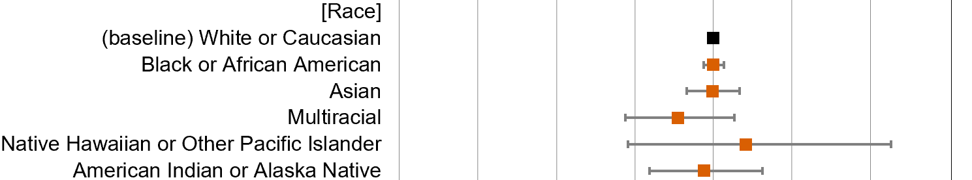
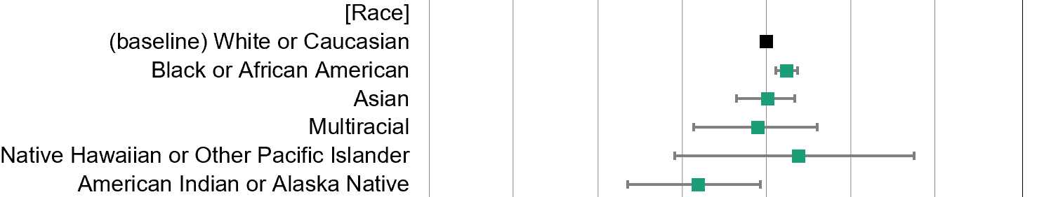
By Race:
Less
More utilization
Odds Ratio
American Indian and Alaska Native are
Underserved populations
Results
33
Introduction
Methods
Results
Discussion
Future work
Grant opportunities
Conclusion
Notes:
The next is about the racial gaps. As shown the bar is on the left for American Indian or Alaska Native, we could find American Indian and Alaska Native are underserved populations in Southeast Wisconsin. Compared with in-person visits, the rate is also not significantly higher than average.

Slide 34
By Language
Less
More utilization
Odds Ratio
Patients who don’t speak English are underserved population
(Telemedicine may not address their care needs
Due to Non-English speakers. )
Results
34
Introduction
Methods
Results
Discussion
Future work
Grant opportunities
Conclusion
Notes:
In terms of language: you can see the utilization drops significantly under telemedicine group.
What does it mean?
Patients who don’t speak English are underserved population.
The red bar shows, when non-English speakers need healthcare, they often do not hope for telemedicine. Instead, they go to hospital.

Slide 35

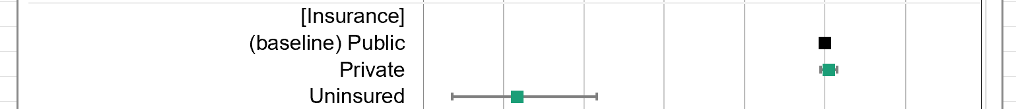
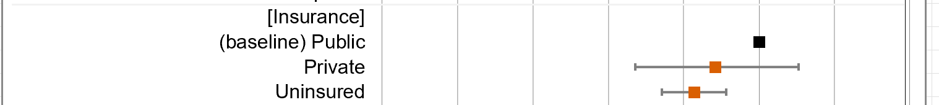
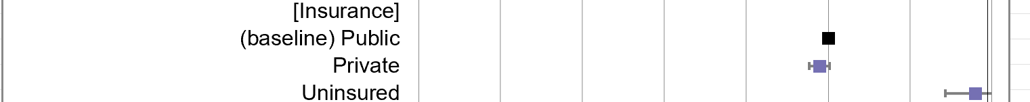

By insurance type
Uninsured patients almost do not use Telemedicine
(0.07x odds compared with insured patients)
More
utilization
Less
Odds Ratio
Uninsured patients use 3.7 times more on
calling/messaging for healthcare needs
Results
35
Introduction
Methods
Results
Discussion
Future work
Grant opportunities
Conclusion
Notes:
For the social and economic status we can also observe the gaps from insurance status.
Uninsured patients use 3.7 times more on calling/messaging for healthcare needs
In the mean time, they have about half of in-person visits. Compared to public insurers.
In telemedicine, they would not even consider it in any way, if they don’t have any insurances.

Slide 36
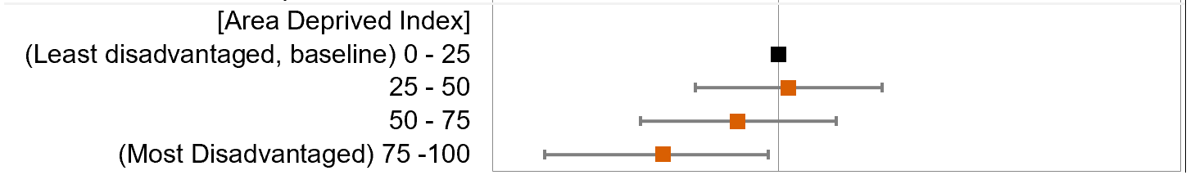
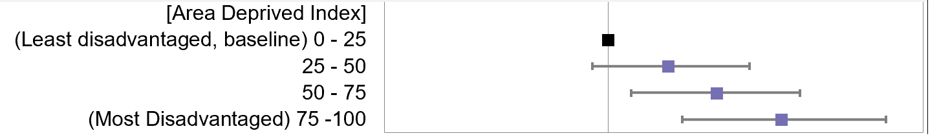
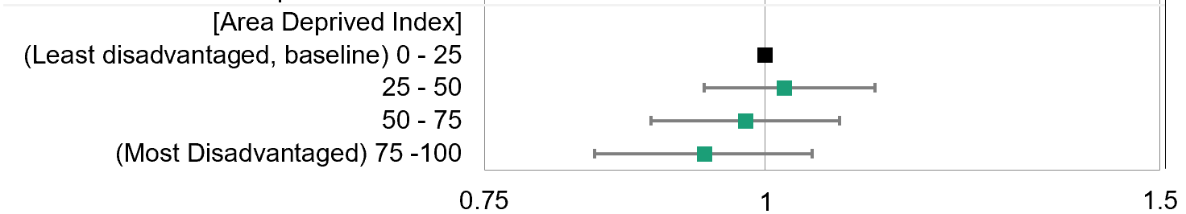
By Area Deprived Index
Summary:
Patient in lower socioeconomic
Status will choose less in-person
Care, less telemedicine care.
And more Telephone or messages.
Odds Ratio
Results
36
Introduction
Methods
Results
Discussion
Future work
Grant opportunities
Conclusion
Notes:
A more direct way is to use the area deprived index to show the gaps for the four quartiles. If people have lower income and conditions, they will be less likely to use telemedicine. Instead, they will choose to use more telephones.
Also they would reduce the in-person care.

Slide 37
By Rural-urban Continuum Code
Patients in rural area go to hospital
less frequently. (0.89x)
Less
Odds Ratio
More utilization
Non-metropolitan residents have more phone calls (1.26x)
Results
37
Introduction
Methods
Results
Discussion
Future work
Grant opportunities
Conclusion
Notes:
Finally, if they life far from the hospital, what would happen?
Non-metropolitan residents have more phone calls (1.26x)
They seems do not have significant difference in telemedicine use.
However, we can find patients in rural area go to hospital less frequently. (0.89x)

Slide 38
Discussion
Study review: measurement of healthcare disparity
Introduction
Methods
Results
Discussion
Future work
Grant opportunities
Conclusion
Notes:
That’s all the result so far.
A Lot of information, right?
Let me summarize everything from beginning for you.
Next, I will do a review of the study, and see How I used the measurement to highlight the problems.

Slide 39
Telemedicine Utilization:
Coverage remains low (~21%)
Phone and in-person care are major forms (60-70%)
Telemedicine only work in basic e-meetings and consultants, etc
Discussion
39
Introduction
Methods
Results
Discussion
Future work
Grant opportunities
Conclusion
Notes:
The utilization of telemedicine has been a hot topic.
Obviously, telemedicine will be a forms of care in the next years for the healthcare industry.
According to the data I have, the coverage remains pretty low, and have a lot of rooms to grow.
Compared with 21% rate, the 60-70% coverage should be good for all patients – and we estimate those the rate would be slightly higher
As we make everything a bit easier to use.

Slide 40
Reason of limited telemedicine?
Treatment & diagnosis impossible via telemedicine
Physical therapy, inpatient examinations, lab test, and many treatment options are not possible via telemedicine
Solution
Make use of the online consultation services for complicated cases Convenient, cost-effective, and can include more specialties
Discussion
40
Introduction
Methods
Results
Discussion
Future work
Grant opportunities
Conclusion
Notes:
The limited utilization makes sense,
Because the treatment and diagnosis is impossible via telemedicine.
For physical therapy, examinations or other things requires patients to be in place.
To increase the rate, a good idea is to expand the use of online consultation services, and work on reducing the cost of healthcare and benefit more patients for lower cost. With telemedicine it is possible.

Slide 41
Discovery of population gaps
We demonstrated the telemedicine exacerbated disparities in:
Uninsured (0.07x)
People who do not speak English (with a 0.30 odds ratio compared to baseline)
Racial minority (American Indian and Alaska Native, 0.55x)
Low socioeconomic status (Lowest quartile, 0.84x)
Older age (65y/o+, 0.89x)
Rural residences (0.89x)
Discussion
41
Introduction
Methods
Results
Discussion
Future work
Grant opportunities
Conclusion
Notes:
In terms of socioeconomic gaps, here is my findings:
We demonstrate the utilization is a problem in different population groups – which created a gap.
We find people who do not speak English, Racial minority, Low socioeconomic status, older age, and rural residences are less likely to use telemedicine.
Some of them, like older age adults, are use other forms of care like in-person care.
However, some uninsured patients and low income patients can only use telephone – which is generally not consider a care solution.

Slide 42

Socioeconomic factors
Age
Racial minority
Low Income -> Insurance
Rural residences
Language
Introduction
Methods
Results
Discussion
Future work
Grant opportunities
Conclusion
Notes:
To discuss each factors separately, I will try to discuss each of them:

Slide 43

Age
Solution:
Provide easy-to-use technology
Offer technical training
A caregiver or family member to assist
Introduction
Methods
Results
Discussion
Future work
Grant opportunities
Conclusion
Notes:
The biggest problem for age is the technology problem.
Imagine the use of Zoom – which is a pain.
But for people who do not know that much technology, it’s just impossible for them to know how to use the platform.
In the future, I see there is a room to grow to provide an easy-to-use technology and technical support.
For the follow up visits, it’s also a good idea to provide training so patient can learn how to fully adopt it.
An assistance from caregiver or family could also help to improve the utilization rate.

Slide 44

Racial minority
Education gaps - Address health literacy
providing plain language materials
Using visual aids
Avoiding technical jargon
Distrust of Medical System and Minority Health Care - WebMD
Introduction
Methods
Results
Discussion
Future work
Grant opportunities
Conclusion
Notes:
For the underserved population of racial minority, I believe there are two issues:
Education.
The education gaps would be a possible reason for underserved population – a good direction could be addressing the health literacy.
This includes a lot of things we can to – to provide a plan language materials to encourage the use of telemedicine
Using visual aids and avoiding technical jargon could also help.

Slide 45

Internet supports
Ensure basic digital devices and internet
Partnership with community organizations
Fight with poverty to address health literacy and promote remote care
Introduction
Methods
Results
Discussion
Future work
Grant opportunities
Conclusion
Notes:
The money problem.
The income is basically a barrier for a better care – which we are looking is to provide basic devices
Such as internet and digital devices, phone or tablets,
To improve the healthcare, it requires the community and organizations, such as school, library or other public warfare, to
Address the health literacy problem and let everybody have that resources.

Slide 46

The support of multi-languages
Use video remote interpreting technology: (an on-time translation voice capturing and translation software)
E.g. MS Teams is doing live translation for video transcriptions
Provide trained medical interpreters
Announcing live translation for captions in Microsoft Teams
Introduction
Methods
Results
Discussion
Future work
Grant opportunities
Conclusion
Notes:
In terms of language gap – it is also a problem that technology did not achieve their goals.
Ideally, we can have the remote interpreting technology – Which definitely needs to take a long time to develop.
For example, Microsoft teams have tried a few live captioning and live translation. We can borrow some ideas from their work.
Before the technology can help to support the multiple languages, we can provide trained interpreters in the online process, to ensure those non-English speakers do not feel isolated.

Slide 47

Conclusion
Telemedicine: an under-used service have potentials
Minority socioeconomic groups: Unequal utilization
Systematic guideline is needed.
Introduction
Methods
Results
Discussion
Future work
Grant opportunities
Conclusion
Notes:
Telemedicine as a new service, have not been achieving its potential in current healthcare industry,
It’s underused, and have a lot of socioeconomic gaps in the minority gaps –
Therefore, a good idea is to have a follow up and create agenda, so the systematic guideline could be created.

Slide 48
Future Work
Introduction
Methods
Results
Discussion
Future work
Grant opportunities
Conclusion
Notes:
With that being said, I’ll further be working in the current projects:

Slide 49
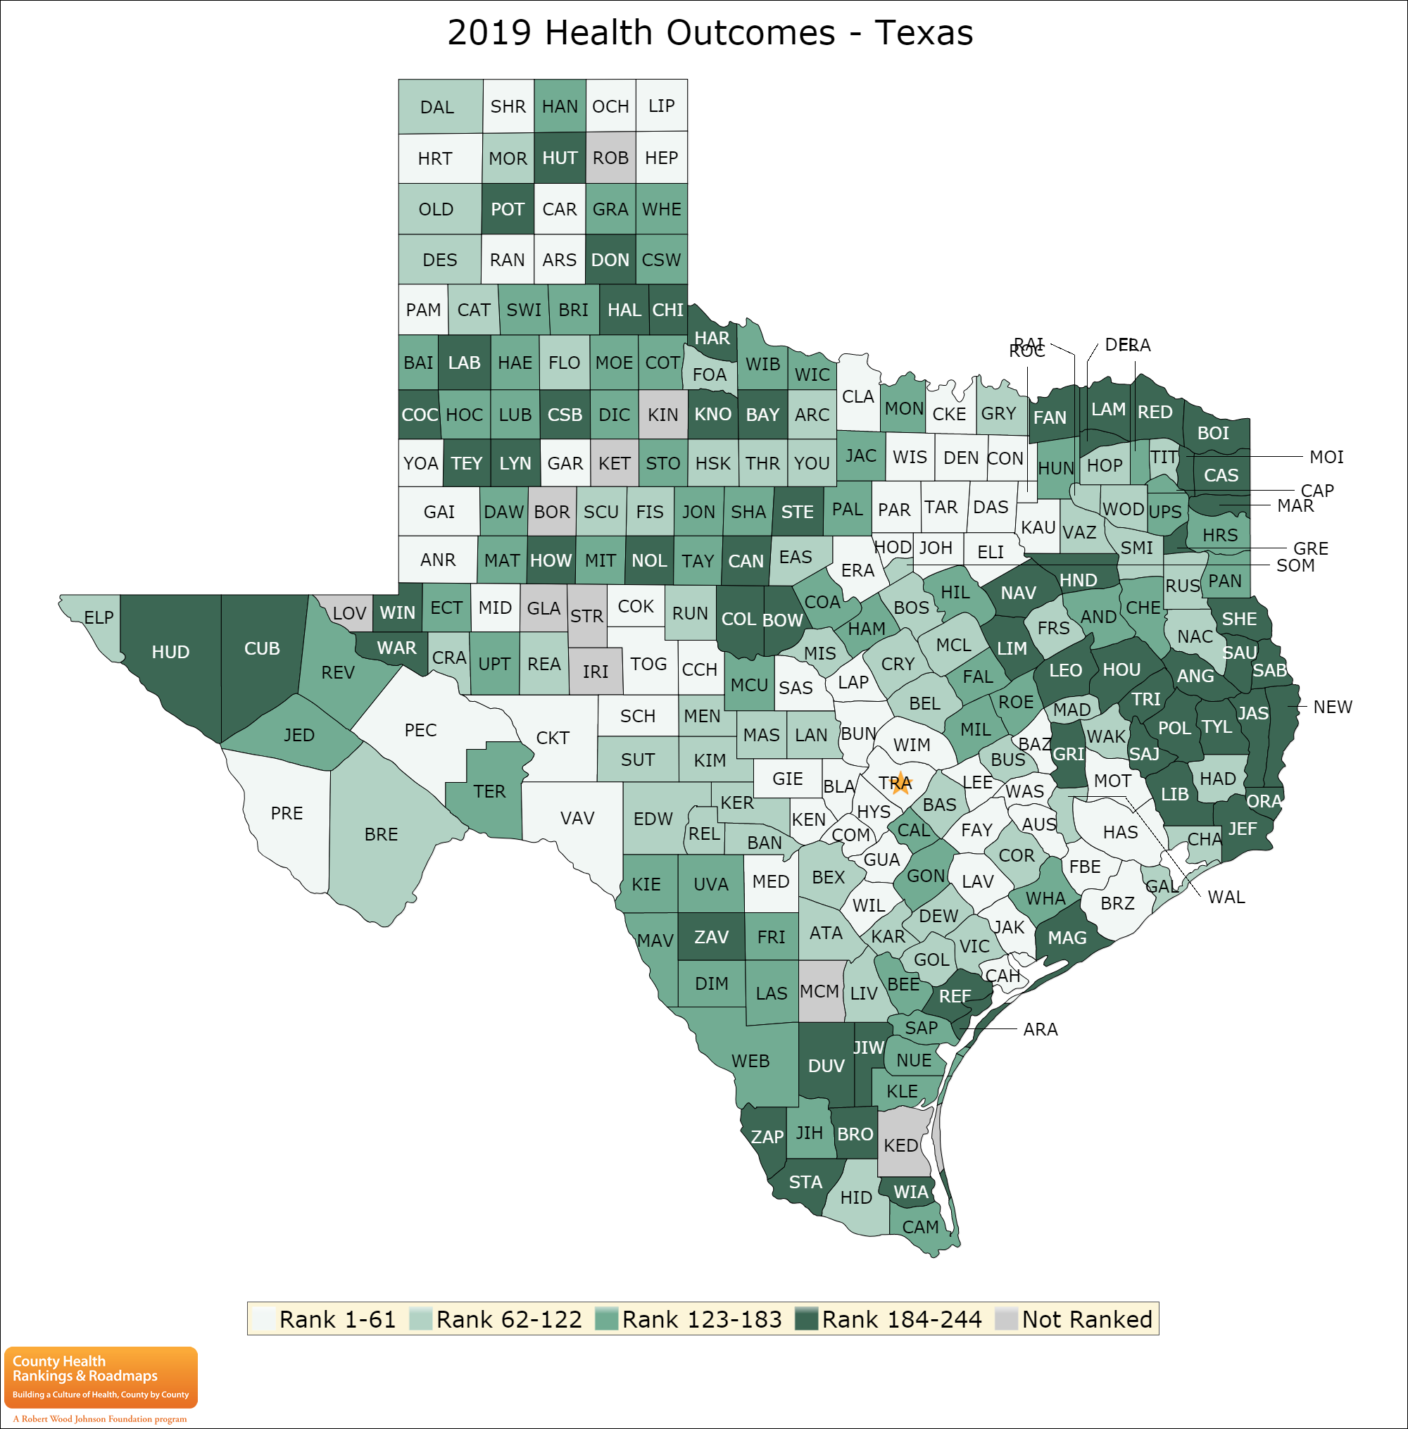
1. Geospatial Analysis
Offering map-based analysis
visualize the under-served area
Applies to general or specific socioeconomic factors.
ECONOMIC IMPACTS OF HEALTH DISPARITIES IN TEXAS 2020
49
Introduction
Methods
Results
Discussion
Future work
Grant opportunities
Conclusion
Notes:
The first direction is to use a geospatial analysis to show the underutilization on a map basis.
This would create a more straightforward view for socioeconomic factors – such as which area is underserved.
Therefore, we can highlight the gaps in a straight forward way.

Slide 50

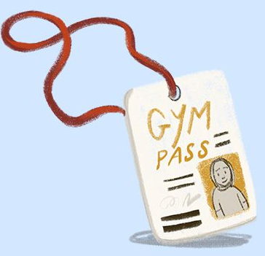


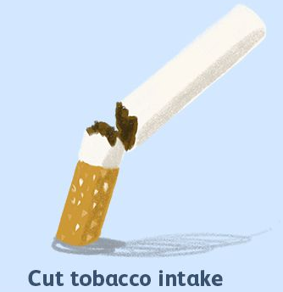
2. Including social and cultural factors
Social, cultural factors for different populations:
Occupation
Food
Exercise
Smoking
Drinking habits.
Introduction
Methods
Results
Discussion
Future work
Grant opportunities
Conclusion
Notes:
Other social and cultural factors, such as exercise, food, smoking and drinking habits also can be a factor
To affect the healthcare adoption – we can explore what kind of social and cultural factors have not been widely explored.

Slide 51

3. Using technology to addressing the health literacy
Deploying technology to reduce the gap
E.g. Online, Clinical Decision support tools
I recently submitted an initiative in the Healthy Longevity Innovation, founded by U.S. National Academy of Medicine – To create a AI-based assistant tools for older nursing home seniors
Introduction
Methods
Results
Discussion
Future work
Grant opportunities
Conclusion
Notes:
The development of technology has also been an interesting topic: Because I have the expertise to
Develop those tools to improve healthcare.
I recently submitted an initiative in the Healthy Longevity Innovation,
It is founded by U.S. National Academy of Medicine.
The purpose is to create an AI-based assistant tools for older nursing home seniors.
I will find a chance to share more details for my projects in the future if I have chance.

Slide 52
5. More collaborations
Interdisciplinary is key
health services and population studies.
Collaborate with other departments
Introduction
Methods
Results
Discussion
Future work
Grant opportunities
Conclusion
Notes:
Lastly, It is always welcome for more collaborations!

Slide 53
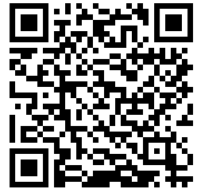
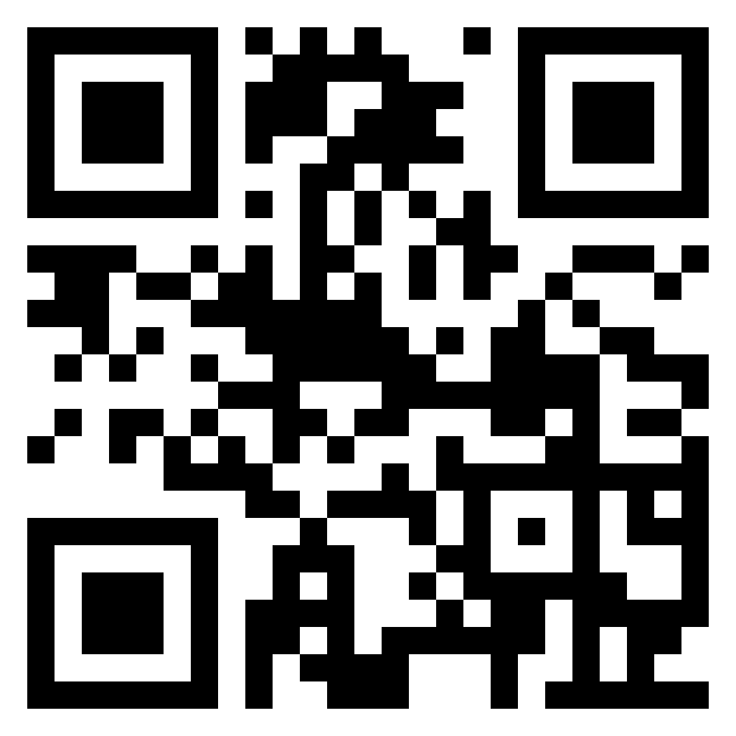
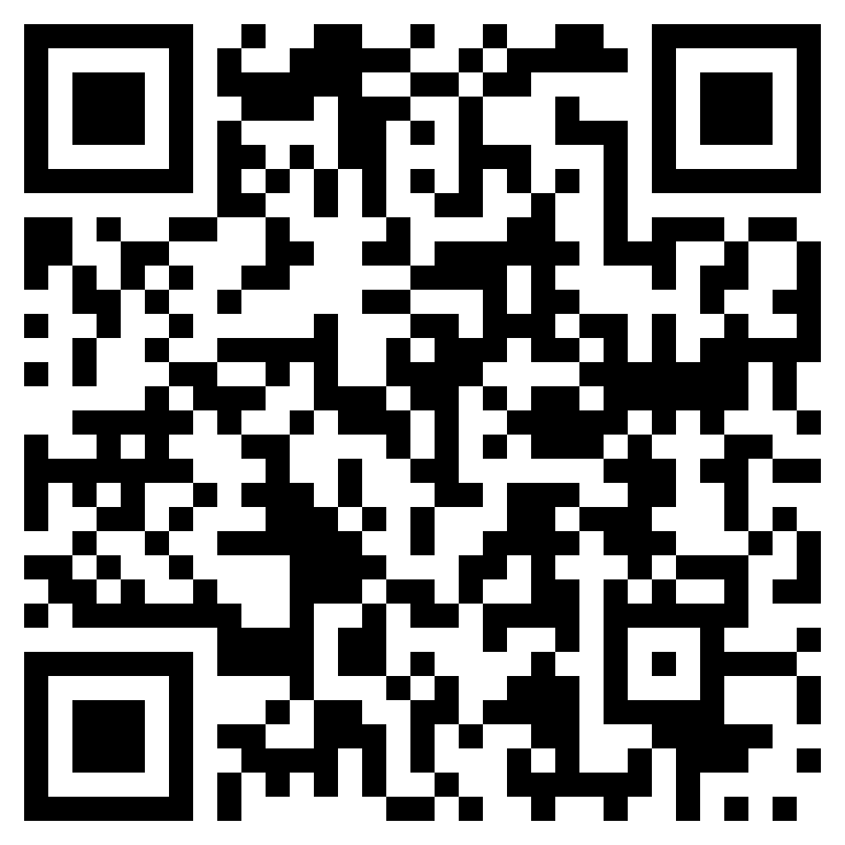
Thank You!
Download the paper
Visit Ling’s website
Download this slides
Telemedicine Adoption during the COVID-19 Pandemic: Gaps and Inequalities
Notes:
It’s been super long, so if you are still listening, thank you so much! The healthcare inequality is an ongoing issue.
What I can do, is to work with physicians and provide evidence and possible guidelines.
So we can finally have a good use of telemedicine for all populations.
If you need to download the paper, visit my website, or download this slides, please scan the QR code.
Thank you again for listening!

