Slide 1
Anomalous Traffic Prediction
Kaiyue Zhang, Wei Zheng, Tong Wu

Slide 2
Outline
Innovation points
Approach
Models
Related works
Questions
Optimize objectives
Data
Conclusion

Slide 3
Innovation Point
Normal network abnormal traffic detection generally uses only one model. Our innovation is to integrate the two models to further improve the accuracy of network traffic detection.

Slide 4
Approach
Model fusion:
LSTM model
K-means clustering algorithm

Slide 5
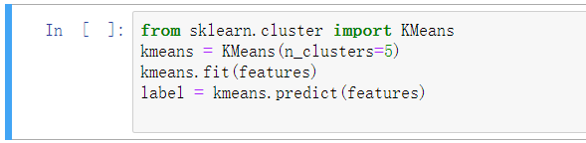
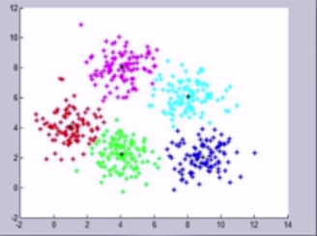
Clustering
Unsupervised learning
Find structure and similarity among the dataset

Slide 6
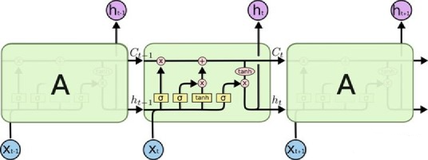
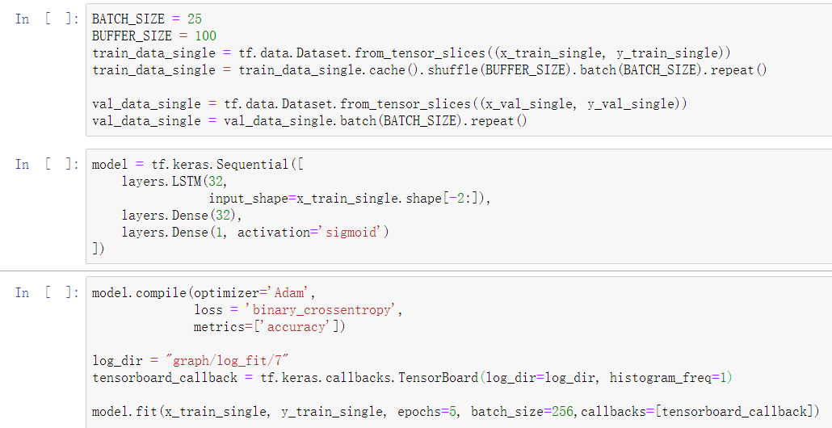
LSTM (Long Short Term Memory)
Predict the probability from a single data or a sequence of data
Solve the long-term dependency problem

Slide 7
Related Works
[1] Using K-means algorithm to get the anomalous data set
Data preprocessing is necessary and beneficial
85% anomalous traffic directed to unusual destination port
[2] Using K-means algorithm to detect anomalous traffic
The clustering result may unstable
4% false alarm rate
[3]Using LSTM autoencoder to detect network anomalous
Provide guideline of the model
Hard to get balanced data

Slide 8
Questions
How to make the detection method more precise and have lower false alarm rate?
How to make the detection method can detect large amount of data in real time?
How to provide a balance dataset to avoid naïve behaviour?

Slide 9
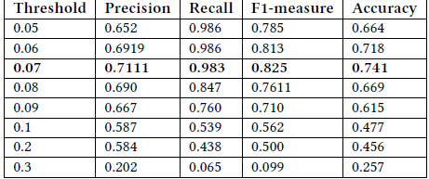
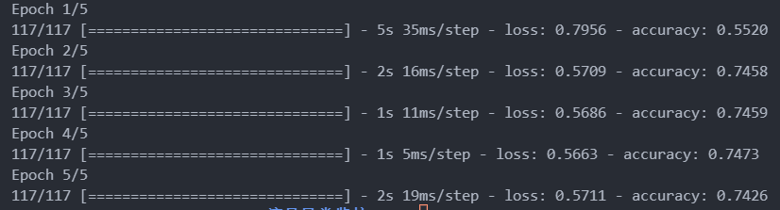
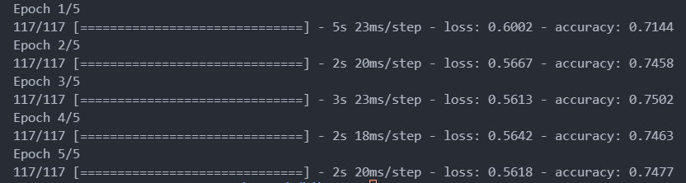
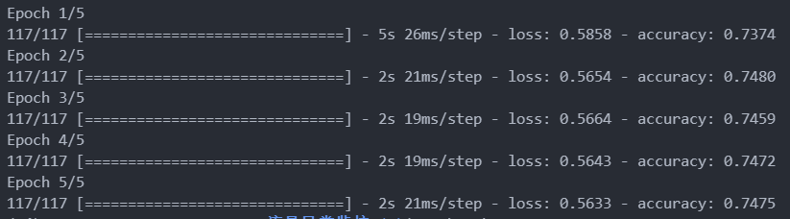
data
As you can see the above data is just using LSTM model when measure the accuracy, and the right data is using both LSTM and K-mean algorithm.

Slide 10
How to optimize the subject objectives for innovation points
First, prove why model fusion can improve accuracy and fusion of low-correlation results can get better results. Use a probability example to illustrate.
If there are now 10 records, the probability of each record being correctly classified is 70%, or a model can classify these 10 records with 70% accuracy.
Now fit three equivalent models. In the case of majority voting, for each record, the probability that the three models are correct is 0.7*0.7*0.7~=0.34, and the probability that the two models are correct is 0.7*0.7 *0.3*3~=0.44, then if three models with an accuracy rate of 0.7 are used for fusion, in theory, the probability that each record can be classified correctly will increase to 0.78!
Model fusion is feasible and can improve accuracy .

Slide 11
conclusion
We refer to both the related works of the LSTM model and the related works of the K-mean algorithm. This gives us a clear understanding of the advantages of the two models. After that, we used a simple statistical knowledge to prove the feasibility of model fusion. After that, we did a model fusion that produced a traffic detection accuracy higher than that of a single model.
Future work: In the future we are going to evaluate the detection performance using different dataset such as DARPA'98 traces as well as real Internet traffic.

