Slide 1
Anomalous Traffic Prediction
Kaiyue Zhang, Wei Zheng, Tong Wu

Slide 2
Outline
Models
Related works
Questions
Approach
Innovation points
Optimize objectives
Data
Conclusion

Slide 3
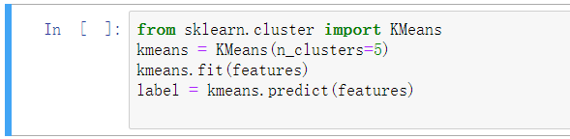
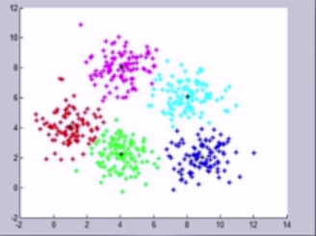
Clustering
Unsupervised learning
Find structure and similarity among the dataset

Slide 4
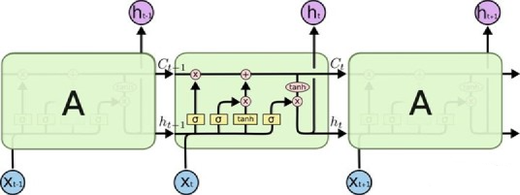
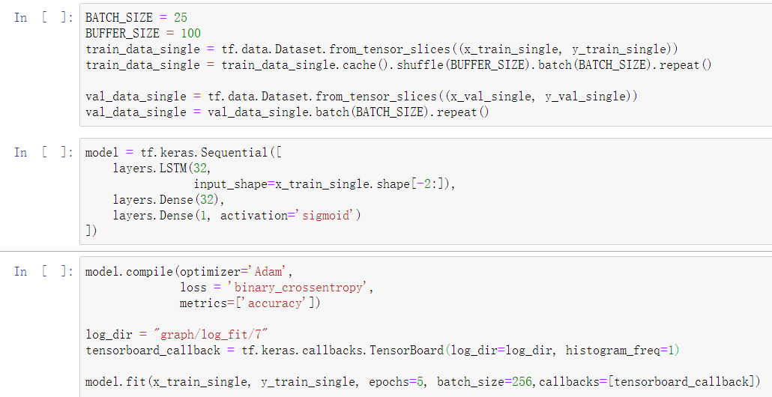
LSTM (Long Short Term Memory)
Predict the probability from a single data or a sequence of data
Solve the long-term dependency problem

Slide 5
Related Works
[1] Using K-means algorithm to get the anomalous data set
Data preprocessing is necessary and beneficial
85% anomalous traffic directed to unusual destination port
[2] Using K-means algorithm to detect anomalous traffic
The clustering result may unstable
4% false alarm rate
[3]Using LSTM autoencoder to detect network anomalous
Provide guideline of the model
Hard to get balanced data

Slide 6
Questions
How to make the detection method more precise and have lower false alarm rate?
How to make the detection method can detect large amount of data in real time?
How to provide a balance dataset to avoid naïve behavior?

Slide 7
Approach
Models:
LSTM model
K-means clustering algorithm

Slide 8
Innovation Point
Normal network abnormal traffic detection generally uses only one model. Our innovation is to integrate the two models to further improve the accuracy of network traffic detection.

Slide 9
How to optimize the subject objectives for innovation points
First, prove why model fusion can improve accuracy and fusion of low-correlation results can get better results. Use a probability example to illustrate.
If there are now 10 records, the probability of each record being correctly classified is 70%, or a model can classify these 10 records with 70% accuracy.
Now fit three equivalent models. In the case of majority voting, for each record, the probability that the three models are correct is 0.7*0.7*0.7~=0.34, and the probability that the two models are correct is 0.7*0.7 *0.3*3~=0.44, then if three models with an accuracy rate of 0.7 are used for fusion, in theory, the probability that each record can be classified correctly will increase to 0.78!
Model fusion is feasible and can improve accuracy .

Slide 10
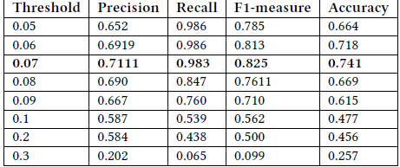
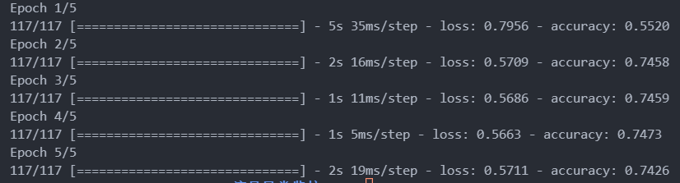
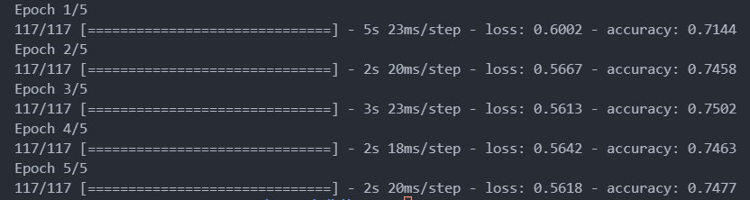
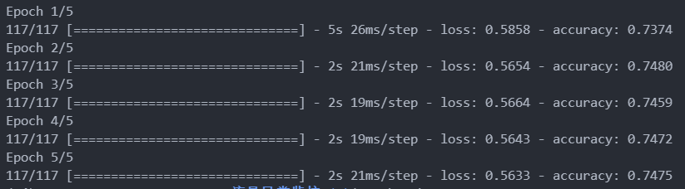
data

Slide 11
conclusion
We presented the K-means clustering algorithm and LSTM model’s principle.And we presented our data through the image. The innovation point for us is to improve the accuracy through Model fusion and I prove the feasibility of the model fusion through statistic.
Future work: In the future we are going to evaluate the detection performance using different dataset such as DARPA'98 traces as well as real Internet traffic.

