Slide 1
IT5002
Tutorial #6
Intro to OS, Scheduling

Slide 2
Question 1

Slide 3
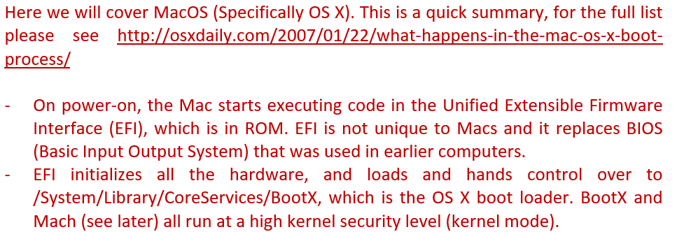
Question 1

Slide 4
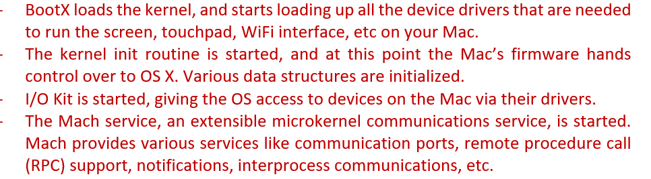
Question 1

Slide 5
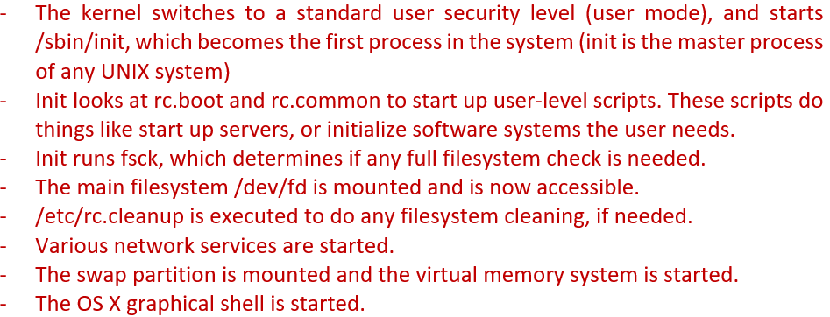
Question 1

Slide 6
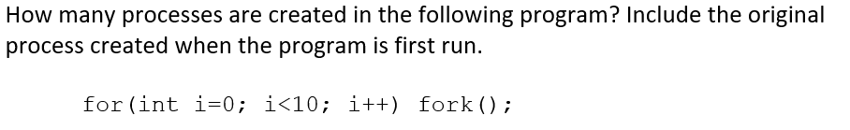
Question 2

Slide 7
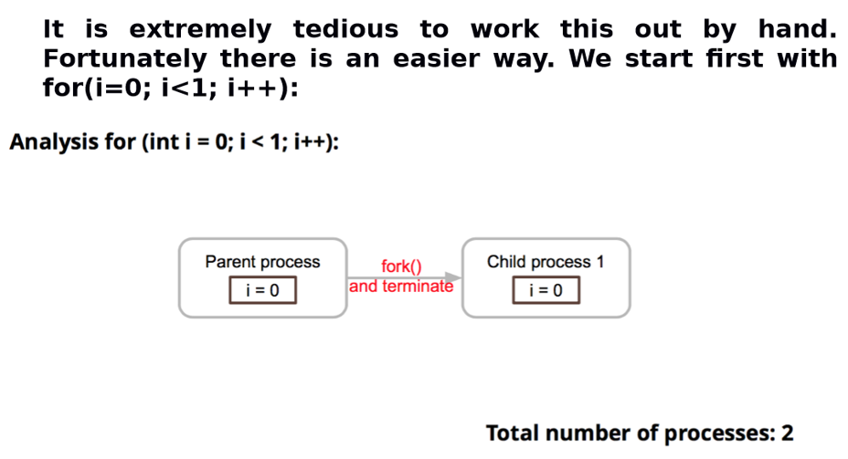
Question 2

Slide 8
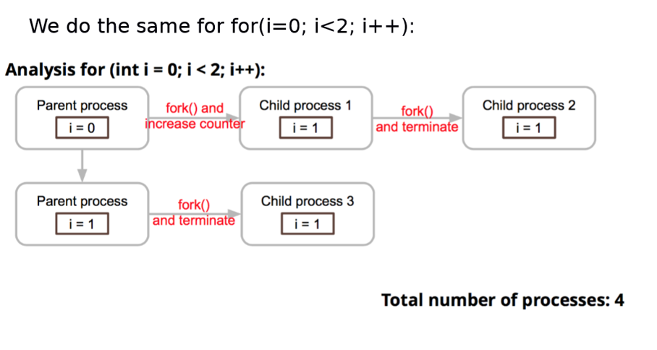
Question 2

Slide 9
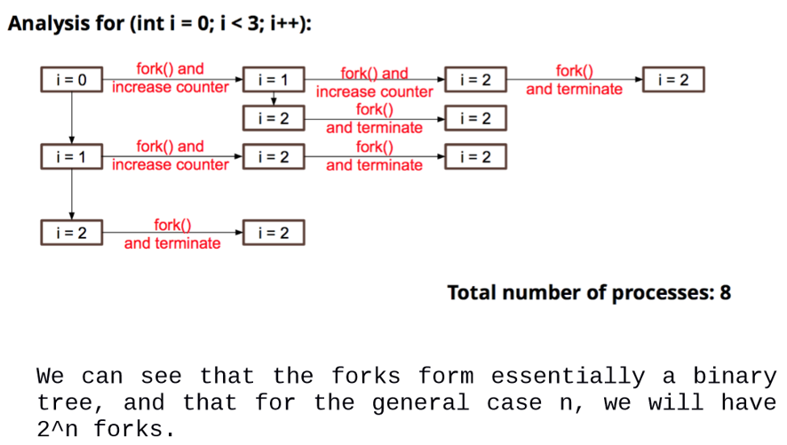
Question 2

Slide 10
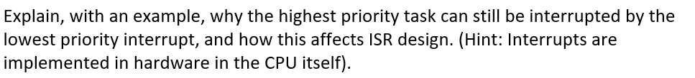
Question 3

Slide 11
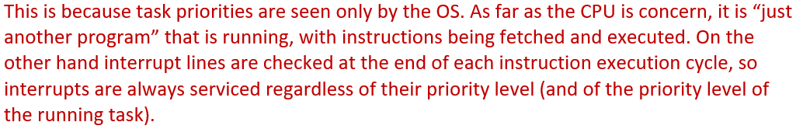
Question 3

Slide 12
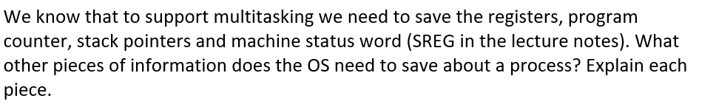
Question 4

Slide 13
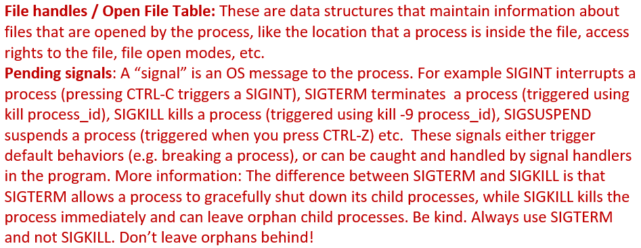
Question 4

Slide 14
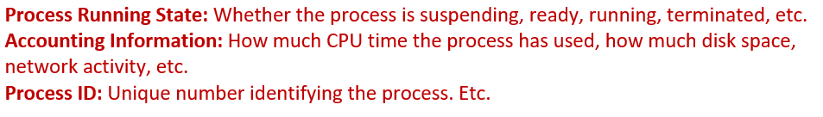
Question 4

Slide 15
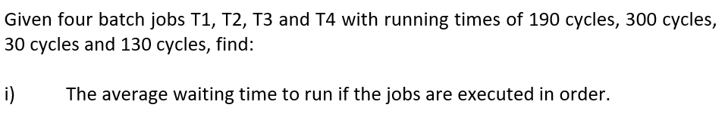
Question 5

Slide 16
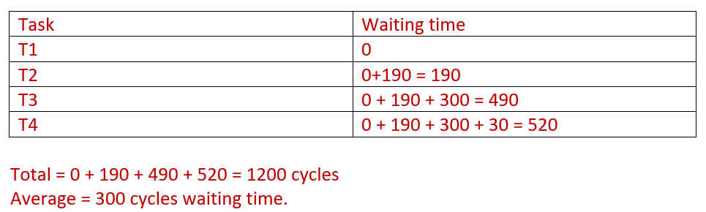
Question 5

Slide 17
Question 5

Slide 18
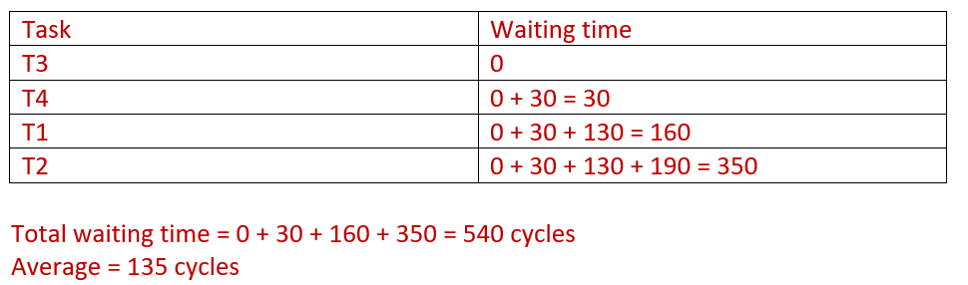
Question 5

Slide 19
Question 5

Slide 20
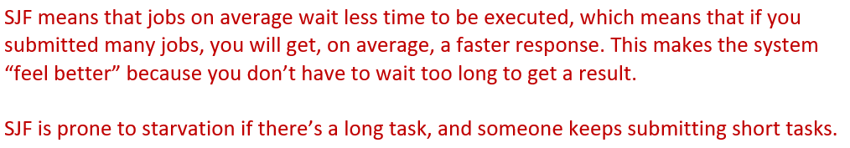
Question 5

Slide 21
END OF FILE

