Slide 1
IT5002
Tutorial #4
Pipelining and cache
(Prepared by: Aaron Tan and colin tan)

Slide 2
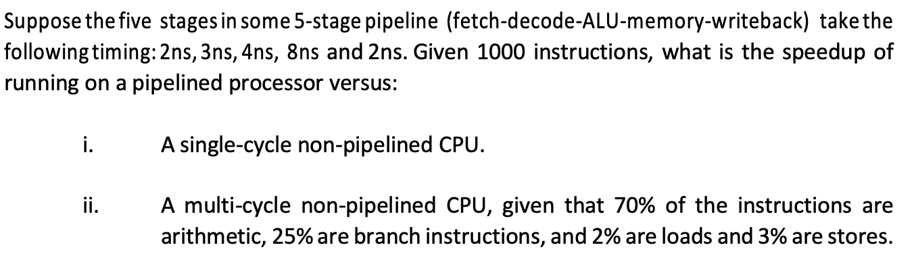
Question 1

Slide 3
Question 1

Slide 4
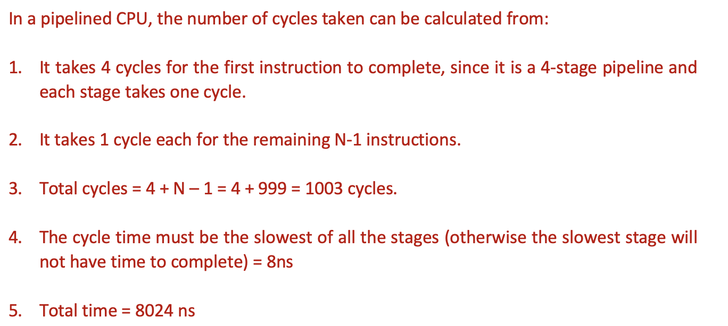
Question 1

Slide 5

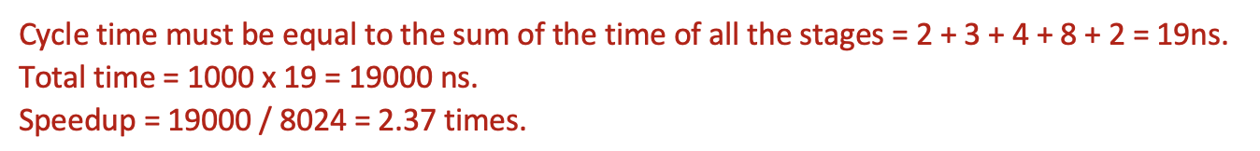
Question 1

Slide 6
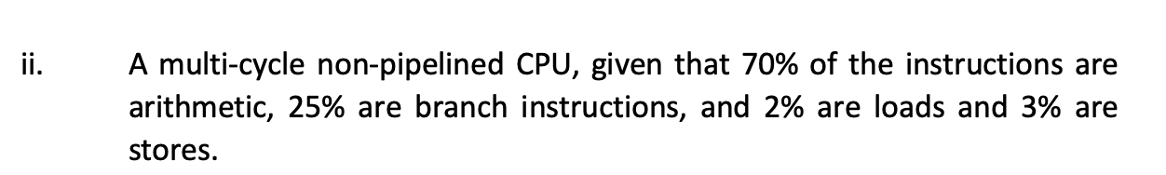
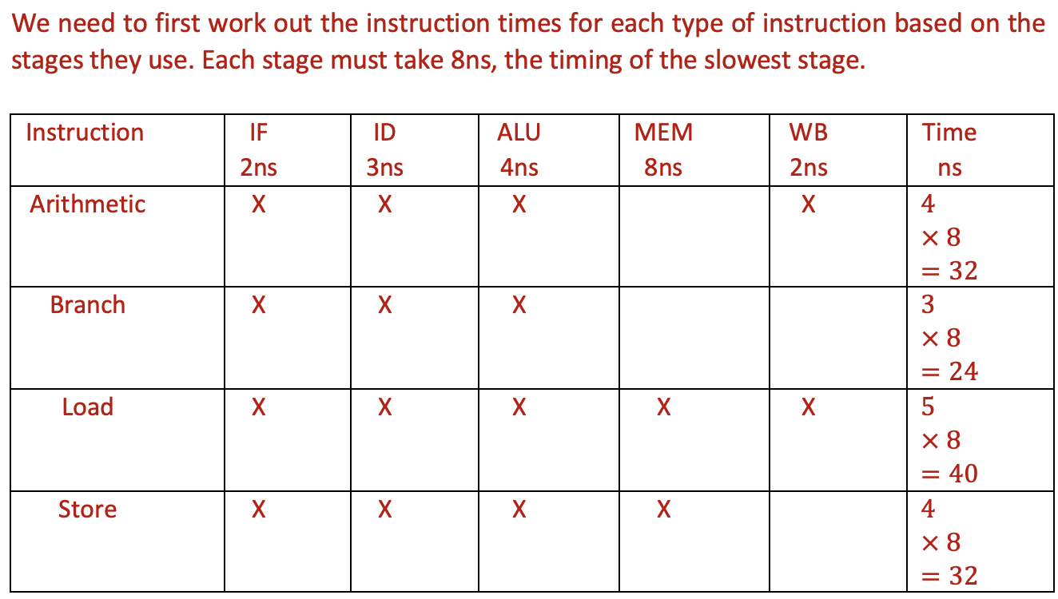
Question 1

Slide 7
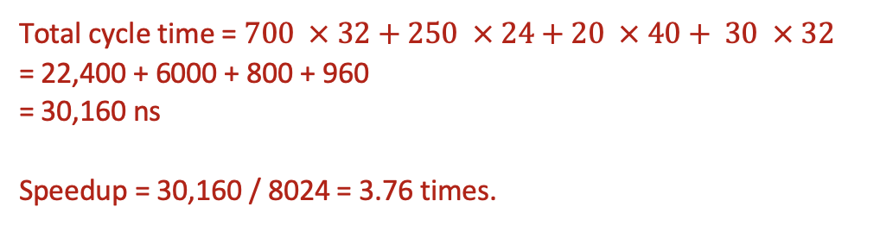
Question 1

Slide 8
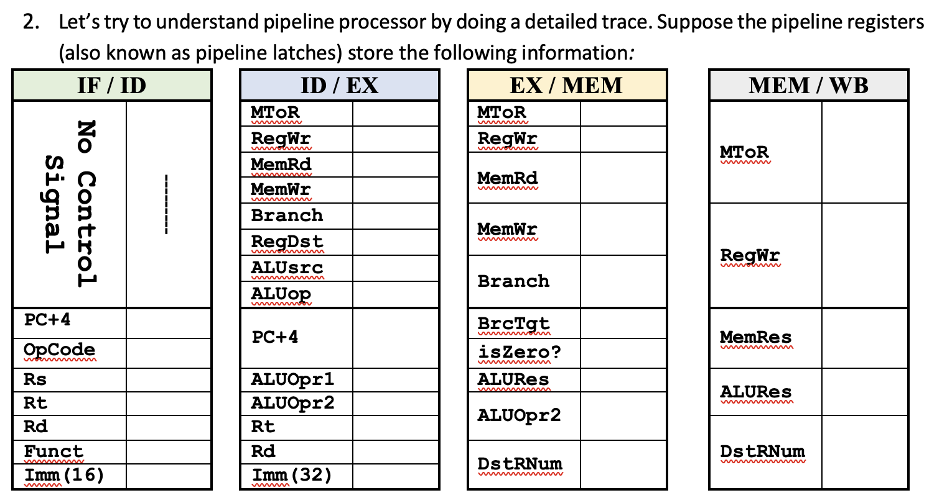
Question 2

Slide 9
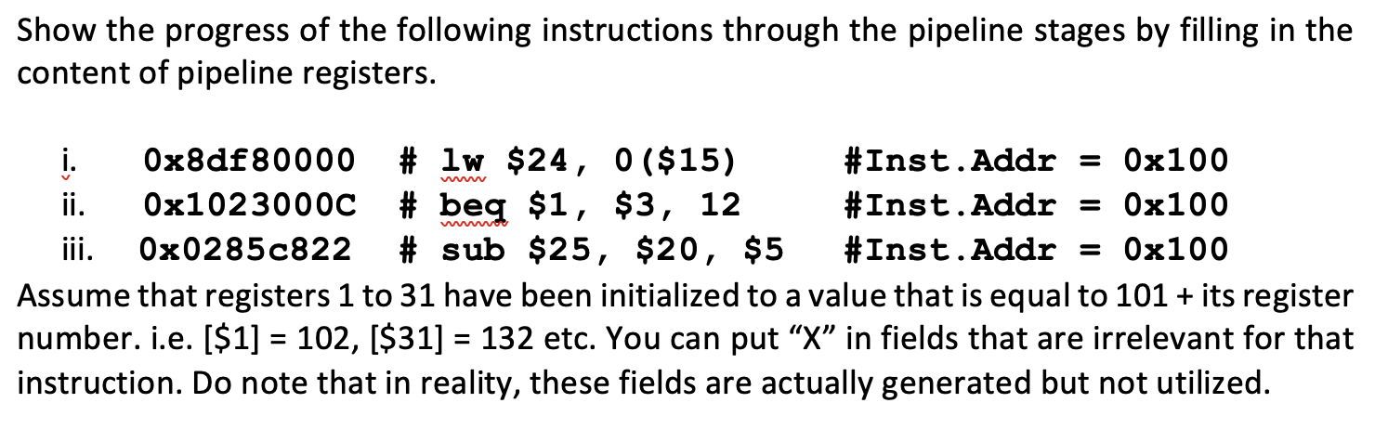
Question 2

Slide 10
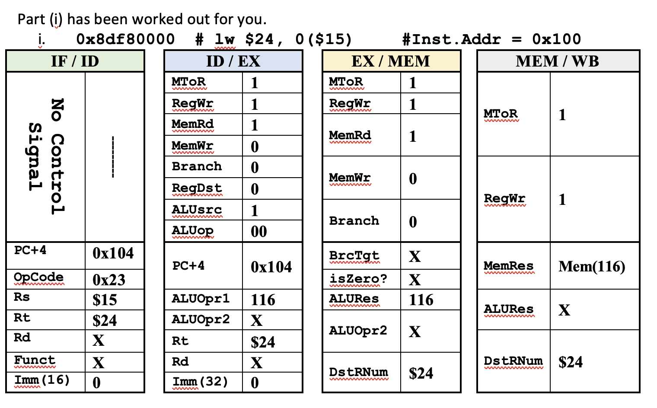
Question 2

Slide 11
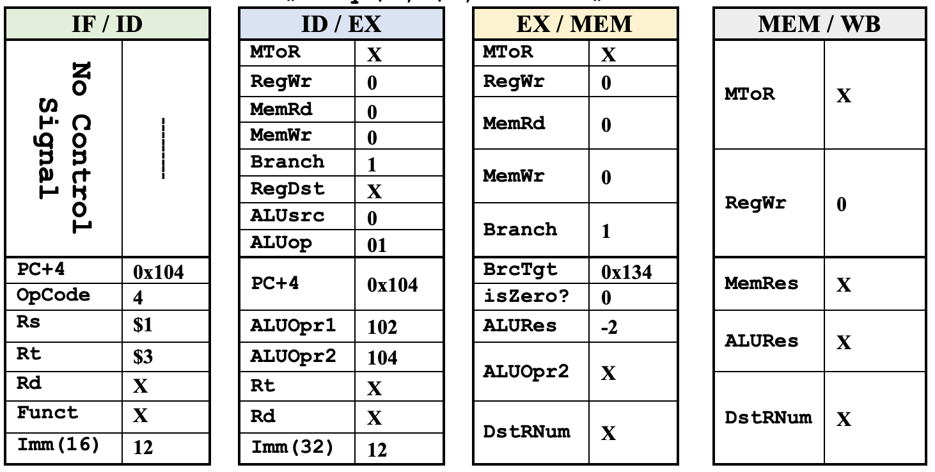
Question 2

Slide 12
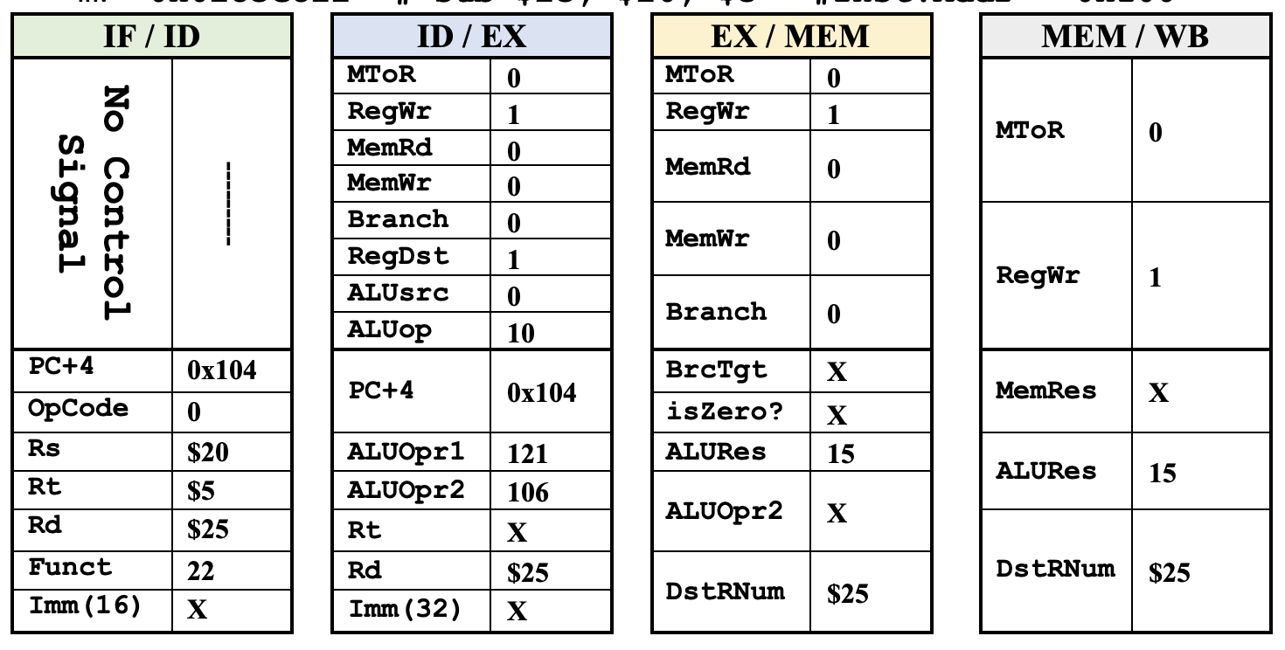
Question 2

Slide 13
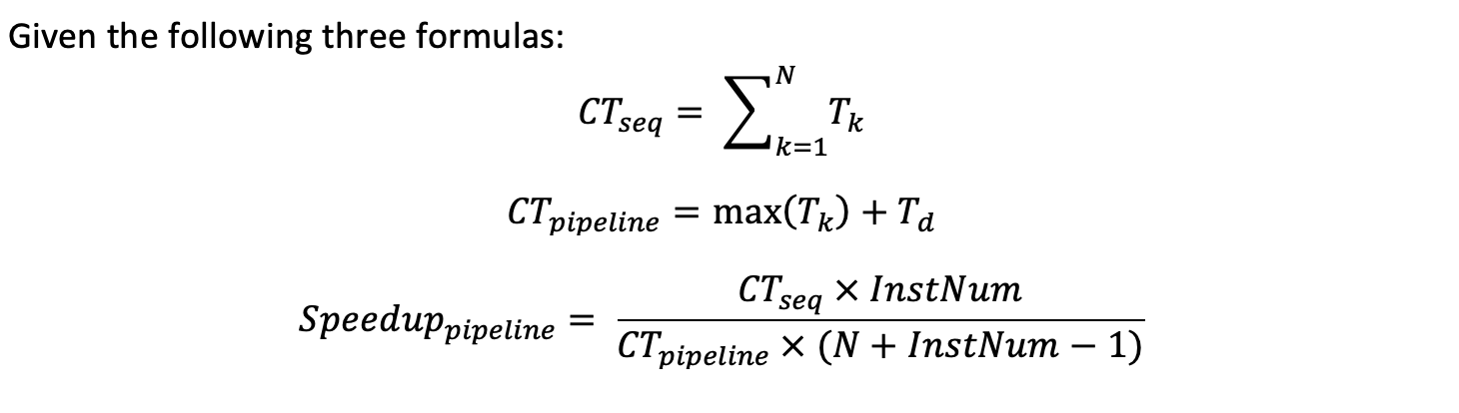
Question 3

Slide 14
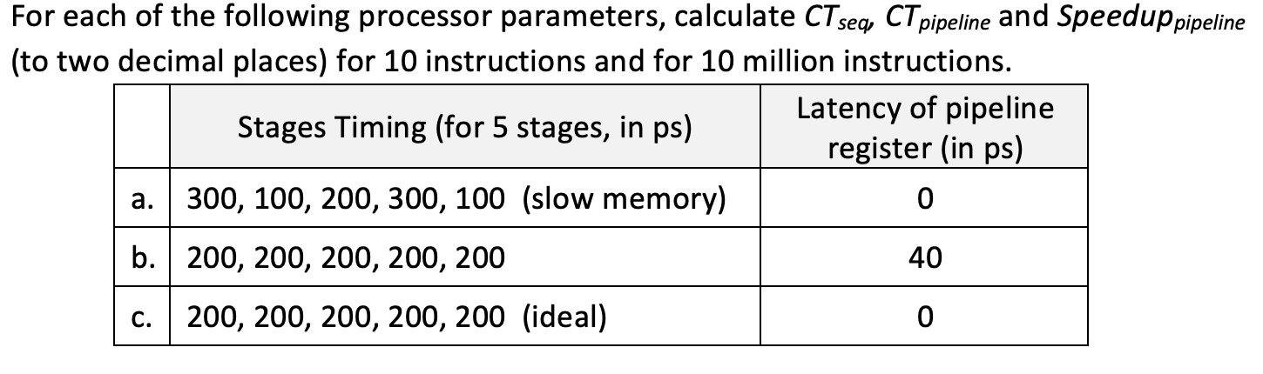
Question 3

Slide 15
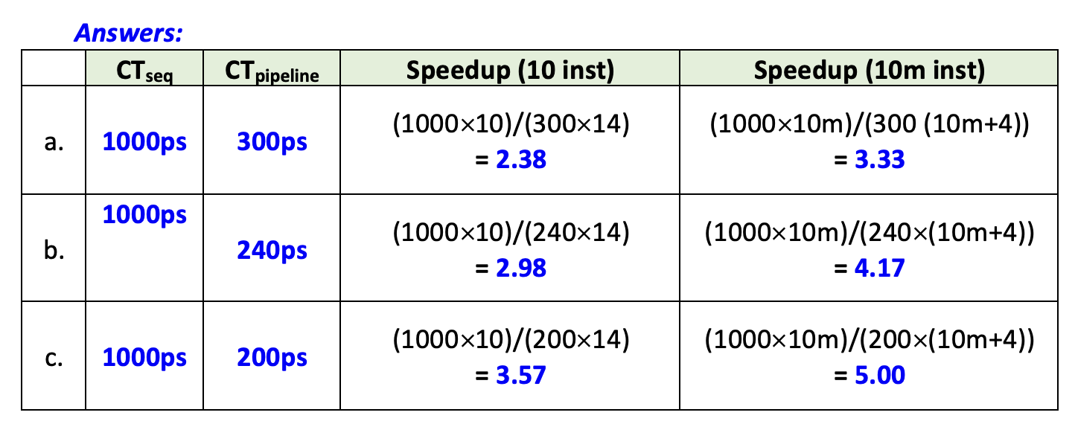
Question 3

Slide 16
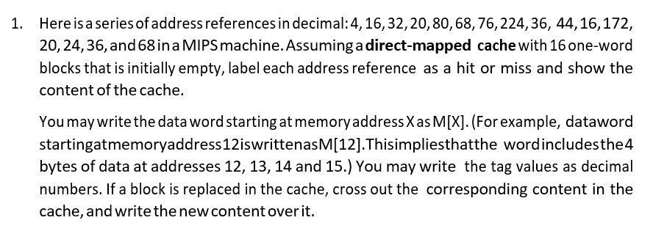
Question 4

Slide 17
Q1.
4, 16, 32, 20, 80, 68, 76, 224, 36, 44, 16, 172, 20, 24, 36, 68.
MIPS: 1 word = 4 bytes
1 block = 1 word
16 blocks total
Direct-mapped cache
Offset = ?
2 bits
Index = ?
4 bits
Index
Offset
4: 00…00 0001 00
16: 00…00 0100 00
32: 00…00 1000 00
20: 00…00 0101 00
80: 00…01 0100 00
68: 00…01 0001 00
76: 00…01 0011 00
224: 00…11 1000 00
36: 00…00 1001 00
44: 00…00 1011 00
16: 00…00 0100 00
172: 00…10 1011 00
20: 00…00 0101 00
24: 00…00 0110 00
36: 00…00 1001 00
68: 00…01 0001 00
Index | Valid | Tag | Word
0 | 0
1 | 0
2 | 0
3 | 0
4 | 0
5 | 0
6 | 0
7 | 0
Index | Valid | Tag | Word
8 | 0
9 | 0
10 | 0
11 | 0
12 | 0
13 | 0
14 | 0
15 | 0

Slide 18
Q1.
4, 16, 32, 20, 80, 68, 76, 224, 36, 44, 16, 172, 20, 24, 36, 68.
MIPS: 1 word = 4 bytes
1 block = 1 word
16 blocks total
Direct-mapped cache
Offset = ?
2 bits
Index = ?
4 bits
Index
Offset
4: 00…00 0001 00
16: 00…00 0100 00
32: 00…00 1000 00
20: 00…00 0101 00
80: 00…01 0100 00
68: 00…01 0001 00
76: 00…01 0011 00
224: 00…11 1000 00
36: 00…00 1001 00
44: 00…00 1011 00
16: 00…00 0100 00
172: 00…10 1011 00
20: 00…00 0101 00
24: 00…00 0110 00
36: 00…00 1001 00
68: 00…01 0001 00
Index | Valid | Tag | Word
0 | 0
1 | 0
2 | 0
3 | 0
4 | 0
5 | 0
6 | 0
7 | 0
Index | Valid | Tag | Word
8 | 0
9 | 0
10 | 0
11 | 0
12 | 0
13 | 0
14 | 0
15 | 0
1
0
M[32]
M[224]
3
1
0
M[4]
M[68]
1
0
1
M[36]
1
1
M[76]
1
0
M[172]
2
M[44]
1
0
M[16]
M[80]
M[16]
1
0
1
0
M[20]
1
0
M[24]
Hit
Hit
Hit

Slide 19
END OF FILE

