Slide 1
Zoom Cloud Recording Link (SSG-funded)
We are fully onsite at iCube Auditorium (FAQ: recorded)
For SSG-funded students (35 pax): You will have to somehow appear in the Zoom session (not going to be recorded)…
The Zoom link for Wed+Sat sessions have been emailed to the 35 of you
You also need to declare your attendance here:
https://inetapps.nus.edu.sg/ctr/Home (see the QR code)
Non SSG-funded students (MComp students) don’t need to do this

Slide 2
IT5003 04 Oct - 07 Dec 2023 (~9 weeks, accelerated indeed…)
Welcome to our First Class

Slide 3
https://www.wikihow.com/Address-a-Professor
Before Tue, 13 June 2023, 3pm
Title | First Name | Last (Sur) Name
Mr ⊗ (I spent 5 years for my PhD!) | Steven | Halim
Dr √
Associate Professor ⊗ (not yet)
Professor ⊗ (not yet)
Prof √ (general version, “ok-ish”)
After Tue, 13 June 2023, 3pm
Title | First Name | Last (Sur) Name
Mr ⊗ (I spent 5 years for my PhD!) | Steven | Halim
Dr √ (but why just use this?)
Associate Professor √ (but too long)
Professor √ (my next rank actually)
Prof √ (general version, best now)
Summary: The best version is Prof Halim

Slide 4
Agenda for the First Lecture
Introduction
About me and 7 other TAs
About (~217* of) you (+102 :O from 115 last S2 AY 2022/23 a few months ago…)
Course (online :O) tools + live demos
VisuAlgo (type https://visualgo.net or… Google search “algo visualization” :O)
Steven’s private “Canvas” (doubles as course admin talk)
Kattis (https://nus.kattis.com) online judge
(with Python introduction, review some problems from the warm-up PS0 set, due 8.00pm)
Setting Expectations for this Course (now mostly onsite) module
[ADS] CP4 Book 1, e-book version (unlikely to be reprinted soon)

Slide 5
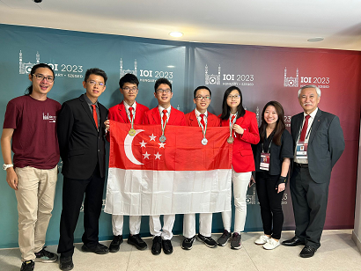
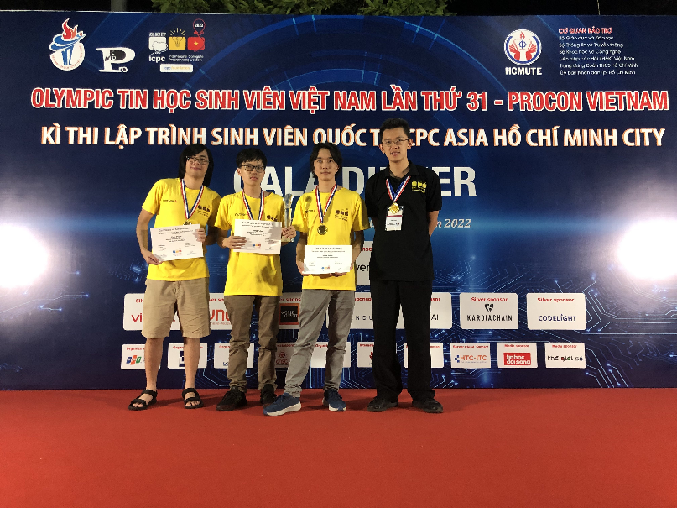
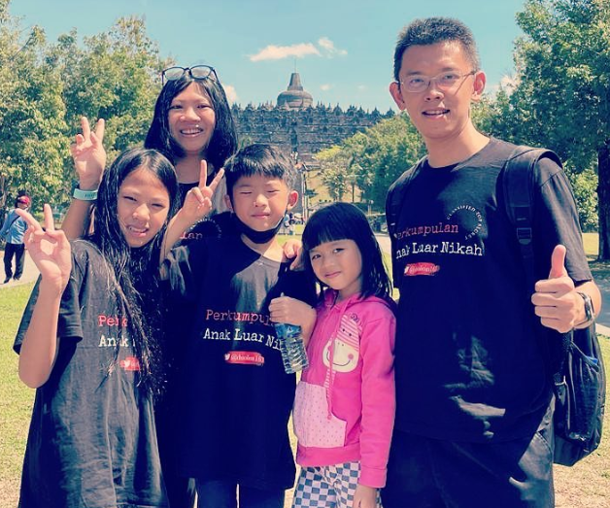
Lecturer: Prof Halim
Read my IOI stuff (IOI 2023) or my ICPC stuff (ICPC HCMC 2022) or my achievements (NDA18, ATEA list, SoC list)
Office: COM2-03-37
(usually in every Mon-Fri, 10am-5pm)
Office Phone: [not used, just email me]
Email: dcssh@nus.edu.sg
‘prof_halim’ at Discord
On https://www.instagram.com/steven_halim_7/, Facebook, Telegram
I have 1 wife (Grace) and 3 ‘J’ kids (Jane, Joshua, Jemimah)
Wish for IT5003 S1 AY23/24: Uh, new class record…?
Notes:
Extras this, this, this, this
steven_halim_7

Slide 6
TAs: 8 of us
See https://www.comp.nus.edu.sg/~stevenha/it5003.html#registration

Slide 7
217 of you, Live Survey, just raise your hand (1)
Age | < 24 I am still young | [24..26] Fresh Graduate | [27..29] Not-so Fresh | [30..34] UG was ~10y ago | [35..40] :O | >= 41 years old Steven is here
Previous (Highest) Education Background | Engineering (Elec/Chem/Mech/etc) |  | Science (Math/Stats/Phys/Bio/etc) |  | Others (mention)
Roughly centered here around 1-2 pax
about 70-80 about 70-80 the rest

Slide 8
217 of you, Live Survey, just raise your hand (2)
Student Status | Full-time |  |  | Part-time
Programme | MComp Gen Track (100+) | MComp Digital FinTech (~30?) | MComp Biomed (~30?) | GDCert-CF I or 2 (21+2 = 23) | NUS L3 Life-Long Learners (12)
approx 140 approx 80
Notes:
Is it still there? Industry 4.0 sub-group?

Slide 9
So that I don’t forget
For GCCF-I, GCCF-II, and NUS L3 students at Zoom (total 35 pax), let’s take a screenshot (turn on your webcam)
Regardless whether you are actually also onsite at iCube-Auditorium
Also, complete your attendance taking using QR code at https://inetapps.nus.edu.sg/ctr/Home one more time...

Slide 10
Assumption About Your Coding Skill
You should have background in at least one programming language
By passing IT5001/CS1010/its variants
I assume that most of you can code in Python 3 (at least a bit)
Perhaps will be surprising?
I prefer not to teach too much basic Python in my version of IT5003
You will mostly self-learn, GIYF (Google Is Your Friend), see demos today
We will help A LOT along the way
Real life experience: My kids learning (real) language(s)
Notes:
[not done in S1 AY23/24]: From #off-topic ice-breaking questions in Discord, your background varies…

Slide 11
217 of you, Live Survey, just raise your hand (3)
C | C++ | Java
Python | JavaScript | Others
The assumption is that everyone can code in Python

Slide 12
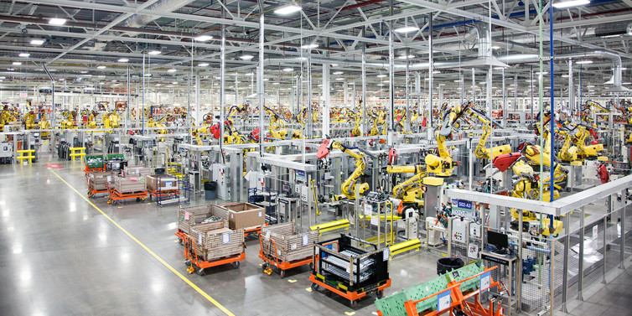
Age of Machines

Slide 13
VisuAlgo (https://visualgo.net --- ask Google about “algo visualization”)
Built (since 2011) and controlled by myself (on active development again now)
My dream is to have a good virtual copy of myself available 24/7
Very patient in explaining basic concepts; Never complains; Always available
Your lecture notes (the e-Lecture mode, demo)
zh/id languages are ready for IT5003 related topics so far ☺
Print-friendly, click the handwriting note, or go to URL like this
Your personal instructor/tutor (the exploration mode, demo)
Your examiner (the 3x9=27% Online Quiz, demo)
User accounts should have been mailed to you
https://visualgo.net/password/reset it if you feel that you haven’t got it, use your NUSNET email (also check your junk mail), then open https://visualgo.net/en/sorting?slide=1 NOW (VA OQ 0 at the end of tonight)
Notes:
login for tracking (no need for 2019++ until I fix that sytem)

Slide 14
Flipped Classroom Strategies (for medium to large class)
The style will be enforced, i.e., no basic discussion of ‘trivial stuffs’ if VisuAlgo e-Lecture slides are already clear enough for majority of students
Consequently, those who do not read the prescribed e-Lecture slides before lecture will be really lost during the real lecture…
PS: I know that many of you are working (esp the part-time students), what I am asking for is at least 30m to skim-through the prescribed reading material before each next e-class
For this module, Steven will just use his experience to discuss the usually top-X hardest slides/topics to be re-explained live (but online), in e-class
We will then be able to use remaining lecture time to solve some (easier) Kattis problems that require understanding of the ongoing topic that week

Slide 15
Classroom Strategies
Wed 6.30-8.30pm lecture at iCube Auditorium
Recorded centrally by NUS CIT, (e-)attendance is compulsory for SSG-funded students
Fri 2-4pm recitation at COM1-02-06 (SR1)
Optional: Mostly for full-time students who may need this, (self-)recorded using own Zoom link
Link not published :O… The intention is for onsite discussions only
Sat 9-10am lecture at iCube Auditorium
Recorded centrally by NUS CIT, (e-)attendance is compulsory for SSG-funded students
8 onsite labs (my B5 is over-crowded ☹…)
Attendance is compulsory for SSG-funded students
PS: See https://www.comp.nus.edu.sg/~stevenha/it5003.html#lessonplan for some exceptions
We need to discuss the fate of Sat, 11 Nov 2023 [ok let’s just cancel it]
Important:
Ask class related questions at official class Discord instead of emailing me/TA directly, there should be others who are “free-er”

Slide 16
Python IDE (or lack thereof)
Our default standard is Python 3
Read https://nus.kattis.com/help/python3 for more technical details
Python 2 already reached its end of life on 1 January 2020
Personally (without the Internet), I use Python IDLE offline
Notes:
But for e-lectures demo, I may occasionally use this instant stuff: https://replit.com/@stevenhalim7/pydemo#main.py
But be careful that everything here is public and only good for quick testing
If you do your PSes online like this, your code can become the source of plagiarism by others who Googled :O…
Update from 2023: I don’t use repl.it anymore

Slide 17
Steven’s IT5003 Private Canvas (https://www.comp.nus.edu.sg/~stevenha/it5003.html)
Let’s do a tour:
Overview of the module, Learning Objectives, TAs, syllabus, and course registration info
Latest news will be prominent upon loading that page
Very detailed lesson plan, detailing each week, with integrated ‘Files’ and clear weightage indicator for each weekly milestones
Bookmark important dates on your calendar!
PS: Discussion forum is at Discord (can be anonymous)
Join if you haven’t, you may miss interesting updates otherwise
Prof Halim will send a dummy “Hi” message to @everyone
Be FOMO, email me NOW if you are *not yet* in that class Discord channel…
I will invite you after this class tonight

Slide 18
Kattis Online Judge (OJ), NUS version :O (https://nus.kattis.com)
Online judges for (much) more programming exercises
Registration since ~2 weeks ago (18 Sep 23) to clear many registration issues
Prof Halim will mention relevant, IT5003 level problems from these OJs
Our PSes will use nus.kattis too
Let’s do a live demo of solving a few simple problems with Python
Easy Python coding live review of some PS0 tasks:
Live SPEED coding, then I will re-explain
Especially for those who have not cleared 3 tasks of PS0 (“free” 1%)
Reference: CP4 – Book 1, page 23-30
metronome (> 198/217 ACs), so I will just show this directly
print(int(input())/4) # discuss / 4, / 4.0, // 4, 2dp precision?
# small precision error (usually) does not really matter in Kattis
Notes:
Last few AYs
Kattis hello, really just to test the O part of I/O
Kattis judgingmoose, simple if else
Kattis timeloop, simple I and N times O, curly braces styles, indentation styles
Kattis mia, can be used to demonstrate the usage of function to simplify/modularise code, if-else
Kattis treasurehunt, chosen to showcase recursive function (can be written iteratively), also about 2d array and recursive function :O, and first time showing the usage of … global variable :O
Kattis statistics, highlighting either a simple array or on-the-fly computation with built in library
Kattis compass, Remarks about indentation, preference of as local variable as possible vs global variables :O, variable naming, etc
Kattis keylogger (there is an easy way to do this) also has partial grading

Slide 19
Kattis Online Judge (OJ) – continued (1) (https://nus.kattis.com)
Continued:
addingtrouble (> 190/217 ACs), again, very easy, so I just discuss one point
# hard to do any shorter than this
# discussion of 'code golf' and ternary conditional operator
A,B,C=map(int,input().split())
print("correct!"if A+B==C else"wrong!")
babypanda (> 98/217 ACs only, ~45%), so let’s discuss this in details + live coding
# is about working backwards: m down to 0 (odd vs even cases)
# n is useless, long (but it is handled by default by Python)
# start with the 'long(er)' solution first (will take 'some time')
# then show:
print(bin(int(input().split()[1])).count('1'))

Slide 20
Kattis Online Judge (OJ) – continued (2) (https://nus.kattis.com)
Continued:
coffeecupcombo (> 119/217 ACs only, 55%), so let’s code this live
# is about 1D Boolean flag array/list
# and greedy: buy two cups per coffee machine
# there are several way to implement this, introducing 'sentinels'
n=int(input())
s=list(input()) # discuss list(input())
a=['0']*(n+2) # discuss +2 for list a (awake)
for i in range(n):
if s[i]=='1':
a[i]=a[i+1]=a[i+2]='1' # discuss this
print(a[:-2].count('1')) # discuss [:-2]

Slide 21
Week 00 Tasks for S1 AY23/24 – the rest CP4 – Book 1, page 23-30
The other 6 tasks:
/codetosavelives is about simple loops/repetitions (much simpler I/O solution exist)
/internationaldates, token split by ‘/’, simple check, 3 cases only [EU/US/either]
/undeadoralive is about selection, 4 cases
/electionparadox is about SORTING (next Week 02) + simple greedy solution
/sifferprodukt is about digit sum function, repeat the process
/bokhyllor is a case analysis task with some nasty corner cases…
No, I am not going to reveal the secret test cases
If you still get WA after deadline, just keep trying yourself or move on to PS1
This is an early indicator whether your IT5001/variant grade is good or not
Prof Alan may give me more information soon…
Notes:
For CS2040C only -> Remarks about #include <bits/stdc++.h>, https://www.quora.com/Is-it-good-practice-to-use-include-bits-stdc++-h-in-programming-contests-instead-of-listing-a-lot-of-includes

Slide 22
VisuAlgo Online Quiz 0 (0.6% :O)
Last minute addition to make *EVERYONE* do this (there were still around 80 out of 217 students who have not done this as of Tue, 03 Oct 2023, 3pm)
Login to VisuAlgo https://visualgo.net/login
Use exxxxxxx@u.nus.edu email address, not any other friendly email/personal email
If you forget your password, use https://visualgo.net/password/reset
Open https://visualgo.net/tests (notice ‘s’ at the back of ‘tests’)
Do test #139
Half of you will start at 8.20pm, the other half will start at 8.21pm
You have 5 minutes to enter this and click “submit”: “77_C4Ts”
No (double or single) quotes

Slide 23
Setting Expectations
You pay (a lot) to join this course (some with SSG subsidy...)
So, put some effort
My IT5003 (8 weeks) will be a subset of my CS2040C (13 weeks) and in (the easier) Python instead of (the slightly harder) C++
IT5003 will be taught at slower pace than CS2040/C/S
The level of difficulty for this semester should be similar as the last one
At 3.9 difficulty rating (i.e., on par with any other courses in NUS)
Work hard to self learn as many programming language components
As I said, we will help along the way, throughout this module
IT5003/CS2040/C/S will NOT use very deep Python/C++/Java concepts
IT5003/CS2040/C/S assignments will be short (< 50 SLOC)

Slide 24
Recitation This Fri, 06 Oct 2-4pm
At COM1-02-SR1
Predominantly for full-time students
We will discuss the many other basic Python exercises that are not discussed tonight
Self-Recorded (Zoom Link)
It is optional for the rest of the students whether you want to follow the recitation topics or not

Slide 25
PS Rules 1 (from PS1b onwards) PS1a has very easy solution
Write your matric number, full name (as in Canvas class roster), lab group number, lab group TA name as the first FOUR lines of comments in your code
We need to tie your submission with you, as some of you use personal email address etc when signing up with nus.kattis and a few still have wrong display names at the moment
For those of you with “wrong” display name, please ask Kattis’s tech support (bottom right corner of https://nus.kattis.com to change your name as per your Matric card)
No “real” penalty for any wrong submission, but of course the more wrong submissions that you make, the lower your chance to do well in Final Assessment
Rank is determined by total number of unit time
Top 54 (Top 75%-ile of 217 pax) are publicly shown in the ranklist
The rest are “hidden”, none of your peer knows where you are unless you reveal (Me & TAs know this)
Top students who don’t like to show hand can wait until 54 others have showed their hands and be the first few at rank 55++ ☺
You can also set yourself as “Hidden user” in your Kattis profile and will only be (accidentally) shown if I show my screen

Slide 26
PS Rules 2
Public discussion of the ALGORITHM is allowed (e.g., in official Discord or anywhere)
But, sharing code totally NOT allowed
Challenge to future As students: Do NOT use (sorting) libraries in your code for PS2 later
To minimize ‘similarities’ with code of other peers that you ‘interact with’…
Scoring for PSes is as score indicated by Kattis/200 points * 3→2.5% (NEW: already 1% for PS0)
Getting about 100+ points is easy but getting full 200 points may be going to be tedious…
TA generally will not check too much, i.e., manpower saving by using automated judging system
We give *very small* partial additional marks for non green, i.e., red submissions at the end
TA generally only see last red submission and will try to give you closure AFTER deadline
We give 0 (see next slide) to anyone who are reported by Kattis system to have plagiarized and can be proven without reasonable doubt that the student
Submit friend’s OR senior’s code
Submit Google-able code :O, i.e., somebody’s solution in public GitHub, public repl, public ideone, etc…
Uploads/shares code to other(s), privately or publicly (i.e., the SOURCE)…
“Helps a friend” and “accidentally” submit that friend’s code under YOUR own account…
NEW: Uses Generative AI tools, e.g., ChatGPT, and submit the ‘generated code’ verbatim, and someone else does the same ☹
NEW: Uses Virtual Judge… https://vjudge.net/

Slide 27
PS Rules 3
A strict policy (1% PS0 is not subject to this, it is mostly “free” for all):
Anyone caught in PS1b-8 (the proper PSes with 2.5% each) will have the rest of your PS set to 0, i.e., we will NOT grade your future PSes anymore (e.g., if caught in PS2, then entire 7x2.5 = 17.5% gone)
That person can still take VA OQ/final, etc, but this can be up to ~3.5 letter grades penalty,
A+ (rethink if you want "to help peers") down to B+, A down to B, A- down to B-, and…
More seriously, those who could have gotten a C (and survive) will then get an F…
I used this strict policy from last semester and it caused a bit of “emotional damage” to a few students who get caught…
Let’s not be in this situation…
Any other loopholes that may still exist will be closed over time
All the best in completing PS1 (and the rest) with your own strength
TAs will help, but not on PS opening day, we maintain radio silence on PS opening day ☺
TAs will especially help nearing PS deadline :O…

Slide 28
CP4 Book 1 Advertisement
CP4 Book 1 sales, suitable for IT5003/CS2040/C/S level
No more physical copy left in Singapore
From lulu.com (get the e-book, 17.99 USD)
https://www.lulu.com/shop/suhendry-effendy-and-felix-halim-and-steven-halim/competitive-programming-4-book-1/ebook/product-2978pr.html
Instant delivery, do *not* pirate this

Slide 29

Help with Flipped Classroom
This learning technique is likely very new for many of you
It takes lots of self-discipline to make it work
Pre-read the e-Lecture slides @ VisuAlgo before coming to lecture
You will be very lost otherwise…, I will be strict on this :O
All sessions are recorded for review
Ask lecturer or TAs for help, especially during the early days
But try to use Discord as primary means (don’t email us personally)

Slide 30
Prelude to the First Real Flipped Classroom
Read https://visualgo.net/en/sorting?slide=6 to slide 6-11
We will review this on Sat, 07 Oct 2023 and we will have a lab session on basic Python coding and basic algorithm analysis afterwards (for the Saturday lab groups)
Mon lab groups will start the first lab on Mon, 09 Oct 2023
https://nus.kattis.com/courses/IT5003/IT5003_S1_AY2324/assignments/aa9x5h GRADED PS1 is now out (a quick overview)
It is about “basic Python”… PS1a has easy solution
Try it; we will discuss them in high level during lab session too
Not today ☺, TAs/staff will be ‘silent’ on the day of PS release (every Wednesdays)
Then, by next Wed, 11 Oct 2023, you must have read https://visualgo.net/en/sorting?slide=1 until slide 8-3 at least
Super duper lost otherwise…
See you again soon…
This Fri (recitation, COM1-02-SR1) and/or this Sat (official lecture, iCube Auditorium)

Slide 31
Postlude
These admin slides and all relevant Py demo code will be uploaded to (real) Canvas “Files” every Wednesday night
Let’s make this a habit each week
For Saturday class, I probably do so by Saturday evening before I rest for the weekend
Again, for SSG-funded students: [scan the QR code, last chance]

