Slide 1
IT5003
Near ppt-less class continues
For SSG-funded students: [scan QR code]

Slide 2
Admins
VA OQ 0 part 2 (for 36 pax who got ‘issues’ (or really absent))
Go through last few slides of 1a (PS_rules, etc)
Take we-fie (esp SSG-funded) at Zoom and at iCube Auditorium

Slide 3
From Online Recitation Yesterday
We discussed these tasks
https://nus.kattis.com/problems/sifferprodukt from PS0
https://nus.kattis.com/problems/basicprogramming1
Only ~10/215 pax appeared
So, for the other 215-10 = 205, you can review the recording
https://nus-sg.zoom.us/rec/share/dDq5Nc7ezNUPR4nMdY3H8Oy7TLd2OzCzdrU6aHh4kUVN-je7Zsv42tj8ndjqHS7D.S-vWzMPSyVsZCoib?startTime=1696572193000
Passcode: Z66&?K$w
Notes:
spehrling → I gave the key idea of common prefix, again not too far from here
busskortet -> I gave the brute force idea, only missing something involving 'wasted’

Slide 4
Algorithm Analysis : Math Checks https://visualgo.net/en/sorting?slide=6-1
1+2+3+…+n = ______________
(n-1)+(n-2)+(n-3)+…+1 = ______________
n+n/2+n/4+n/8+…+1 = ______________
7^{x} = 823,543, x = ______________
Notes:
Click to go to ‘modern students' solution’: wolframalpha
1. n*(n+1)/2, O(n^2)
2. (n-1)*n/2, O(n^2)
3. Sum of convergent geometric series, but just let the summation to continue to infinity (1+1/2+1/4+1/8+…) * n, so it is upper bounded by 2*n (no need to be very precise, i.e., the close form is 2n-1 if we want to be very precise, as we will later do asymptotic analysis and simplify this to O(n)),
4. log(823543)/log(7) = 7, O(log n)

Slide 5
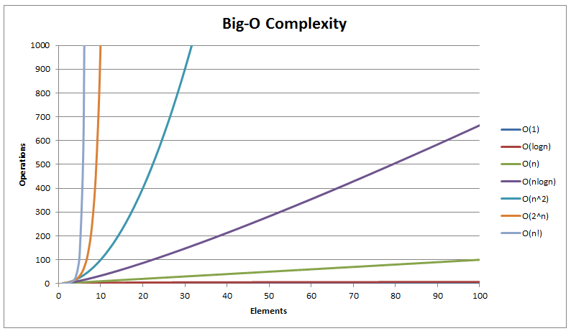
Typical Picture Review of https://visualgo.net/en/sorting?slide=6 to 6-11
Notes:
Screenshot from: https://www.hackerearth.com/practice/notes/sorting-and-searching-algorithms-time-complexities-cheat-sheet/ but I can always generate such thing by myself

Slide 6
Asymptotic Algorithm Analysis
The tasks discussed in PS0 https://nus.kattis.com/courses/IT5003/IT5003_S1_AY2324/assignments/amqr3d/standings (and in Recitation 1) so far have small ranges
We (re-)discuss ‘some of them’ and let the rest be discussed at Lab
Simple live demonstration of O(n), O(n log n), O(n²), O(n³)
See SpeedTest.cpp | py (for IT5003) | java
We will use these demo code to show these:
Runtime measurement (bad, inconsistent, *unless you ask an ‘independent’ judge, like Kattis*)
Counting actual # of operations (tedious, error prone, can also be inconsistent)
Asymptotic analysis, especially Big-O analysis ☺
We will complicate this with other common Big-O: O(1), log n, n!, 2^{n} in the future
Review the math of Big-O notation
https://visualgo.net/en/sorting?slide=6-9
It is OK to gloss this over for IT5003 level, but this thing is very important in my other CS3230

Slide 7
Asymptotic Algorithm Analysis (2)
Now, let’s solve another easy task that has interesting analysis
https://nus.kattis.com/problems/thanos, using this non-graded tracking session https://nus.kattis.com/courses/IT5003/IT5003_S1_AY2324/assignments/jtf69q/standings
It has interesting analysis: O(log_{R} F) = O(log F)
Worst case is when F = 10⁹, R is as low as possible (R = 2), and P = 1
PS: We will frequently do such big-O asymptotic algorithm analysis throughout our IT5003 class, so this topic is not a one-off lecture but will be repeated many times…
Hopefully, most of you master it by the time this course is over

Slide 8
For Next Week: 11+13+14 October 2023
Self read https://visualgo.net/en/sorting?slide=1 to the end
Most of those slides should be “self-explanatory” (hopefully even for this IT5003/non-computing batch)
However, any topics/slides that are still found to be hard (by some of you next week) will be further refined for future IT5003/CS2040/C/S classes
PS1 already open and run until Wednesday, 11 October 2023, 07.59am
For exactly 168 hours (7 days * 24 hours) - 1 second
PS2 will open on Wednesday, 11 October 2023, 08.00am
For exactly 168 hours (7 days * 24 hours) - 1 second too
This pattern will repeat until the last PS8
Each PS worth 2.5% of the course weightage (except PS1 is 1.5% as 1% is chopped for PS0)
A bunch of PS rules shown earlier
Basically, don’t plagiarize, don’t use ChatGPT output verbatim…

Slide 9
Review all these, see you again next Wed
Reminder: Read sorting e-Lecture slides before Lecture 2a
https://visualgo.net/en/sorting?slide=1
At least until slide 9-3, preferably more

Slide 10
IT5003 Lab 1
B5 (35? pax) is with Steven at PL1
I will join by 10.15am latest after I clear last QnA at iCube Auditorium
Monday groups, join your respective group this coming Monday

Slide 11
Introduction (Again)
Ice breaking

Slide 12
SpeedTest.py Revisited
Let’s do more interesting time complexity analysis, live, with a real Python code
You can then “feel” the speed (or the slowness)
Let’s start from this one again
https://www.comp.nus.edu.sg/~stevenha/cs2040c/demos/SpeedTest.py
Showing the O(1), O(log n), O(n³), and the
https://github.com/stevenhalim/cpbook-code/blob/master/ch3/cs/itertools1.py O(n!) version
https://github.com/stevenhalim/cpbook-code/blob/master/ch3/cs/itertools2.py O(2^{n}) version

Slide 13
Warm-up exercises 1+2 Revisited (with Analysis) https://wiki.python.org/moin/TimeComplexity
See it5003lab1-ans.pdf

Slide 14
Warm-up exercises problem, continued
Vaccine Efficacy
Let’s code along, we will give hints along the way
Tracker: https://nus.kattis.com/courses/IT5003/IT5003_S1_AY2324/assignments/jtf69q/standings

