Slide 1
IT5003
“Optional” Topic
The problem type described today is far harder than everything else before :O
(but not examinable in VA OQ 3, and not going to appear in final on 7 Dec 23 either)
PS: Scan the QR code for attendance taking (everyone must do this)

Slide 2
The Limit of Computation
All problems discussed in IT5003 so far (up to L8a) and the required algorithm(s) + data structure(s) to solve them are still polynomial
e.g., O(1), O(log n), O(n), O(n log n), O(n²), O(n³), or even O(n⁷⁷)
But there are problems where “nobody on earth knows how to solve them in polynomial (efficient) time complexity yet
Or perhaps these problems really don’t have any polynomial solution
Nobody has proven this direction either
The typical “complete search” time complexity is in order of O(2^{n}) or O(n!)
These problems are called NP-complete (decision) problems
Some are called NP-hard (optimization) problems
For IT5003 level, let’s just call them “very hard problems”

Slide 3
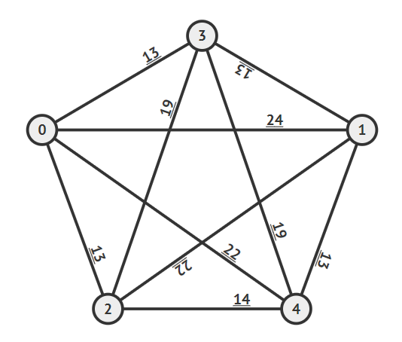
Example of a “Very Hard” Problem (1)
In this K₅, find the “shortest cycle” starting from the source vertex s = 0 so that we visit all vertices exactly once before we return to s
The answer for this example is 0-2-4-1-3-0 with cost 66 (the solution may not be unique)
But there are O(n!) possible tours
That’s a lot
See https://visualgo.net/en/tsp

Slide 4
Example of a “Very Hard” Problem (2)
This problem is called the Traveling-Salesperson-Problem (TSP)
If we only know IT5003 skills:
DFS (s = 0) can be modified to explore one of the many (n!) possible tours
e.g., 0-1-2-3-4(-and-return-to-0) for this case
BFS (s = 0) usually won’t give us a tour…
e.g., a star graph with center 0 and leaves {1, 2, 3, 4} is not a cycle
Dijkstra’s will give us shortest path from s = 0 to all other vertices and we have hard time stitching the answers to get a shortest tour that visits each vertex exactly once

Slide 5
What If We Just Try All? (see tsp_bf.py and beepers)
from itertools import permutations
from math import inf
n = 5
AM = [[0, 24, 13, 13, 22], ... ] # as per last slide, we randomize later
best_tour = inf
for p in permutations(range(n)):
cur = AM[p[-1]][p[0]] # last vertex back to vertex 0
for i in range(n-1):
cur += AM[p[i]][p[i+1]] # between successive vertices in the tour
if cur < best_tour: # keep the current best
best_tour = cur
print(p, cur)

Slide 6
So, What Should We Do?
Take the next course(s) :O
Or self-learn if you are not planning to continue further…
Many of you are currently taking MComp GT (or in GC-CF and considering to)
All these “very hard problems” are discussed in
CS3230 – Design and Analysis of Algorithms,
CS3233 – Competitive Programming,
CS4234 – Optimisation Algorithms (my other module – requires CS3230), and
PS: apparently 2 ex-IT5003 can appeal to take this (they are in my CS4324 *this* sem)
a few other graduate (level 5/6 CS courses)
IT5003 is just a subset of CS2040/C/S (my other course), which is a prerequisite of CS3230

Slide 7
Final Assessment
12 days later, Thu, 07 Dec 2023, 5-7pm SGT
Venue: MPSH5
40% MCQs (tricky); 20% easier short questions; 40% harder/differentiator questions
Be very careful in the MCQ section, double/triple check your answers… I have warned you that they are tricky
(weighted) SSSP (the proper question) obviously must appear somewhere
Open Book only, not Open Laptop (we cannot let you access to GPT-4/equivalent)
Designed to be of medium level (most of you will pass and I get nice grade distribution)
Easier than last semester (I hope)
Past papers on my IT5003 page (without any model answer)
See recitation recordings for most official answers

Slide 8
Last Admins
Scan QR code for attendance (for ALL)
Recording link from r8 (mostly about SSSP)
https://nus-sg.zoom.us/rec/share/bE4RkdfOT9pvzK-qvItjE5h_wOkj85qM2QLPsQ72Oi0CK5R0P9ewmxzd1niZsylO.tTUZ-XLc1ksIQO7O
Passcode: 8^8#F!A9

