Slide 1
IT5005
Tutorial #4
Logical Inference II and Search

Slide 2

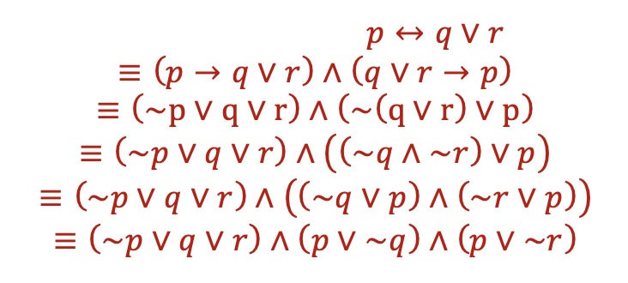
Question 1
(a)

Slide 3

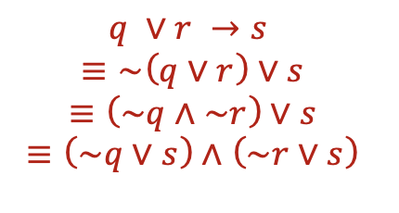

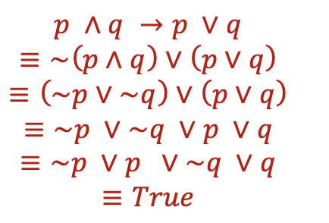
Question 1
(b)
(c)

Slide 4
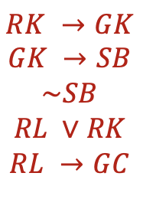
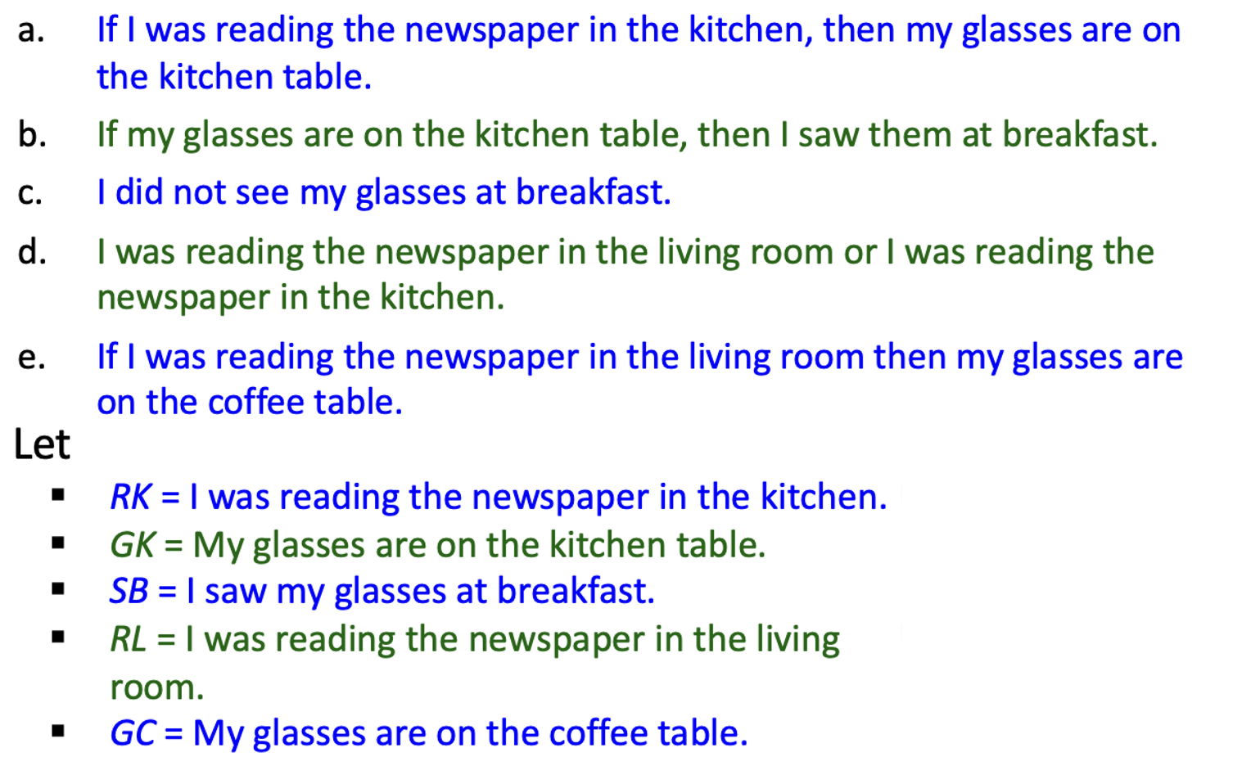
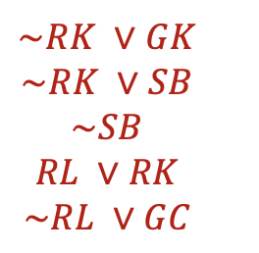
Question 2
(a) Write out the statements in propositional logic.
(b) Convert the statements into CNF form.

Slide 5
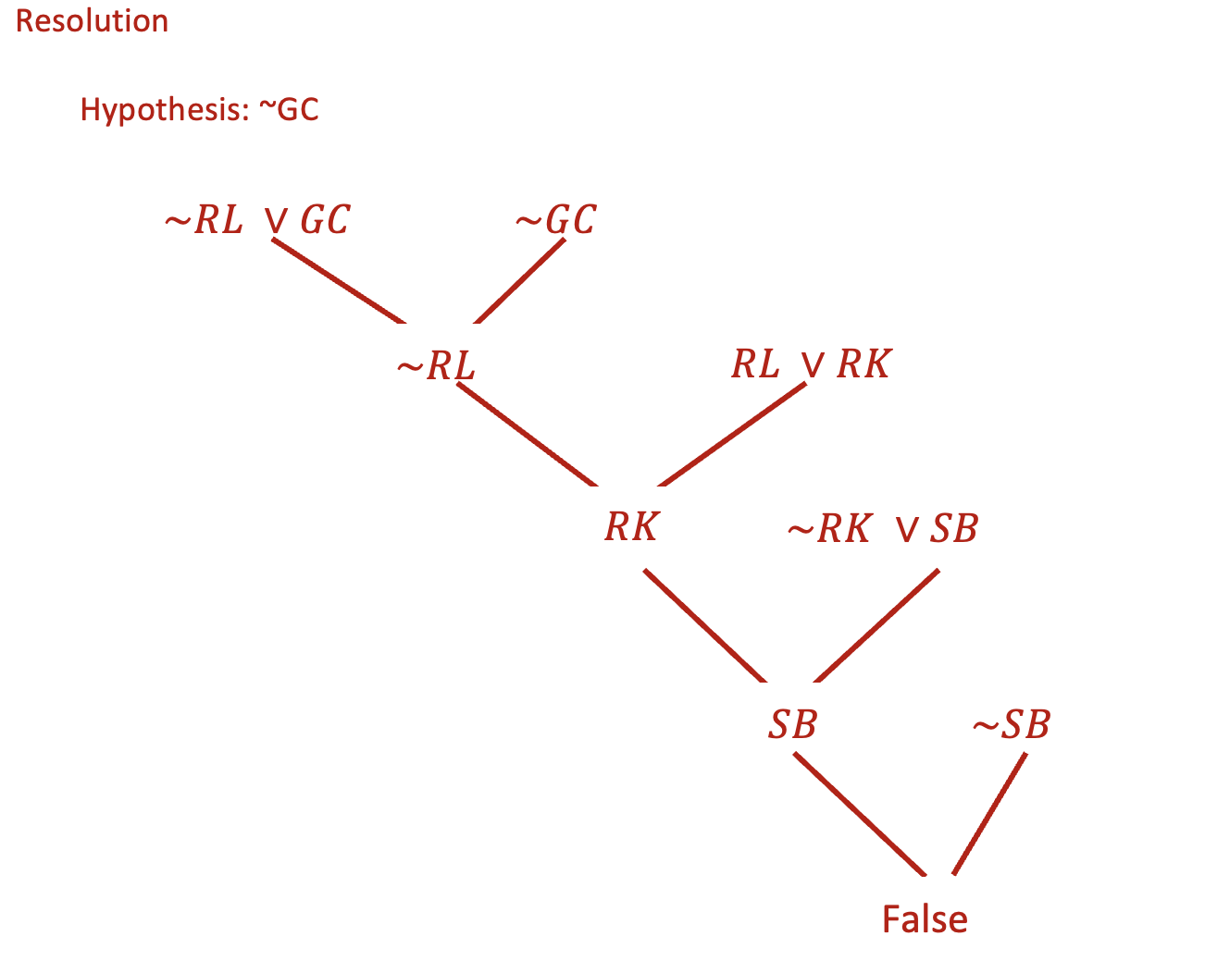
Question 2
(c) Use resolution to prove that the glasses are on the coffee table.

Slide 6
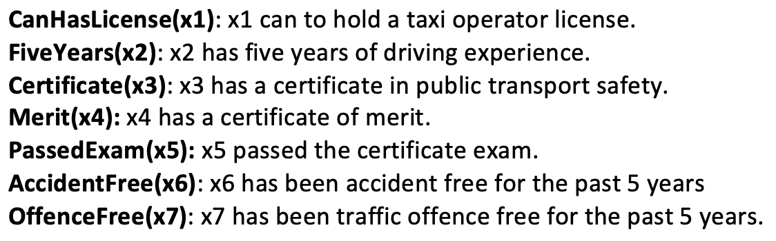
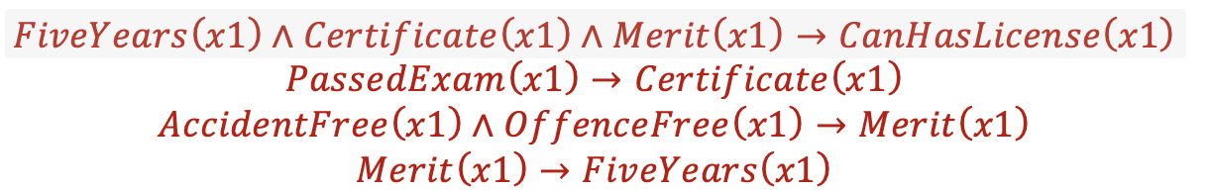
Question 3
(a) Write out the full set of rules as stated above using the predicates given.

Slide 7
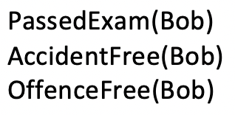
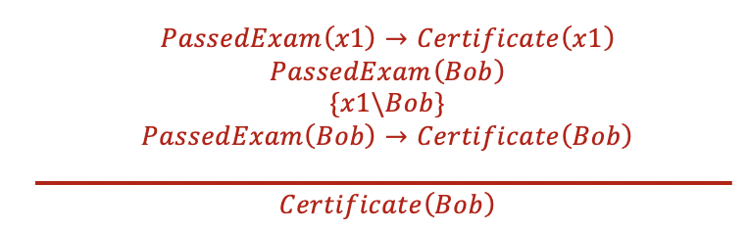
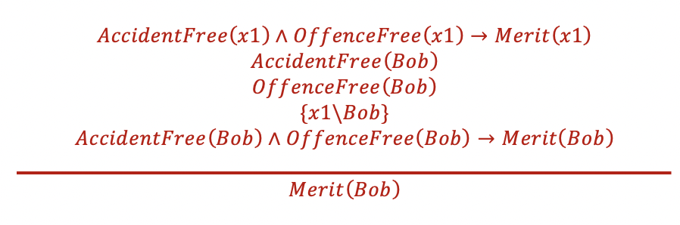
Question 3
(b) Use unification and forward-chaining to prove that Bob is qualified to hold a taxi operator license. Show all the unification and inference steps.

Slide 8

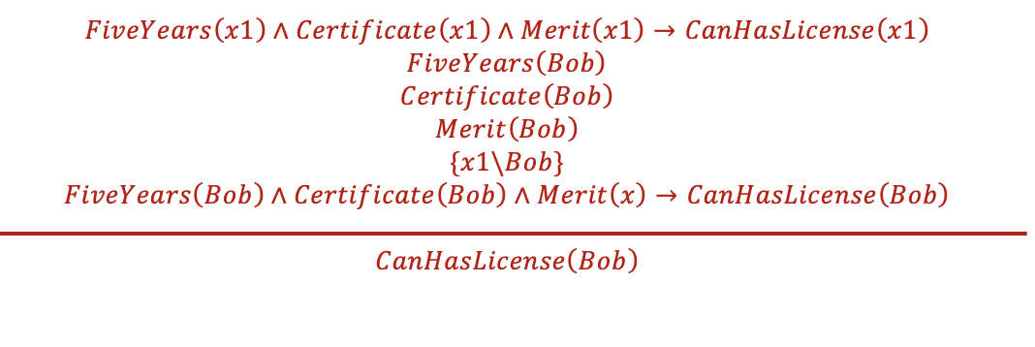
Question 3
(b) Use unification and forward-chaining to prove that Bob is qualified to hold a taxi operator license. Show all the unification and inference steps.

Slide 9
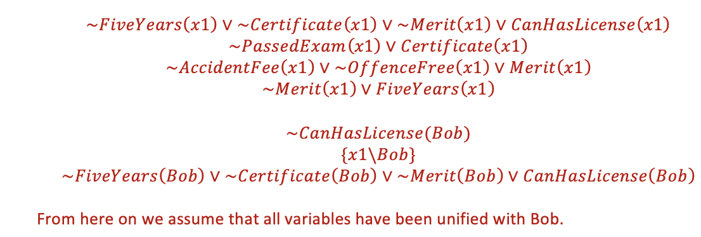
Question 3
(b) Rewrite the rules in CNF, and use unification and resolution to prove that Bob is qualified to hold a taxi operator license.

Slide 10
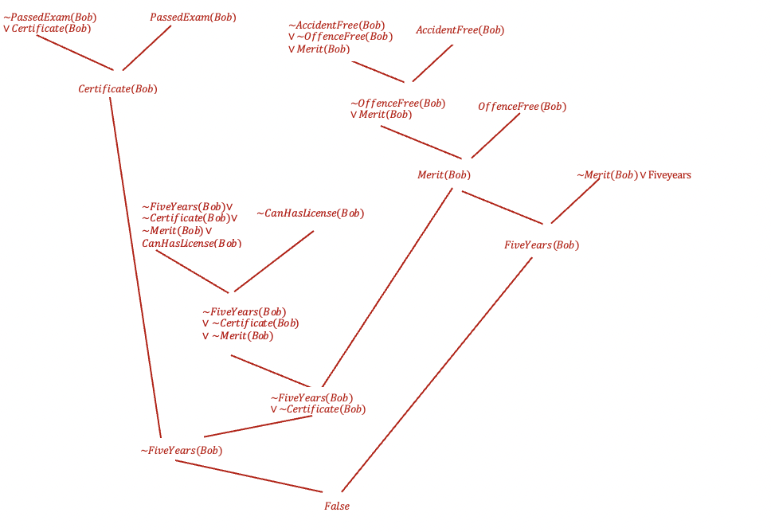
Question 3

Slide 11
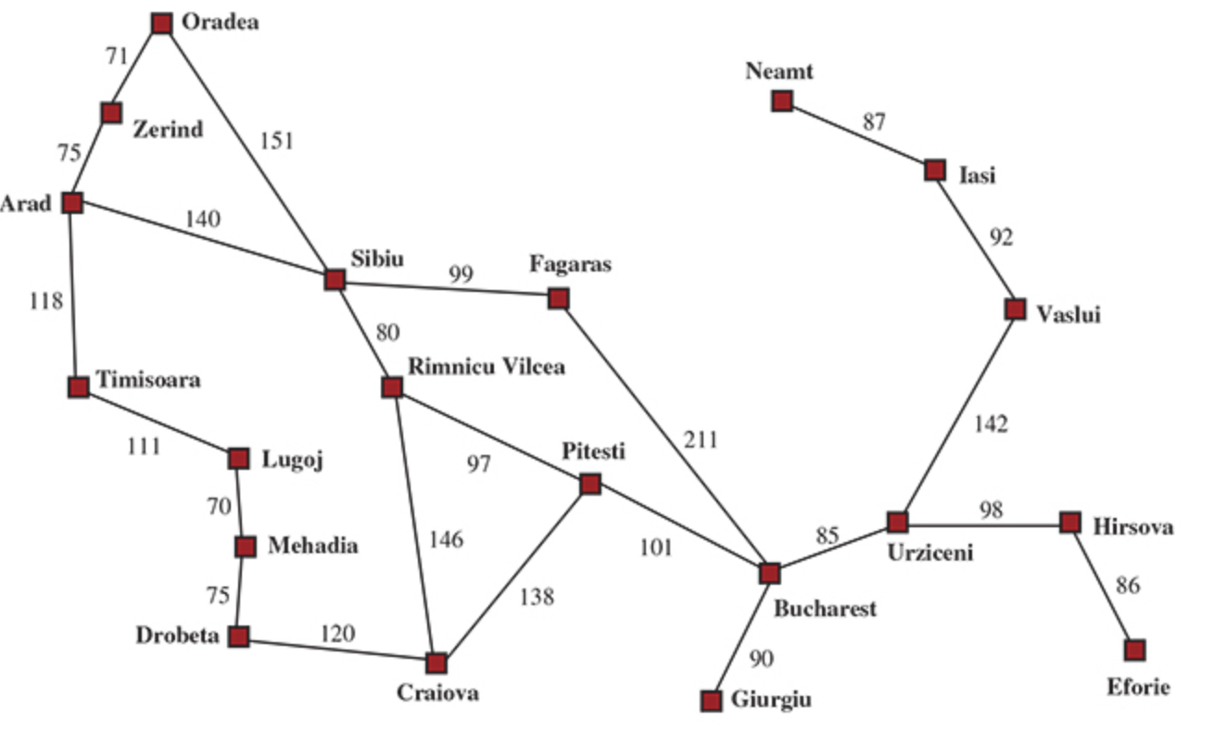

Slide 12
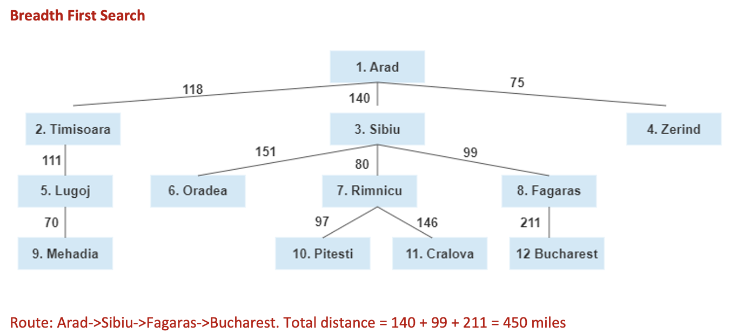
Question 4

Slide 13
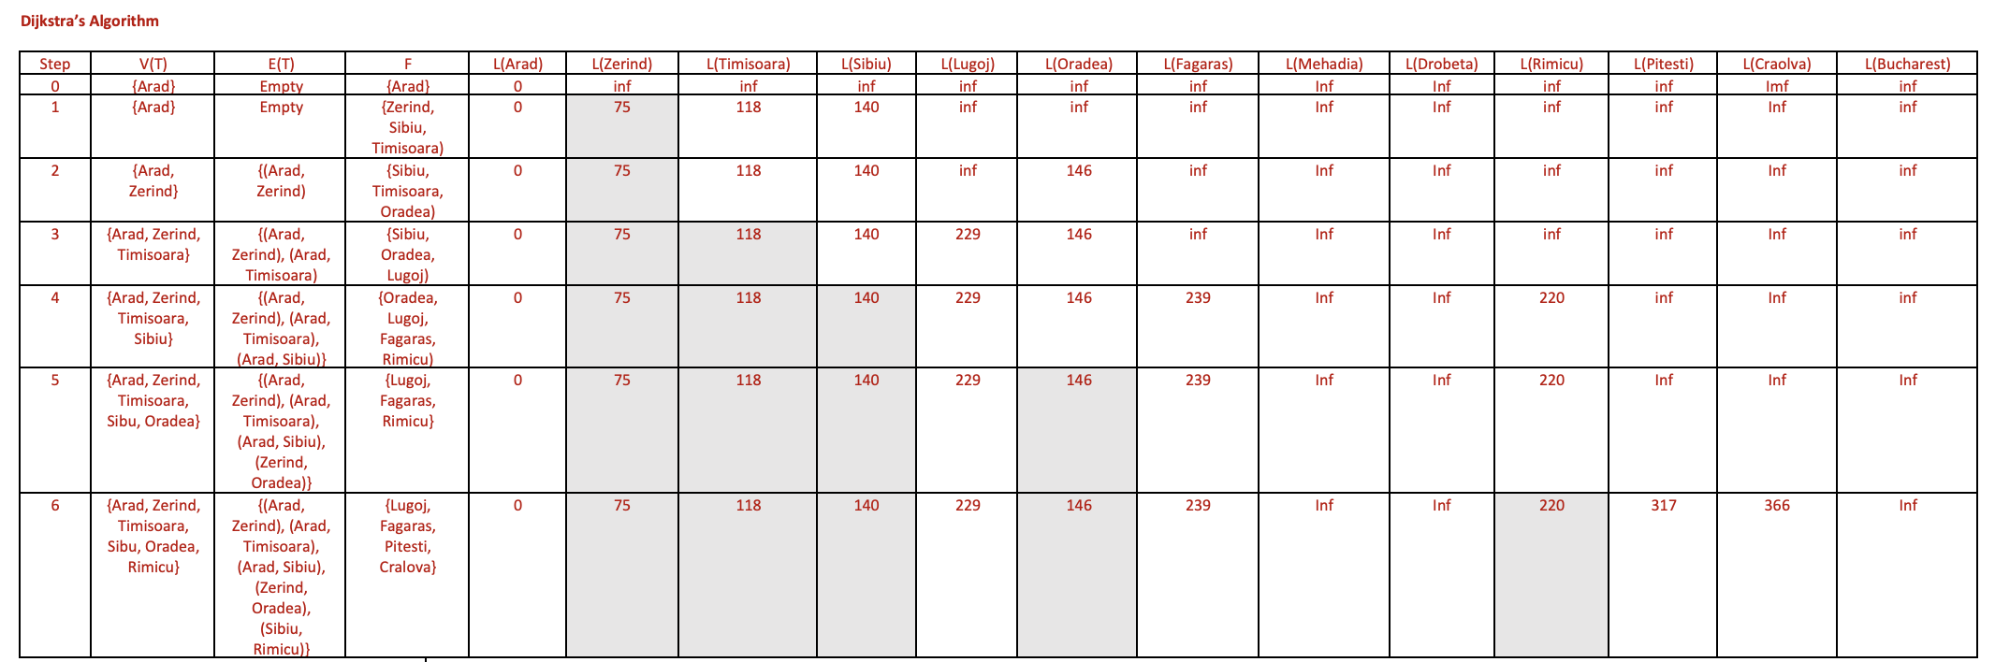
Question 4

Slide 14
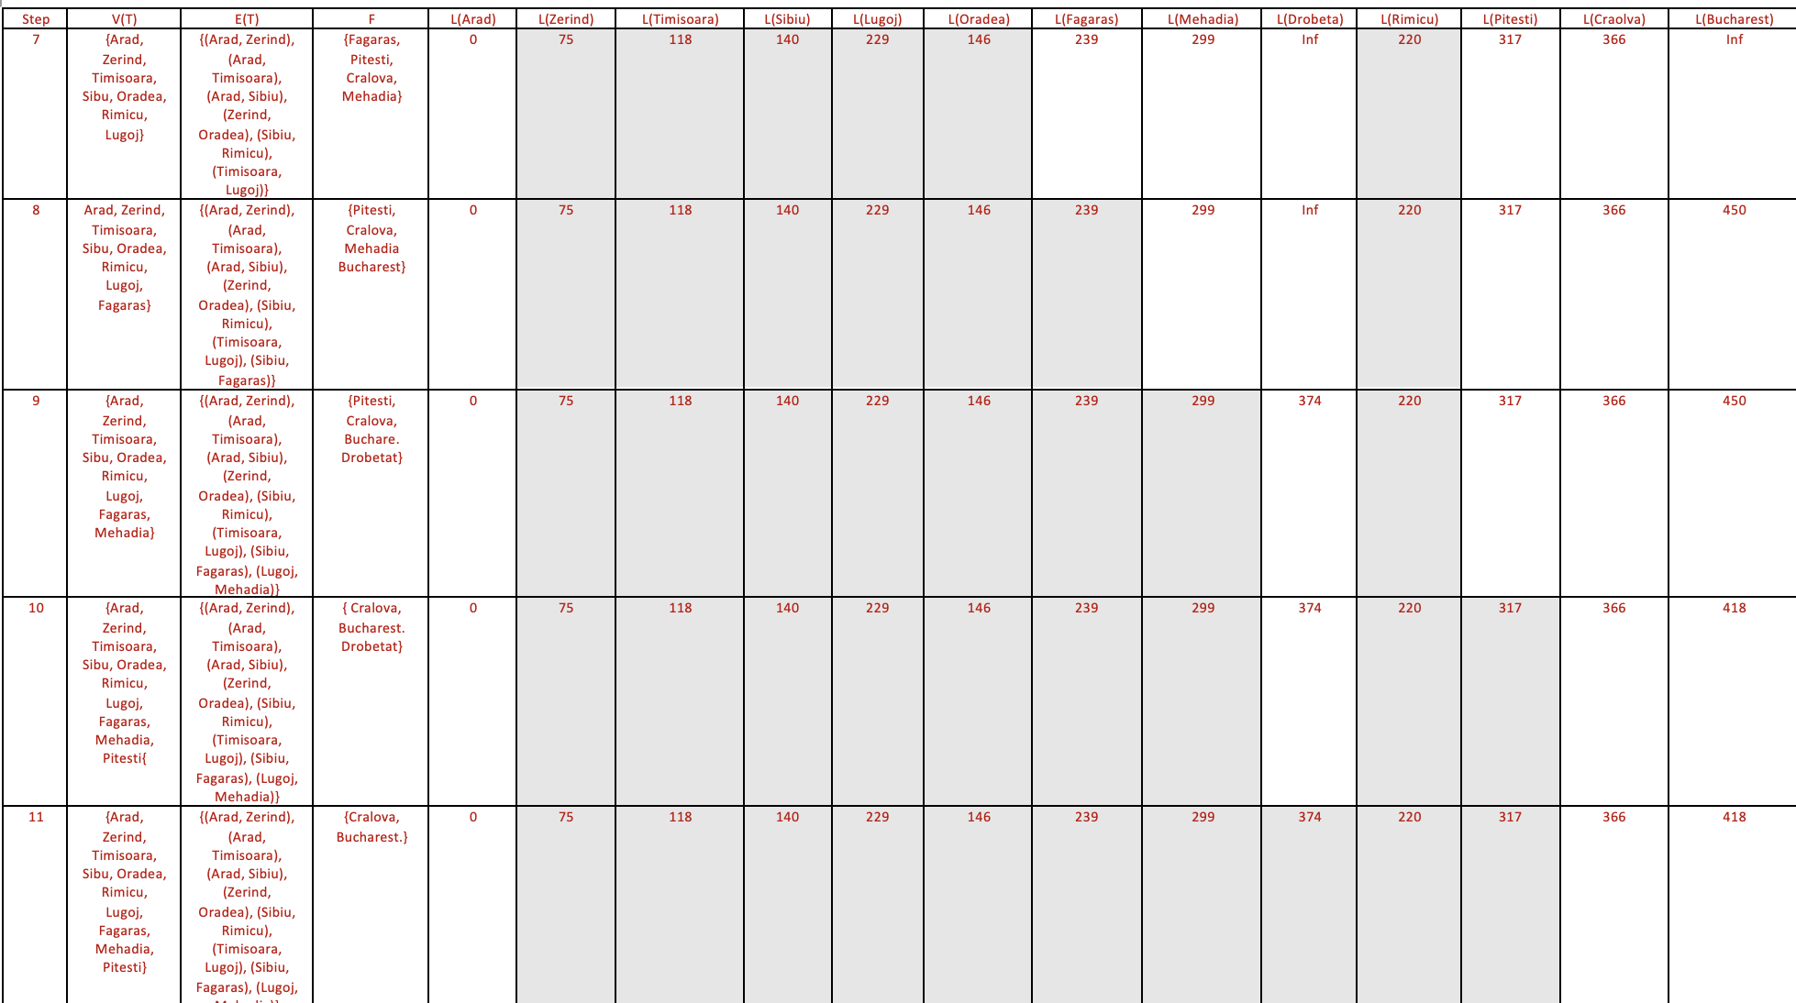
Question 4

Slide 15
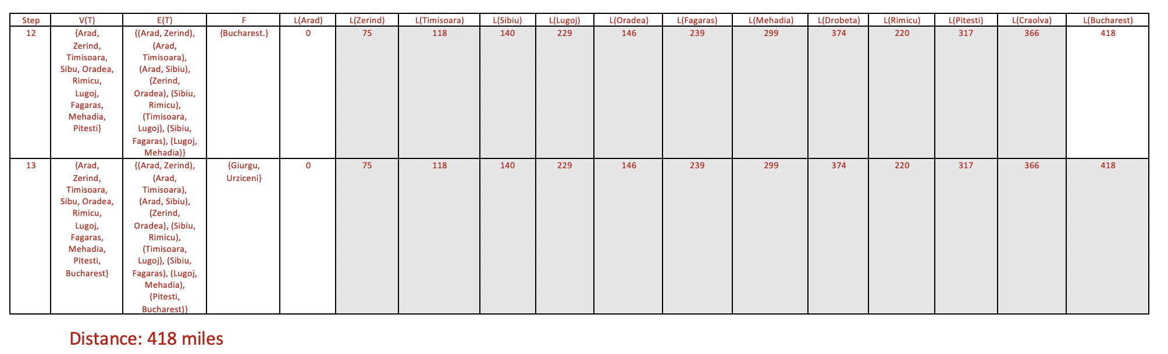
Question 4

Slide 16
THE END

