Slide 1
CS1231S Tutorial #1
Propositional Logic and Proofs

Slide 2
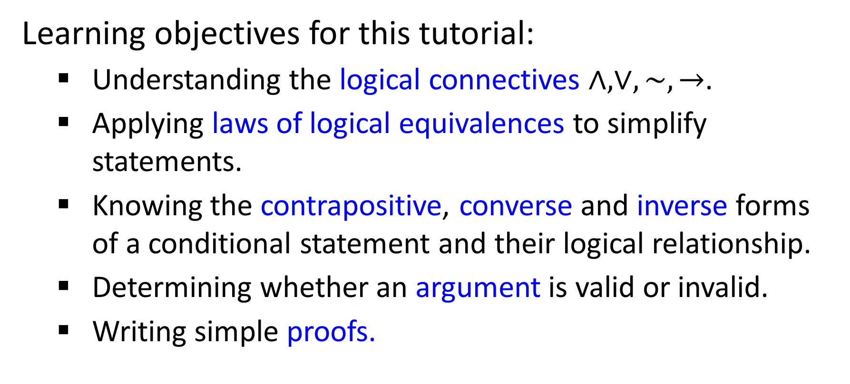
Learning objectives for this tutorial:
Understanding the logical connectives $∧,∨,\sim ,→$.
Applying laws of logical equivalences to simplify statements.
Knowing the contrapositive, converse and inverse forms of a conditional statement and their logical relationship.
Determining whether an argument is valid or invalid.
Writing simple proofs.

Slide 3






Q1
(a) Negating “$1 < a < 5$” becomes “$1≥a≥5$”
$$1<a<5$$
$$≡\left(1<a\right)∧(a<5)$$
Implicit AND
$$\sim \left(\left(1<a\right)∧\left(a<5\right)\right)$$
$≡\sim \left(1<a\right)∨\sim (a<5)$ (De Morgan’s)
$$≡\left(1≥a\right)∨(a≥5)$$
Are they logically equivalent?

Slide 4

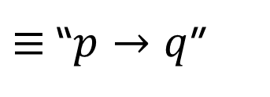
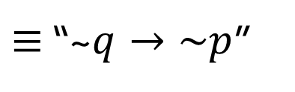
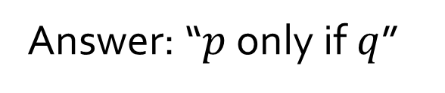

Q1
(b) “He’s welcome to come along only if he behaves himself” means “if he behaves himself then he’s welcome to come along”.
Let $p$ be “He’s welcome to come along”
and $q$ be “He behaves himself”.
Question: is “$p$ only if $q$” $≡$ “$q→p$”?
Answer: “$p$ only if $q$”
$≡$ “~$q→\sim p$”
$≡$ “$p→q$”
(Lecture #2 slide 45)

Slide 5
Q2
Theorem 2.1.1 Logical Equivalences
1 | Commutative laws | p ∧ q ≡ q ∧ p | p ∨ q ≡ q ∨ p
2 | Associative laws | (p ∧ q) ∧ r ≡ p ∧ (q ∧ r) | (p ∨ q) ∨ r ≡ p ∨ (q ∨ r)
3 | Distributive laws | p ∧ (q ∨ r) ≡ (p ∧ q) ∨ (p ∧ r) | p ∨ (q ∧ r) ≡ (p ∨ q) ∧ (p ∨ r)
4 | Identity laws | p ∧ true ≡ p | p ∨ false ≡ p
5 | Negation laws | p ∨ ~p ≡ true | p ∧ ~p ≡ false
6 | Double negative law | ~(~p) ≡ p
7 | Idempotent laws | p ∧ p ≡ p | p ∨ p ≡ p
8 | Universal bound laws | p ∨ true ≡ true | p ∧ false ≡ false
9 | De Morgan’s laws | ~(p ∧ q) ≡ ~p ∨ ~q | ~(p ∨ q) ≡ ~p ∧ ~q
10 | Absorption laws | p ∨ (p ∧ q) ≡ p | p ∧ (p ∨ q) ≡ p
11 | Negation of true and false | ~true ≡ false | ~false ≡ true

Slide 6
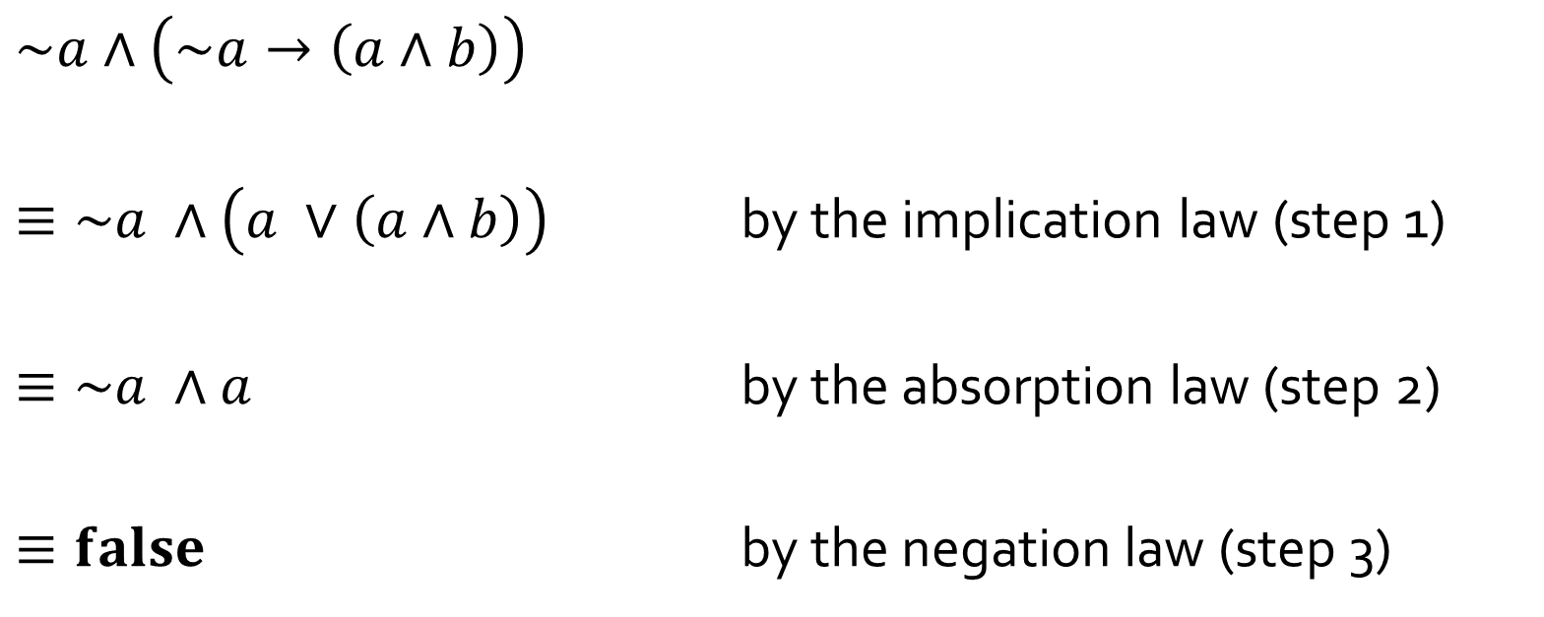
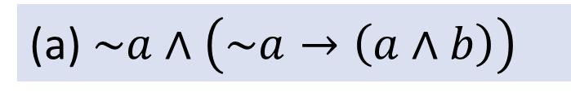
Q2
(a) $\sim a∧\left(\sim a→\left(a∧b\right)\right)$
$$\sim a∧\left(\sim a→\left(a∧b\right)\right)$$
$≡\sim a ∧\left(a ∨\left(a∧b\right)\right)$ by the implication law (step 1)
$≡\sim a ∧a$ by the absorption law (step 2)
$≡false$ by the negation law (step 3)
$≡\sim a ∧\left(\sim (\sim a) ∨\left(a∧b\right)\right)$ by the implication law
double negative law
$≡a∧\sim a$ by the commutative law

Slide 7
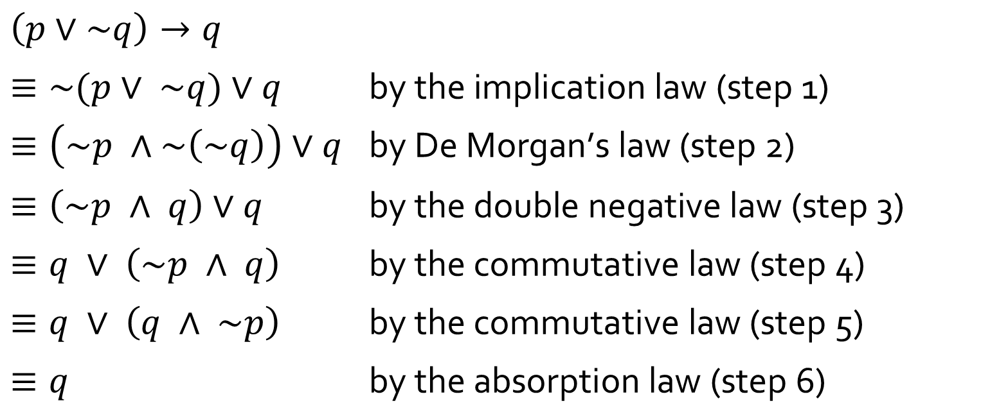
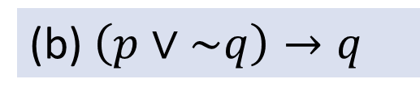
Q2
(b) $\left(p∨\sim q\right)→q$
$$\left(p∨\sim q\right)→q$$
$≡\sim (p∨ \sim q)∨q$ $\text{by} \text{the} \text{implication} \text{law}\text{ (}\text{step}\text{ 1)}$
$≡\left(\sim p ∧\sim \left(\sim q\right)\right)∨q$ $\text{by} \text{De} \text{Morgan}\text{’}\text{s} \text{law}\text{ (}\text{step}\text{ 2)}$
$≡\left(\sim p ∧ q\right)∨q$ $\text{by} \text{the} \text{double} \text{negative} \text{law}\text{ (}\text{step}\text{ 3)}$
$≡q ∨ \left(\sim p ∧ q\right)$ $\text{by} \text{the} \text{commutative} \text{law}\text{ (}\text{step}\text{ 4)}$
$≡q ∨ \left(q ∧ \sim p\right)$ $\text{by} \text{the} \text{commutative} \text{law}\text{ (}\text{step}\text{ 5)}$
$≡q$ $\text{by} \text{the} \text{absorption} \text{law}\text{ (}\text{step}\text{ 6)}$

Slide 8
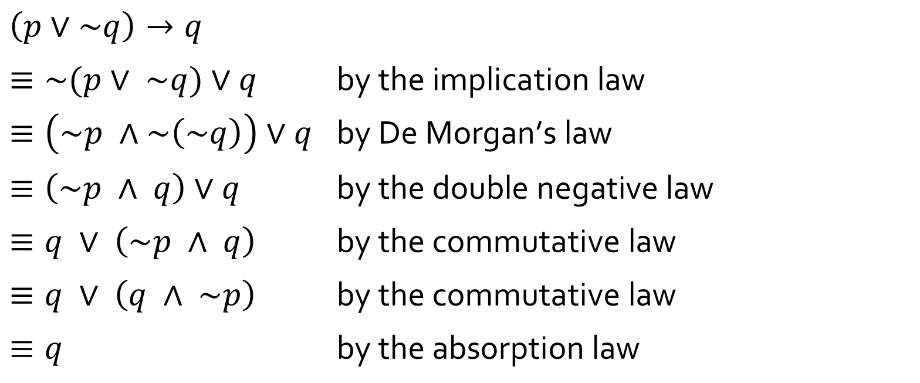
Q2
(b) $\left(p∨\sim q\right)→q$
You may combine two simple steps into one line, by citing the laws applied. Try not to combine more than 2 steps into one line or it may confuse your readers
$$\left(p∨\sim q\right)→q$$
$≡\sim (p∨ \sim q)∨q$ $\text{by} \text{the} \text{implication} \text{law}$
$≡\left(\sim p ∧\sim \left(\sim q\right)\right)∨q$ $\text{by} \text{De} \text{Morgan}\text{’}\text{s} \text{law}$
$≡\left(\sim p ∧ q\right)∨q$ $\text{by} \text{the} \text{double} \text{negative} \text{law}$
$≡q ∨ \left(\sim p ∧ q\right)$ $\text{by} \text{the} \text{commutative} \text{law}$
$≡q ∨ \left(q ∧ \sim p\right)$ $\text{by} \text{the} \text{commutative} \text{law}$
$≡q$ $\text{by} \text{the} \text{absorption} \text{law}$
twice

Slide 9
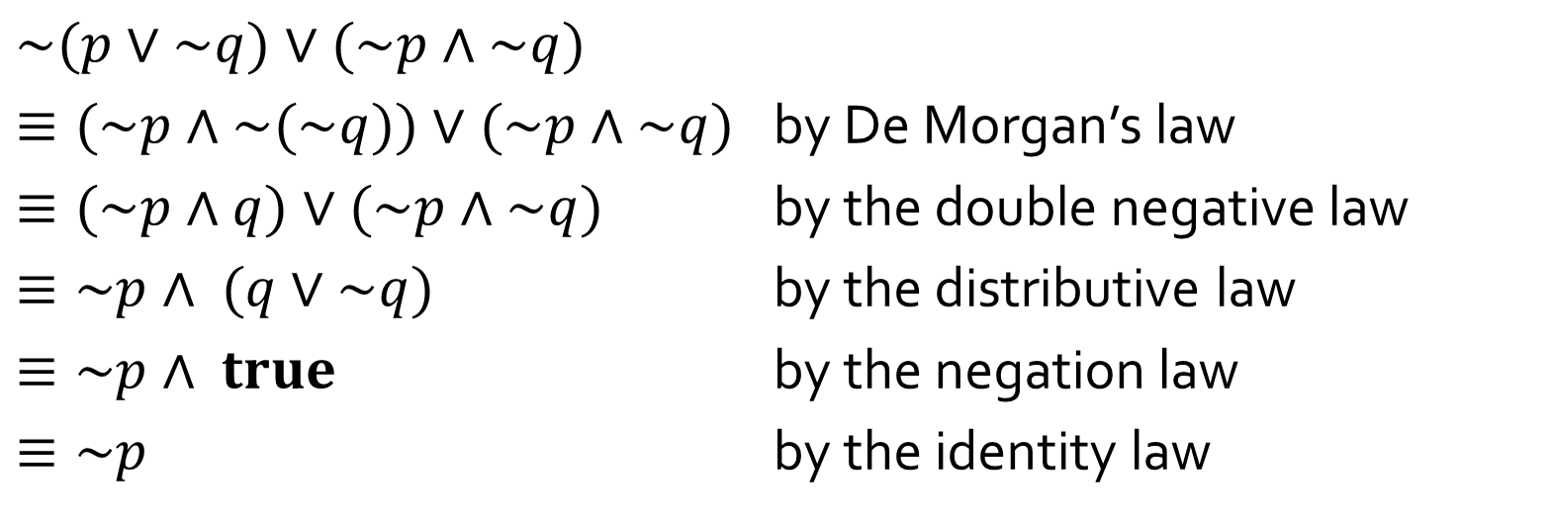
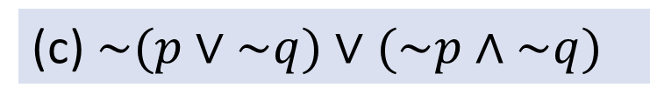
Q2
(c)$\sim (p∨\sim q)∨(\sim p∧\sim q)$
$$\sim (p∨\sim q)∨(\sim p∧\sim q)$$
$≡(\sim p∧\sim (\sim q))∨(\sim p∧\sim q)$ by De Morgan’s law
$≡(\sim p∧q)∨(\sim p∧\sim q)$ by the double negative law
$≡\sim p∧ (q∨\sim q)$ by the distributive law
$≡\sim p∧ true$ by the negation law
$≡\sim p$ by the identity law

Slide 10
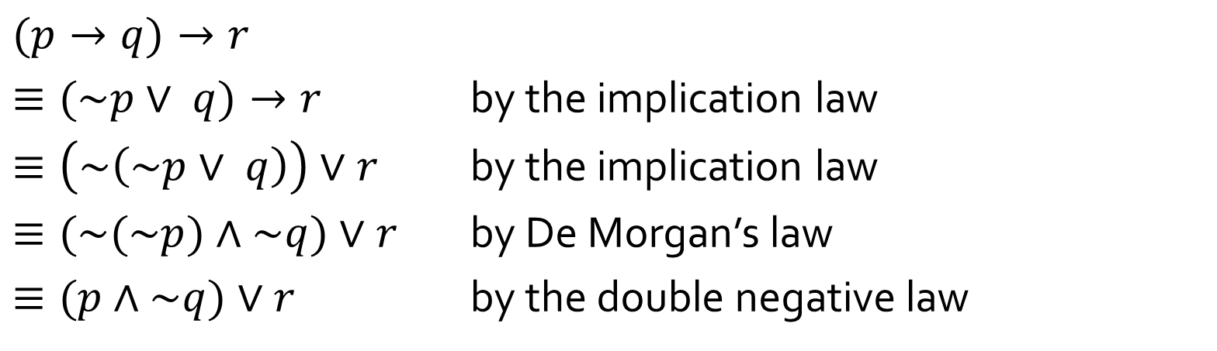
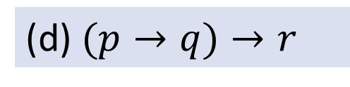
Q2
(d)$(p→q)→r$
$$(p→q)→r$$
$≡(\sim p∨ q)→r$ by the implication law
$≡\left(\sim \left(\sim p∨ q\right)\right)∨r$ by the implication law
$≡(\sim (\sim p)∧\sim q)∨r$ by De Morgan’s law
$≡(p∧\sim q)∨r$ by the double negative law

Slide 11

Q3
To qualify for the draw to win 100,000 AirAsia Miles, credit card holders must “charge a minimum of S$50 nett to their card during the Qualifying Period”.
C = “charge a minimum of S$50 net”,
P = “charge during the Qualifying Period”,
W = “win 100,000 AirAsia Miles”.
(a) Write a conditional statement that describes the rule above.
$$W→(C∧P)$$

Slide 12



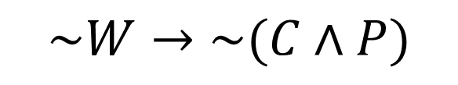
Q3
(b) Write the converse, inverse, contrapositive and negation forms of the statement in part (a).
$$W→(C∧P)$$
Converse:
$(C∧P)$ $→W$
Inverse:
$$\sim W→\sim (C∧P)$$
Contrapositive:
$\sim (C∧P)$ $→\sim W$
Negation:
$$W∧\sim (C∧P)$$

Slide 13
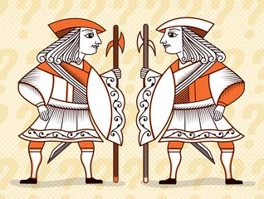
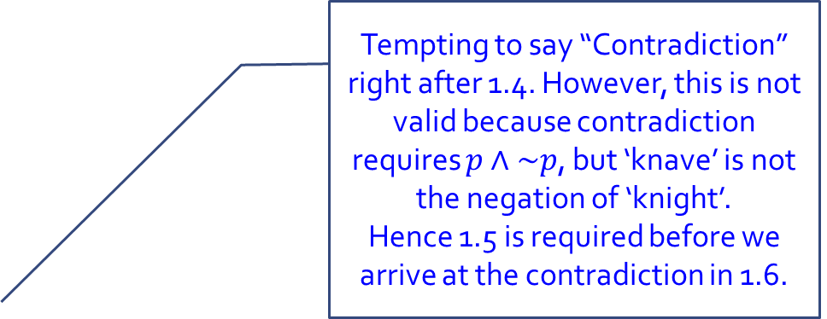
Q4
(a) Two natives A and B:
A says: Both of us are knights.
B says: A is a knave.
Tempting to say “Contradiction” right after 1.4. However, this is not valid because contradiction requires $p∧\sim p$, but ‘knave’ is not the negation of ‘knight’.
Hence 1.5 is required before we arrive at the contradiction in 1.6.
Proof (by contradiction):
1. If A is a knight, then:
1.1 What A says is true. (by definition of knight)
1.2 ∴ B is a knight too. (that’s what A says)
1.3 ∴ What B says is true. (by definition of knight)
1.4 ∴ A is a knave. (that’s what B says)
1.5 ∴ A is not a knight. (since A is either a knight or a knave, but not both)
1.6 ∴ Contradiction to 1.
2. ∴ A is not a knight.
3. ∴ A is a knave. (since A is either a knight or a knave, but not both)
4. ∴ What B says is true.
5. ∴ B is a knight. (by definition of knight)
6. Conclusion: A is a knave and B is a knight.

Slide 14
Q4
(b) Two natives C and D:
C says: D is a knave.
D says: C is a knave.
How many knights and knaves are there?
Proof (by division in cases):
1. If C is a knight, then:
1.1 What C says is true. (by definition of knight)
1.2 ∴ D is a knave. (that’s what C says)
2. If C is not a knight, then:
2.1 Then C is a knave. (one is either a knight or a knave)
2.2 ∴ what C says is false. (by definition of knave)
2.3 ∴ D is not a knave. (C says D is a knave, but what C says is false)
2.4 ∴ D is a knight. (one is either a knight or a knave)
3. Conclusion: in both cases, there is one knight and one knave.

