Slide 1
IT5005 Tutorial #2
Predicate Logic

Slide 2
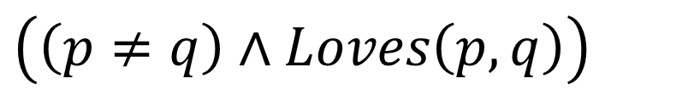
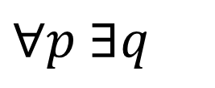
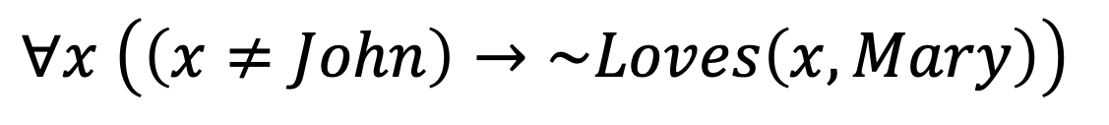

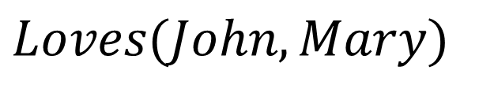
Q1
(a) Everybody loves someone else.
$$∀p ∃q$$
$$\left(\left(p≠q\right)∧Loves\left(p,q\right)\right)$$
(b) Nobody except John loves Mary.
$$Loves(John,Mary)$$
$$∧$$
$$∀x \left(\left(x≠John\right)→\sim Loves\left(x,Mary\right)\right)$$

Slide 3
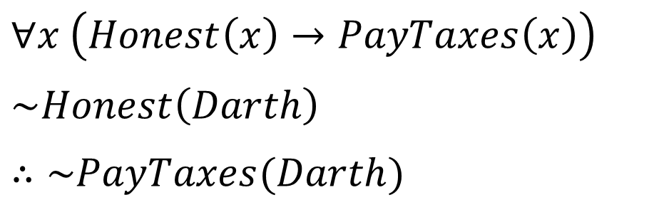
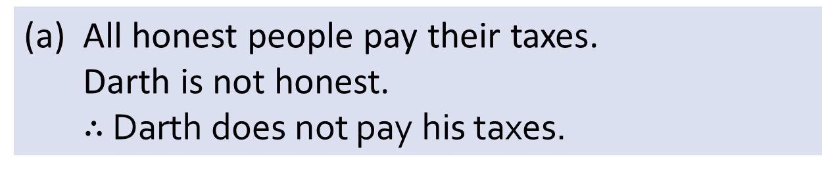
Q2
(a) All honest people pay their taxes.
Darth is not honest.
$∴$ Darth does not pay his taxes.
$$∀x \left(Honest\left(x\right)→PayTaxes\left(x\right)\right)$$
$$\sim Honest\left(Darth\right)$$
$$∴\sim PayTaxes(Darth)$$
Invalid;
Inverse error.

Slide 4
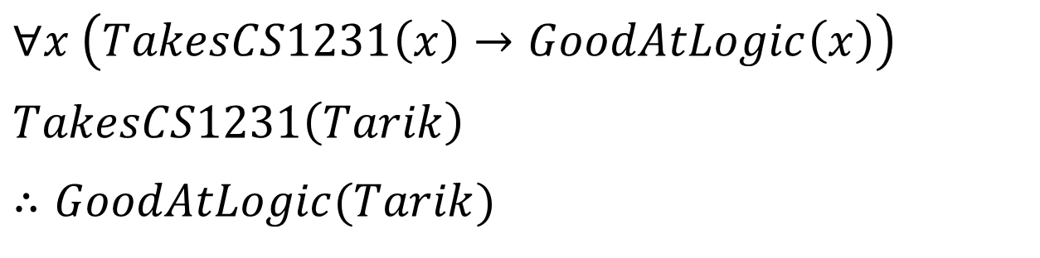
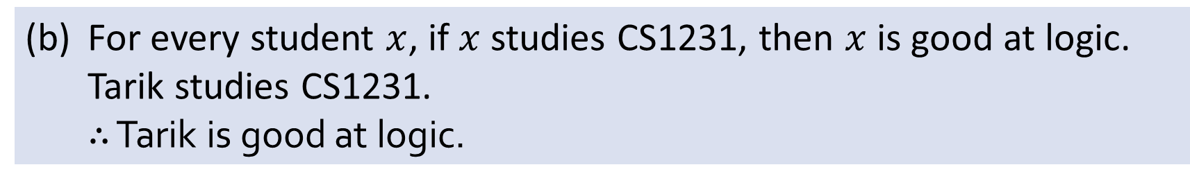
Q2
(b) For every student $x$, if $x$ studies CS1231, then $x$ is good at logic.
Tarik studies CS1231.
$∴$ Tarik is good at logic.
$$∀x \left(TakesCS1231\left(x\right)→GoodAtLogic\left(x\right)\right)$$
$$TakesCS1231\left(Tarik\right)$$
$$∴GoodAtLogic(Tarik)$$
Valid;
Universal modus ponens.

Slide 5
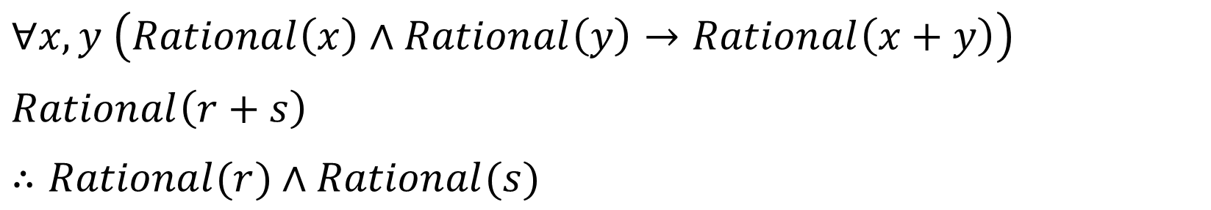
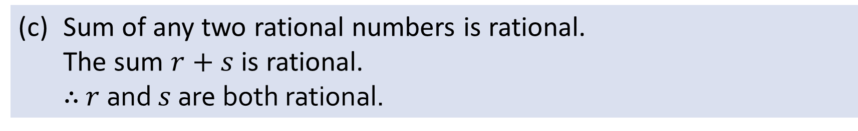
Q2
(c) Sum of any two rational numbers is rational.
The sum $r+s$ is rational.
$∴$ $r$and $s$ are both rational.
$$∀x,y \left(Rational\left(x\right)∧Rational\left(y\right)→Rational\left(x+y\right)\right)$$
$$Rational\left(r+s\right)$$
$∴Rational(r)$ $∧Rational(s)$
Invalid;
Converse error.

Slide 6
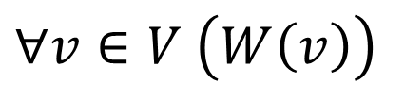
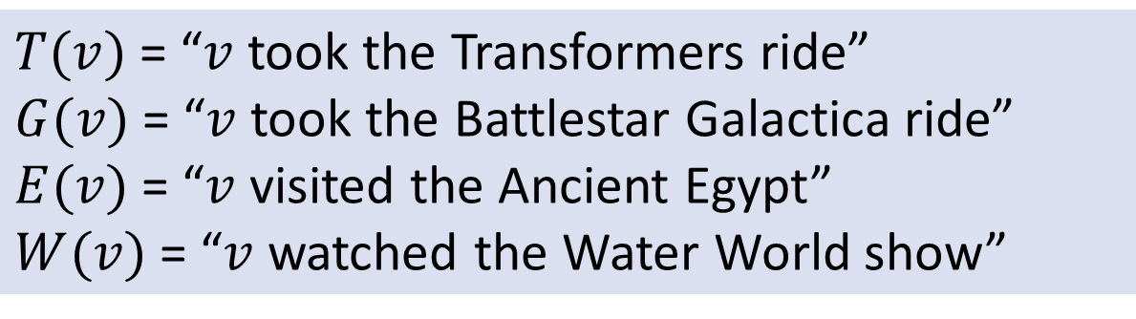
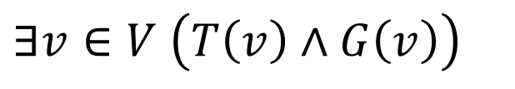
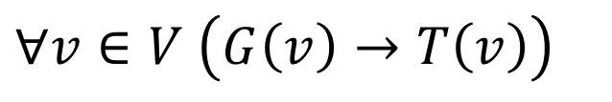
Q3
$T(v)$= “$v$ took the Transformers ride”
$G(v)$= “$v$ took the Battlestar Galactica ride”
$E(v)$= “$v$ visited the Ancient Egypt”
$W(v)$= “$v$ watched the Water World show”
(a) Every visitor watched the Water World show.
$$∀v∈V \left(W\left(v\right)\right)$$
(b) Every visitor who took the Battlestar Galactica ride also took the Transformers ride.
$$∀v∈V \left(G\left(v\right)→T\left(v\right)\right)$$
(c) There is a visitor who took both the Transformers ride and the Battlestar Galactica ride.
$$∃v∈V \left(T\left(v\right)∧G\left(v\right)\right)$$

Slide 7
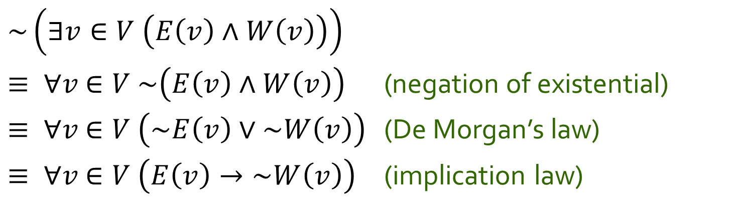
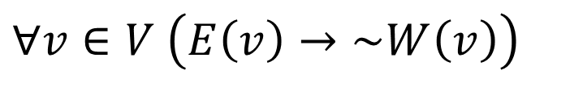
Q3
(d) No visitor who visited the Ancient Egypt watched the Water World show.
$$∀v∈V \left(E\left(v\right)→\sim W\left(v\right)\right)$$
Equivalently,
~(there is a visitor who visited the Ancient Egypt and watched the Water World show).
$$\sim \left(∃v∈V \left(E\left(v\right)∧W\left(v\right)\right)\right)$$
$≡ ∀v$ $∈V \sim \left(E\left(v\right)∧W\left(v\right)\right)$ (negation of existential)
$≡ ∀v$ $∈V \left(\sim E\left(v\right)∨\sim W\left(v\right)\right)$ (De Morgan’s law)
$≡ ∀v$ $∈V \left(E\left(v\right)→\sim W\left(v\right)\right)$ (implication law)

Slide 8
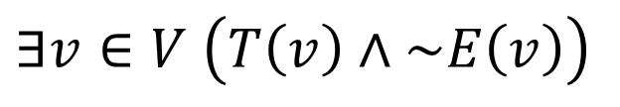
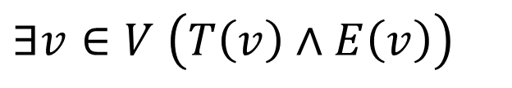

Q3
(e) Some visitors who took the Transformers ride also visited the Ancient Egypt but some (who took the Transformers ride) did not (visit the Ancient Egypt).
$$∃v∈V \left(T\left(v\right)∧E\left(v\right)\right)$$
$$∧$$
$$∃v∈V \left(T\left(v\right)∧\sim E\left(v\right)\right)$$

Slide 9
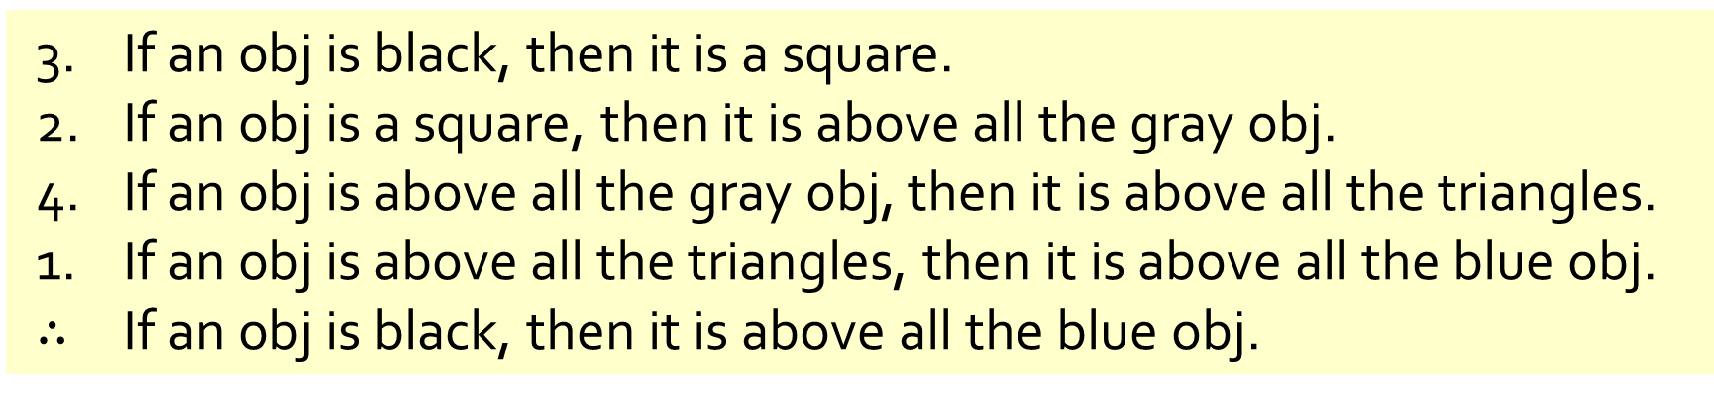
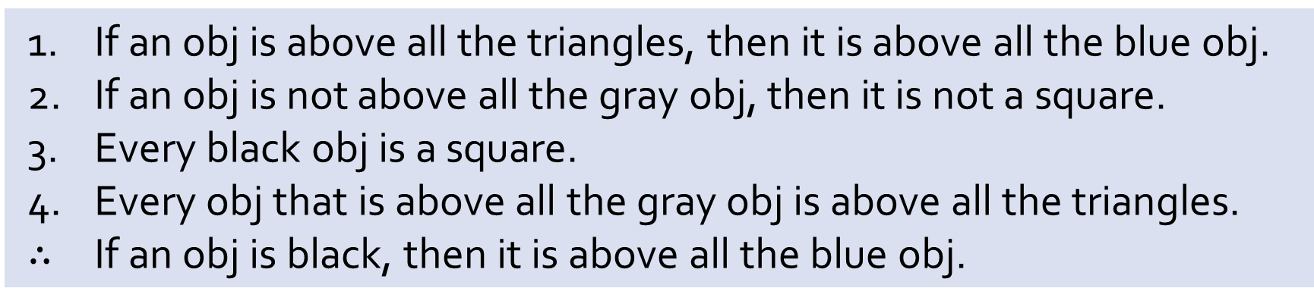
Q4
If an obj is above all the triangles, then it is above all the blue obj.
If an obj is not above all the gray obj, then it is not a square.
Every black obj is a square.
Every obj that is above all the gray obj is above all the triangles.
$∴$ If an obj is black, then it is above all the blue obj.
(a) Reorder the premises to show that the conclusion follows as a valid consequence from the premises by applying universal transitivity.
3. If an obj is black, then it is a square.
2. If an obj is a square, then it is above all the gray obj.
4. If an obj is above all the gray obj, then it is above all the triangles.
1. If an obj is above all the triangles, then it is above all the blue obj.
$∴$ If an obj is black, then it is above all the blue obj.

Slide 10
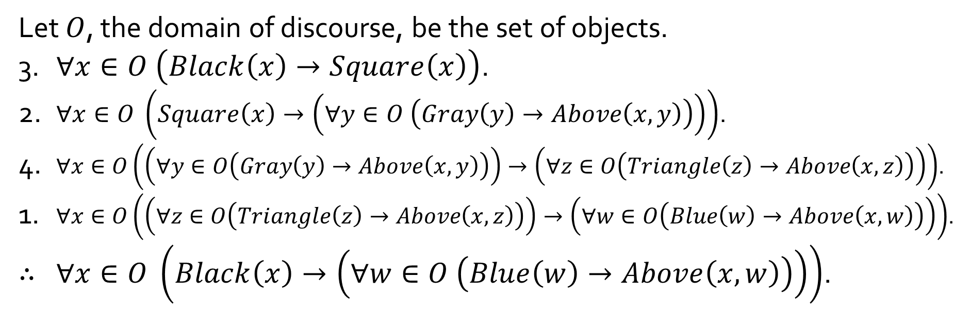
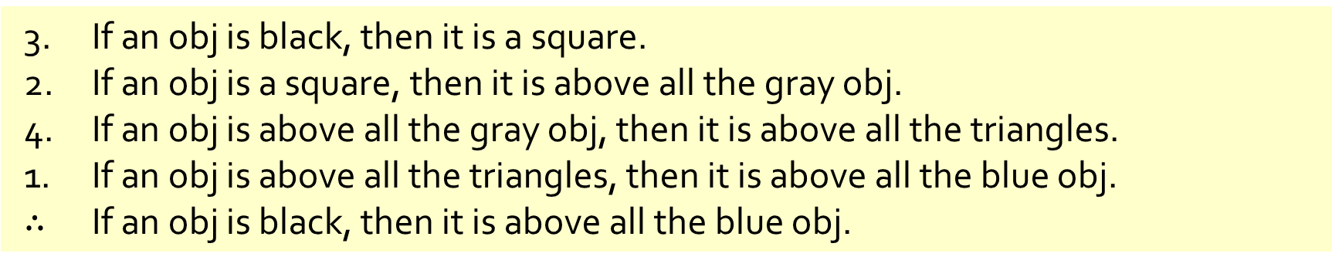
Q4
3. If an obj is black, then it is a square.
2. If an obj is a square, then it is above all the gray obj.
4. If an obj is above all the gray obj, then it is above all the triangles.
1. If an obj is above all the triangles, then it is above all the blue obj.
$∴$ If an obj is black, then it is above all the blue obj.
(b) Rewrite your answer in (a) using predicates and quantified statements.
Let $O$, the domain of discourse, be the set of objects.
3. $∀x∈O \left(Black\left(x\right)→Square\left(x\right)\right)$.
2. $∀x∈O \left(Square\left(x\right)→\left(∀y∈O \left(Gray\left(y\right)→Above\left(x,y\right)\right)\right)\right)$.
4. $∀x∈O\left(\left(∀y∈O\left(Gray\left(y\right)→Above\left(x,y\right)\right)\right)→\left(∀z∈O\left(Triangle\left(z\right)→Above\left(x,z\right)\right)\right)\right)$.
1. $∀x∈O\left(\left(∀z∈O\left(Triangle\left(z\right)→Above\left(x,z\right)\right)\right)→\left(∀w∈O\left(Blue\left(w\right)→Above\left(x,w\right)\right)\right)\right)$.
$∴$ $∀x∈O \left(Black\left(x\right)→\left(∀w∈O \left(Blue\left(w\right)→Above\left(x,w\right)\right)\right)\right)$.

Slide 11
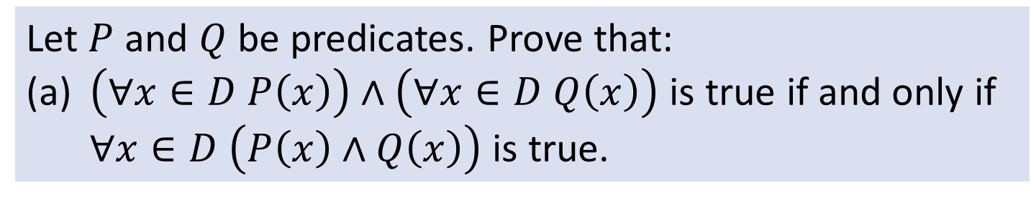
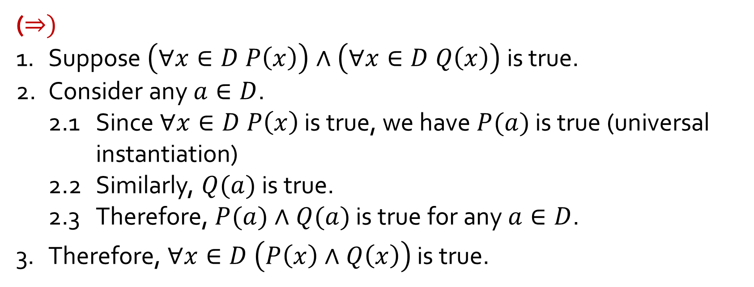
Q5
Let $P$ and $Q$ be predicates. Prove that:
(a) $\left(∀x∈D P\left(x\right)\right)∧\left(∀x∈D Q\left(x\right)\right)$ is true if and only if $∀x∈D \left(P\left(x\right)∧Q\left(x\right)\right)$ is true.
$$\left(∀x∈D P\left(x\right)\right)∧\left(∀x∈D Q\left(x\right)\right)⇔∀x∈D \left(P\left(x\right)∧Q\left(x\right)\right)$$
($⇒)$
1. Suppose $\left(∀x∈D P\left(x\right)\right)∧\left(∀x∈D Q\left(x\right)\right)$ is true.
2. Consider any $a∈D$.
2.1 Since $∀x∈D P\left(x\right)$ is true, we have $P(a)$ is true (universal instantiation)
2.2 Similarly, $Q(a)$ is true.
2.3 Therefore, $P(a)∧Q(a)$ is true for any $a∈D$.
3. Therefore, $∀x∈D \left(P\left(x\right)∧Q\left(x\right)\right)$ is true.

Slide 12
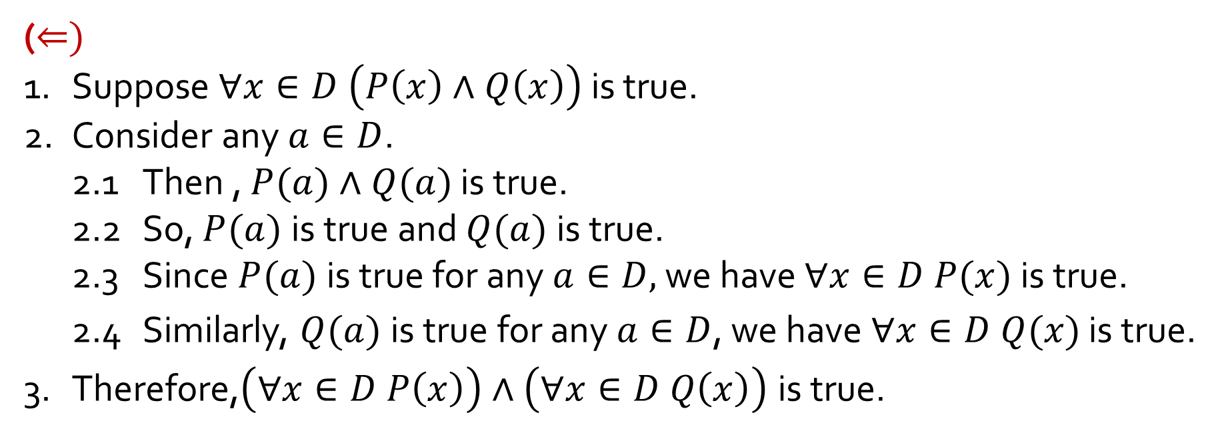
Q5
Let $P$ and $Q$ be predicates. Prove that:
(a) $\left(∀x∈D P\left(x\right)\right)∧\left(∀x∈D Q\left(x\right)\right)$ is true if and only if $∀x∈D \left(P\left(x\right)∧Q\left(x\right)\right)$ is true.
$$\left(∀x∈D P\left(x\right)\right)∧\left(∀x∈D Q\left(x\right)\right)⇔∀x∈D \left(P\left(x\right)∧Q\left(x\right)\right)$$
($⇐)$
1. Suppose $∀x∈D \left(P\left(x\right)∧Q\left(x\right)\right)$ is true.
2. Consider any $a∈D$.
2.1 Then , $P(a)∧Q(a)$ is true.
2.2 So, $P(a)$is true and $Q(a)$is true.
2.3 Since $P(a)$is true for any $a∈D,$ we have $∀x∈D P(x)$ is true.
2.4 Similarly, $Q(a)$is true for any $a∈D$, we have $∀x∈D Q(x)$ is true.
3. Therefore,$\left(∀x∈D P\left(x\right)\right)∧\left(∀x∈D Q\left(x\right)\right)$ is true.

Slide 13
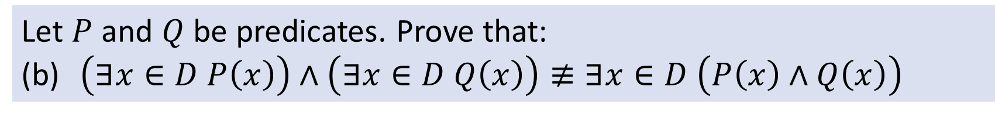
Q5
Let $P$ and $Q$ be predicates. Prove that:
(b) $\left(∃x∈D P\left(x\right)\right)∧\left(∃x∈D Q\left(x\right)\right)≢∃x∈D \left(P\left(x\right)∧Q\left(x\right)\right)$
Counterexample:
Let $D=ℕ$, $P(x)$ be “$x^{2}=0$” and $Q(x)$ be “$x^{2}=1$”.
$$\left(∃x∈ℕ x^{2}=0\right)∧\left(∃x∈ℕ x^{2}=1\right)$$
True
$$∃x∈ℕ \left(x^{2}=0∧x^{2}=1\right)$$
False

Slide 14
THE END

