Slide 1
IT5005 Tutorial #3
Logical Inference I

Slide 2
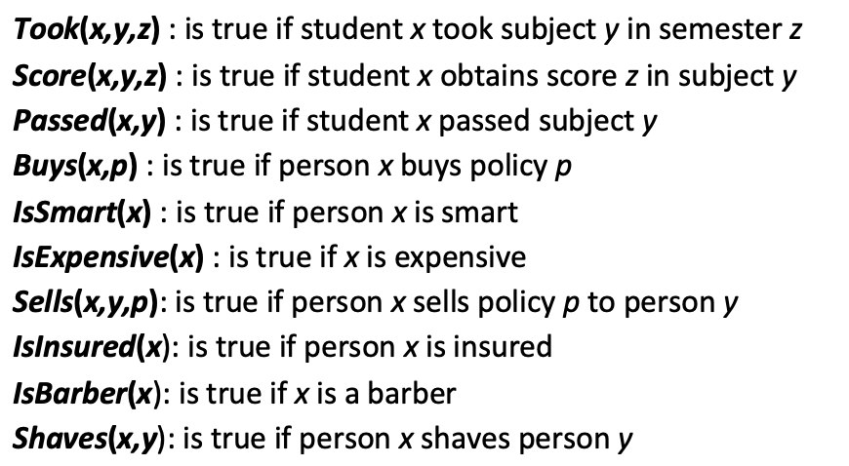

Question 1
(a) Some students took French in Spring 2001.
(b) Every student who takes French passes it.

Slide 3

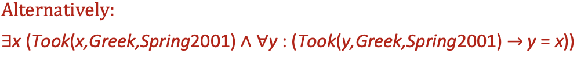
Question 1
(c) Only one student took Greek in Spring 2001.

Slide 4


Question 1
(d) The best score in Greek is always higher than the best score in French.
(e) Everyone who buys a policy is smart.

Slide 5

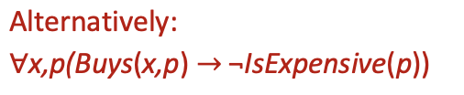

Question 1
(f) No person buys an expensive policy.
(g) There is an agent who sells policies only to those people who are not insured.

Slide 6
Question 1
(h) There is a barber who shaves all men in town who do not shave themselves.
(i) There is a barber who shaves all men in town who do not shave themselves.

Slide 7
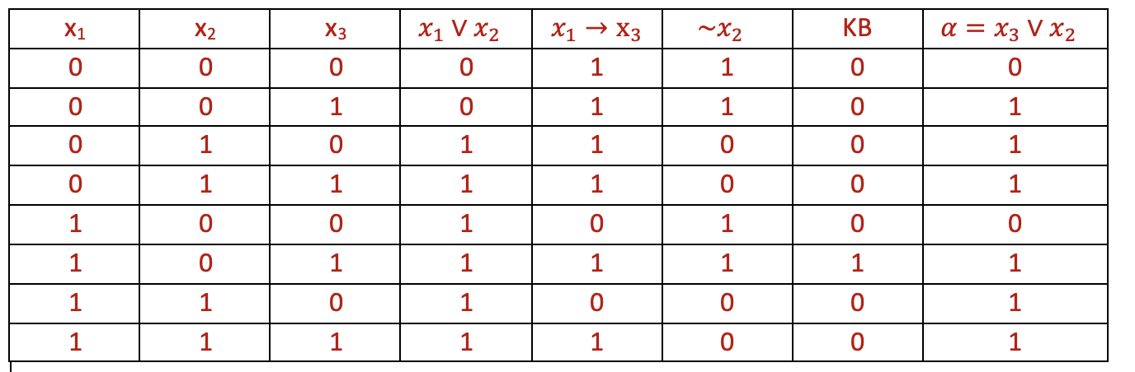

Question 2
(a) KB =(x₁ ∨ x₂) ∧ (x₁ $→$ x₃) ∧ ¬x₂ , α =x₃ ∨ x₂
For KB to be true, (x₁ ∨ x₂), x₁ $→$ x₃ and ¬x₂ must all be true.
Thus $KB⊨ α$

Slide 8
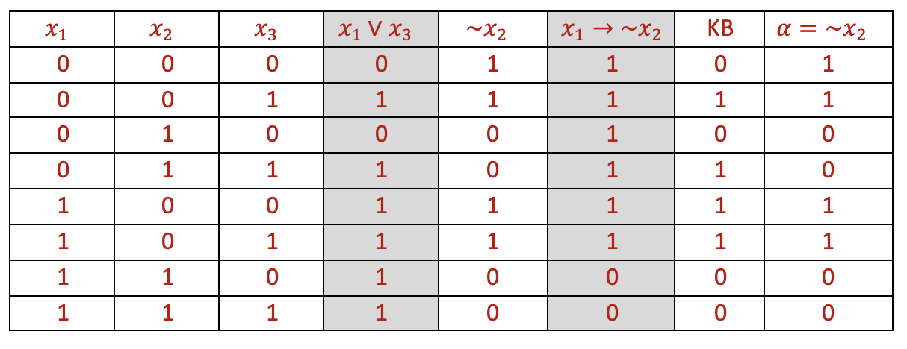
Question 2
(b) KB =(x₁ ∨ x₃) ∧ (x₁ ⇒ ¬x₂), α =¬x₂
Thus $\sim \left(KB⊨α\right)$

Slide 9
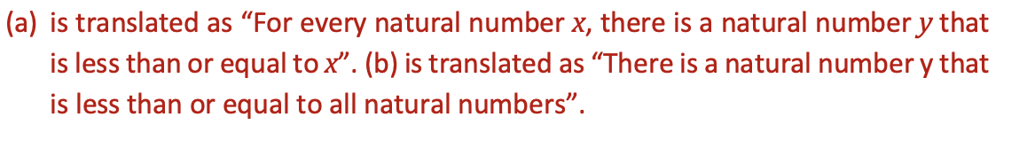
Question 3
(a) ∀x∃y (x ≥ y)
(b) ∃y ∀x (x ≥ y)
(i) Assume that the variables range over all the natural numbers 0,1,2,... and that the “≥” predicate means “is greater than or equal to”. Under this interpretation, translate (a) and (b) into English.

Slide 10
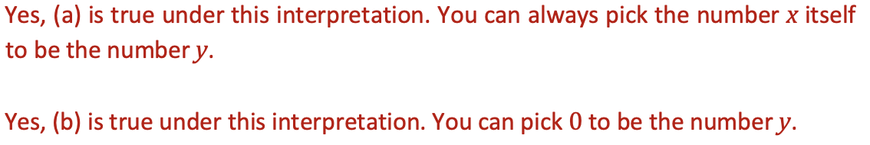
Question 3
(a) ∀x∃y (x ≥ y)
(b) ∃y ∀x (x ≥ y)
(ii) Assume that the variables range over all the natural numbers 0,1,2,... and that the “≥” predicate means “is greater than or equal to”. Is (a) true under this interpretation? Is (b) true under this interpretation?

Slide 11
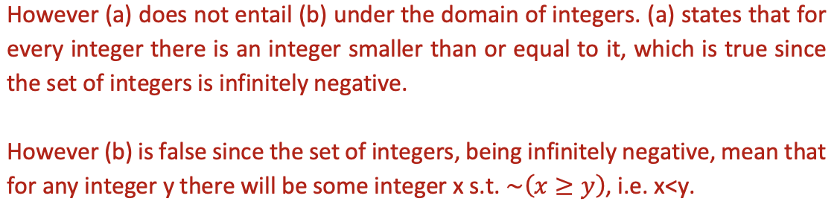
Question 3
(a) ∀x∃y (x ≥ y)
(b) ∃y ∀x (x ≥ y)
(iii) Does (a) entail (b)? Does (b) entail (a)?

Slide 12
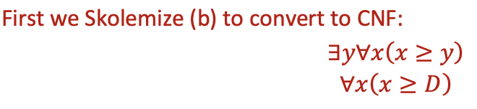
Question 3
(a) ∀x∃y (x ≥ y)
(b) ∃y ∀x (x ≥ y)
(iii) Does (a) entail (b)? Does (b) entail (a)?

Slide 13
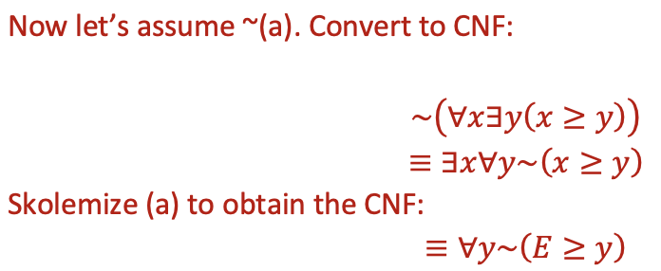
Question 3
(a) ∀x∃y (x ≥ y)
(b) ∃y ∀x (x ≥ y)
(iii) Does (a) entail (b)? Does (b) entail (a)?

Slide 14
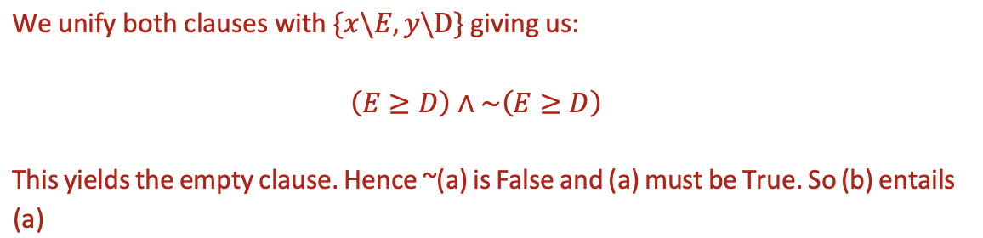
Question 3
(a) ∀x∃y (x ≥ y)
(b) ∃y ∀x (x ≥ y)
(iii) Does (a) entail (b)? Does (b) entail (a)?

Slide 15

Question 4
Given a graph G = <V, E> we say that a subset of vertices X ⊆ V is an independent set if no two vertices in X share an edge. Here we assume pairwise independent sets. I.e. each independent set has at most two vertices.
(a) “no two vertices in X share an edge”
The variable $x_{i}$ means node i is a member of the indepnedent set.

Slide 16
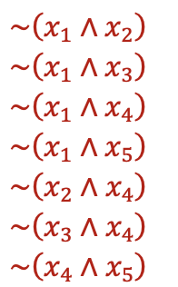
Question 4
(b) Write down the independent set constraints for the following graph in propositional logic. We assume that all independent sets have at most two vertices.
1
2
3
4
5

Slide 17

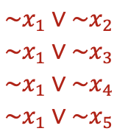
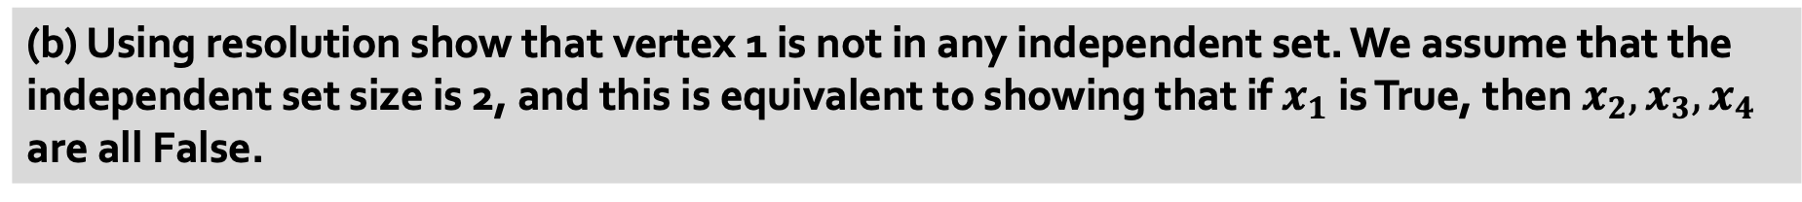
Question 4
(b) Using resolution show that vertex 1 is not in any independent set. We assume that the independent set size is 2, and this is equivalent to showing that if $x_{1}$ is True, then $x_{2},x_{3},x_{4}$ are all False.

Slide 18
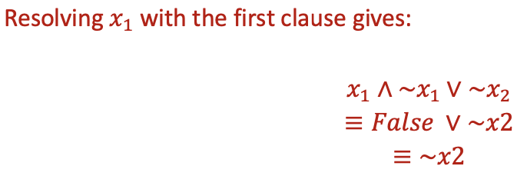
Question 4
(b) Using resolution show that vertex 1 is not in any independent set. We assume that the independent set size is 2, and this is equivalent to showing that if $x_{1}$ is True, then $x_{2},x_{3},x_{4}$ are all False.

Slide 19
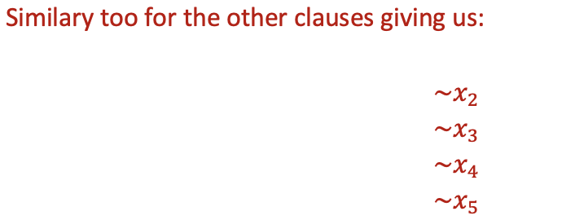
Question 4
(b) Using resolution show that vertex 1 is not in any independent set. We assume that the independent set size is 2, and this is equivalent to showing that if $x_{1}$ is True, then $x_{2},x_{3},x_{4}$ are all False.

Slide 20
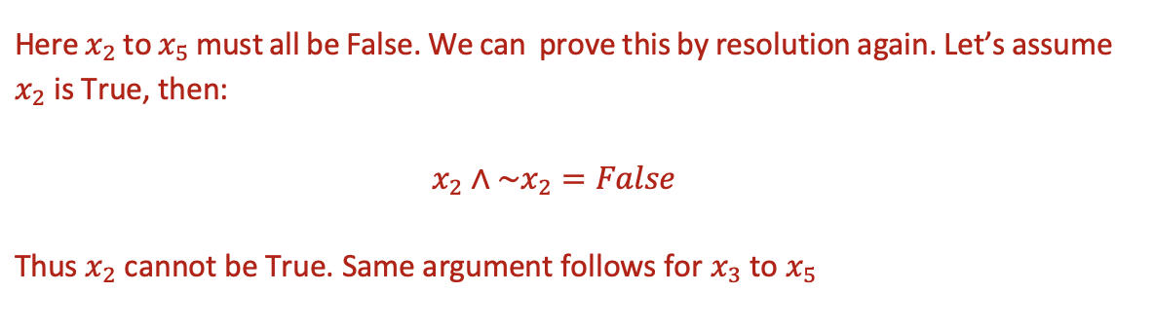
Question 4
(b) Using resolution show that vertex 1 is not in any independent set. We assume that the independent set size is 2, and this is equivalent to showing that if $x_{1}$ is True, then $x_{2},x_{3},x_{4}$ are all False.

Slide 21
THE END

