Slide 1
IT5005
Tutorial #5
Informed and Adversarial Search

Slide 2
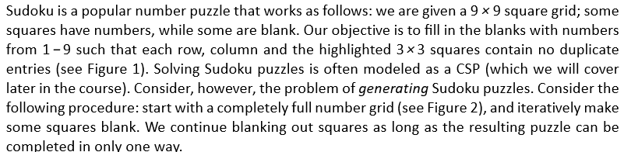
Question 1
(a) Give the representation of a state in this problem

Slide 3
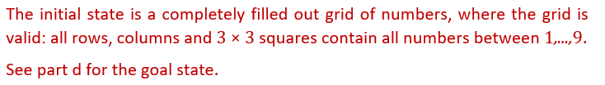
Question 1
(b) Using the state representation deﬁned above, specify the initial state and goal state.

Slide 4
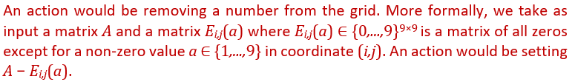
Question 1
(c) Deﬁne its actions; and

Slide 5
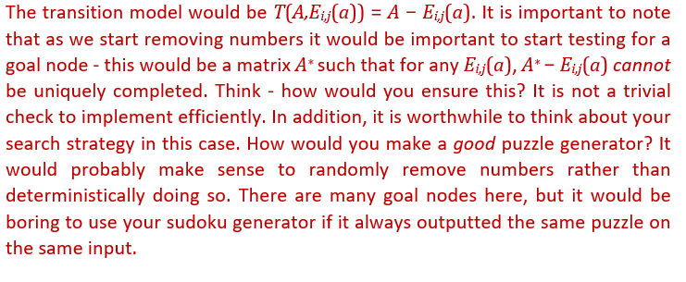
Question 1
(d) Using the state representation and actions deﬁned above, specify the transition model/functionT (i.e., when each of the actions deﬁned above is applied to a current state, what is the resulting next state?).

Slide 6
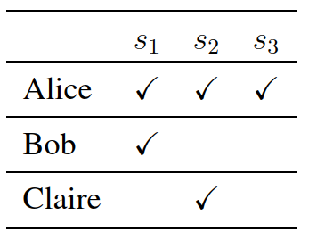
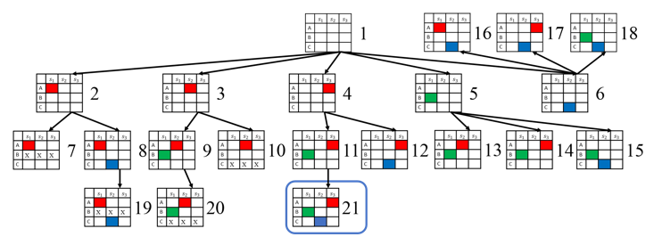
Question 2
(a) Give a trace of the BFS algorithm in the style of Figure 3. That is, show the search tree at each stage (all repeated states are eliminated).

Slide 7
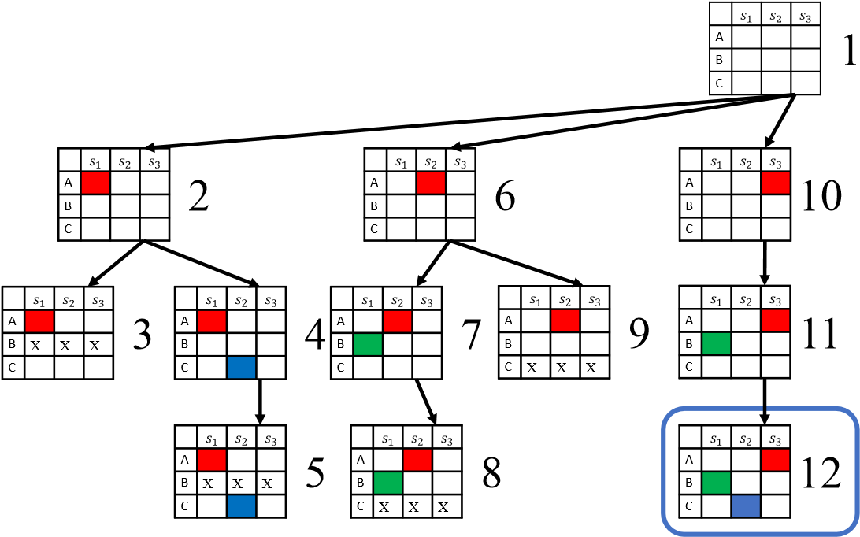
Question 2
(b) Give a similar trace of the DFS search algorithm.

Slide 8
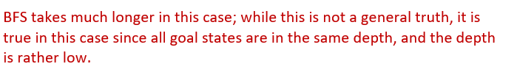
Question 2
(c) Which of these two search algorithms is better for this problem? Why? Is one search strategy always better than the other in general?

Slide 9
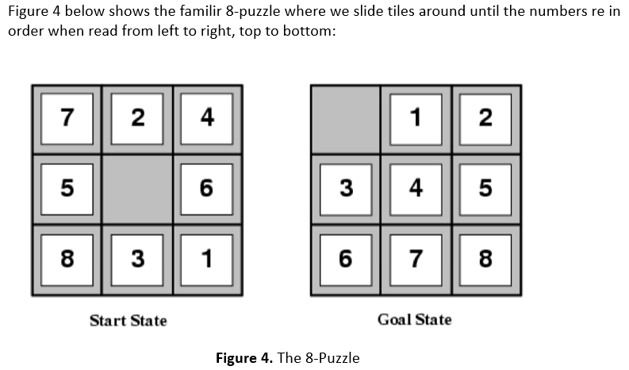
Question 3

Slide 10
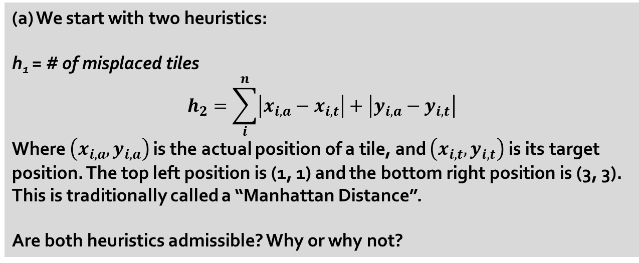
Question 3
(a) We start with two heuristics:
h₁ = # of misplaced tiles
$$h_{2}=\sum_{i}^{n}{\left|x_{i,a}−x_{i,t}\right|}+\left|y_{i,a}−y_{i,t}\right|$$
Where $\left(x_{i,a},y_{i,a}\right)$ is the actual position of a tile, and $\left(x_{i,t},y_{i,t}\right)$ is its target position. The top left position is (1, 1) and the bottom right position is (3, 3). This is traditionally called a “Manhattan Distance”.
Are both heuristics admissible? Why or why not?

Slide 11
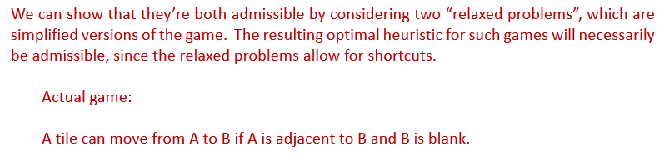
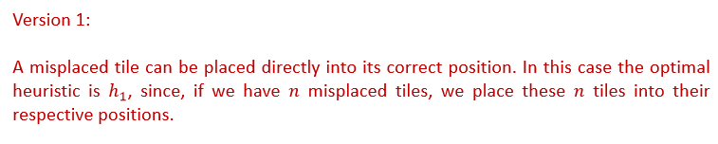
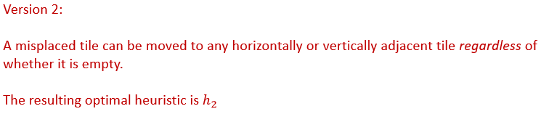
Question 3

Slide 12
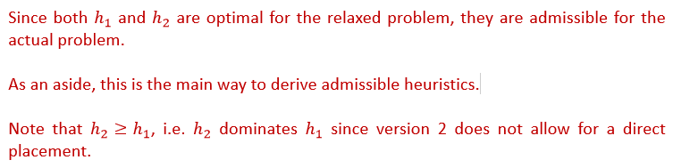
Question 3

Slide 13
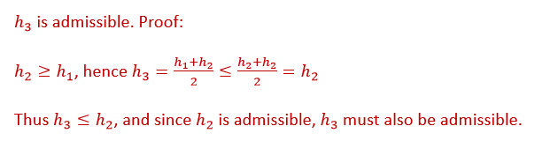
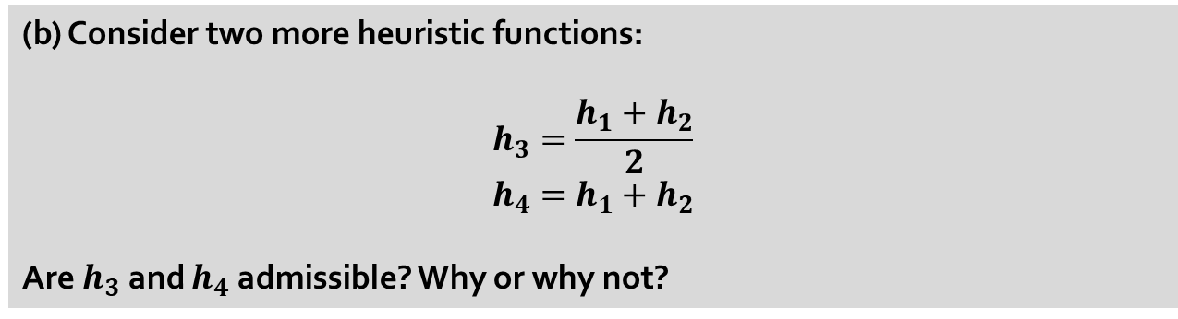
Question 3
(b) Consider two more heuristic functions:
$$h_{3}=\frac{h_{1}+h_{2}}{2}$$
$$h_{4}=h_{1}+h_{2}$$
Are $h_{3}$ and $h_{4}$ admissible? Why or why not?

Slide 14
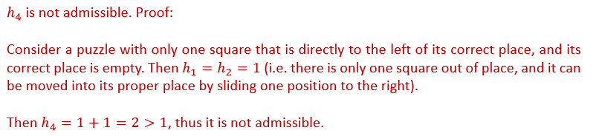
Question 3
(b) Consider two more heuristic functions:
$$h_{3}=\frac{h_{1}+h_{2}}{2}$$
$$h_{4}=h_{1}+h_{2}$$
Are $h_{3}$ and $h_{4}$ admissible? Why or why not?

Slide 15
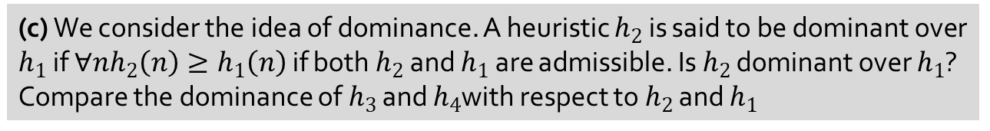
Question 3
(c) We consider the idea of dominance. A heuristic $h_{2}$ is said to be dominant over $h_{1}$ if $∀nh_{2}\left(n\right)≥h_{1}\left(n\right)$ if both $h_{2}$ and $h_{1}$ are admissible. Is $h_{2}$ dominant over $h_{1}$? Compare the dominance of $h_{3}$ and $h_{4}$with respect to $h_{2}$ and $h_{1}$

Slide 16
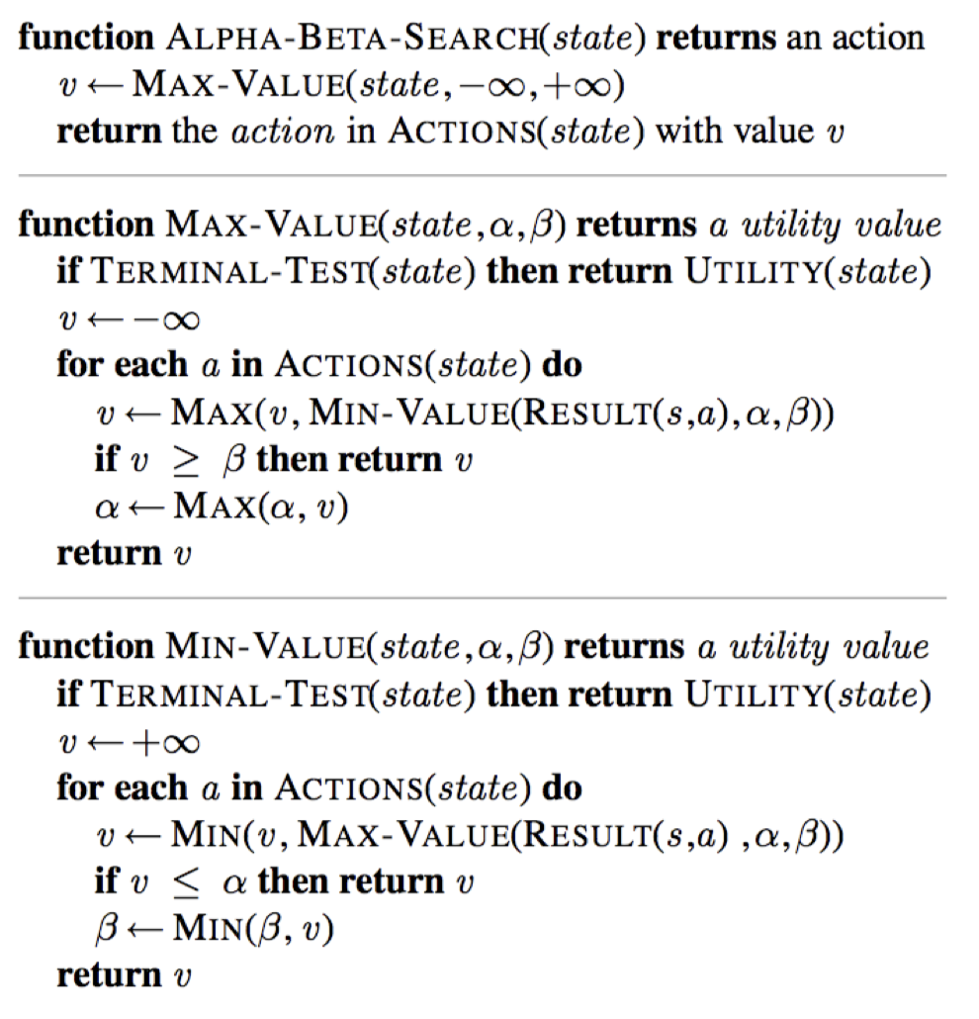
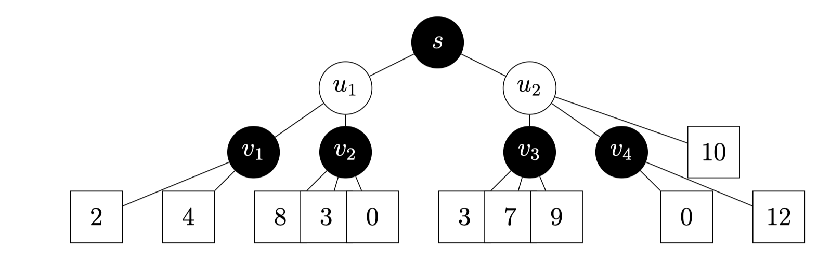
Question 4

Slide 17
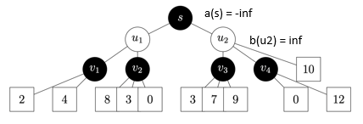
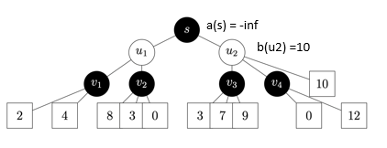
Question 4
(a) Assume that we iterate over nodes from right to left; mark with an ‘X’ all ARCS that are pruned by α-β pruning, if any

Slide 18
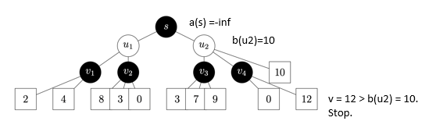
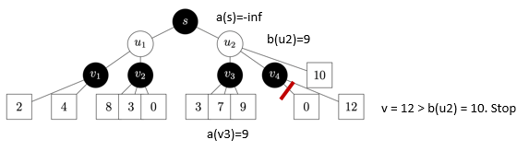
Question 4
(a) Assume that we iterate over nodes from right to left; mark with an ‘X’ all ARCS that are pruned by α-β pruning, if any

Slide 19
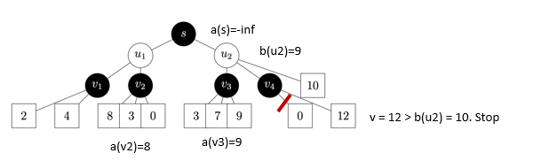
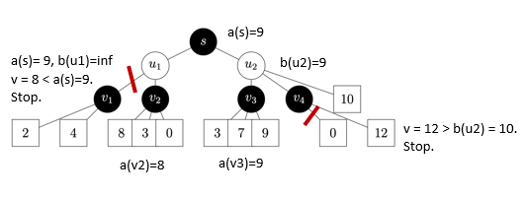
Question 4
(a) Assume that we iterate over nodes from right to left; mark with an ‘X’ all ARCS that are pruned by α-β pruning, if any

Slide 20
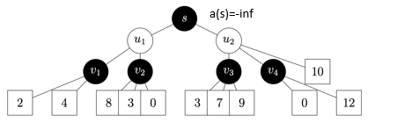
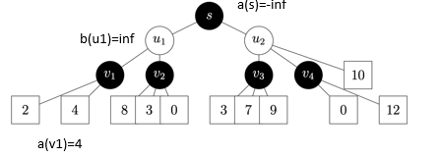
Question 4
(b) Does you answer change if we iterate over nodes from left to right?

Slide 21
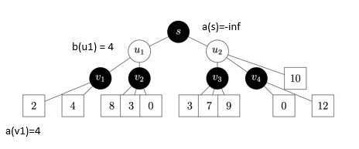
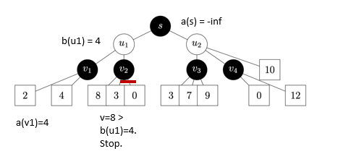
Question 4
(b) Does you answer change if we iterate over nodes from left to right?

Slide 22
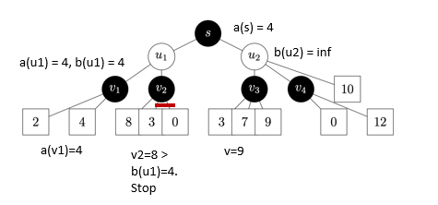
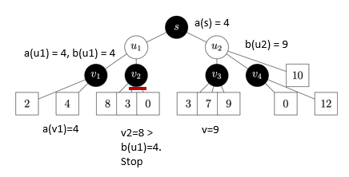
Question 4
(b) Does you answer change if we iterate over nodes from left to right?

Slide 23
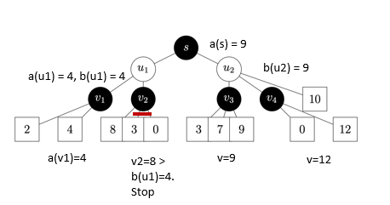
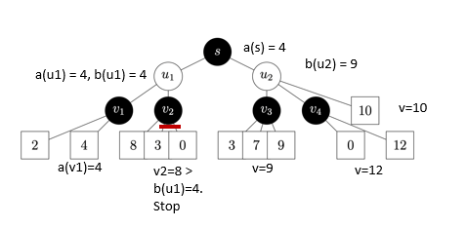
Question 4
(b) Does you answer change if we iterate over nodes from left to right?

Slide 24
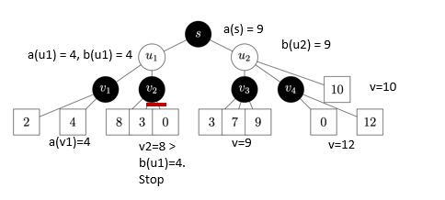
Question 4
(b) Does you answer change if we iterate over nodes from left to right?

Slide 25
THE END

