Slide 1
IT5005
Tutorial #6
Adversarial Search, Neural Networks

Slide 2
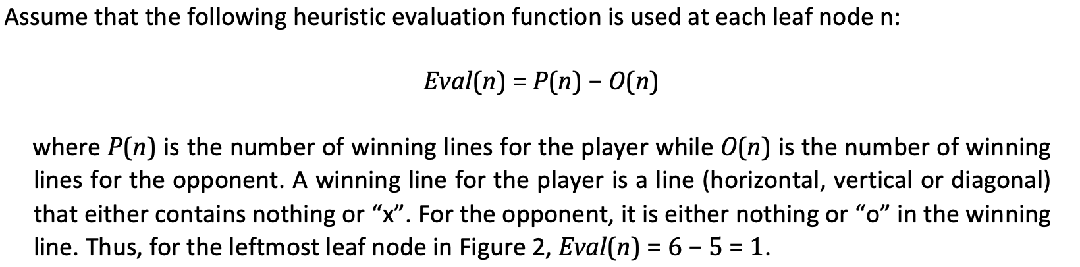
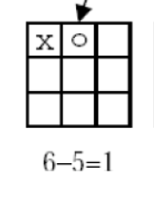
Question 1

Slide 3
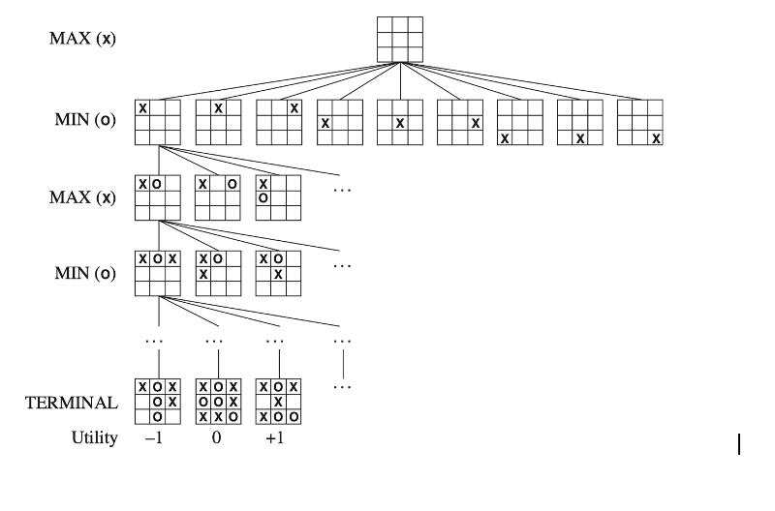
Question 1

Slide 4
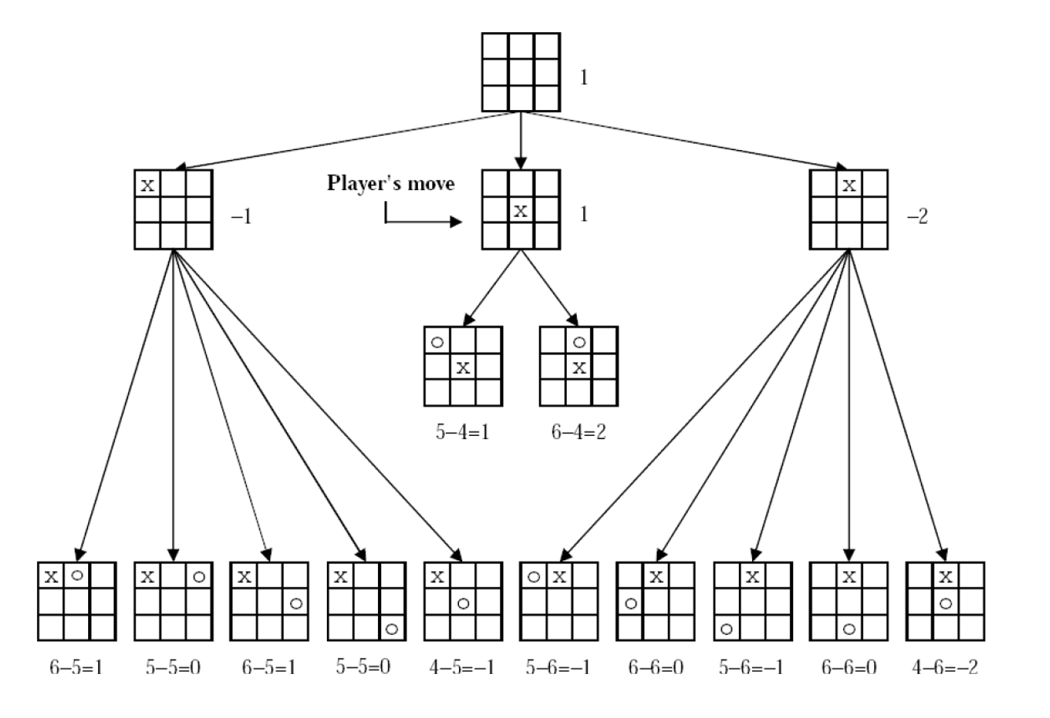
Question 1
(a)
Use the minimax algorithm to determine the first move of the player, searching 2-ply deep search space shown in Figure 2.

Slide 5
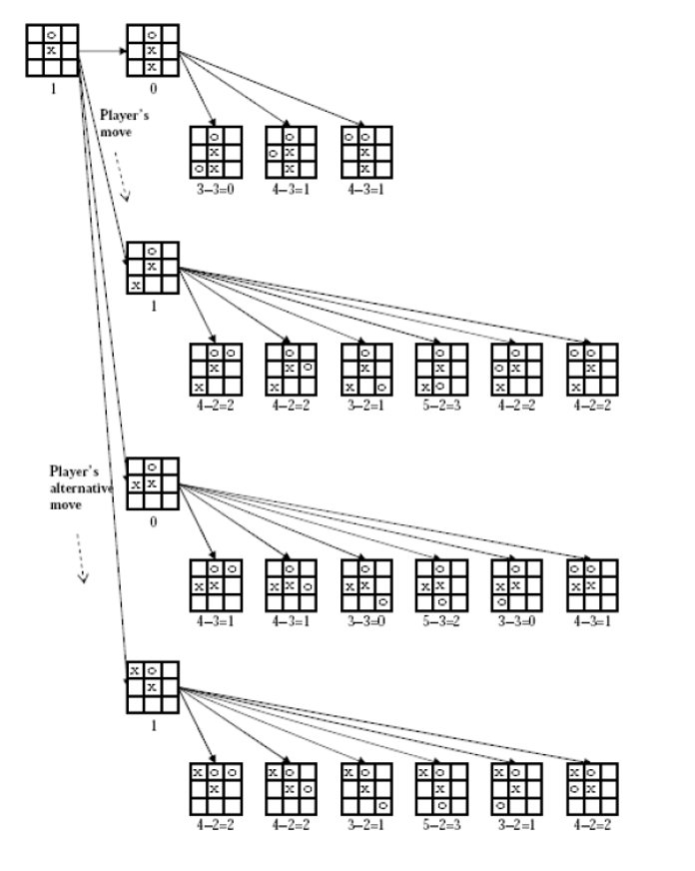
Question 1
(b)
Assume that the “x” player will now make his second move after his opponent has placed an “o”. Complete the following minimax tree in Figure 3 by filling the remaining blank boards at the leaf nodes. Compute the evaluation function for each of the filled leaf nodes and determine the second move of the “x” player (searching 2-ply deep).

Slide 6
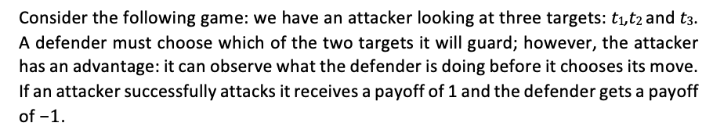
Question 2

Slide 7
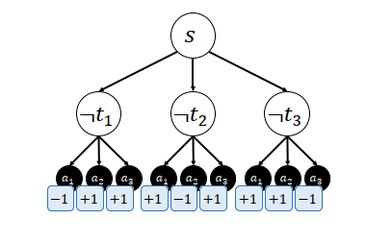
Question 2
(a)
Model this problem as a minimax search problem. Draw out the search tree. What is the defender’s payoff in this game?

Slide 8
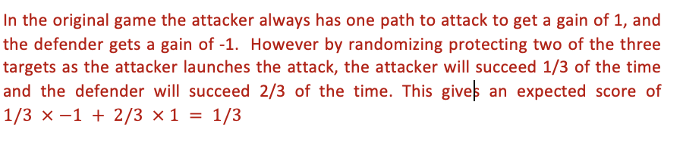
Question 2
(b)
Can the defender do better by randomizing? What is the defender’s optimal strategy? Prove your claim.

Slide 9
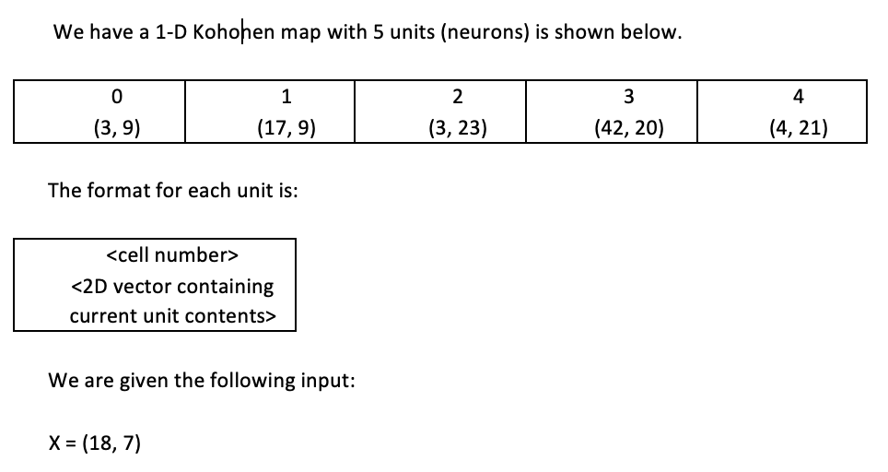
Question 3

Slide 10
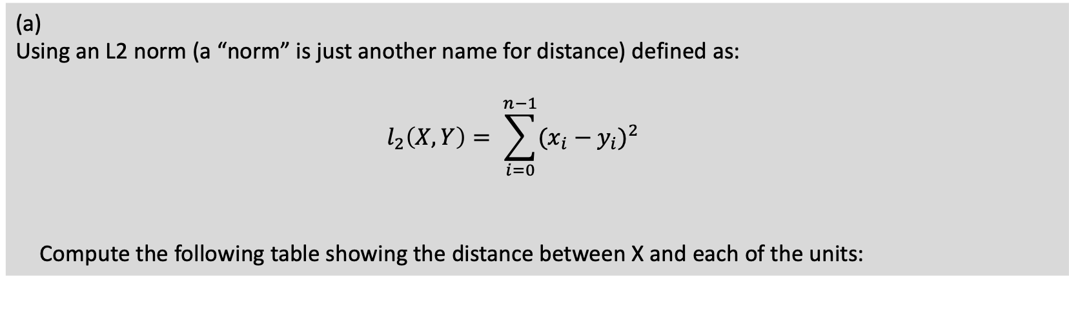
Question 3
(a)
Using an L2 norm (a “norm” is just another name for distance) defined as:
$$l_{2}\left(X, Y\right)= \sum_{i=0}^{n−1}{{(x_{i}−y_{i})}^{2}}$$
Compute the following table showing the distance between X and each of the units:

Slide 11
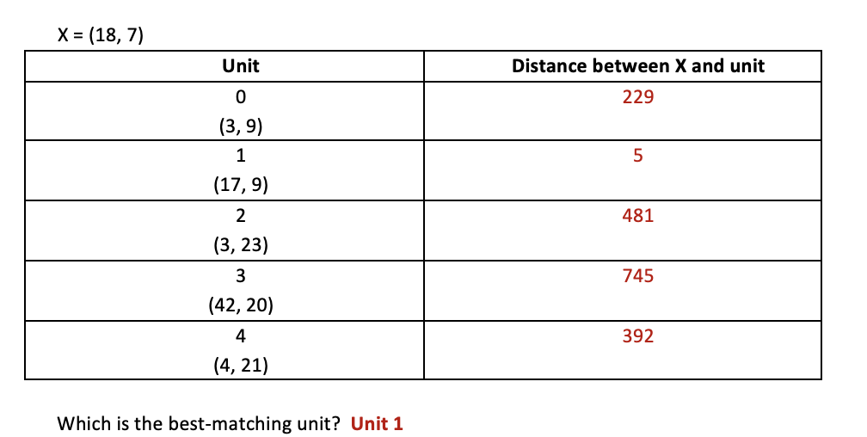
Question 3

Slide 12
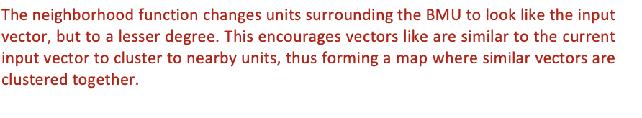
Question 3
(b)
Explain the purpose of the neighborhood function in Kohonen maps.

Slide 13
Question 3
(b)
We have the following neighborhood function:
Using a training rate α = 0.7, update the Kohonen map based on your results in part a. Write out the new map below

Slide 14
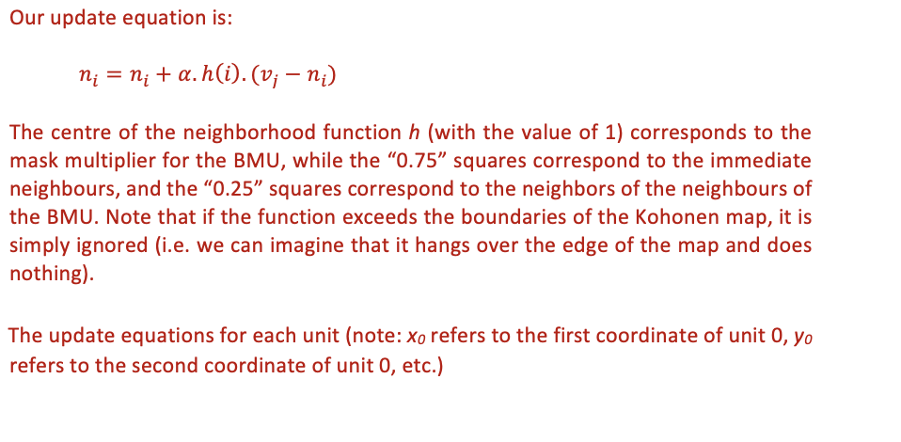
Question 3

Slide 15
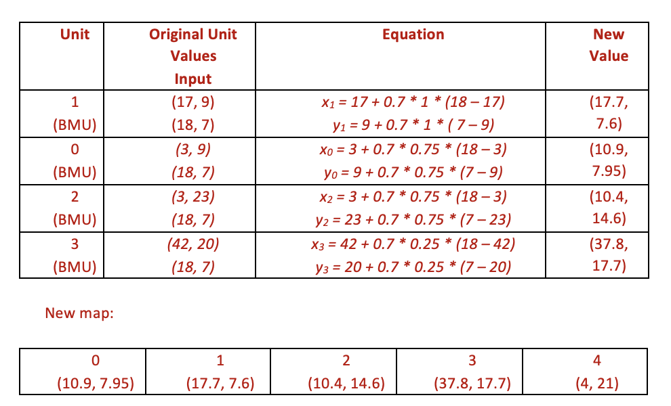
Question 3

Slide 16
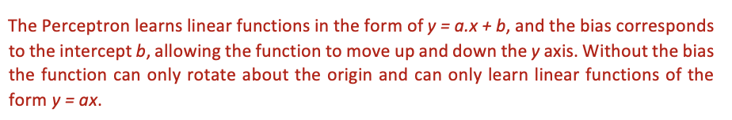
Question 4
(a)
What is the purpose of the bias in Perceptrons? Show, using a suitable example, the importance if this bias.

Slide 17
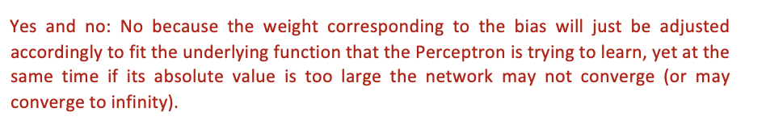
Question 4
(b)
Does the value of the bias matter? Why or why not?

Slide 18
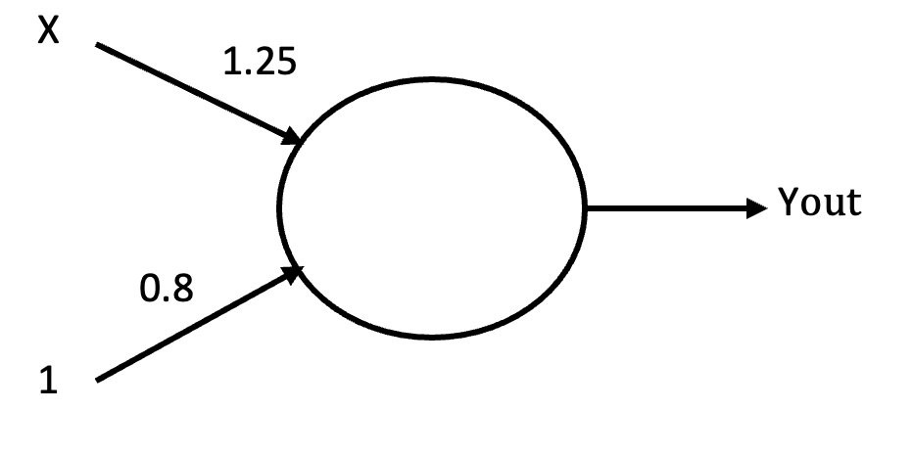
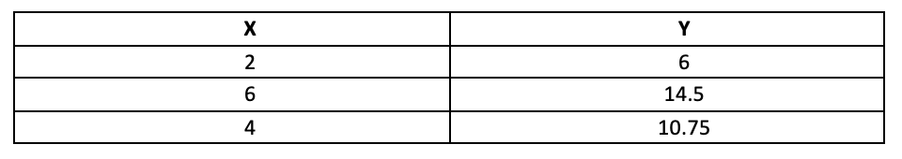
Question 4
(c)
We have a 1-input Perceptron shown below, with a bias input of 1:
Given the following data to be learnt:
Complete the following table:
s

Slide 19
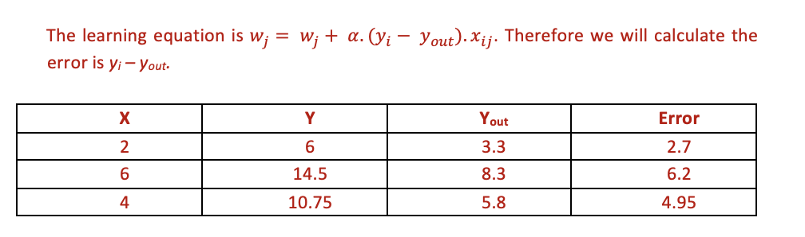
Question 4

Slide 20
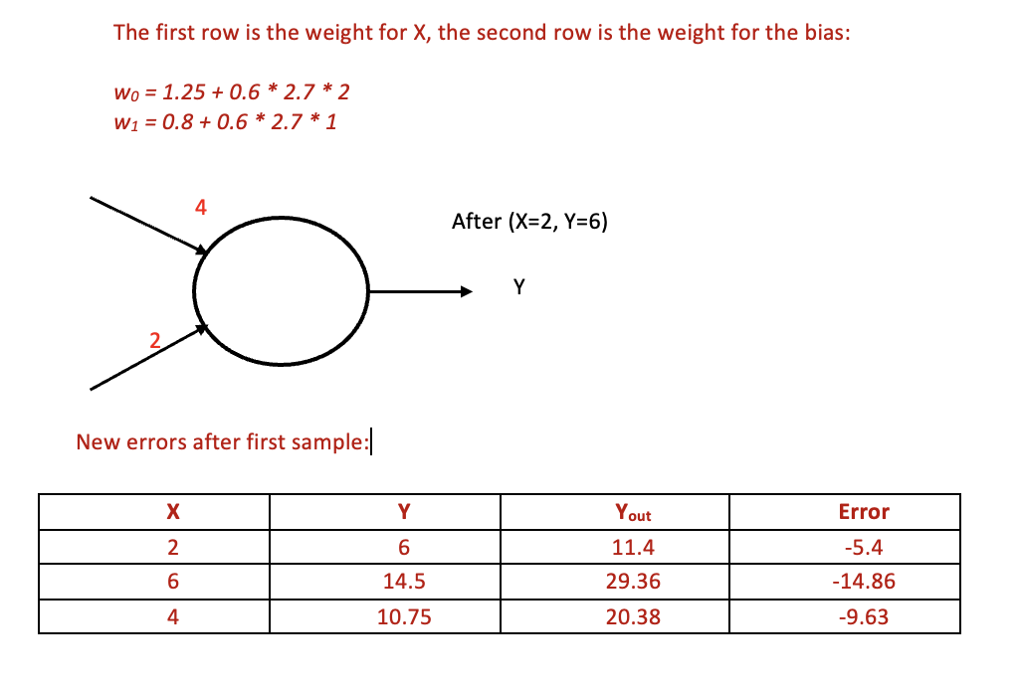
Question 4
(d)
Using the results in part c., apply the Perceptron learning law to update the weights, using a learning rate of α = 0.6. Write the new weights on the diagrams below:

Slide 21
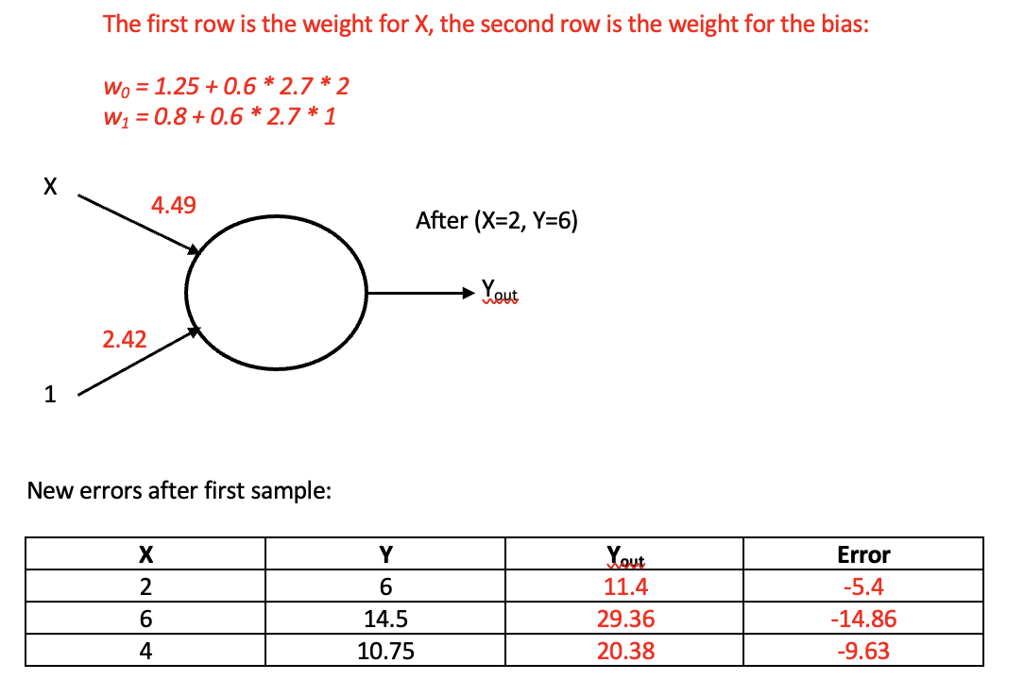
Question 4

Slide 22
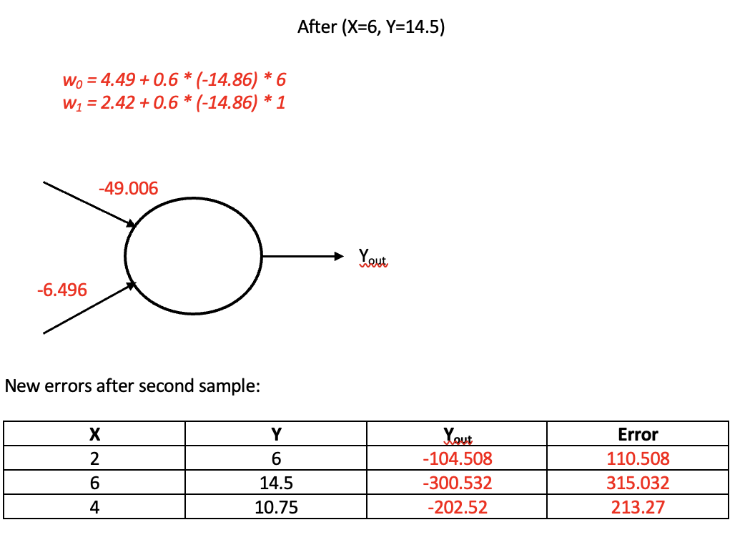
Question 4

Slide 23
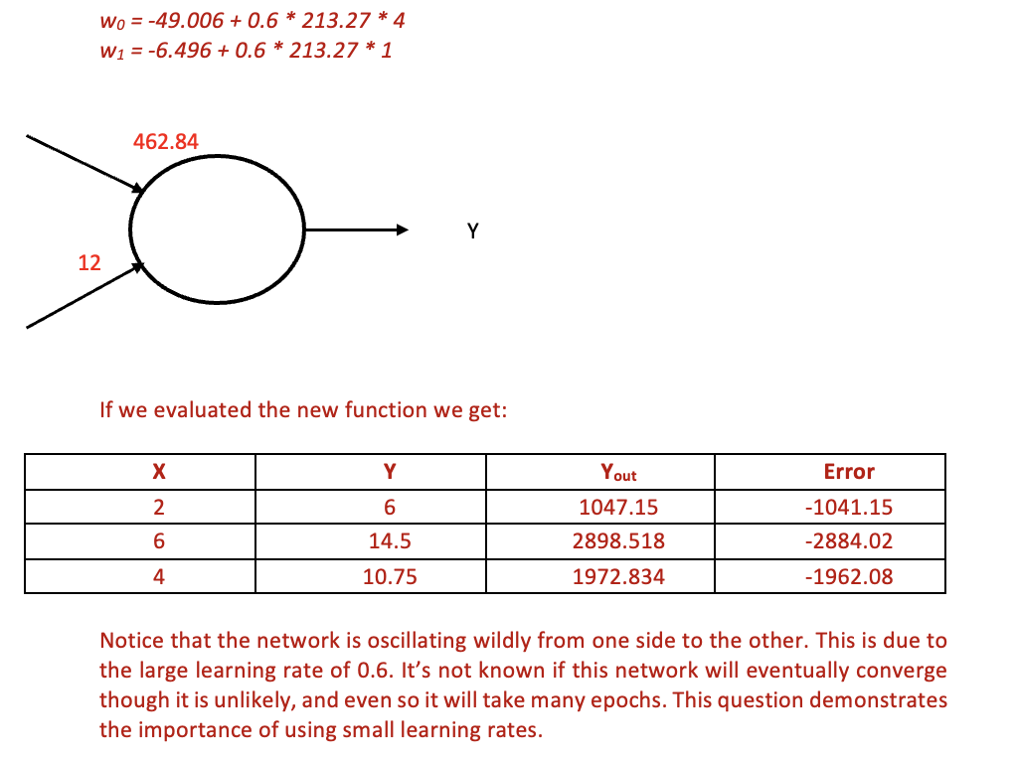
Question 4

Slide 24
THE END

