Slide 1
Enhancing Data and Algorithm
in Offline Reinforcement Learning
Project Report of the course ‘Deep Reinforcement Learning’
Tonghe Zhang, Yucheng Pan, Yulong Xia, Wei Zhang
June 11, 2024
Department of Electronic Engineering, Department of Computer Science and Technology, Department of Physics, Tsinghua University

Slide 2
Contents
Literature Review
Our Idea
Preliminary Experiments
Improvements
Future Work

Slide 3
Literature Review
Offline RL algorithm
BCQ
CQL
IQL
SAC-N
Dataset trimming strategy
DiffStitch
Exploration by RND
Survival Instinct
Synthetic trajectories with Diffusion models
Synthetic Experience Replay (SER)
Generative Trajectory Augmentation (GTA)
Policy-Guided Diffusion (PGD)
Literature
Our Idea
Design
Results
Future Work

Slide 4
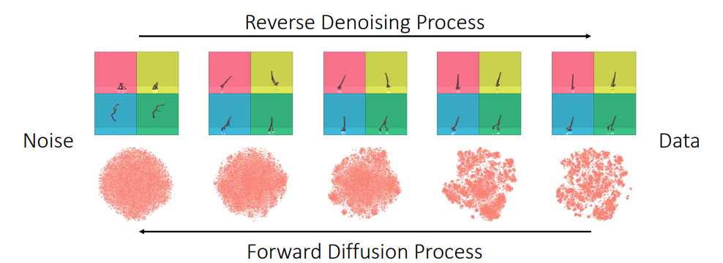
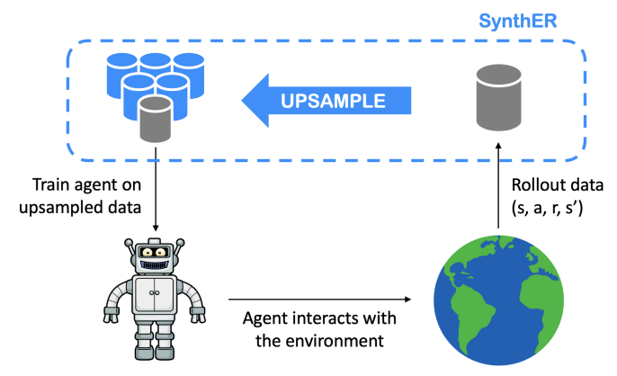
Literature Review—Diffusion
SER
Unconditionally generate synthetic experiences and upsample data for training.
Improves the performance on small datasets and enhances the transferability of networks.
Literature
Our Idea
Design
Results
Future Work

Slide 5
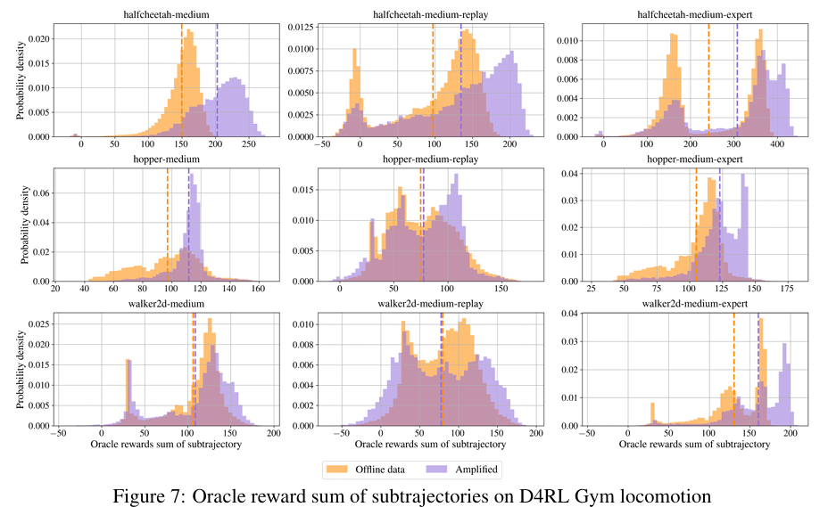


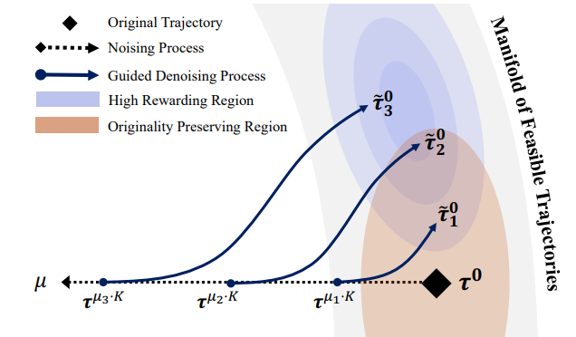
Literature Review—Diffusion
GTA
Partially noises original trajectories.
Denoising: classifier-free guidance via conditioning on amplified return value with diffusion.
Enhances the performance of widely used offline RL algorithms in both dense and sparse reward settings, and improves the quality of the data.
Literature
Our Idea
Design
Results
Future Work

Slide 6
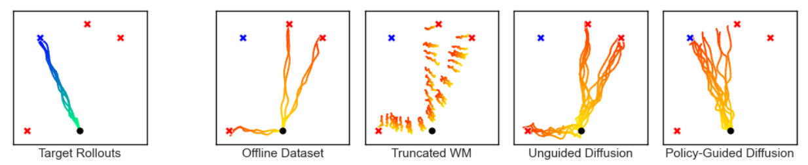
Literature Review—Diffusion
PGD
Inspired by classifier-guided diffusion, applies guidance from the target policy to generate synthetic trajectories that are
(a.) more representative of the target policy, while
(b.) do not diverge too far from the behavior policy.
Addresses the issue of distribution shift between the target and behavior policies
More controllable generation;
Enables the development of less conservative algorithms for offline RL.
Literature
Our Idea
Design
Results
Future Work

Slide 7
Our Idea
Survival Instinct tells us offline RL is not sensitive to the manipulation of reward signal.
Diffusion model can be used to generate high-quality trajectories.(DiffStitch)
Diversity of diffusion models can enhance the generalization of offline RL.(SER)
(function approximation error)
Literature
Our Idea
Design
Results
Future Work

Slide 8
Our Idea
We build upon GTA(Generative Trajectory Augmentation) to
augment the dataset with high return trajectories.
However, using synthetic data harms fidelity, compared with solely relying on original data.
Our approach: use the mixture of synthetic and original dataset
Different from GTA.
To further enhance the fidelity of the synthetic data, we suggest to do the following
train a forward dynamics model to filter and trim the generated dataset.
Train an ensemble diffusion models to get more accurate trajectories, and use the model uncertainty to perform importance sampling.
Literature
Our Idea
Design
Results
Future Work

Slide 9
Design
Baseline
Run CQL, BCQ, IQL with 0%, 10%, 20%, 30%, 40% and 50% trim respectively.
Run EDAC with no trim.
Advanced
Generate high-return pseudo trajectories with conditional diffusion model, and rerun baseline with the generated dataset with no trim. (Following GTA)
Learn the policy with the mixture of the generated dataset and the original dataset. (Running currently)
Literature
Our Idea
Design
Results
Future Work

Slide 10
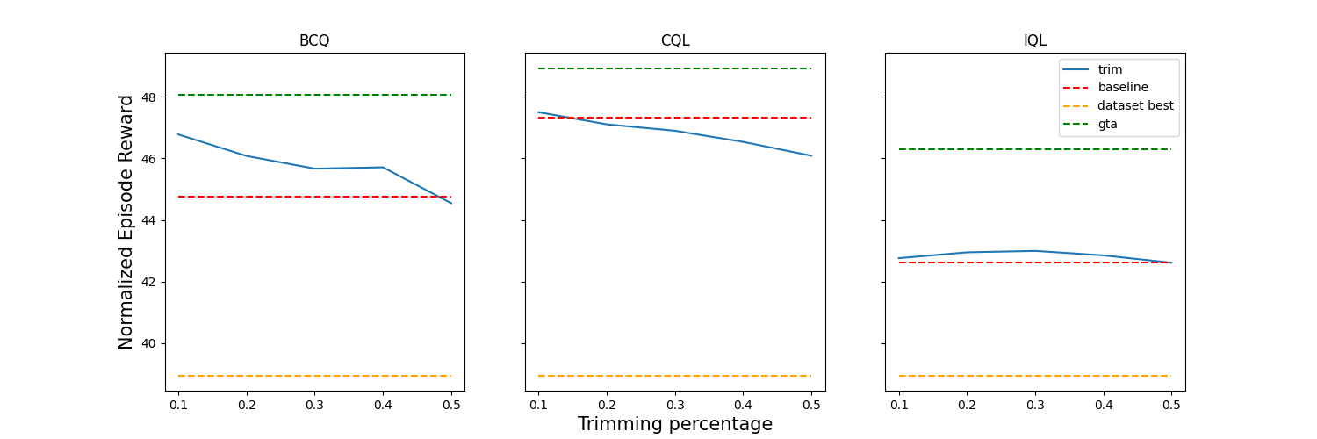
Results—d3rlpy Algorithms
Literature
Our Idea
Design
Results
Future Work

Slide 11
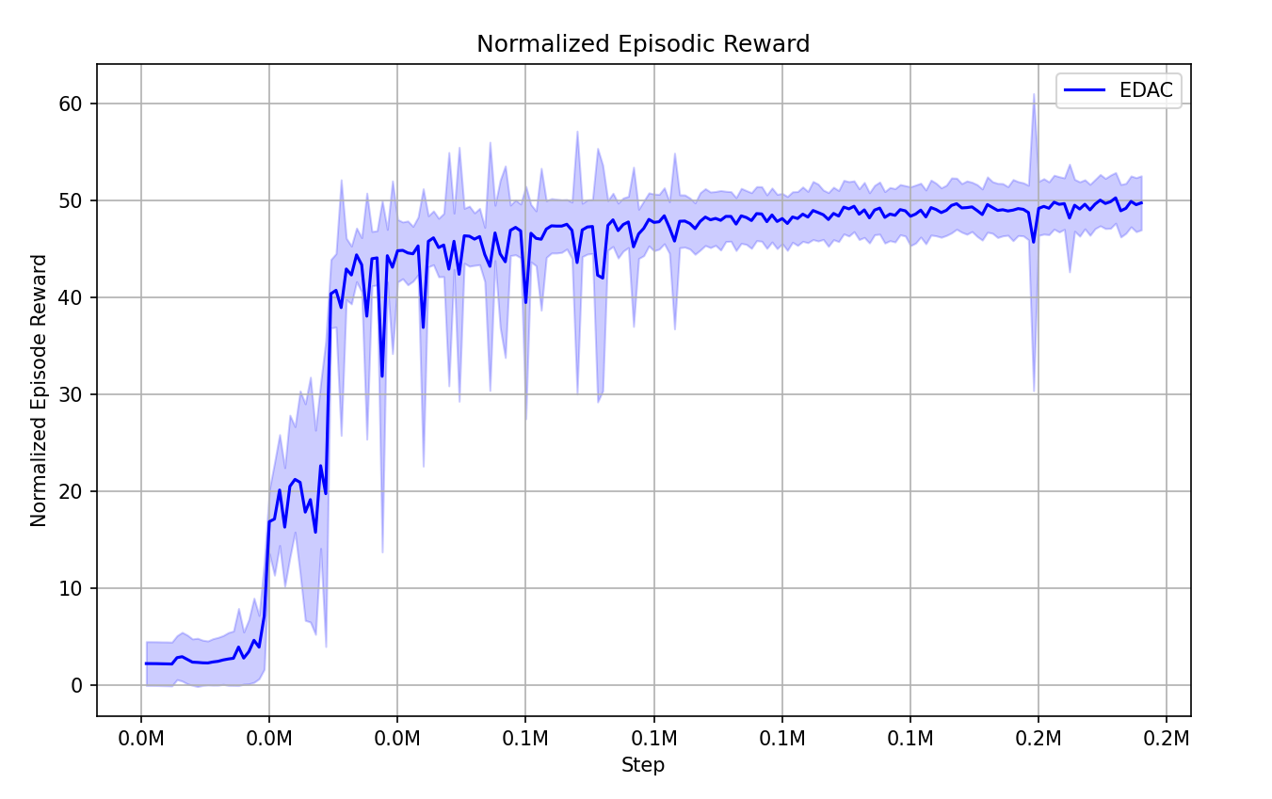
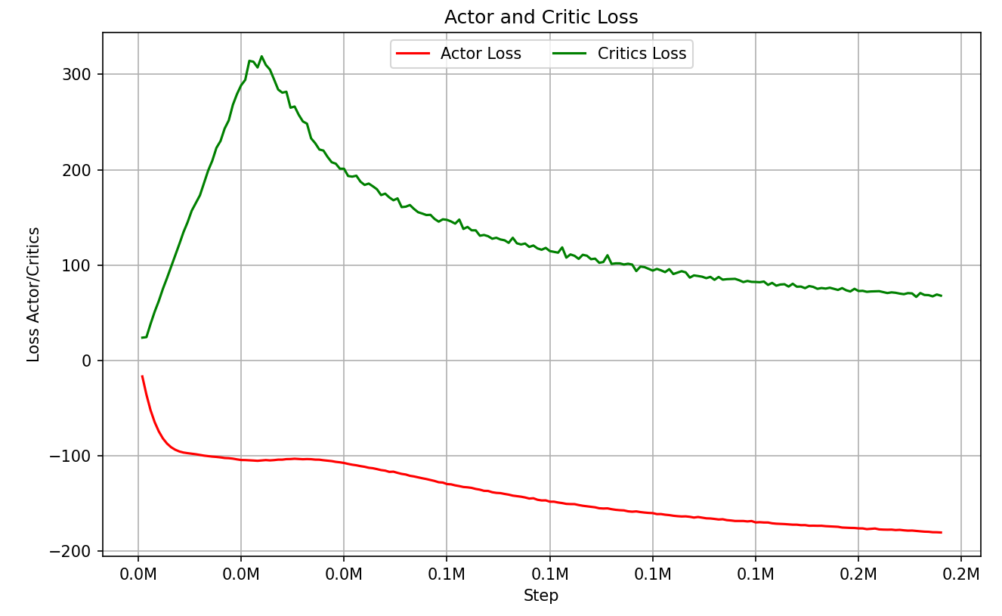
Basic Results—EDAC
EDAC agent trained on the original data set. We can see that the agent learns very fast and the loss curves are smooth.
Literature
Our Idea
Design
Results
Future Work

Slide 12
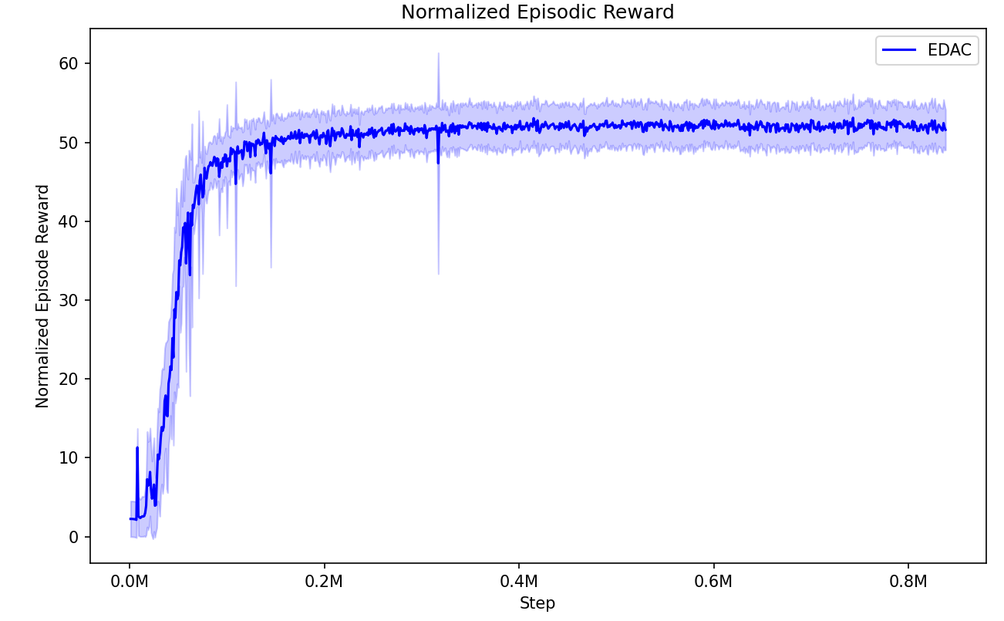
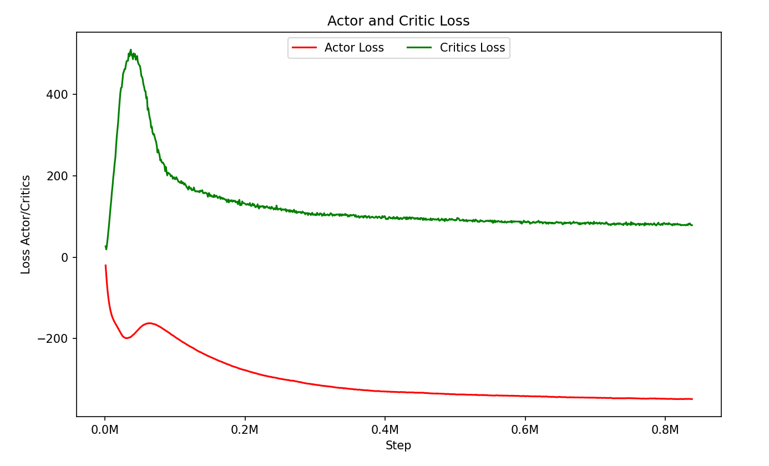
Advanced Results—EDAC
Training an EDAC agent with the untrimmed dataset completely generated by diffusion model. Our experiment shows that the algorithm converges fast and yields normalized regret more than 50, which is greater than the three classical algorithms trained on the same synthetic data.
Literature
Our Idea
Design
Results
Future Work

Slide 13
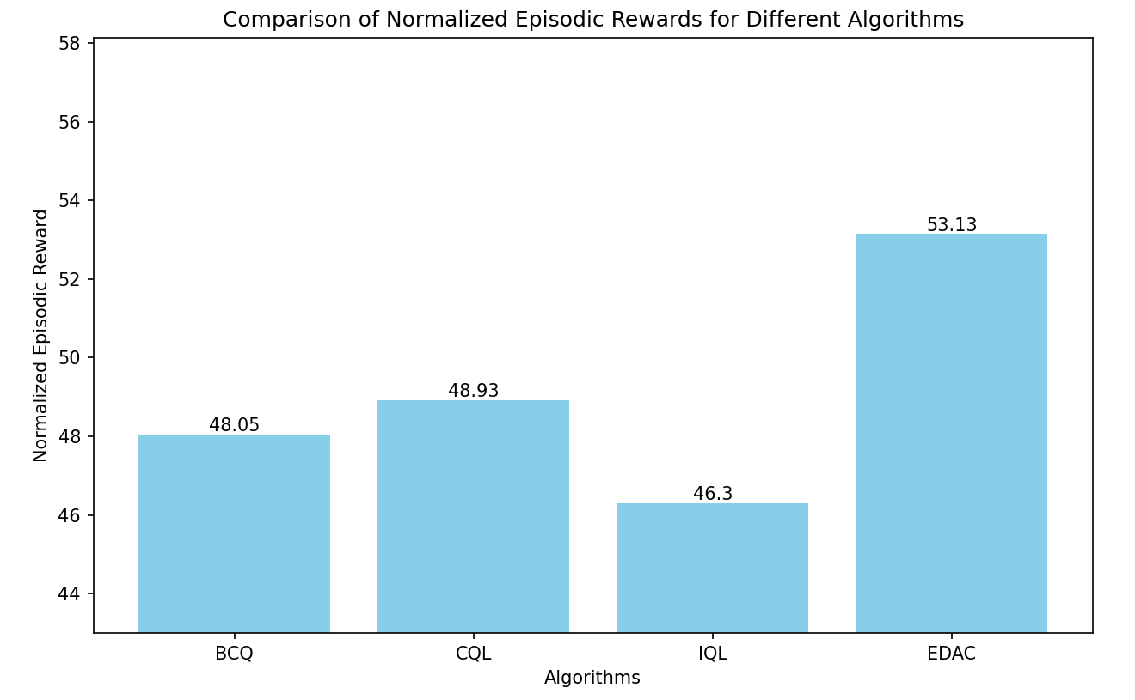
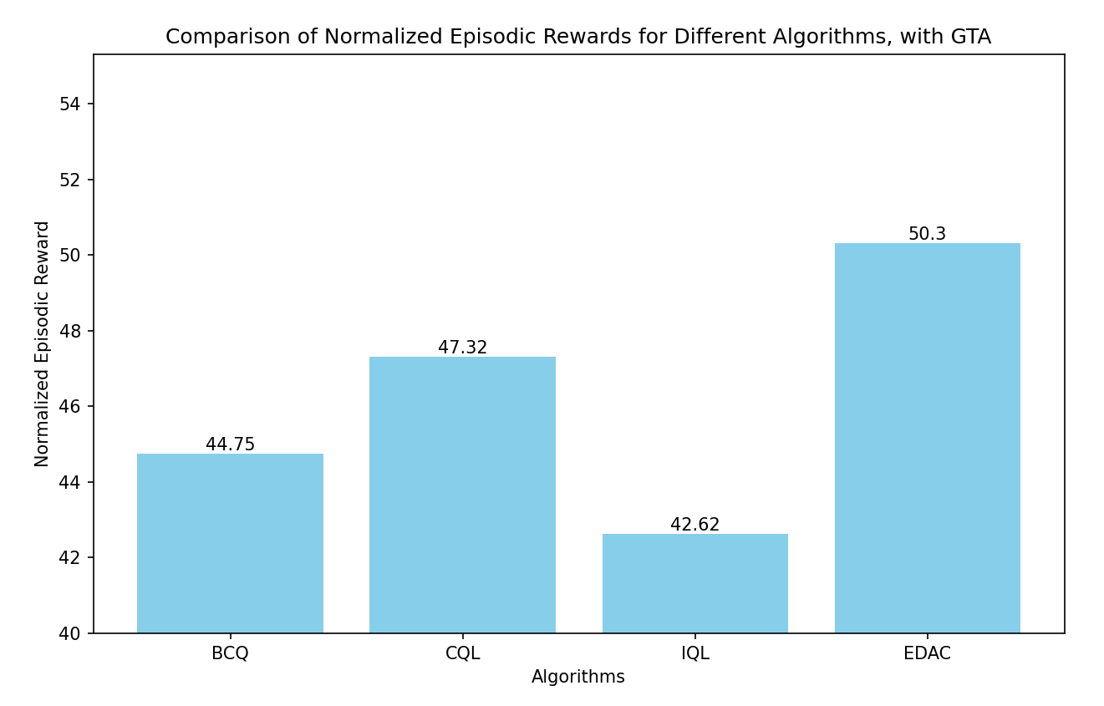
Comparison of various algorithms on synthetic datasets
EDAC wins by a large margin on large synthetic dataset.
BCQ and CQL share similar spirit, while IQL is lower by a large margin.
on the original dataset
on the synthetic dataset
Literature
Our Idea
Design
Results
Future Work

Slide 14
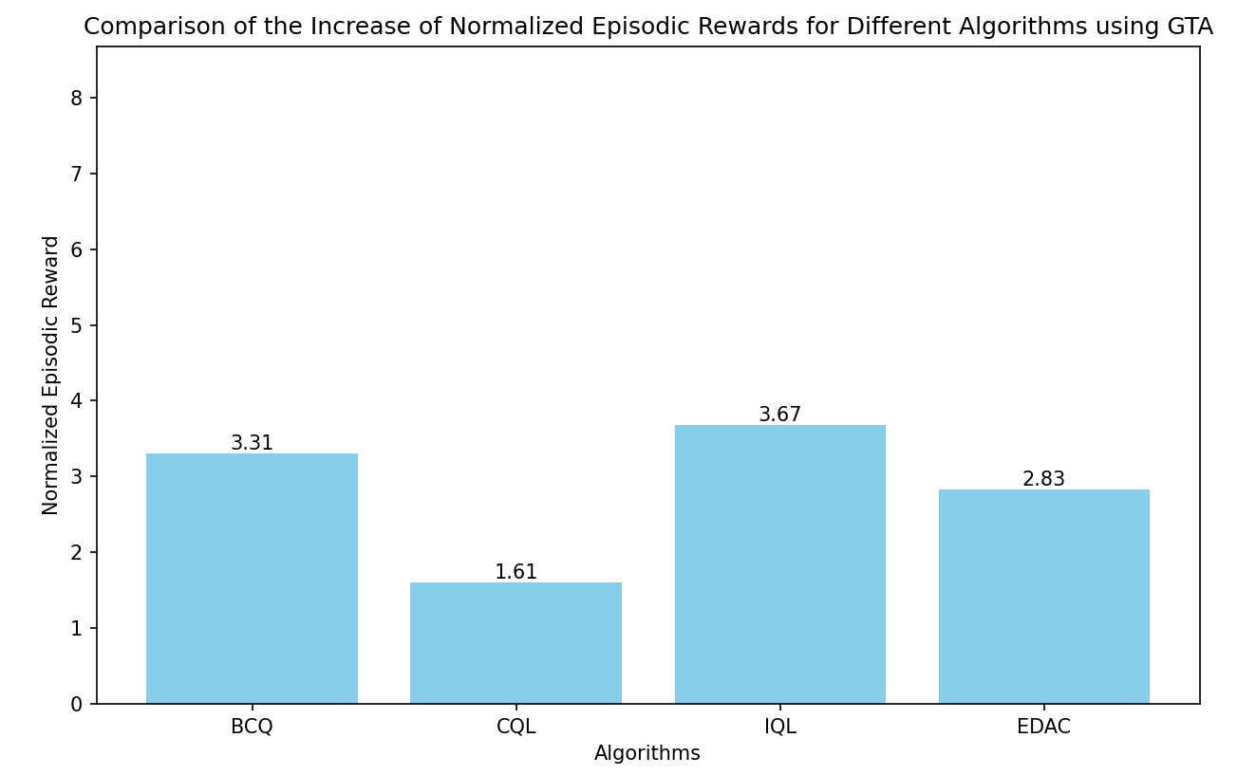
Comparison of various algorithms on synthetic datasets
However, using synthetic data is not the most beneficial configuration for EDAC algorithm.
In fact, IQL is the one mostly benefited from an augmented dataset.
Literature
Our Idea
Design
Results
Future Work

Slide 15
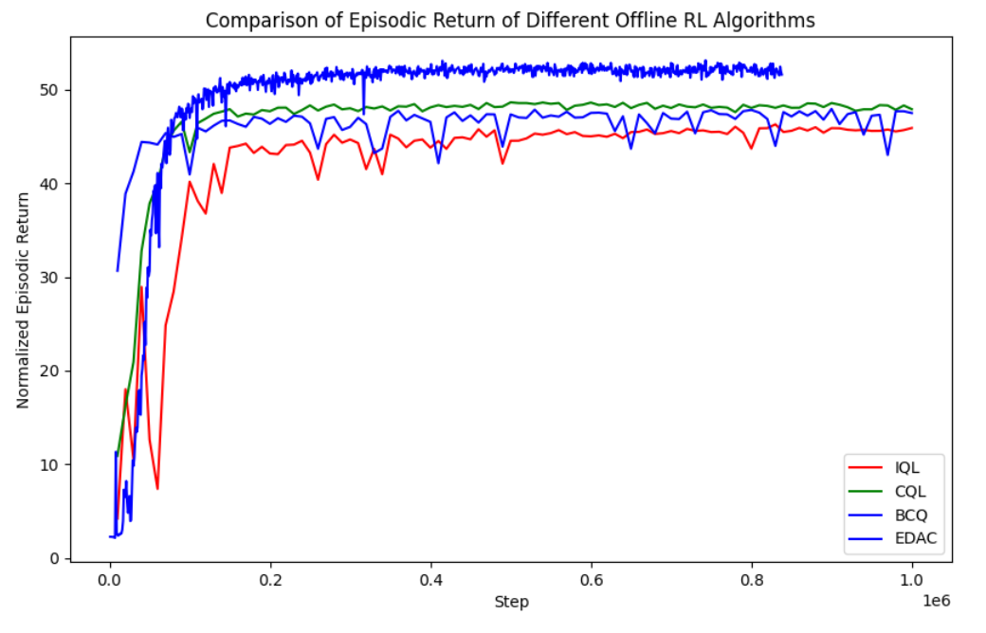
Comparison of various algorithms on synthetic datasets
EDAC converges faster on the large amount of synthetic data than the other three algorithms,
with IQL being the slowest to converge.
Literature
Our Idea
Design
Results
Future Work

Slide 16
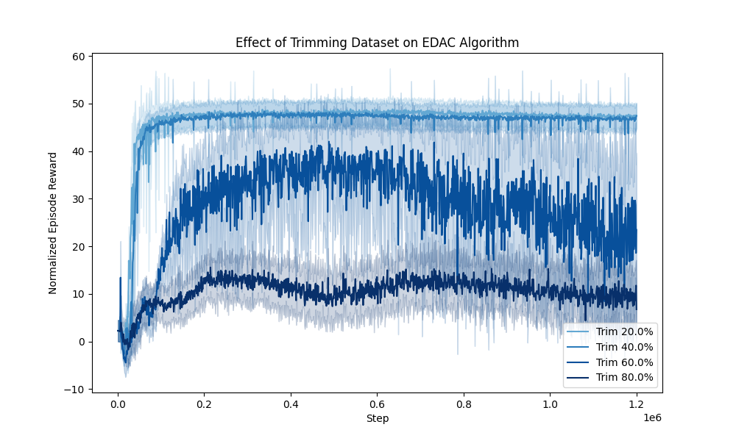
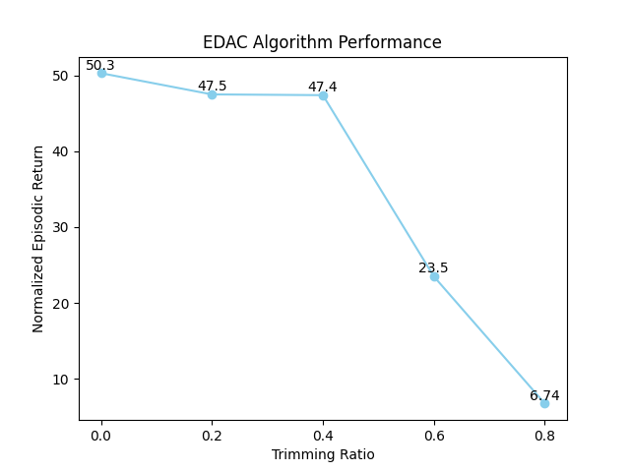
Trimming original dataset deteriorates EDAC’s performance
Literature
Our Idea
Design
Results
Future Work

Slide 17
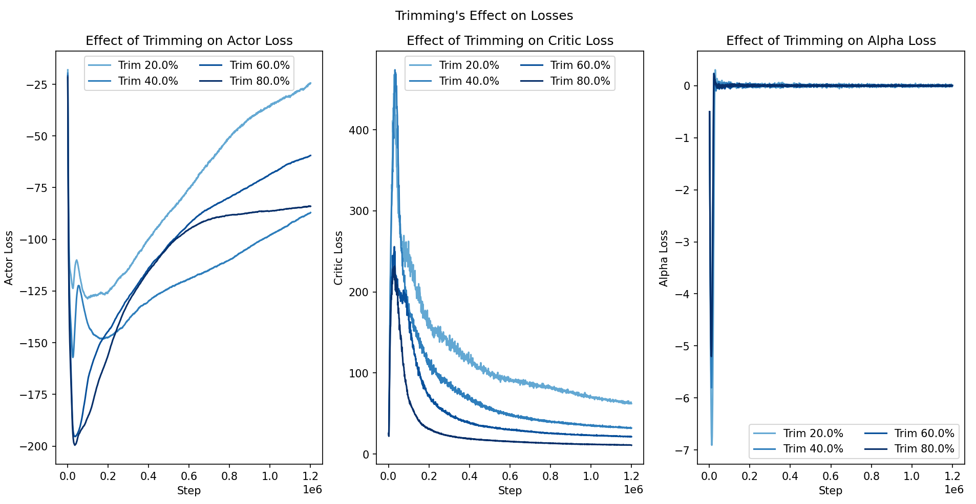
Trimming original dataset deteriorates EDAC’s performance
Literature
Our Idea
Design
Results
Future Work

Slide 18
Trimming original dataset deteriorates EDAC’s performance
EDAC algorithm is highly data-driven in current setup.
Having 10 Q network heads, it possesses large amount of parameters, making it data-hungry.
Small dataset makes it overfit quickly.
Literature
Our Idea
Design
Results
Future Work

Slide 19
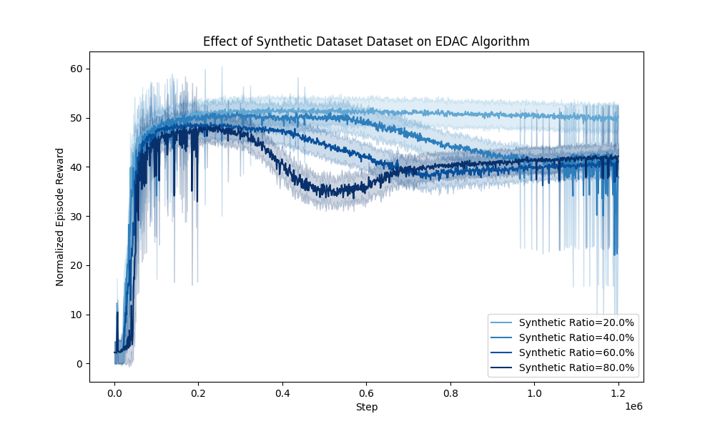
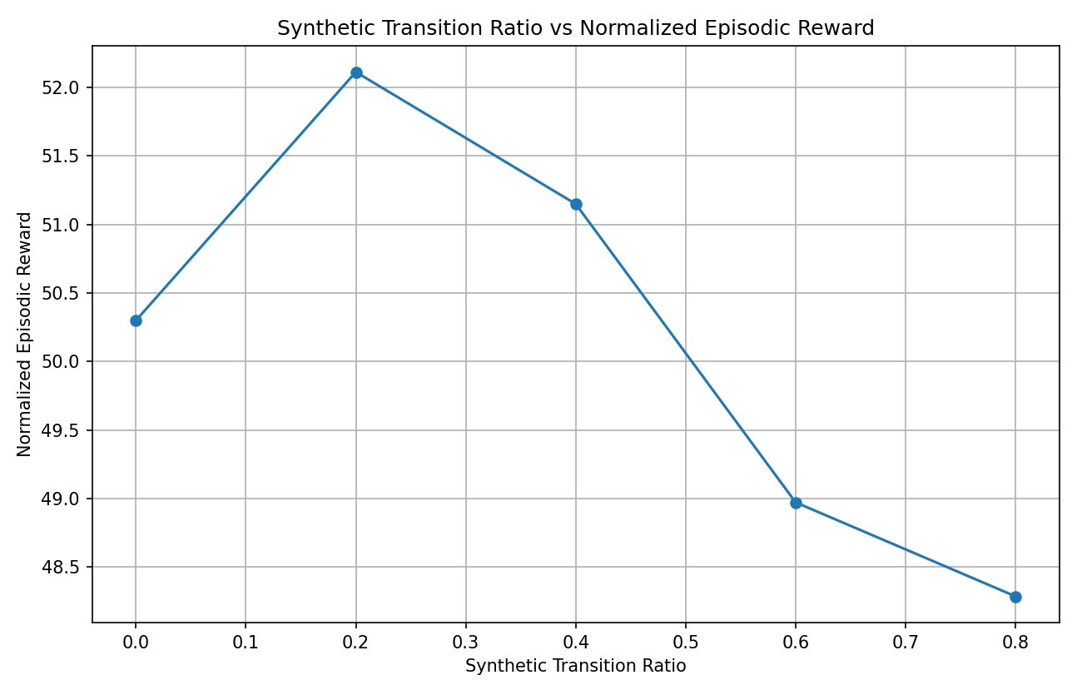
Merging original dataset with synthetic dataset for EDAC
Preliminary Experiment:
Scatter all the episodes from both datasets
Merge the transitions.
Problem: Deteriorates. Better not to merge ?
Trying to solve (still running experiments now):
(a) Hyperparameters.
(b) Merge episodes then cut to transitions.
(c) Random shuffle to prevent distribution shift.
Rethink: GTA. Initial dist != stationary dist ?
Literature
Our Idea
Design
Results
Future Work

Slide 20
Future Work
Data augmentation with model-based method: train a forward dynamics model, and filter the pseudo trajectories.
Ensemble diffusion models and perform importance sampling for pseudo trajectories with weights of uncertainty.
Follow Policy-guided diffusion, try to apply a more controllable diffusion, and see if we can combine methods from RND to boost exploration offline.
Literature
Our Idea
Design
Results
Future Work

Slide 21
Thanks for listening!
References
[1] Guanghe Li, Yixiang Shan, Zhengbang Zhu, Ting Long, and Weinan Zhang. Diffstitch: Boosting offline reinforcement learning with diffusion-based trajectory stitching, 2024.
[2] Cong Lu, Philip J. Ball, Yee Whye Teh, and Jack Parker-Holder. Synthetic experience replay, 2023.
[3] Junjie Zhang, Jiafei Lyu, Xiaoteng Ma, Jiangpeng Yan, Jun Yang, Le Wan, and Xiu Li. Uncertainty-driven trajectory truncation for data augmentation in offline reinforcement learning, 2023.
[4] Lee, Jaewoo, et al. "GTA: Generative Trajectory Augmentation with Guidance for Offline Reinforcement Learning." arXiv preprint arXiv:2405.16907 (2024).

