Slide 1
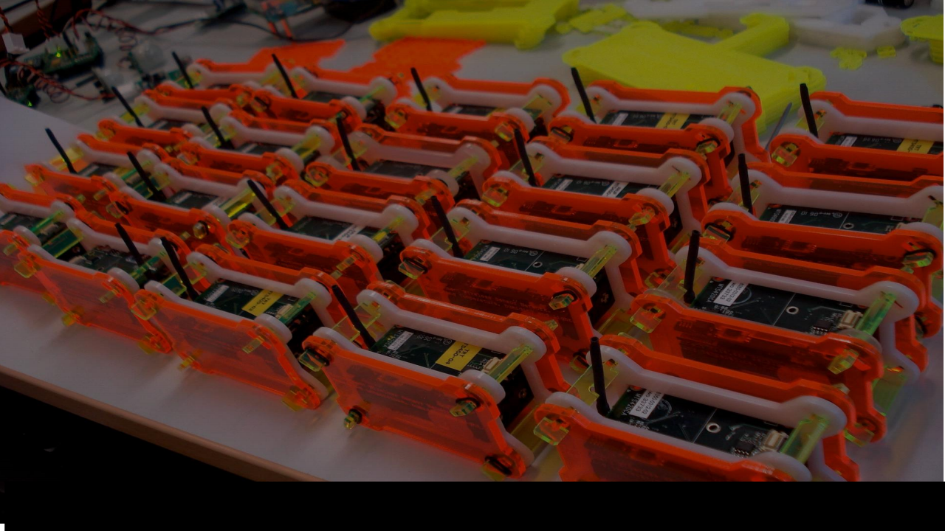



CASA0016: Making, designing & building connected sensor systems
Cat Litter Monitor
Xintong Shao
25124122

Slide 2
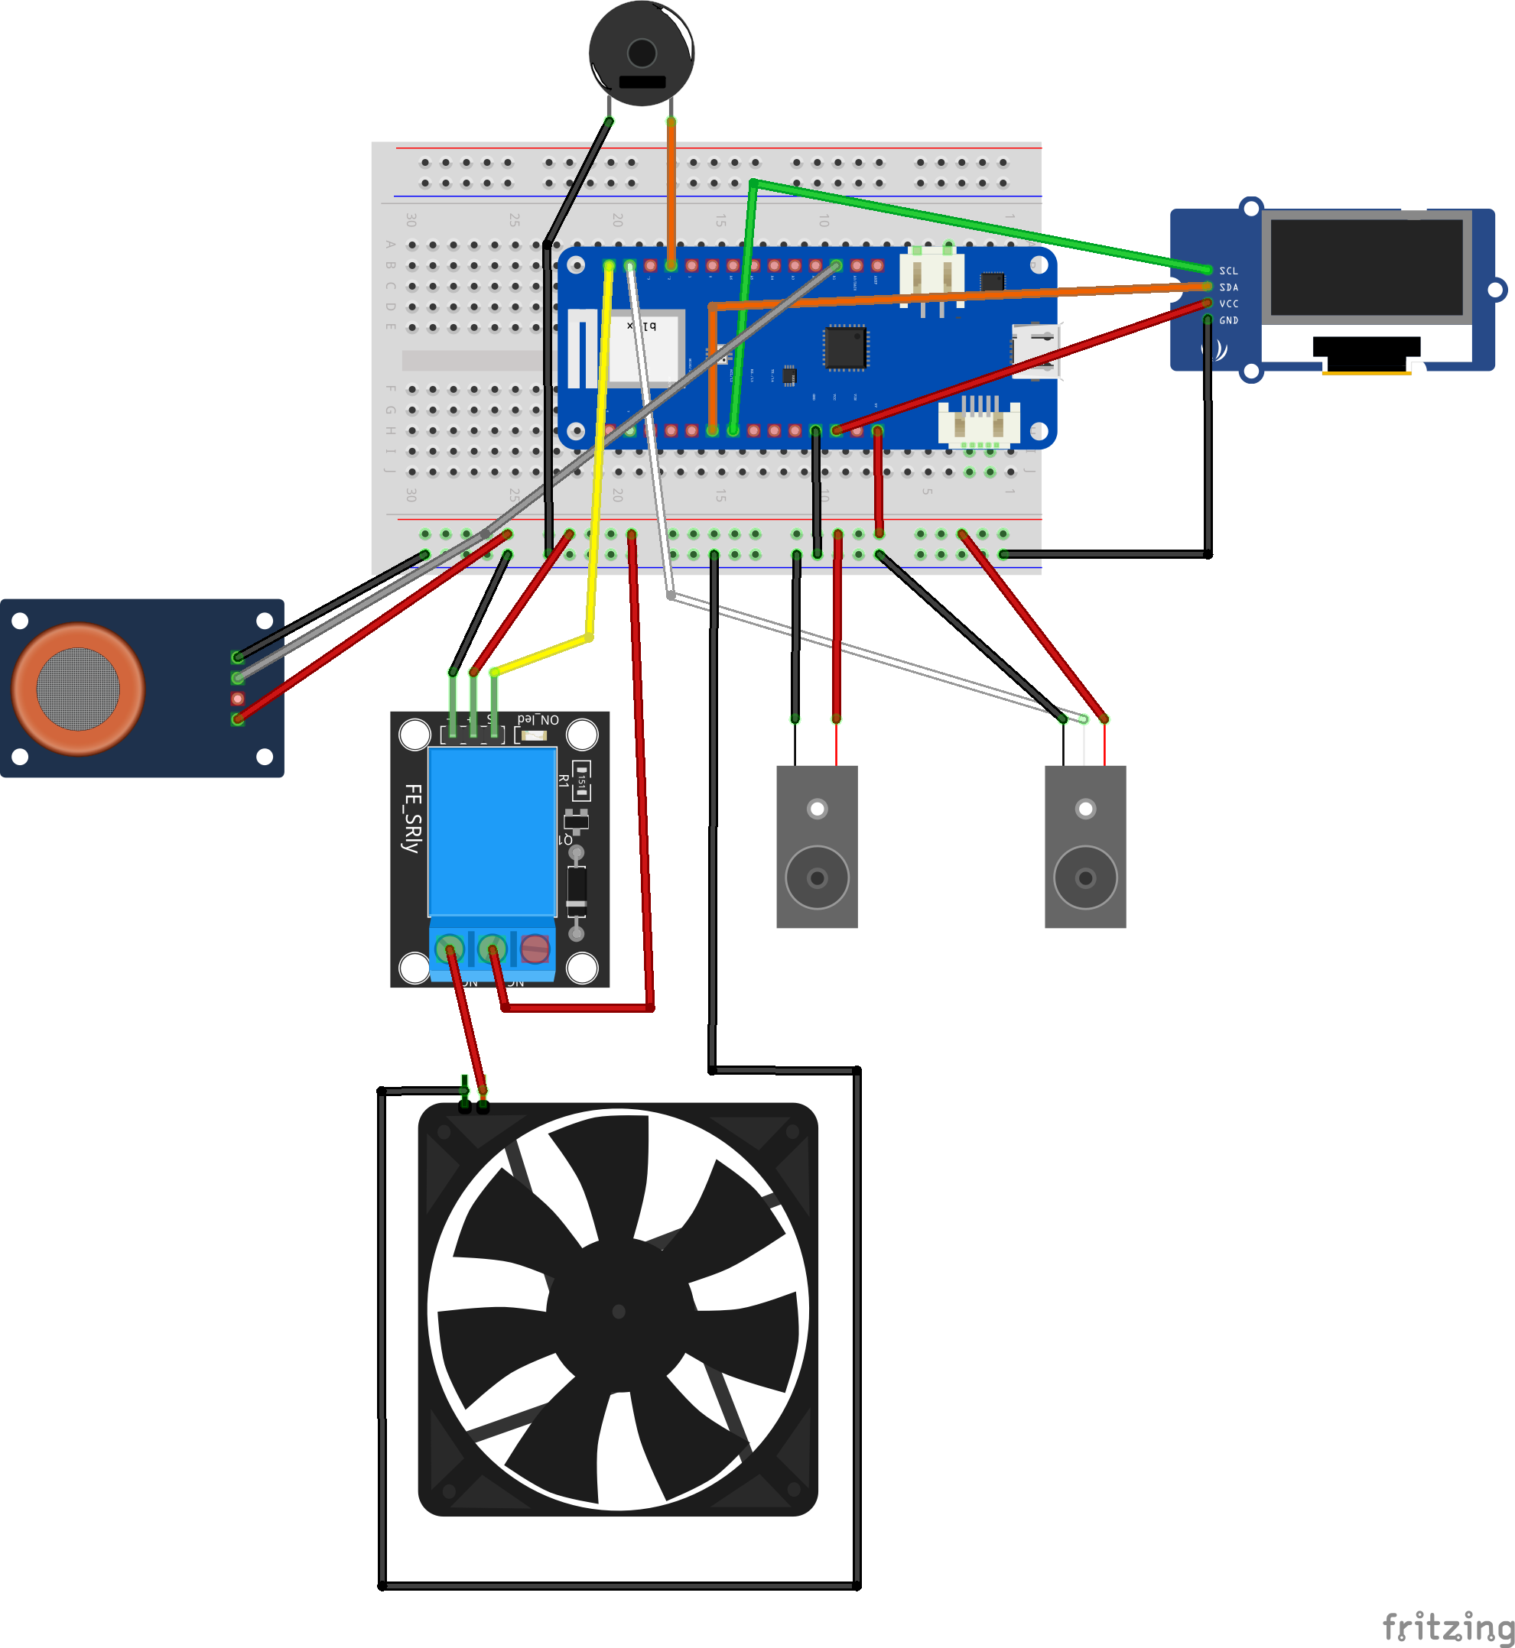
What I have done
A smart environmental monitoring system for a cat litter box.
Function
Track how many times a cat uses the litter box.
Automatically ventilate the area when odor levels increase.
When the odor exceeds the set limit, the buzzer will sound an alarm to alert for cleaning.

Slide 3
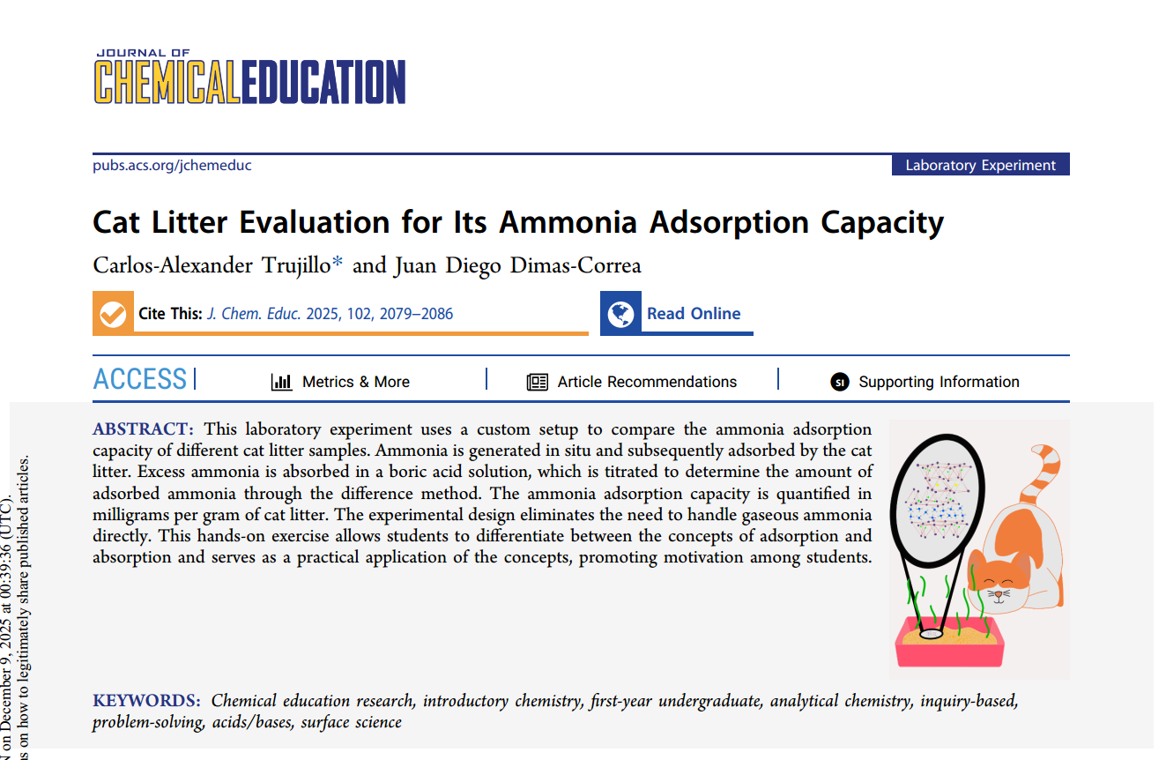

Motivation
Cat litter produces ammonia from the bacterial breakdown of urea and other nitrogen compounds, which impacts indoor air quality (Trujillo & Dimas-Correa, 2025).
Changes in urination behaviour—such as increased frequency—are common clinical signs of feline lower urinary tract disease (FLUTD) (Little, 2011).
Monitoring both odor levels and litter box usage can therefore support early detection of urinary issues and improve feline welfare.

Slide 4
Github

Slide 5
References
Trujillo, C.-A. and Dimas-Correa, J. D. (2025) ‘Cat Litter Evaluation for Its Ammonia Adsorption Capacity.’ Journal of chemical education. 102 (5), pp. 2079–2086. doi: https://doi.org/10.1021/acs.jchemed.4c01404 (Accessed at: December 2, 2025)
Little, S. E. (2012) The cat : clinical medicine and management. Susan Little. St. Louis, MO: Saunders. PP. 982 – 983. Available at: https://www.sciencedirect.com/science/book/9781437706604 (Accessed at: December 7, 2025)

Slide 6
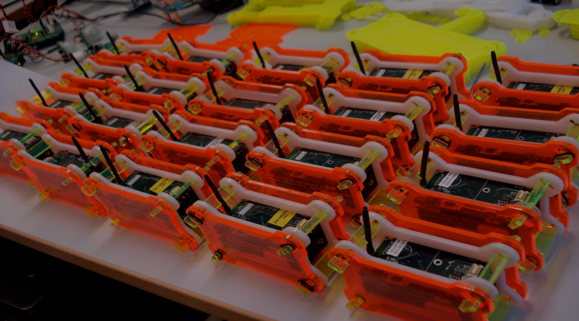
Thanks ！

