Slide 1
ZURI ELECTRONICS
Business Intelligence Analysis
Power BI Dashboard | Data Cleaning | DAX Modeling | Row-Level Security
Prepared by: Oluwatoni Oladipo
Role: Data Analyst
Date: July 2026
Contact: toni@tonianalytics.com.ng
Zuri Electronics Analysis | Oluwatoni Oladipo | 1/16

Slide 2
TABLE OF CONTENTS
01 Executive Summary
08 DAX Measures
02 Project Overview
09 Dashboard Design
03 Dataset Overview
10 Key Performance Indicators
04 Data Cleaning (Power Query)
11 Business Insights
05 Null City & Region Resolution
12 Recommendations
06 Cost & Discount Handling
13 Row-Level Security
07 Data Modeling (DAX)
14 Data Refresh & Conclusion
Zuri Electronics Analysis | Oluwatoni Oladipo | 2/16

Slide 3
EXECUTIVE SUMMARY
This report presents a comprehensive Business Intelligence analysis of Zuri Electronics, a retail company operating across four U.S. regions. The analysis covers three years of transactional data (2023-2025) spanning 1,250 orders across Technology, Office Supplies, and Furniture categories.
$4.31M
$1.27M
1,250
29.48%
Total Sales
Total Profit
Total Orders
Profit Margin
Key findings reveal a declining year-over-year trend, consistent mid-year sales dips, Corporate segment underperformance, and significant regional differences in product mix profitability.
Data Cleaning
Data Model
Dashboard
Security
Power Query (M Language)
Star Schema + DAX Date Table
Dark-themed Executive Dashboard
4 RLS Roles Implemented
Zuri Electronics Analysis | Oluwatoni Oladipo | 3/16

Slide 4
PROJECT OVERVIEW
Objective
Transform raw transactional data into a fully interactive Power BI executive dashboard that enables stakeholders to monitor sales performance, identify trends, compare regional and segment performance, and make data-driven business decisions.
Tools & Technologies
Tool | Purpose
Power BI Desktop | Dashboard design, data modeling, and visualization
Power Query (M Language) | Data cleaning and transformation
DAX | Calculated columns, measures, and Date table generation
Power BI Service | Publishing, sharing, and RLS management
Cloudflare + Zoho Mail | Custom domain email for Power BI publishing
Project Workflow
Data Cleaning
>
Data Modeling
>
DAX Measures
>
Dashboard
>
RLS
>
Publish
Zuri Electronics Analysis | Oluwatoni Oladipo | 4/16

Slide 5
DATASET OVERVIEW
Source: Zuri_Electronics.xlsx | 3 Tables + 1 DAX-Generated Date Table
Orders (Fact Table)
Products (Dimension)
1,250+ transactional records
Product catalog
Order ID, Order Date, Ship Date, Customer ID, Product ID, Sales, Cost, Quantity, Discount, Segment, Ship Mode
Product ID, Product Name, Category, Sub-Category
Customers (Dimension)
DateTable (DAX Generated)
85 customer records
Continuous calendar
Customer ID, Customer Name, Segment, City, State, Region, Country
Date, Year, Month Name, Month Number, Quarter, Day, Day Name, Week Number, Year-Month
Data Model: Clean Star Schema — Orders as central fact table connected to Customers, Products, and DateTable via one-to-many relationships
Zuri Electronics Analysis | Oluwatoni Oladipo | 5/16

Slide 6
DATA CLEANING (POWER QUERY)
Issues identified and resolved during the data cleaning process:
Issue | Action Taken | Impact
Duplicate Rows | Removed from Orders table | Prevented double-counting
Null Region (2 rows) | Filled using geographic patterns | Complete regional analysis
Null City (4 rows) | Filled using State + Region mapping | Complete geographic data
Null Discount | Replaced with 0 (no discount) | Discount Band column works
Null Cost (46 rows / 3.6%) | Retained as null (documented) | Data integrity preserved
Null Ship Date | Treated as pending shipment | Shipped Status column created
Zuri Electronics Analysis | Oluwatoni Oladipo | 6/16

Slide 7
NULL VALUE RESOLUTION
Region Null Values (2 rows)
CustomerID | City | State | Region (Fixed) | Logic
C008 | New York | New York | East | East coast state (like MA, PA, GA)
C014 | Columbus | Ohio | Central | Existing OH/Columbus = Central
City Null Values (4 rows)
CustomerID | State | Region | City (Fixed)
C005 | Florida | East | Miami
C021 | Texas | South | Austin
C062 | Florida | South | Orlando
C067 | Pennsylvania | East | Philadelphia
Method: Conditional custom columns in Power Query using if...then...else logic based on State + Region patterns discovered in the existing data. Region cleanup was performed before City cleanup since City values depend on Region.
Zuri Electronics Analysis | Oluwatoni Oladipo | 7/16

Slide 8
COST & DISCOUNT HANDLING
Null Discount Values
Null Cost Values (46 rows / 3.6%)
REPLACED WITH 0
RETAINED AS NULL
A null discount most likely means no discount was applied. Replacing with 0 ensures the Discount Band calculated column functions correctly and no orders are excluded from discount-related analysis.
Setting Cost to 0 would inflate Profit to equal the full Sales amount for those rows, producing misleading results. No reliable imputation method was found — cost per unit varied from $67 to $710 for the same product. These rows are excluded from profit calculations; DAX functions automatically skip nulls.
Investigation Summary
Since only Quantity, Sales, and Discount are available, Cost could not be reliably inferred due to lack of supporting variables. Cost per unit varied significantly across orders for the same product. The cost-to-sales ratio also varied widely with high standard deviations. The Products table contained no cost or price information. Retaining null values and flagging them as data quality issues while continuing analysis on available data was the most principled approach.
Zuri Electronics Analysis | Oluwatoni Oladipo | 8/16

Slide 9
DATA MODELING (DAX)
Calculated Columns (Added to Orders Table)
Column | DAX Formula | Purpose
Profit | Orders[Sales] - Orders[Cost] | Calculate profit per transaction
Price Per Unit | Orders[Sales] / Orders[Quantity] | Revenue generated per unit sold
Days to Ship | DATEDIFF(Order Date, Ship Date, DAY) | Measure shipping performance
Discount Band | SWITCH(TRUE(), ... ) => No Discount / Low / Medium / High | Categorize discount levels for analysis
Date Table (DAX New Table)
DateTable = ADDCOLUMNS(CALENDAR(MIN(Orders[Order Date]), MAX(Orders[Order Date])), "Year", YEAR([Date]), "Month Number", MONTH([Date]), "Month Name", FORMAT([Date], "MMMM"), "Quarter", "Q" & QUARTER([Date]))
Marked as official Date table and related to Orders[Order Date] in a one-to-many relationship. Month Name sorted by Month Number for correct calendar ordering in visuals.
Zuri Electronics Analysis | Oluwatoni Oladipo | 9/16

Slide 10
DAX MEASURES
Measure | DAX Formula | Category
Total Sales | SUM(Orders[Sales]) | Core
Total Cost | SUM(Orders[Cost]) | Core
Total Profit | [Total Sales] - [Total Cost] | Core
Profit Margin % | DIVIDE([Total Profit], [Total Sales], 0) | Core
Total Orders | DISTINCTCOUNT(Orders[Order ID]) | Core
Total Quantity | SUM(Orders[Quantity]) | Core
Avg Order Value | DIVIDE([Total Sales], [Total Orders], 0) | Core
Sales YTD | TOTALYTD([Total Sales], DateTable[Date]) | Time Intel
Sales Last Year | CALCULATE(... SAMEPERIODLASTYEAR(...)) | Time Intel
YoY Growth % | DIVIDE([Sales] - [Last Year], [Last Year]) | Time Intel
% of Total Sales | DIVIDE([Sales], CALCULATE(... ALL(...))) | Comparative
Avg Days to Ship | AVERAGE(Orders[Days to Ship]) | Operational
Sales 12M Moving Avg | AVERAGEX(DATESINPERIOD(-12, MONTH)...) | Trend
Zuri Electronics Analysis | Oluwatoni Oladipo | 10/16

Slide 11
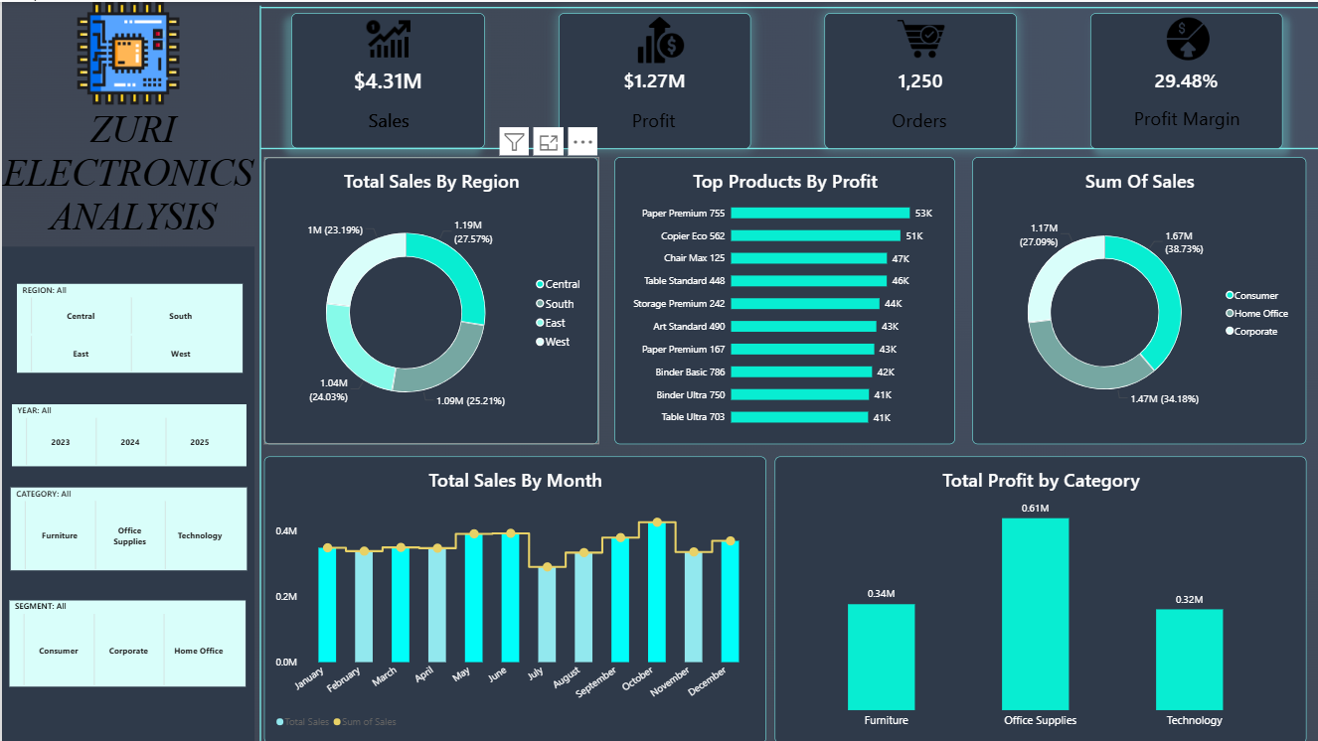
DASHBOARD DESIGN
Zuri Electronics Analysis | Oluwatoni Oladipo | 11/16
Interactive executive dashboard with KPI cards, donut charts, bar charts, line trend, and slicers for Region, Year, Category, and Segment

Slide 12
KEY PERFORMANCE INDICATORS
Regional Performance
East
South
Central
West
$1.19M
$1.09M
$1.04M
$1.00M
27.57% | 1st
25.21% | 2nd
24.03% | 3rd
23.19% | 4th
Segment Performance
Consumer
Home Office
Corporate
$1.67M
$1.47M
$1.17M
38.73%
34.18%
27.09%
Top 5 Products by Profit
Paper Premium 755 — $53K
Copier Eco 562 — $51K
Chair Max 125 — $47K
Table Standard 448 — $46K
Storage Premium 242 — $44K
Zuri Electronics Analysis | Oluwatoni Oladipo | 12/16

Slide 13
BUSINESS INSIGHTS
Corporate Segment Underperformance
Corporate generates only $1.17M (27%) of sales — nearly $500K behind Consumer. This is a missed opportunity since corporate buyers typically place larger, recurring orders that could stabilize revenue without increasing acquisition costs.
Consistent Mid-Year Sales Dip (June-August)
Sales drop from ~$400K in April to ~$300K every mid-year. In 2023, August was lowest; in 2024 and 2025, July was lowest. This predictable gap could be addressed with targeted promotions or seasonal campaigns.
Technology Products Drive Profitability
Technology sub-categories (Copiers $147K, Accessories $137K) deliver 2-3x more profit than Furniture (Bookcases $40K). The West region's lower sales may be a product mix issue — underselling high-margin Tech products.
Year-over-Year Revenue Decline (2023-2025)
2023 had the highest sales and profit. Both 2024 and 2025 showed declines. Two consecutive years of decline signals a need for strategic intervention to reverse the trend.
Central Region Leads Through Product Mix
Central has the most consistent year-round sales and highest profit. Drill-down shows this isn't from Furniture (where it lags) but from strong Office Supplies and Technology performance — success driven by mix, not volume.
Zuri Electronics Analysis | Oluwatoni Oladipo | 13/16

Slide 14
RECOMMENDATIONS
01
Grow Corporate Segment
04
Investigate YoY Decline
Implement B2B marketing, offer volume discounts, and establish account management programs for corporate clients.
Analyze churn rates, competitive landscape, and pricing to identify root causes of the 2024-2025 decline.
02
Address Mid-Year Dip
05
Customer Retention
Launch June-August promotions, product bundles, and seasonal campaigns to smooth revenue throughout the year.
Implement loyalty programs and personalized marketing for the Consumer segment to increase lifetime value.
03
Push Tech in West Region
06
Optimize Furniture
Increase Technology product penetration in the West through targeted marketing and sales incentives.
Evaluate pricing and supplier costs for underperforming Furniture sub-categories or reallocate resources.
Zuri Electronics Analysis | Oluwatoni Oladipo | 14/16

Slide 15
ROW-LEVEL SECURITY (RLS)
RLS ensures different users only see data relevant to their role, making the solution secure, personalized, scalable, and business-ready.
Role | Access Level | Implementation Method
RegionManager | Sees only their assigned region | RegionMapping table + LOOKUPVALUE + USERPRINCIPALNAME()
SalesRep | Sees only their own sales data | Filters by sales representative email
CategoryManager | Sees only their product categories | Filters by product category assignment
FinancialAnalyst | Full access to all financial data | No filter applied (unrestricted access)
Implementation Details
A RegionMapping table was created with Region and UserEmail columns to map users to their respective regions. The table was linked to the Customers table via a Region-to-Region relationship. The RegionManager role uses LOOKUPVALUE to dynamically filter data based on the logged-in user's email address via USERPRINCIPALNAME(). All roles were tested using Power BI Desktop's View as Roles feature.
Zuri Electronics Analysis | Oluwatoni Oladipo | 15/16

Slide 16
DATA REFRESH & CONCLUSION
Data Refresh Strategy
Key Accomplishments
A daily refresh schedule is recommended, set to 7:00 AM before the business day begins at 8:00 AM. This ensures stakeholders always have yesterday's data ready for morning reviews and decision-making.
Thorough data cleaning with documented decisions
Clean star schema with DAX Date table
13+ DAX measures incl. time intelligence
Interactive dark-themed executive dashboard
4 RLS roles for secure multi-user access
Actionable insights backed by data
THANK YOU
Oluwatoni Oladipo | Data Analyst
toni@tonianalytics.com.ng
Zuri Electronics Analysis | Oluwatoni Oladipo | 16/16

