Slide 1
Emulating Stochastic Processes for Efficient RBDO
APL871: Product Reliability
Term Project
Rishabh Jain (2022AM11793)
Karan Noor Singh (2022AM11220)
Advisor
Prof. Souvik Chakraborty

Slide 2
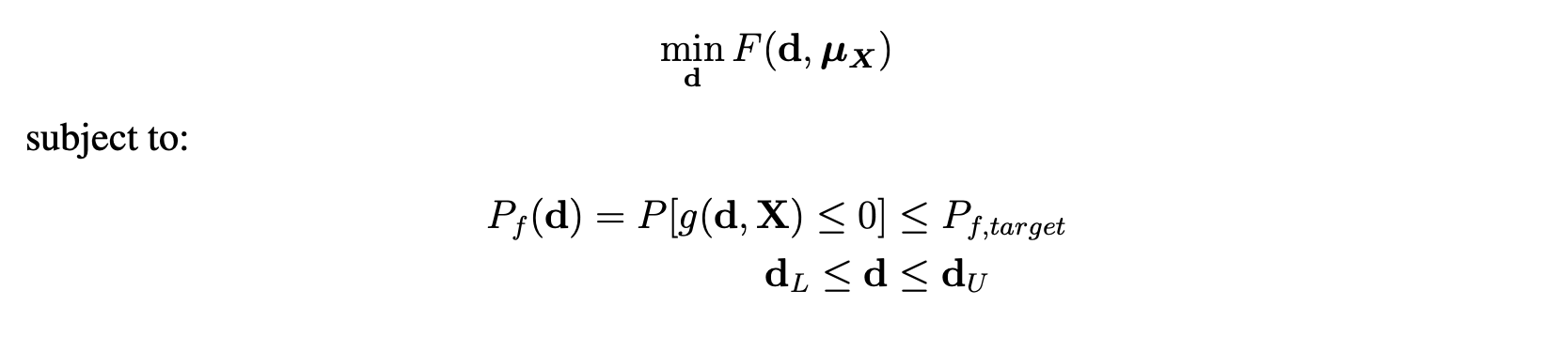
RBDO

Slide 3
The Problem
- RBDO creates a "nested loop" problem:
  Outer Loop: Optimization of design variables (d).
  Inner Loop: Reliability analysis (calculating P_{f}), which is computationally expensive.
Deterministic performance functions
Lack of frameworks handling stochastic simulators (where the limit state itself contains intrinsic randomness/noise) within an RBDO context.

Slide 4
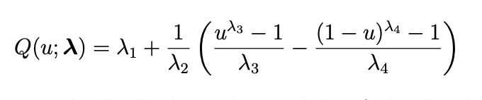
Proposal
Replace the expensive inner reliability loop with a fast Stochastic Emulator.
We propose using Generalized Lambda Models (GLaM) to act as a "probabilistic oracle," predicting the full conditional distribution of the response without needing replicated simulations.
The four parameters govern the distribution’s characteristics: λ1 is a location parameter, λ2 > 0 is a scale parameter, and λ3 and λ4 are shape parameters that control the skewness and kurtosis of the distribution

Slide 5
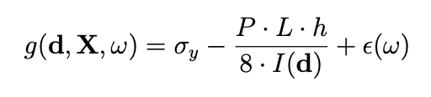
Project Workflow
Validation: Implement GLaM and validate against the Black-Scholes model (analytical benchmark).
Structural Application: Develop a stochastic simulator for a Simply Supported I-Beam subject to random loads and model uncertainty.
Integration: Integrate the trained emulator into a gradient-based optimization loop to solve the RBDO problem efficiently.

Slide 6
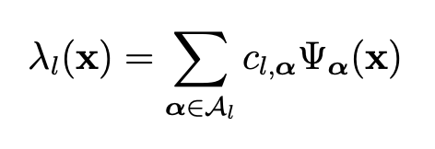
Phase 1: Emulator Implementation
Objective: Build a surrogate that approximates the conditional probability distribution P(Y|X) of a stochastic simulator.
where Ψα(x) are multivariate orthogonal polynomials, cl,α are the unknown coefficients, and Al is a set of multi-indices defining the basis

Slide 7
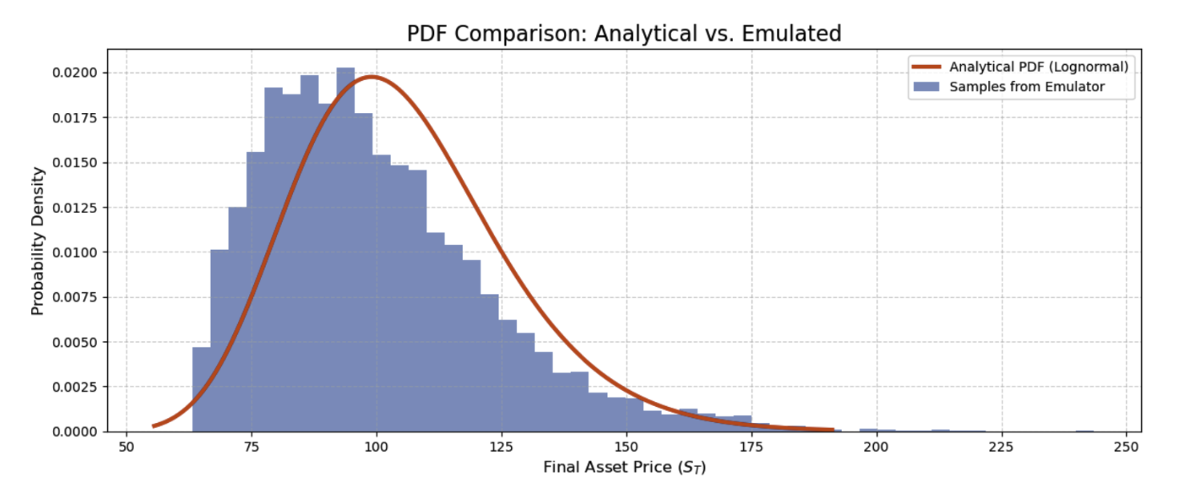
Phase 1: Validation (Black-Scholes Model)

Slide 8
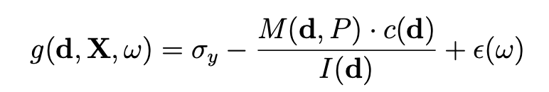
Phase 2: Engineering Application (I-Beam)
Objective: To replace a structural reliability analysis with the GLaM emulator.
Physics Stochastic Simulator:
GLAM Stochastic Simulator (g_{GLAM}):

Slide 9
Phase 2: Complexity vs Stability
A simple (Degree 1) model was stable but inaccurate. A complex (Degree 2) model captured the physics but required fitting 60 coefficients, causing the optimizer to fail (diverge) due to numerical instability
Solution: "Smart" Initialization.
  We developed a routine using the Method of Moments to pre-calculate the best "global" distribution.
  Using this as a starting guess stabilized the optimizer, allowing the high-fidelity model to converge successfully.

Slide 10
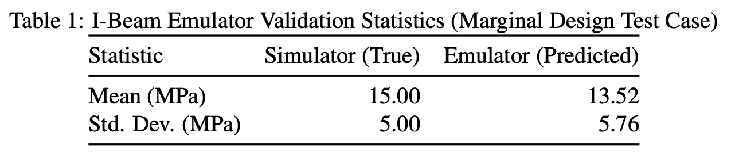
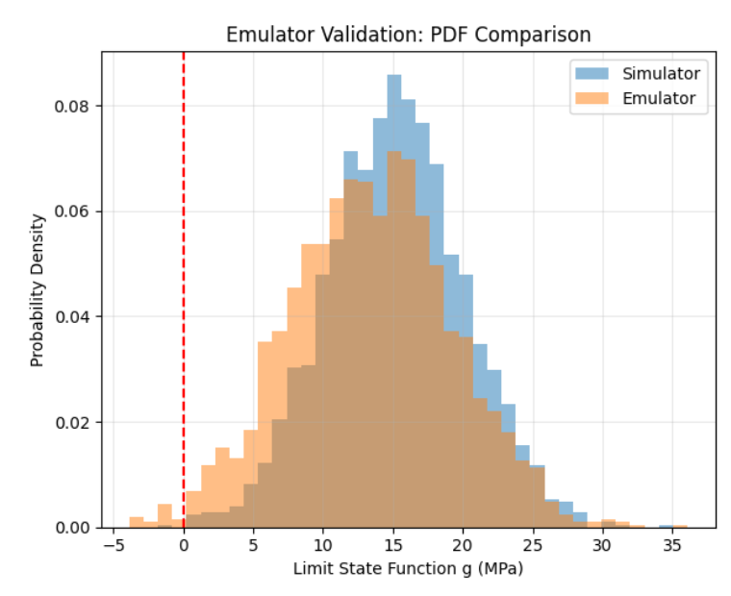
Phase 2: Results

Slide 11

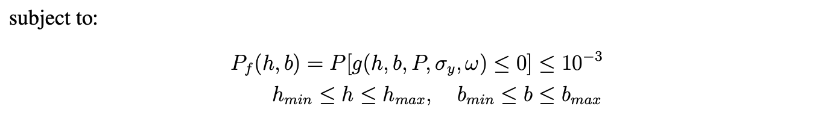
Phase 3: Optimization

Slide 12
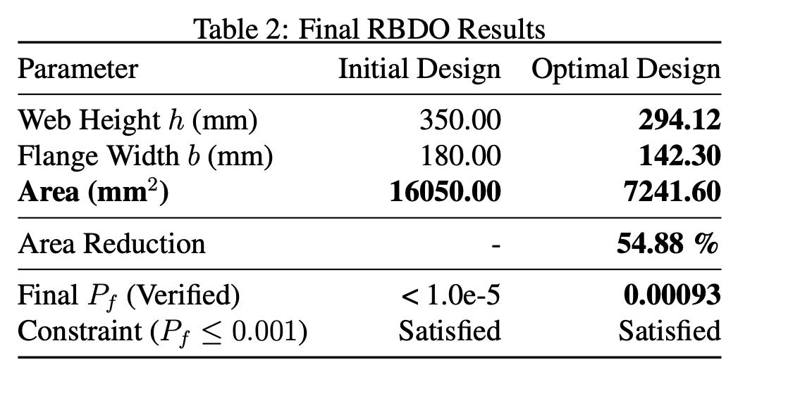
Phase 3: Results

