Slide 1
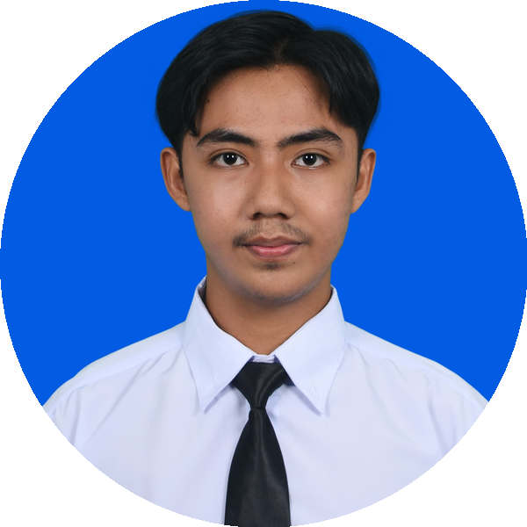
PROFESSIONAL PORTFOLIO · 2026
MUHAMMAD
FATHONI
Electrical Engineering Graduate
IT · AI · Electrical Engineer · IoT · Data Science
Universitas Islam Indonesia · GPA 3.78 / 4.00
fathonimuhammad2411@gmail.com
Yogyakarta, Indonesia
+62 822-5850-3481
linkedin.com/in/muhammad-fathoni-038274266

Slide 2
MUHAMMAD FATHONI
PAGE 2 / 17
Electrical Engineer · AI & IoT Enthusiast
INDEX
Table of Contents
01
About Me
3
Personal profile and career objective
02
Education & Academic Records
4
University, GPA, and key coursework
03
Technical Skills
5
Hard skills, tools, and soft skills
04
Featured Projects
6
Six featured engineering projects
05
Professional Experience
16
Internship and laboratory teaching
06
Leadership & Organizations
18
Roles, committees, and student bodies
07
Achievements & Certifications
19
Competition wins and certifications
08
Contact
20
How to reach me
fathonimuhammad2411@gmail.com
+62 822-5850-3481
linkedin.com/in/muhammad-fathoni-038274266

Slide 3
MUHAMMAD FATHONI
PAGE 3 / 17
Electrical Engineer · AI & IoT Enthusiast
01 · ABOUT ME
About Me
I am a final-year Electrical Engineering student at Universitas Islam Indonesia with a deep enthusiasm for the intersection of power systems, embedded technology, and modern artificial intelligence. As a full scholarship awardee through the UII Excellent Community program, I have consistently maintained academic excellence while actively engaging in research, leadership, and entrepreneurial initiatives.
My professional interests span Electrical Engineering, Internet of Things (IoT), Machine Learning, and Generative AI applications in industry. I have hands-on experience designing end-to-end smart systems, combining hardware (ESP32, sensors, PLC, microcontrollers) with predictive ML models and large language model integrations. Beyond technical work, I bring proven leadership in student organizations and a track record of competition wins and research grants.
I am driven, adaptive, and committed to continuous learning. I thrive in collaborative, forward-thinking environments where I can contribute to meaningful innovation while growing alongside experienced professionals.
CAREER OBJECTIVE
To contribute to a forward-thinking organization as an Engineer, Data, or AI/ML specialist — leveraging my electrical engineering foundation, programming skills, and passion for innovation to build impactful, intelligent industrial solutions.
fathonimuhammad2411@gmail.com
+62 822-5850-3481
linkedin.com/in/muhammad-fathoni-038274266

Slide 4
MUHAMMAD FATHONI
PAGE 4 / 17
Electrical Engineer · AI & IoT Enthusiast
02 · EDUCATION
Education & Academic Records
Universitas Islam Indonesia (UII)
Aug 2022 – Present
Bachelor of Electrical Engineering · Faculty of Industrial Technology
GPA 3.78 / 4.00
140 SKS Completed · UII Excellent Community Scholarship
KEY COURSEWORK
Power Systems
Machine Learning
Control Systems
Digital Systems (VHDL/FPGA)
PLC & SCADA
Microprocessor Systems
Renewable Energy
Telecommunications
Power Electronics
Computer Networks
Embedded Systems
Engineering Mathematics
fathonimuhammad2411@gmail.com
+62 822-5850-3481
linkedin.com/in/muhammad-fathoni-038274266

Slide 5
MUHAMMAD FATHONI
PAGE 5 / 17
Electrical Engineer · AI & IoT Enthusiast
03 · SKILLS
Technical Skills
HARD SKILLS
SOFT SKILLS
POWER & ELECTRICAL SYSTEMS
Critical & Analytical Thinking
Electrical Troubleshooting & Wiring
Circuit Analysis (Analog & Digital)
Problem Solving
Power System Reliability (SAIDI/SAIFI)
Teamwork & Collaboration
PLC Programming · PID Control · LabVIEW
EMBEDDED & IOT
Communication & Public Speaking
Microcontrollers (ESP32, Arduino, ATmega)
Sensors (PZEM-004T, DHT, MQ Series)
Leadership & Coordination
MQTT Protocol & Real-Time Telemetry
Proteus, CodeVision AVR, VHDL/FPGA
Time Management
PROGRAMMING & DATA
Adaptability & Fast Learning
Python, C, C++, HTML, CSS, JS
Machine Learning (Scikit-learn, SVM, Random Forest)
Detail-Oriented & Initiative
Generative AI (Google Gemini API)
Pandas, Matplotlib, Firebase
LANGUAGES
TOOLS & NETWORKING
Microsoft Office Suite
Bahasa Indonesia — Native
English — Professional Working Proficiency
Computer Networking (HCIA-Datacom)
Project Management · Git
fathonimuhammad2411@gmail.com
+62 822-5850-3481
linkedin.com/in/muhammad-fathoni-038274266

Slide 6

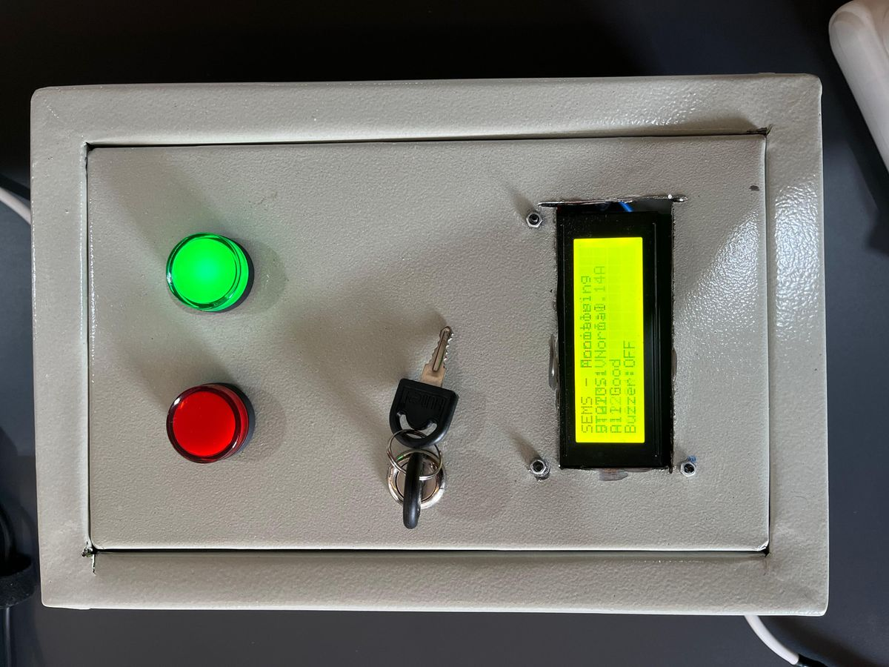
MUHAMMAD FATHONI
PAGE 6 / 17
Electrical Engineer · AI & IoT Enthusiast
04 · PROJECTS
FINAL PROJECT · 2025
SEMS — Smart Energy Management System
Sole Developer (Hardware, Firmware, ML, Web, AI Integration)
ESP32
IoT
Random Forest
Generative AI
Firebase
An end-to-end smart energy monitoring and recommendation platform that combines real-time power telemetry, predictive machine learning, and generative AI to help Indonesian households reduce electricity consumption. The system integrates ESP32-based hardware, a Random Forest forecasting model, Firebase real-time database, and Google Gemini 2.5 Flash to deliver context-aware energy advice.
KEY HIGHLIGHTS
Real-time power monitoring with ESP32 + PZEM-004T + DHT22 sensors over MQTT
Random Forest model achieved R² 0.9893 (98.93% accuracy) for monthly forecasting
Google Gemini 2.5 Flash integration for personalized energy-saving recommendations
Firebase dashboard with PLN tariff calculator (450VA – 5500VA customer profiles)
SEMS device — front panel with LCD display
fathonimuhammad2411@gmail.com
+62 822-5850-3481
linkedin.com/in/muhammad-fathoni-038274266

Slide 7
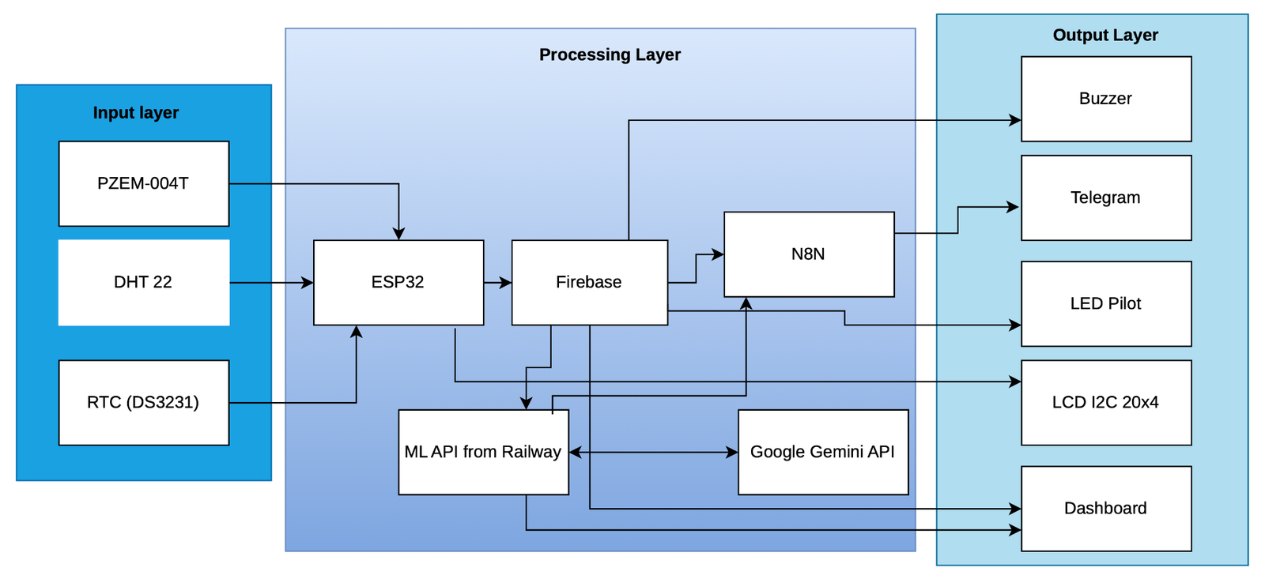
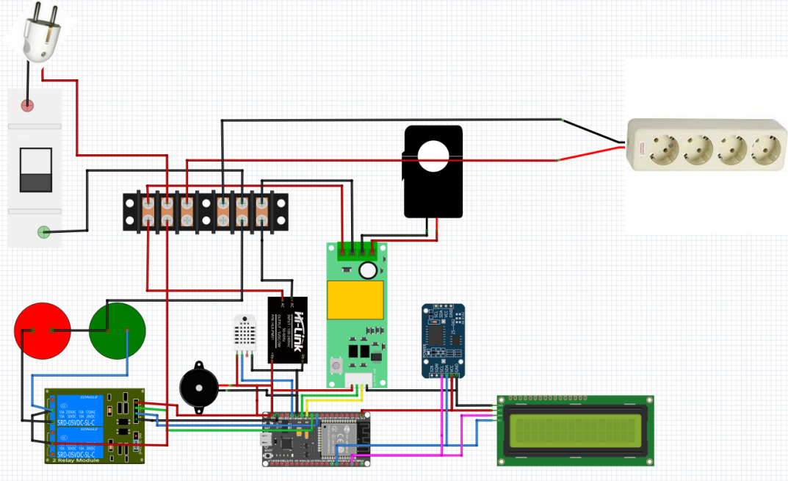
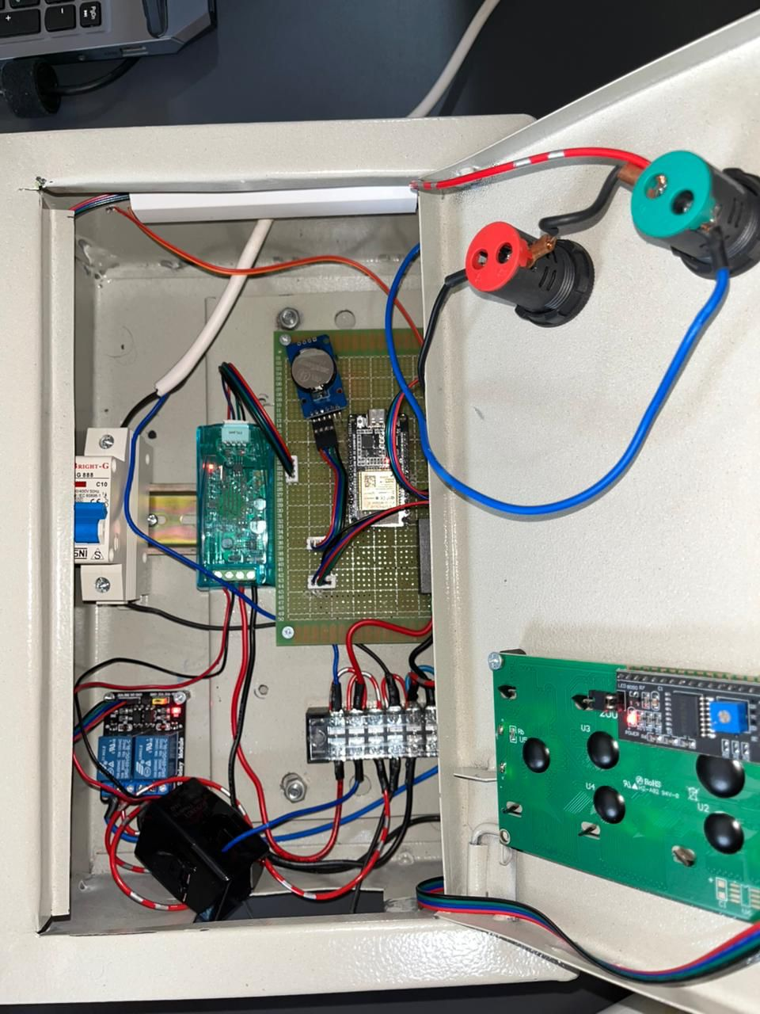
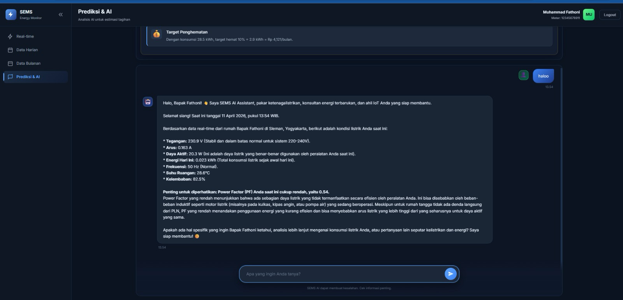
MUHAMMAD FATHONI
PAGE 7 / 17
Electrical Engineer · AI & IoT Enthusiast
04 · PROJECTS (CONT.)
SEMS — System Architecture & Hardware
A complete IoT pipeline: from physical sensors and microcontroller to cloud database, ML inference, and AI-powered dashboard.
System architecture: Input → Processing → Output Layer
Hardware schematic — ESP32, PZEM-004T, MCB, relay, LCD
Internal wiring of the SEMS prototype enclosure
Real-time dashboard with SEMS AI Assistant (Gemini)
fathonimuhammad2411@gmail.com
+62 822-5850-3481
linkedin.com/in/muhammad-fathoni-038274266

Slide 8
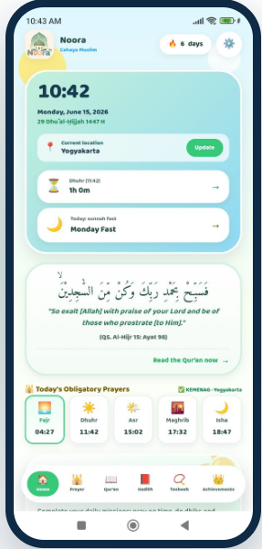

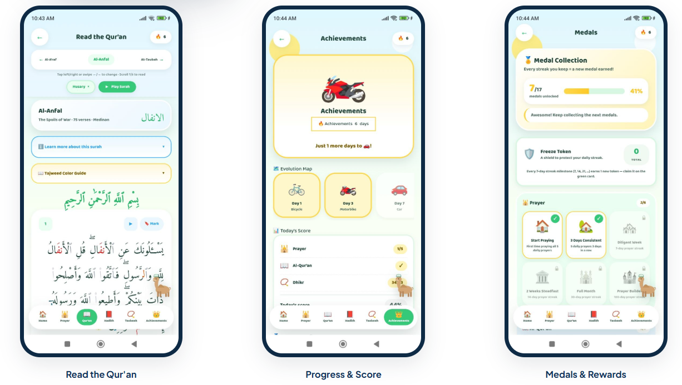
MUHAMMAD FATHONI
PAGE 18 / 20
Electrical Engineer · AI & IoT Enthusiast
04 · PROJECTS (CONT.)
PERSONAL PRODUCT · NOORA DEEN TECHNOLOGY · 2026
Noora: Muslim Habit-Building App
Co-Founder & Sole Engineer (Mobile, Backend, UI)
Capacitor 8
JavaScript
Supabase
REST API
Android
A mobile application that helps Muslims build consistent daily worship habits in a positive, engaging way. Noora combines an international prayer-time engine, a complete digital Qur'an with an authentic 604-page Madinah mushaf mode, and a gamified “Garden” that grows with the user's consistency. Built as the flagship product of Noora Deen Technology, it runs fully online and offline, and is currently in closed testing on the Google Play Store.
KEY HIGHLIGHTS
Region-aware prayer times: Kemenag for Indonesia, auto-switching to JAKIM, MUIS, Umm al-Qura, ISNA or Diyanet abroad
Full Qur'an with verified Saheeh International translation, tafsir, and a 604-page Madinah mushaf with page-turn animation
Gamified habit engine: per-category and combined streaks, freeze tokens, an evolving garden and claimable achievements
Works fully offline, or syncs progress across devices in real time via Supabase; custom real-time ID/EN i18n engine
Noora : habit-building app (closed testing on Play Store)
fathonimuhammad2411@gmail.com
+62 822-5850-3481
linkedin.com/in/muhammad-fathoni-038274266

Slide 9
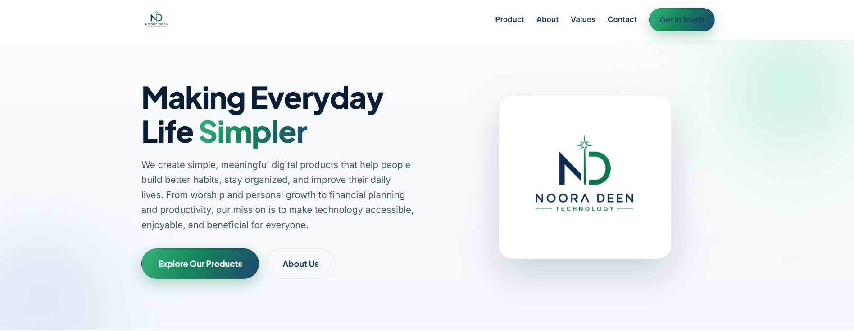

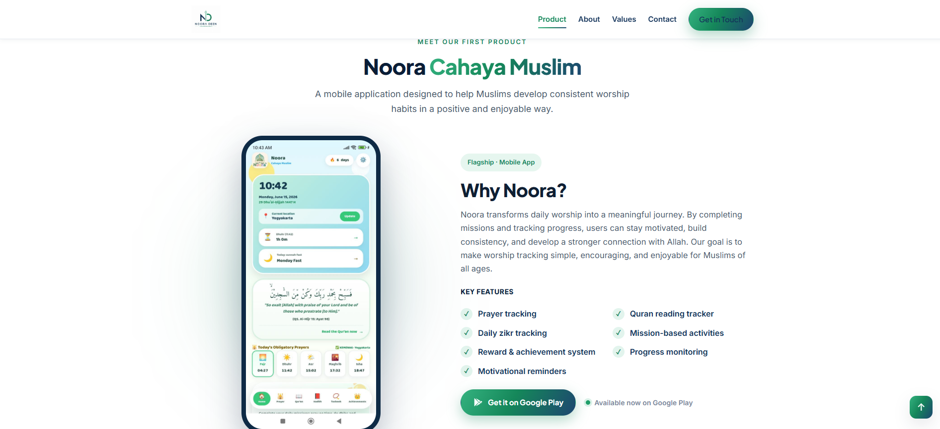
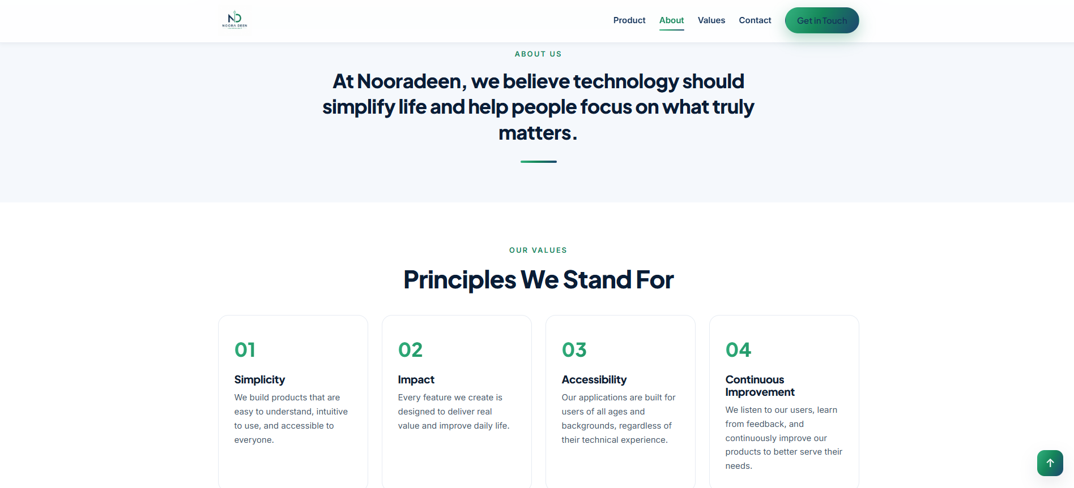
MUHAMMAD FATHONI
PAGE 19 / 20
Electrical Engineer · AI & IoT Enthusiast
04 · PROJECTS (CONT.)
CORPORATE WEBSITE · NOORA DEEN TECHNOLOGY · 2026
Noora Deen Technology: Company Website
Designer & Developer (Front-End, Branding)
HTML
CSS
JavaScript
Responsive
Accessibility
A lightweight, fast single-page company profile for Noora Deen Technology, built entirely with vanilla HTML, CSS and JavaScript, no framework, no build step. The site presents the company's mission (“Making Everyday Life Simpler”), its products, values and contact channels, and is engineered for accessibility and smooth performance on any device.
KEY HIGHLIGHTS
Fully responsive with a sticky navbar, hamburger menu and scroll-spy navigation across desktop, tablet and mobile
Scroll-reveal animations and animated statistic counters built without any external animation library
Accessibility-first: keyboard navigation, ARIA labels, and respect for prefers-reduced-motion
Custom brand system: navy-and-green palette, north-star logo with an “ND” monogram, zero-backend contact form
nooradeen.com single-page company profile
fathonimuhammad2411@gmail.com
+62 822-5850-3481
linkedin.com/in/muhammad-fathoni-038274266

Slide 10
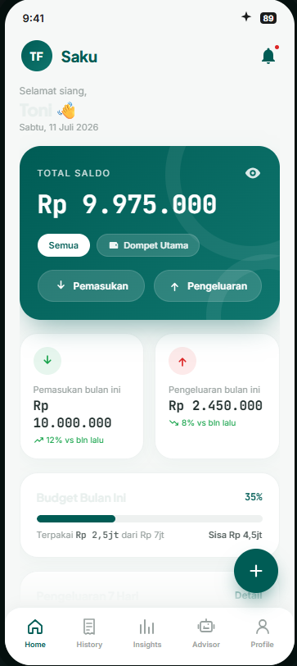
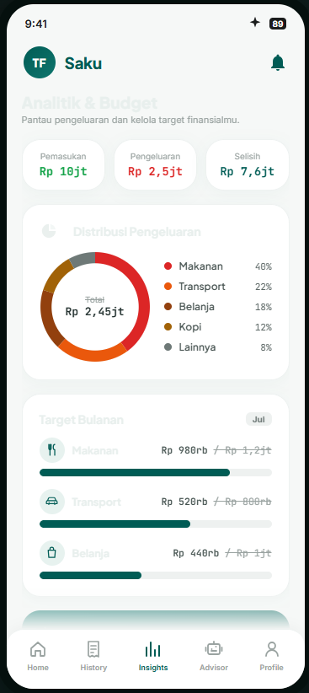

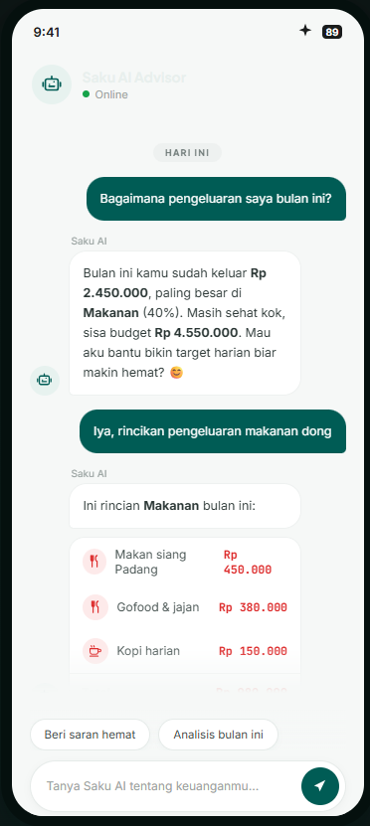
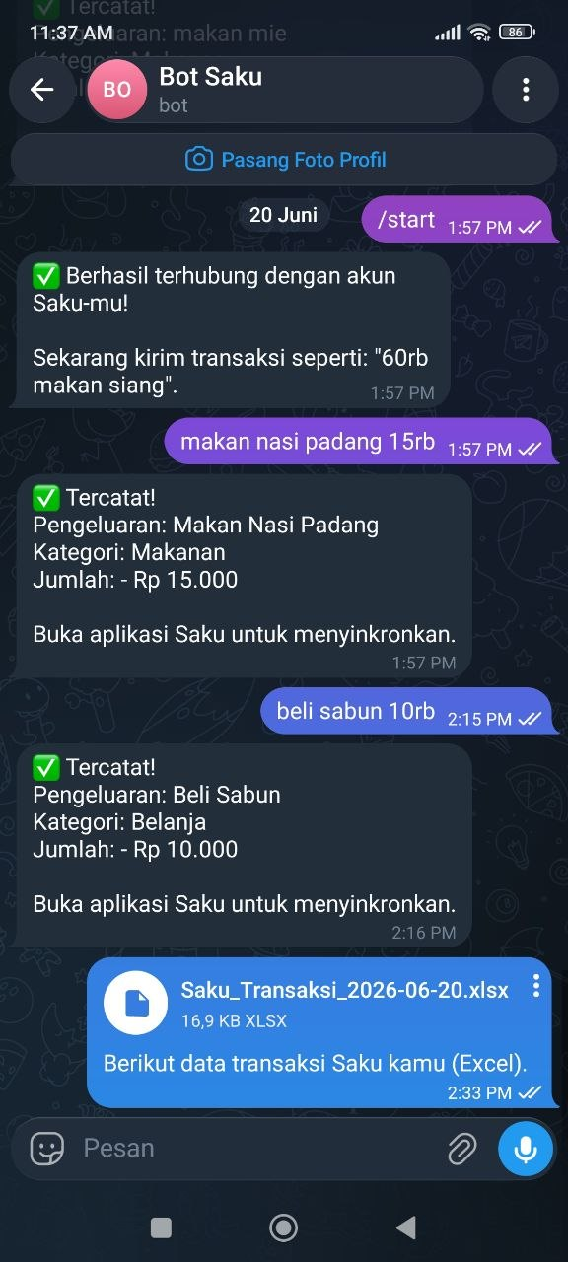
MUHAMMAD FATHONI
PAGE 20 / 20
Electrical Engineer · AI & IoT Enthusiast
04 · PROJECTS (CONT.)
PERSONAL PRODUCT · AI FINANCE · 2026
Saku: AI-Powered Personal Finance Manager
Sole Developer (Front-End, Backend, AI, Mobile)
React 19
TypeScript
Gemini 2.5
Express
Capacitor
A mobile-first personal finance manager for Indonesian users. Saku makes logging income and expenses nearly frictionless, then layers on an AI advisor (Google Gemini 2.5 Flash) that is grounded on the user's own transactions and replies in natural Bahasa Indonesia. A Telegram bot lets users record spending simply by chatting, “60rb makan siang” becomes a categorised expense of Rp 60.000.
KEY HIGHLIGHTS
Telegram bot logs spending from natural language: “60rb makan siang” becomes a categorised Rp 60.000 expense
Grounded AI advisor: WhatsApp-style chat answering questions about the user's real transactions in Bahasa Indonesia
Analytics suite: category donut, 7-day income-vs-expense trends, budget progress and AI-generated insights
Cross-platform React 19 + Vite client wrapped with Capacitor 8, deployed serverless on Vercel with Excel export
Saku dashboard, analytics and AI advisor
fathonimuhammad2411@gmail.com
+62 822-5850-3481
linkedin.com/in/muhammad-fathoni-038274266

Slide 11
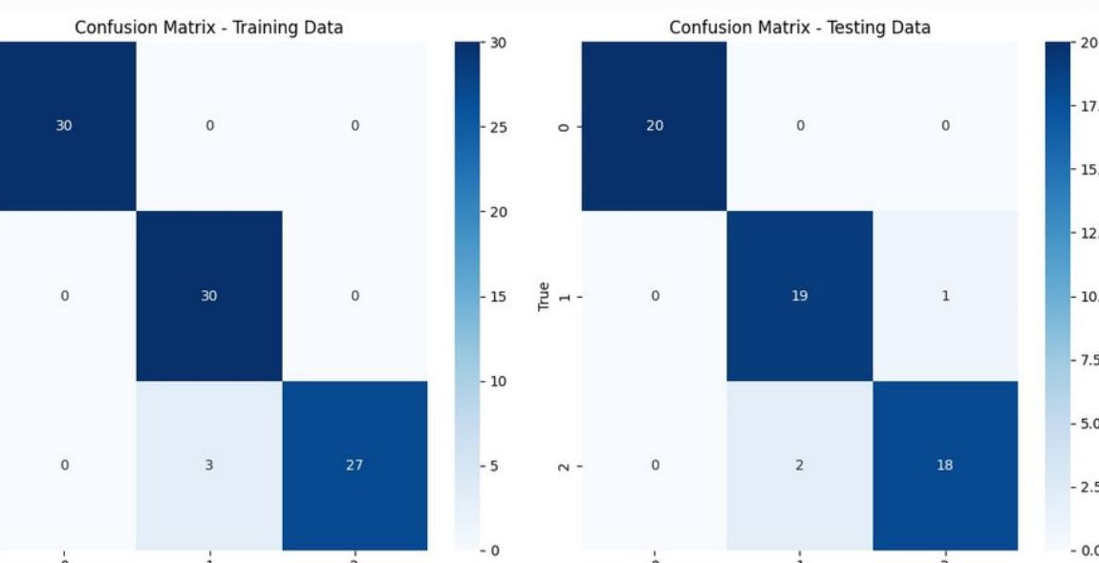

MUHAMMAD FATHONI
PAGE 8 / 17
Electrical Engineer · AI & IoT Enthusiast
04 · PROJECTS (CONT.)
MACHINE LEARNING COURSE · 2024
Iris Flower Classification with Support Vector Machine
Developer
Python
SVM
Scikit-learn
Google Colab
Built and evaluated a Support Vector Machine model to classify Iris flower species using petal and sepal measurements. The project followed a complete ML pipeline — from exploratory data analysis and preprocessing through model training, evaluation with confusion matrices, and classification reporting — strengthening my foundation in supervised learning workflows.
KEY HIGHLIGHTS
Achieved over 90% classification accuracy on test set with linear-kernel SVM
Train-test split of 80:20 with proper cross-validation methodology
Full ML pipeline: preprocessing, training, evaluation, and reporting
Practical foundation for advanced supervised learning workflows
Confusion matrix — training vs testing performance
fathonimuhammad2411@gmail.com
+62 822-5850-3481
linkedin.com/in/muhammad-fathoni-038274266

Slide 12
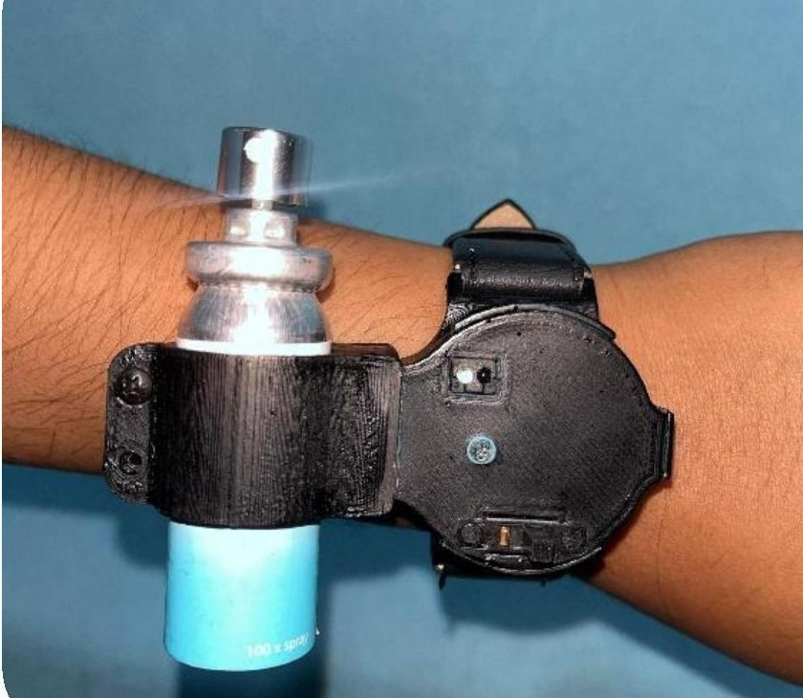

MUHAMMAD FATHONI
PAGE 9 / 17
Electrical Engineer · AI & IoT Enthusiast
04 · PROJECTS (CONT.)
PKM-KC FUNDED PROJECT · 2024
AromatheraWrist — Smart Bracelet for Anxiety Relief
Lead Developer · PKM-KC Team
Wearable
Biomedical
Mobile App
Embedded
An innovative wearable bracelet that integrates aromatherapy delivery with a real-time pulse sensor, controlled via a companion mobile application to help reduce anxiety symptoms in users. The project combined biomedical signal processing with user-centered design, and was awarded PKM Karsa Cipta funding by the Indonesian Ministry of Education.
KEY HIGHLIGHTS
Awarded PKM Karsa Cipta funding by Indonesian Ministry of Education (2024)
4th Place — PKM IC Karsa Cipta Scheme
Real-time pulse rate monitoring with embedded sensor system
Mobile app integration for aromatherapy spray control
AromatheraWrist prototype — aromatherapy spray and pulse sensor
fathonimuhammad2411@gmail.com
+62 822-5850-3481
linkedin.com/in/muhammad-fathoni-038274266

Slide 13
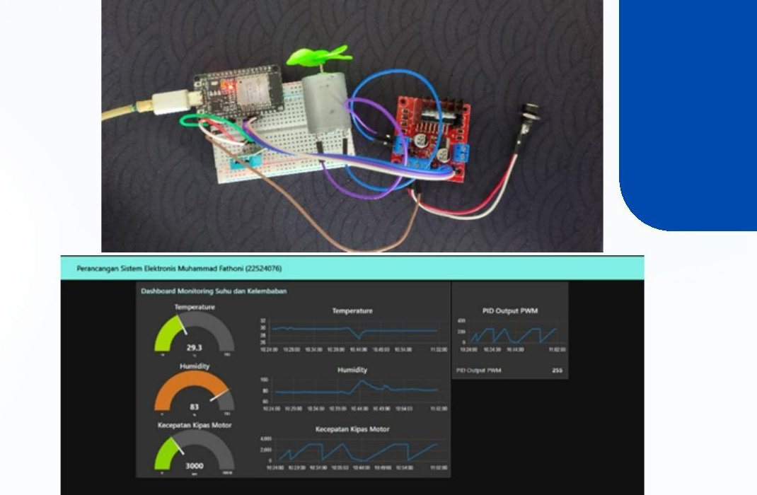

MUHAMMAD FATHONI
PAGE 10 / 17
Electrical Engineer · AI & IoT Enthusiast
04 · PROJECTS (CONT.)
ELECTRONICS SYSTEMS PROJECT · 2024
IoT Automatic Temperature Control
Developer
ESP32
MQTT
PID Control
Python
An IoT-based automatic temperature control system using ESP32 and DHT11 sensor, with a Python-based PID controller communicating via MQTT to dynamically regulate fan speed based on real-time room temperature. The system demonstrated stable closed-loop control with accurate response to environmental changes.
KEY HIGHLIGHTS
ESP32 (publisher) + Python application (subscriber) over MQTT broker
L298N motor driver controlling DC fan with PID-tuned response
Real-time monitoring dashboard with temperature, humidity, and fan speed gauges
Demonstrated stability and accuracy in real-time control loop
Hardware setup + monitoring dashboard with PID output
fathonimuhammad2411@gmail.com
+62 822-5850-3481
linkedin.com/in/muhammad-fathoni-038274266

Slide 14
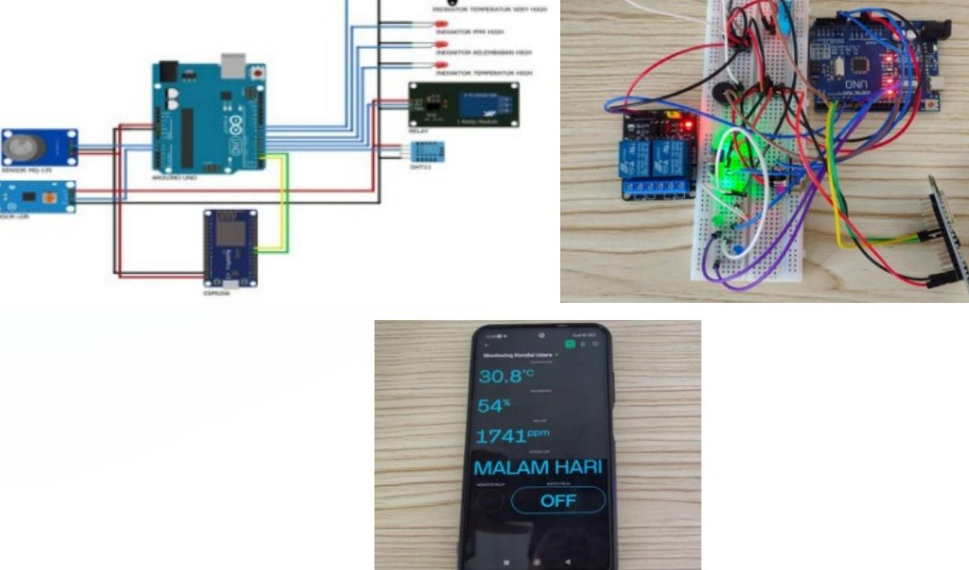

MUHAMMAD FATHONI
PAGE 11 / 17
Electrical Engineer · AI & IoT Enthusiast
04 · PROJECTS (CONT.)
EMBEDDED SYSTEM FINAL PROJECT · 2024
Air Quality Monitoring Tool
Developer
Arduino Uno
NodeMCU ESP8266
Blynk IoT
Multi-Sensor
A real-time air quality monitoring system that measures temperature, humidity, gas concentration (PPM), and light intensity using multiple sensors integrated with Arduino Uno and NodeMCU ESP8266. Data is transmitted to the Blynk IoT platform, enabling real-time monitoring and remote control via smartphone application.
KEY HIGHLIGHTS
Multi-sensor integration: DHT11 (temp/humidity), MQ-135 (gas), LDR (light)
Cloud-based dashboard with mobile remote control via Blynk IoT
Real-time environmental data logging with notification alerts
Day/night mode detection with automatic relay switching
Hardware schematic, breadboard prototype, and Blynk app
fathonimuhammad2411@gmail.com
+62 822-5850-3481
linkedin.com/in/muhammad-fathoni-038274266

Slide 15
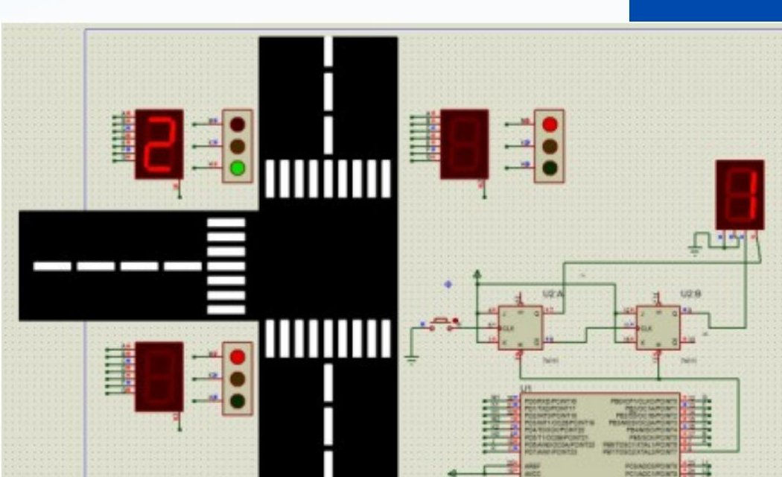

MUHAMMAD FATHONI
PAGE 12 / 17
Electrical Engineer · AI & IoT Enthusiast
04 · PROJECTS (CONT.)
MICROPROCESSOR SYSTEMS PROJECT · 2024
Three-Lane Adaptive Traffic Light Simulator
Developer
ATmega328P
CodeVision AVR
Proteus
C
An adaptive traffic light controller for a three-way intersection, programmed in C via CodeVision AVR (CVAVR) and simulated using Proteus 8 Professional. Each lane is equipped with a seven-segment countdown timer, and the system dynamically adjusts the green light duration based on traffic density signals from push buttons combined with JK flip-flop logic.
KEY HIGHLIGHTS
ATmega328P microcontroller programmed in C via CVAVR
7-segment countdown display per lane with dynamic timing
Density-aware green-phase scheduling using JK flip-flop logic
Simulated and validated in Proteus 8 Professional
Three-way intersection simulation in Proteus 8
fathonimuhammad2411@gmail.com
+62 822-5850-3481
linkedin.com/in/muhammad-fathoni-038274266

Slide 16


MUHAMMAD FATHONI
PAGE 13 / 17
Electrical Engineer · AI & IoT Enthusiast
05 · EXPERIENCE
Professional Experience
Engineering Intern
Sep 2025 – Oct 2025
PT PLN (Persero) — ULP Pasir Pengaraian
Riau, Indonesia
Worked in the Engineering (Teknik) Division, handling customer outage data through the APKT system.
Performed reliability analysis using SAIDI and SAIFI indices to evaluate distribution network performance.
Supported division performance evaluation and collaborated with field technicians on outage resolution.
Gained hands-on understanding of PLN distribution operations, work culture, and customer service standards.
Laboratory Assistant — Telecommunication Systems
Apr 2025 – Present
Department of Electrical Engineering, Universitas Islam Indonesia
Yogyakarta
Guide undergraduate students through hands-on telecommunication systems experiments.
Prepare lab modules, evaluate student reports, and assist with troubleshooting.
Laboratory Assistant — Control Systems (PID & LabVIEW)
2025
Department of Electrical Engineering, Universitas Islam Indonesia
Yogyakarta
Mentored students on PID controller design, tuning, and LabVIEW-based simulation.
Assisted in conducting practical sessions for closed-loop control experiments.
fathonimuhammad2411@gmail.com
+62 822-5850-3481
linkedin.com/in/muhammad-fathoni-038274266

Slide 17
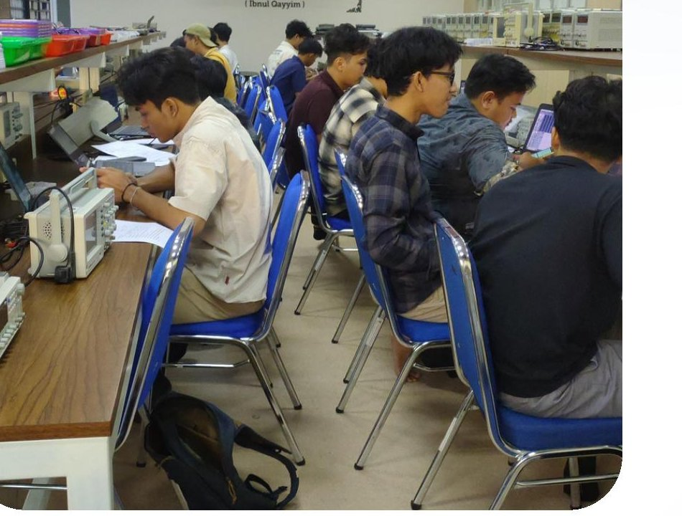
MUHAMMAD FATHONI
PAGE 14 / 17
Electrical Engineer · AI & IoT Enthusiast
05 · EXPERIENCE (CONT.)
Professional Experience
Laboratory Assistant — Digital Systems (VHDL & FPGA)
2024 – 2025
Department of Electrical Engineering, Universitas Islam Indonesia
Yogyakarta
Mentored students on digital logic design using VHDL and FPGA implementation.
Supervised hands-on laboratory work in combinational and sequential logic circuits.
Laboratory Assistant — Electric Circuit II
Feb 2024 – Aug 2024
Department of Electrical Engineering, Universitas Islam Indonesia
Yogyakarta
Mentored second-year students on AC circuit analysis, network theorems, and resonance.
Conducted lab assessments and supported instructors during practical sessions.
Lab session — undergraduate practical
TEACHING PROFICIENCY
Across four semesters as a laboratory assistant, I have mentored over 200 undergraduate students in core electrical engineering subjects — from fundamental circuit theory to modern control systems and digital design. This experience has sharpened my technical communication skills, patience, and ability to break down complex concepts.
fathonimuhammad2411@gmail.com
+62 822-5850-3481
linkedin.com/in/muhammad-fathoni-038274266

Slide 18
MUHAMMAD FATHONI
PAGE 15 / 17
Electrical Engineer · AI & IoT Enthusiast
06 · LEADERSHIP
Leadership & Organizations
IEEE STUDENT BRANCH UII
UASC ELECTRIC VEHICLE
Director of Academies
Head of Programming Division
Jun 2024 – Present
May 2024 – Mar 2025
Academies Staff
Electrical Engineer Staff
Mar 2023 – Jun 2024
Dec 2023 – May 2024
Member (IEEE Global)
Electrical Engineer Intern
Jan 2024 – Dec 2024
Jul 2023 – Dec 2023
UNISI ROBOTIC UII
UII EXCELLENT COMMUNITY (UII EC)
Electrical Division Staff
Full Scholarship Awardee
May 2024 – Present
Aug 2022 – Present
COMMITTEE EXPERIENCE
Electrical Link Togetherness (ELITE) — Master of Ceremony
Events Department · Department of Electrical Engineering UII
Hosted department-wide events; coordinated event flow and on-stage communication.
fathonimuhammad2411@gmail.com
+62 822-5850-3481
linkedin.com/in/muhammad-fathoni-038274266

Slide 19
MUHAMMAD FATHONI
PAGE 16 / 17
Electrical Engineer · AI & IoT Enthusiast
07 · ACHIEVEMENTS AND CERTIFICATIONS
Achievements
Certifications
1ST
1st Place — IT Centrum Startup Hackathon 2024
HCIA-Datacom V1.0
Universitas Islam Indonesia · Dec 13–14, 2024
Huawei Talent Online
Dec 13, 2023
1ST
1st Place — Business Idea Competition
Basic PLC Training
Student Entrepreneur Day 2024
Dept. of Electrical Eng., UII
Dec 21, 2024
4TH
4th Place — PKM IC Karsa Cipta Scheme
Ministry of Education · 2024
Python for Data Science (Beginner)
Nov 2024 & May 2025
★
PKM Karsa Cipta Funding Recipient
Dept. of Electrical Eng., UII
Ministry of Education · 2024
Leadership Training UII EC 2022
3RD
3rd Place — PKM IC Community Service Scheme
UII Student Affairs Directorate
Jun 29, 2024
Ministry of Education · 2025
5TH
5th Place — PKM IC Innovative Work Scheme
Personal Development Basic Training
Jun 25, 2023
Ministry of Education · 2025
UII Student Affairs Directorate
★
UII Excellent Community Full Scholarship Awardee
IEEE Leadership Class 2022
Nov–Dec 2022
UII · 2022 – 2026
IEEE Student Branch UII
fathonimuhammad2411@gmail.com
+62 822-5850-3481
linkedin.com/in/muhammad-fathoni-038274266

Slide 20
08 · CONTACT
Let's Work
Together.
I'm open to engineering, AI/ML, and data roles, and ready to contribute.
EMAIL
fathonimuhammad2411@gmail.com
PHONE
+62 822-5850-3481
LINKEDIN
linkedin.com/in/muhammad-fathoni-038274266
LOCATION
Ngemplak, Sleman, Yogyakarta, Indonesia
THANK YOU FOR YOUR CONSIDERATION

