Slide 1
NETFLIX STOCK PROJECT
BY
OLANIKE ADEOYE

Slide 2
LIST OF VISUALIZATIONS
A visualization of the distribution of the stock prices for Netflix in 2017
A visualization and a summary of Netflix stock and revenue for the past four quarters
A visualization and a brief summary of their earned versus actual earnings per share
A visualization of Netflix stock against the Dow Jones stock (to get a sense of the market) in 2017

Slide 3
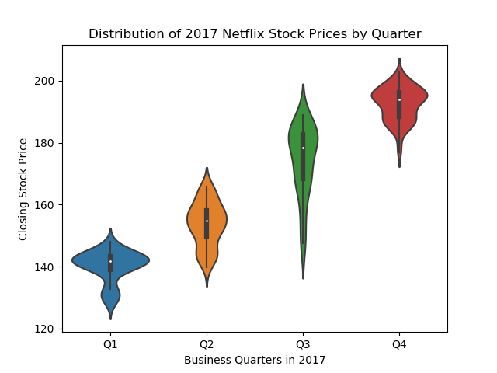
Netflix stock prices distribution in 2017

Slide 4
Netflix's earnings and revenue in the four quarters of 2017
Revenue and earnings follows a growth trend
Approximately 10% of the revenue constitutes earnings

Slide 5
The actual vs. estimated earnings per share for the four quarters in 2017
The purple dots suggest that the actual and estimated values of Netflix Earnings Per Share (EPS) were equal in the second and fourth quarter of 2017.

Slide 6
Netflix Stock price vs the Dow Jones Industrial Average price in 2017
Netflix performed lower than Dow Industrial Average in 2017
Netflix Stock Price was also more volatile than the industry average
Netflix appears to be at the lower rank of industry average for the year

