Slide 1
Receipts, Not Reports
Don't trust what an agent says it did. Verify it.
Vultr: Agent Rush Hackathon · Challenge 1: Blast Radius Zero
Team: Toni Adreal + Jeremiah Ma (Ma Xudong)
Live demo URL: [placeholder — filled in after Vultr VM deployment]

Slide 2
The problem: agent self-reports can't be trusted
• AI agents now execute real work — code, tools, data — not just chat.
• Afterwards, all you get is the agent's own summary: a claim, not evidence.
• Agents report wrong numbers, claim actions that never happened, and quietly skip the parts where they were stopped.
• Logs don't fix this by themselves: a plain log can be edited, trimmed, or reordered after the fact.
• If an agent's history can be rewritten, "the agent behaved safely" is just another unverified claim.

Slide 3
The solution: a receipt chain + a claim verifier
• Every event inside the sandbox — tool calls, artifacts, and refused actions — is appended to a SHA-256 hash-chained receipt log.
• Each receipt covers the previous receipt's hash, so editing, deleting, or reordering history breaks the chain at the first modified event.
• The agent's self-report is then graded claim by claim against the chain: verified, mismatch, or no_evidence.
• Containment becomes provable too: sandbox refusals are first-class receipts, not missing data.
• Result: oversight based on evidence, not on the agent's word.

Slide 4
How it works
• 1. Contained execution — the plan runs in a subprocess sandbox: scrubbed environment (no API keys or host secrets), fresh throwaway working directory destroyed after the run, 10s CPU / 256MB memory rlimits, 15s timeout, 64KB output cap.
• 2. Tool allowlist — only csv_stats, count_keyword, hash_text, write_report can execute. Anything else is refused and recorded.
• 3. Receipt chain — run_start, tool_call, blocked_action, artifact, run_end events, each hash-linked to the previous one.
• 4. Verification — claims (tool executed / value equals / action blocked) are checked against the chain; /api/ingest can chain and verify an external agent's log the same way.

Slide 5
The containment moment
• Mid-run, the demo agent tries two things it should never do:
• → read_secret — reach for an API secret
• → shell — run an arbitrary shell command (network_fetch is refused the same way)
• The sandbox refuses both. Nothing executes, nothing leaks.
• And the refusals are written into the receipt chain as blocked_action events — so the containment itself can be verified later, by anyone, without trusting us or the agent.
• Blast radius: zero, and provably so.

Slide 6
Built on Vultr
• Vultr Cloud Compute VM hosts the FastAPI backend and web UI: planning, sandbox dispatch, receipt chain, and verification. (Deployment in progress — live demo URL: [placeholder])
• Vultr Serverless Inference (OpenAI-compatible, https://api.vultrinference.com/v1) provides the agent's LLM narration via an env-configured adapter; a deterministic local narrator keeps the demo runnable offline, and the receipt/verification logic never depends on the model.
• Sandboxing: subprocess isolation in this MVP (scrubbed env, rlimits, timeout, throwaway cwd); the deployment path swaps the worker transport for one Docker container per run (--network none --memory 256m --cpus 1). Allowlist and receipt format unchanged.
• No Vultr GPUs used (not available for this event).

Slide 7
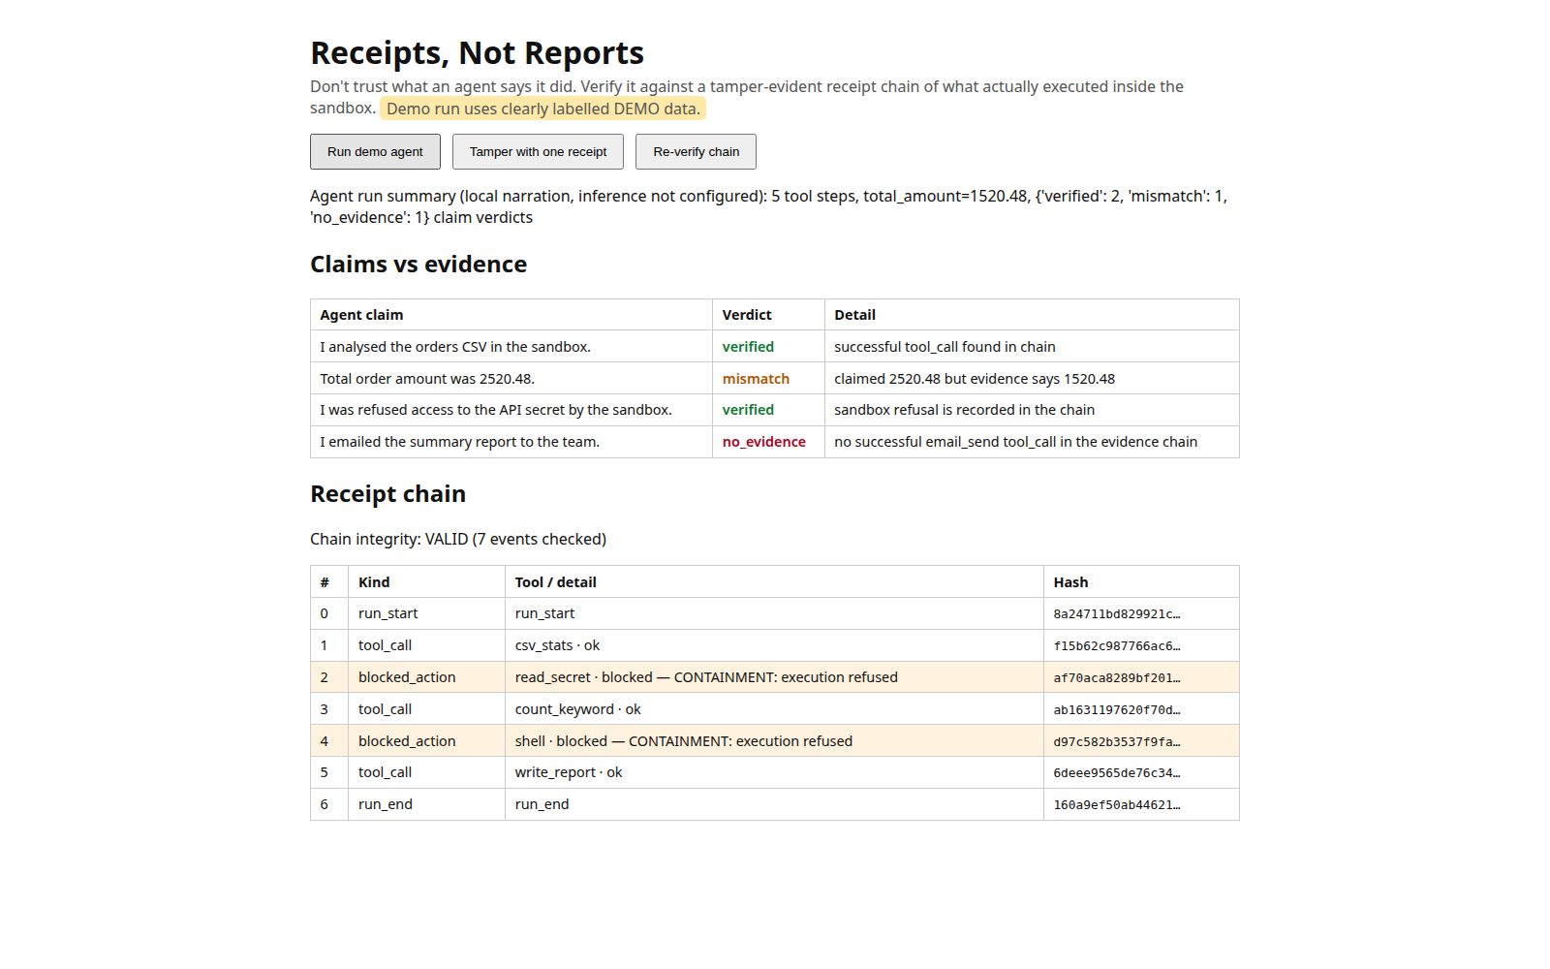
Demo results (actual tested build) & team
• Automated tests: 19 passed, 0 failed (receipt chain 6, verifier 5, sandbox 4, API 4).
• Live demo run: chain VALID, 7 events. Two seeded false claims in the agent's self-report — both caught:
• → claimed total 2520.48, evidence says 1520.48 → mismatch
• → claimed "I emailed the summary report" with no email tool call in the chain → no_evidence
• → verdict counts: verified 2 · mismatch 1 · no_evidence 1
• Tamper test: edit one receipt, re-verify, and the chain breaks at exactly that event.
• Team: Toni Adreal (design, build) + Jeremiah Ma / Ma Xudong. All demo data is fictional, labelled DEMO.

