Slide 1


EXECUTIVE SUMMARY VISUAL
The Anclora
ecosystem
A product architecture that adapts to every business without losing coherence.
Client onboarding document · version 1.0
ANCLORA GROUP · CLIENT ONBOARDING
01
Notes:
Fuente: Manual V1 revisado, portada.

Slide 2
THE PROPOSITION
One system for very different products
Versatility comes from separating the decisions that truly change.
The ecosystem keeps one semantic foundation while adapting structure, identity, brightness and product accent.
01
02
03
04
Structure
Identity
Theme
Product
How the surface is used
How strong the brand feels
Light or dark
Which accent it needs
EXECUTIVE SUMMARY VISUAL
02
Notes:
Source: Manual V1 reviewed, page 4, System taxonomy.

Slide 3
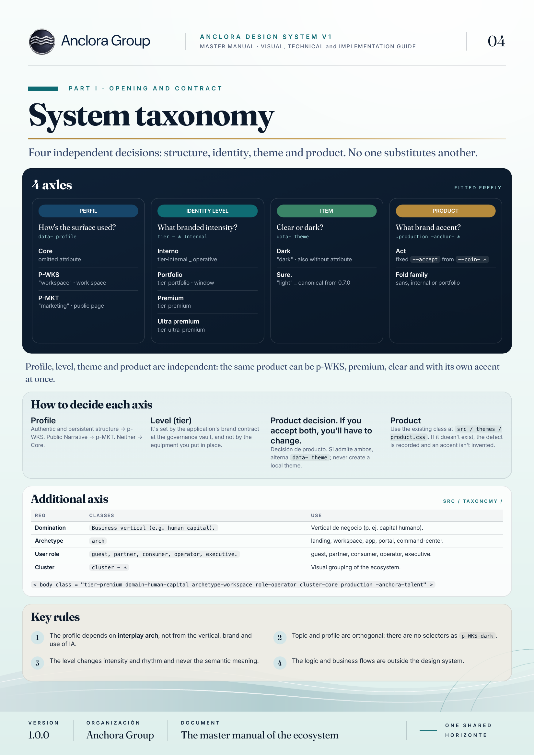
PART I · TAXONOMY
Four independent decisions
One product can combine all four without one replacing another.
Profile
Workspace or Marketing
Defines the surface type
Level
Core, Premium or Ultra premium
Defines intensity and rhythm
Theme
Light or dark
Defines brightness
Product
Brand accent
Defines the product expression
EXECUTIVE SUMMARY VISUAL
03
Notes:
Source: Manual V1 reviewed, page 4, System taxonomy.

Slide 4
PART I · TAXONOMY
The experience adapts without fragmenting
Profile, theme and accent are separate layers of the same contract.
P-WKS
P-MKT
Authenticated workspace
Narrative public page
Persistent navigation
High density
Repeated workflows
Single-scroll journey
Action-oriented
No authentication
The structure changes; semantics and accessibility remain.
EXECUTIVE SUMMARY VISUAL
04
Notes:
Source: Manual V1 reviewed, pages 5 and 6, themes, profiles and P-WKS/P-MKT architecture.

Slide 5
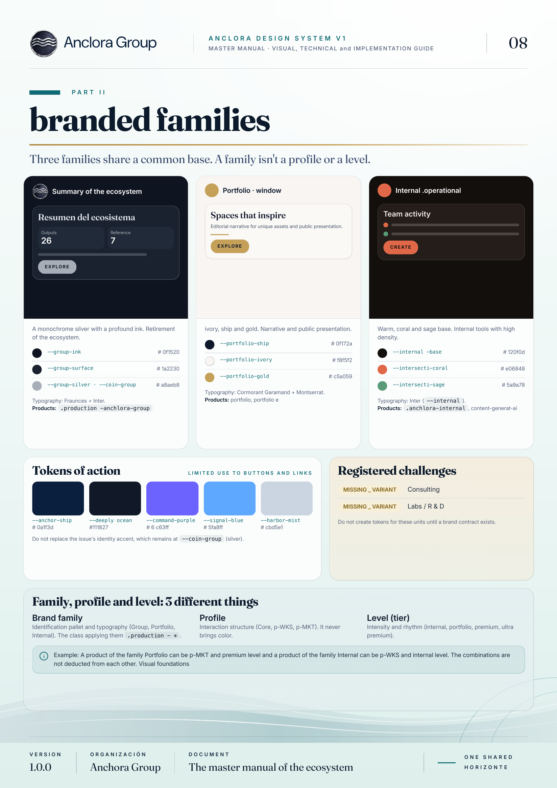
PART II · BRAND FAMILIES
One shared foundation. Three brand expressions.
The family brings identity; the profile brings structure; the level brings intensity.
Group
Monochrome silver on deep ink
Portfolio
Ivory, navy and gold. Editorial narrative
Internal
Warm base, coral and sage. High density
EXECUTIVE SUMMARY VISUAL
05
Notes:
Source: Manual V1 reviewed, page 8, Brand families.

Slide 6
PART II · BRAND FAMILIES
What can change and what must remain
Personalisation follows a contract, not improvisation.
Can change
Must remain
• Identity palette
• Family typography
• Product-specific accent
• Experience intensity and rhythm
• System semantics
• Accessibility
• Navigation contracts
• Coherence across surfaces
The result: recognisable products, even when their visual expression differs.
EXECUTIVE SUMMARY VISUAL
06
Notes:
Source: Manual V1 reviewed, pages 5 and 8, themes, profiles and brand families.

Slide 7
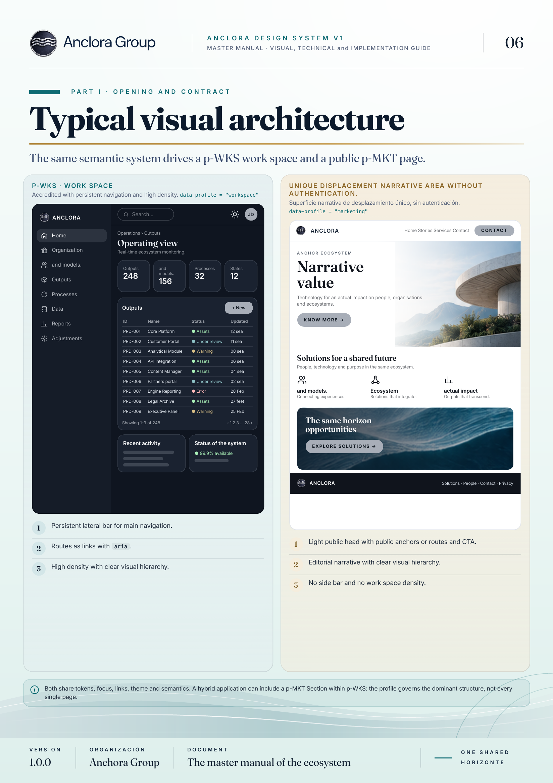
PART IV · PRODUCT ARCHITECTURE
Two surfaces, one logic
The system provides the anatomy; each product defines routes, permissions and data.
P-WKS
Continuous operational work
Authenticated structure, persistent navigation and high density.
P-MKT
Presentation and conversion
Public, narrative and action-oriented surface.
EXECUTIVE SUMMARY VISUAL
07
Notes:
Source: Manual V1 reviewed, page 6, Typical visual architecture.

Slide 8
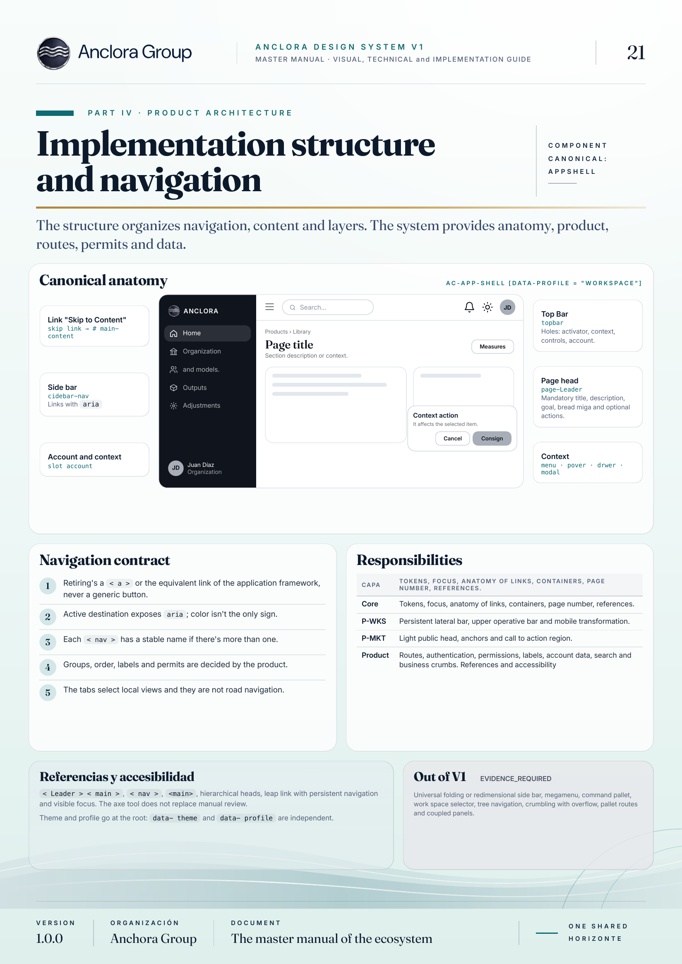
PART IV · PRODUCT ARCHITECTURE
Architecture organises the experience
Structure defines how people discover, use and extend the product.
01
Navigation
Clear routes and hierarchy
02
Content
Visible layers and priorities
03
Accessibility
Focus, semantics and return
04
Product
Permissions, data and business
EXECUTIVE SUMMARY VISUAL
08
Notes:
Source: Manual V1 reviewed, page 21, Application structure and navigation.

Slide 9
PART IV · PRODUCT ARCHITECTURE
Shared patterns accelerate onboarding
Common compositions let the product keep its own business logic.
01
Access
02
Settings
Sign in, recover and communicate errors
Group preferences and actions
03
Upload
04
Results
Separate selection and processing
Show progress, state and actions
05
Bulk actions
06
Confirmation
Act only after explicit selection
Explain the consequence before destruction
The composition is shared. Execution, state and data remain part of the product.
EXECUTIVE SUMMARY VISUAL
09
Notes:
Source: Manual V1 reviewed, page 24, Shared product patterns.

Slide 10
ONBOARDING
An ecosystem ready
to grow with you
The client conversation starts with the product.
Architecture gives every decision a clear place and reason.
01
Understand
02
Configure
03
Activate
Which product and surface the client needs
Which profile, level, theme and family fit
Which patterns and routes form the first release
ANCLORA GROUP · CLIENT ONBOARDING
10
Notes:
Commercial close derived from the taxonomy, brand families and product architecture sections of the reviewed V1 Manual.

