Slide 1
Overall Conceptual Model - challenge with ‘Off Page Connectors’
2025-11-20 V1 Tonia Pedersen/ Manfred Theißen

Slide 2
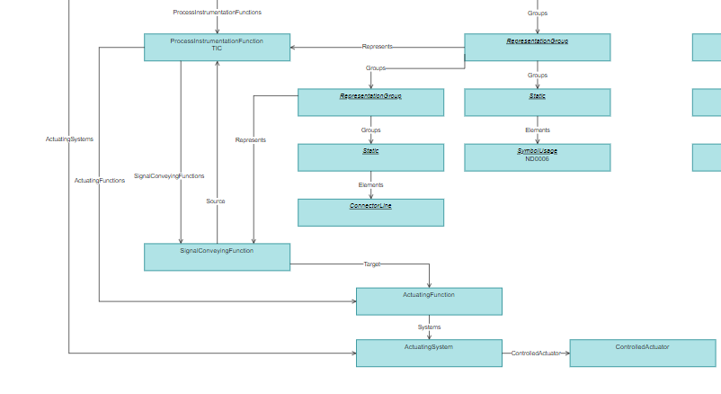
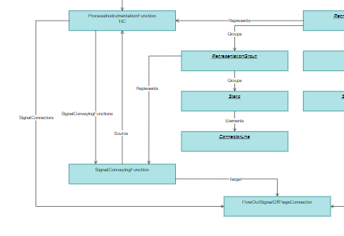
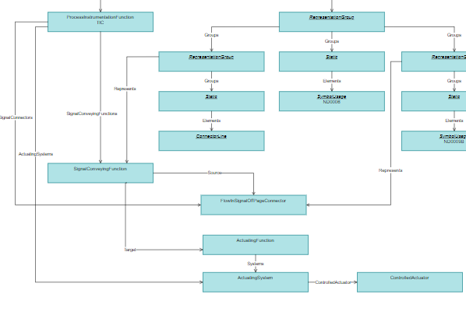
Motivation
DEXPI 2.0 – overall conceptual model
DEXPI 2.0 supports a single conceptual model for multiple drawings
‘Off Page Connectors’ as they are defined cannot be supported using this single model approach.
Gap:
‘Off Page Connectors’ are inherently linked to the drawing boundary
The Conceptual Model should not be bound by the drawing boundary
VS
+

Slide 3
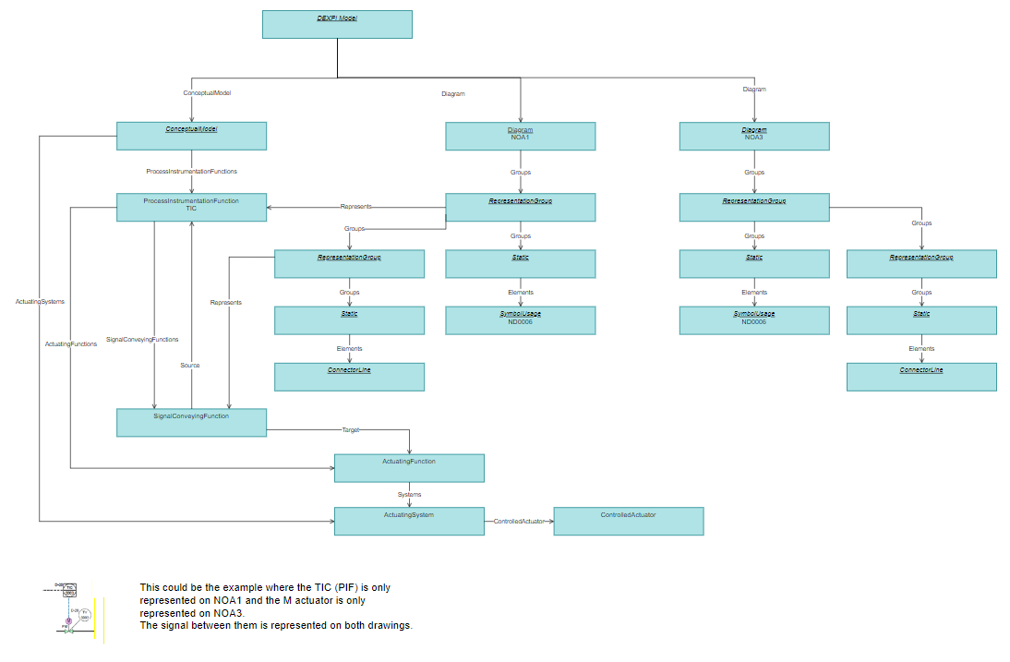
Single Conceptual Model – 2 Drawings
SignalConveying Function
Source: ProcessInstrumentationFunction
Target: ActuatingFunction

Slide 4
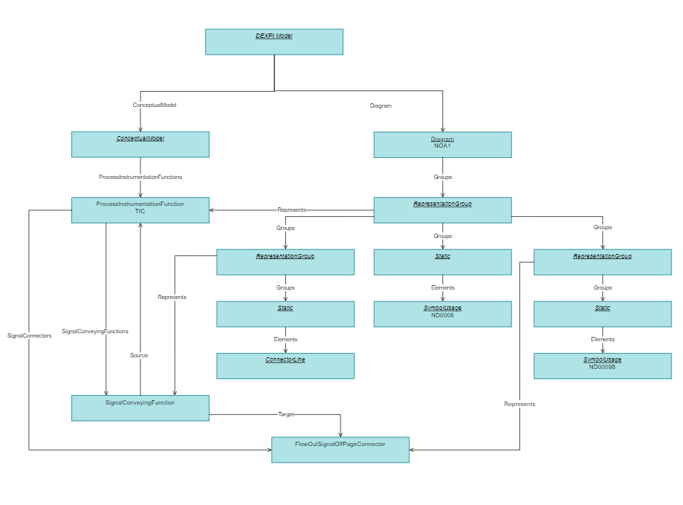
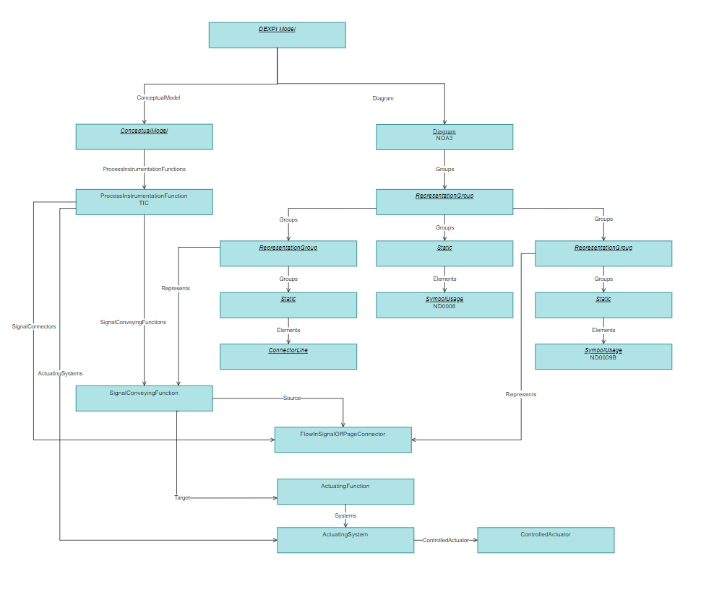
2 Drawings & 2 Conceptual Models
SignalConveying Function
Source: ProcessInstrumentationFunction / FlowInSignalOffPageConnector
Target: FlowOutSignalOffPageConnector / ActuatingFunction
Drawing 1
Drawing 2

