Slide 1
DEXPI Primitives – Stroke / DashStyle
2025-10-?? V1 Tonia Pedersen/Manfred Theißen

Slide 2
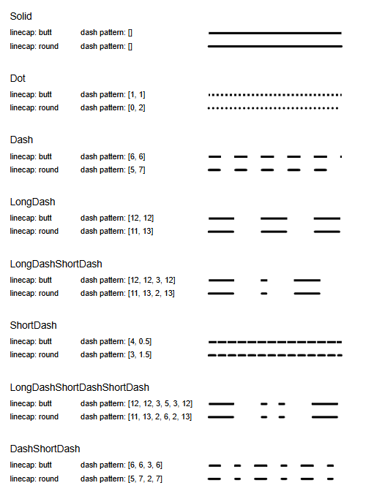

Motivation
Current DEXPI DashStyle:
Limited to basic dash/dot patterns
Limited linecap types
New DashStyles required:
DashStyle to include symbol in pattern
Linecap
Scaling of line – scale the markup as well ?
Dash pattern []
Markup pattern:
Symbol primitive definition -
Symbol distance: 8
Start offset: 6.5

Slide 3
Proposal
Do not copy the features of svg.
Need to cover:
Sub-symbol
Repeating pattern to include dash/dot/sub-symbol
Line caps
Double lines (multi-line?)

