Slide 1
DEXPI Primitives – Stroke / DashStyle
2025-10-29 V1 Tonia Pedersen/Manfred Theißen

Slide 2
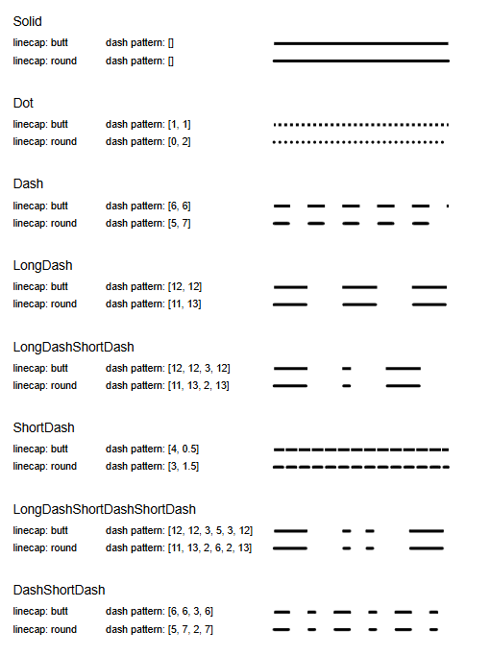
Motivation
Current DEXPI LineStroke:
Limited to basic dash/dot pattern enumeration list.
Current DEXPI standard does not define how the given pattern types shall be graphical represented.
Current DEXPI standards does not support model for more complex line styles used on P&IDs; where a symbol(s) form part of the linestyle.

Slide 3
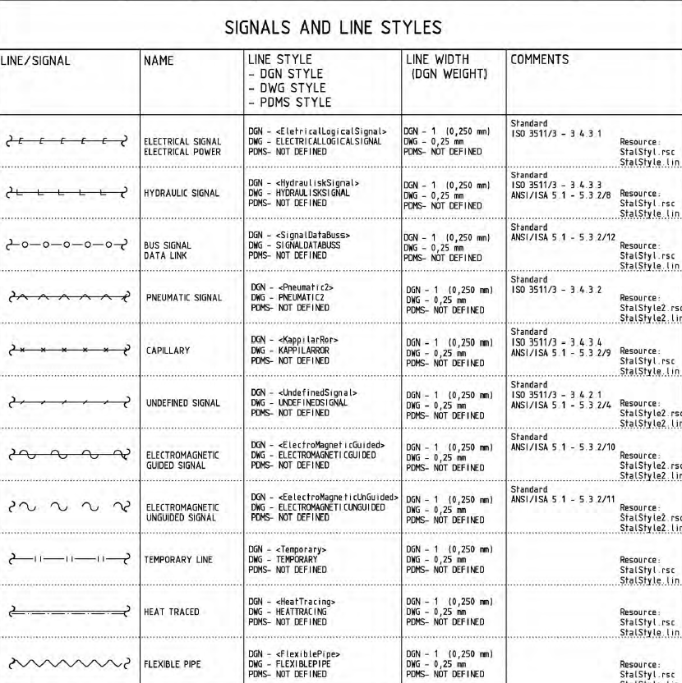
Motivation
New LineStroke/DashStyle required for complex line styles used on P&IDs e.g.:
Electrical signal
Hydraulic signal
Bus signal
Capillary
….

Slide 4
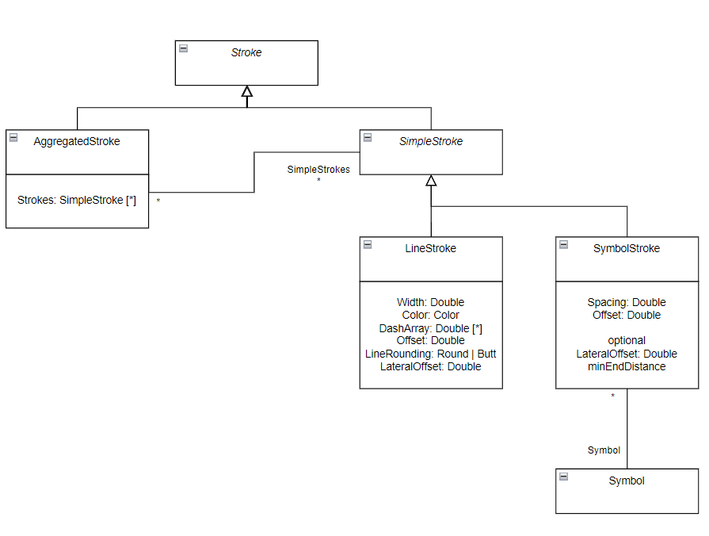
Proposal
New Stroke (Line style) model:
Line Style model to include symbol as ‘markup’ overlay pattern
LineStroke:
Width
Color
DashArray
Offset
LineRounding: Round|Butt
LateralOffset
SymbolStroke:
Spacing
Offset
LateralOffset

Slide 5
Proposal
Special Definitions
DashArray: multi-dimensional array : length of dash, length of space (optional .. additional dash/space lengths)
start at dash
ref. stroke-dasharray - SVG | MDN
Offset: offset on the rendering of the associated dash array
ref. stroke-dashoffset - SVG | MDN
LineRounding: defining the shape to be used at the end of open and corners of subpaths when they are stroked
Valid values: butt | round | square
ref. stroke-linecap - SVG | MDN
LateralOffset: relative lateral offset on rendering of the associated dash array
Symbol: relationship to defined symbol definition.

Slide 6


Example
Symbol overlay example:

