Slide 1
PropertyBreak – Improved definition
2025-11-10 V1 Tonia Pedersen/ Manfred Theißen

Slide 2
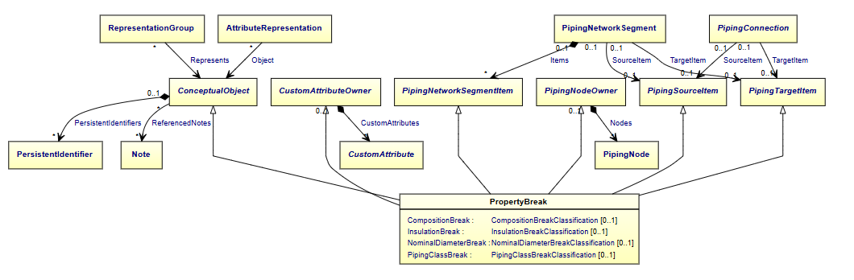
Motivation
Current DEXPI model for PropertyBreak
Limited list of predefined break types
Does not support identifier for break position e.g. for tie-in points
Gap:
Open for other break types
Identification of break point
Break values side1/side2

Slide 3
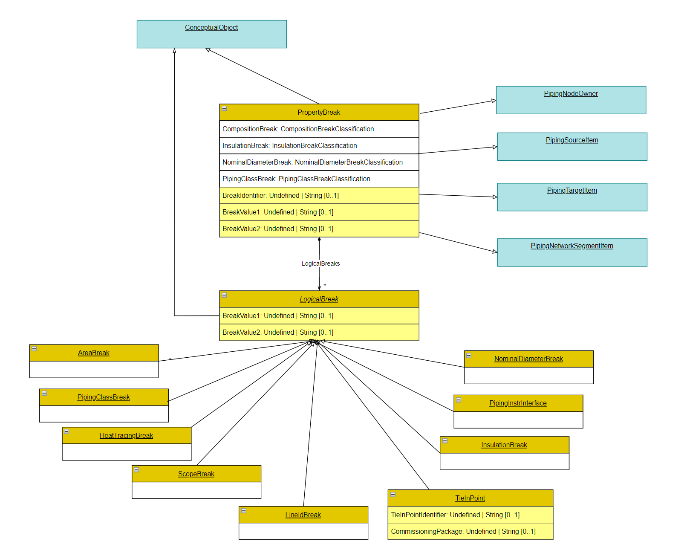
Proposal (DEXPI Information Model)
Modify PropertyBreak class
Add LogicalBreak abstract class to extend the break types available
** Supports: use of 1 symbol for multiple break types.

Slide 4
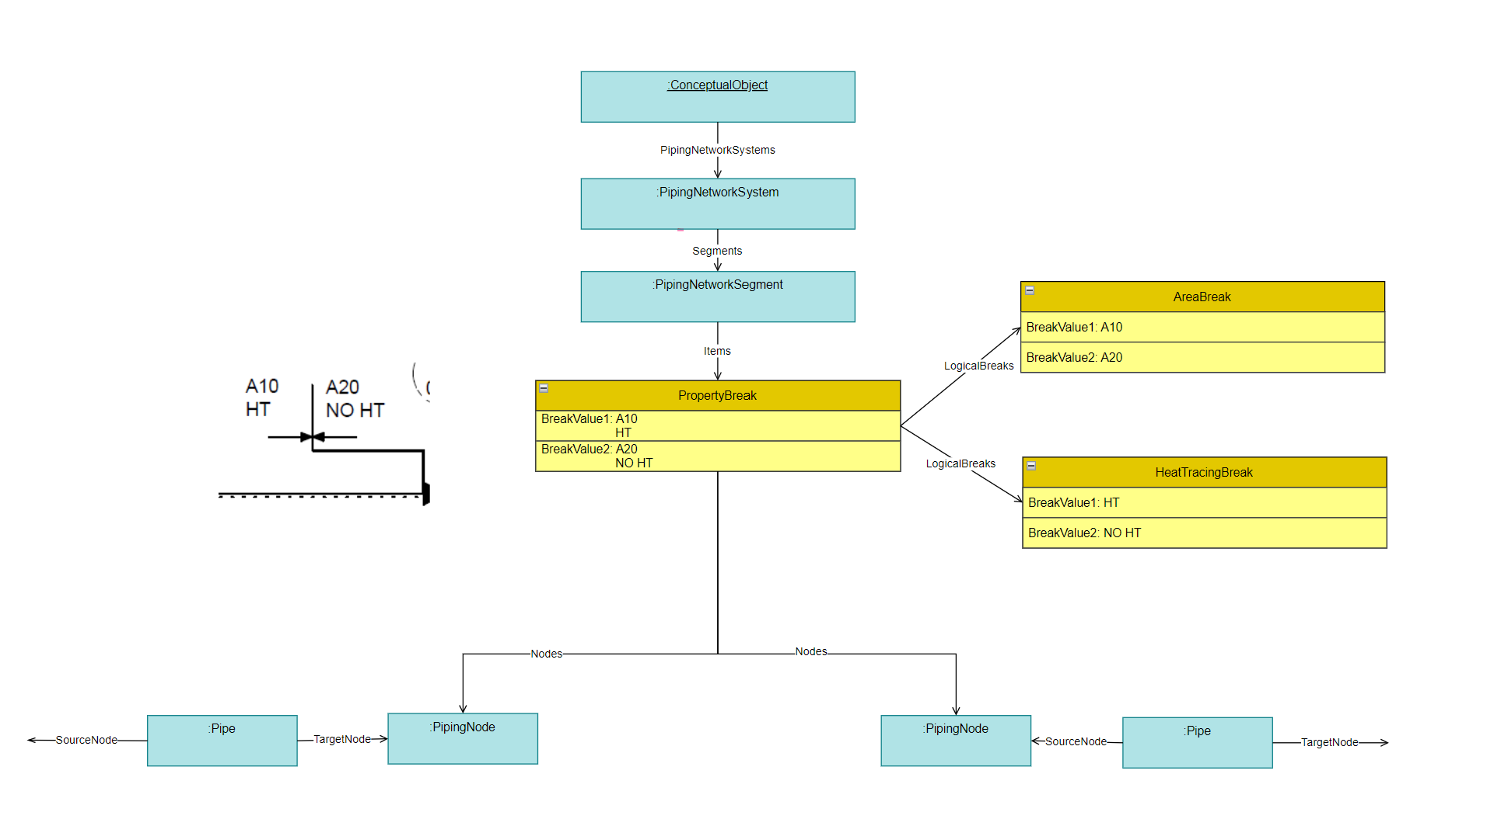
Example

