Slide 1
Vessel & Process Column Internals – capture and relate internal components.
2025-09-29 V1 Tonia Pedersen

Slide 2
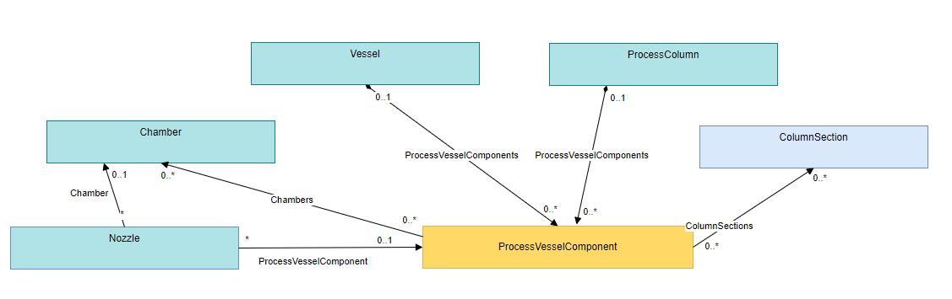
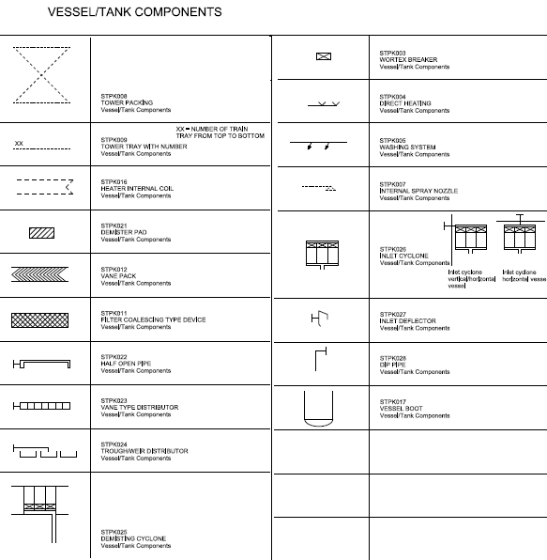
Motivation
Current DEXPI model: There is no possibility to capture vessel & pressure column internal components such as VortexBreaker, Demister.. as components of the main equipment.
Example: vortex breaker, vane pack, tower tray, tower packing, demister pad
How to capture and relate internal components.

Slide 3
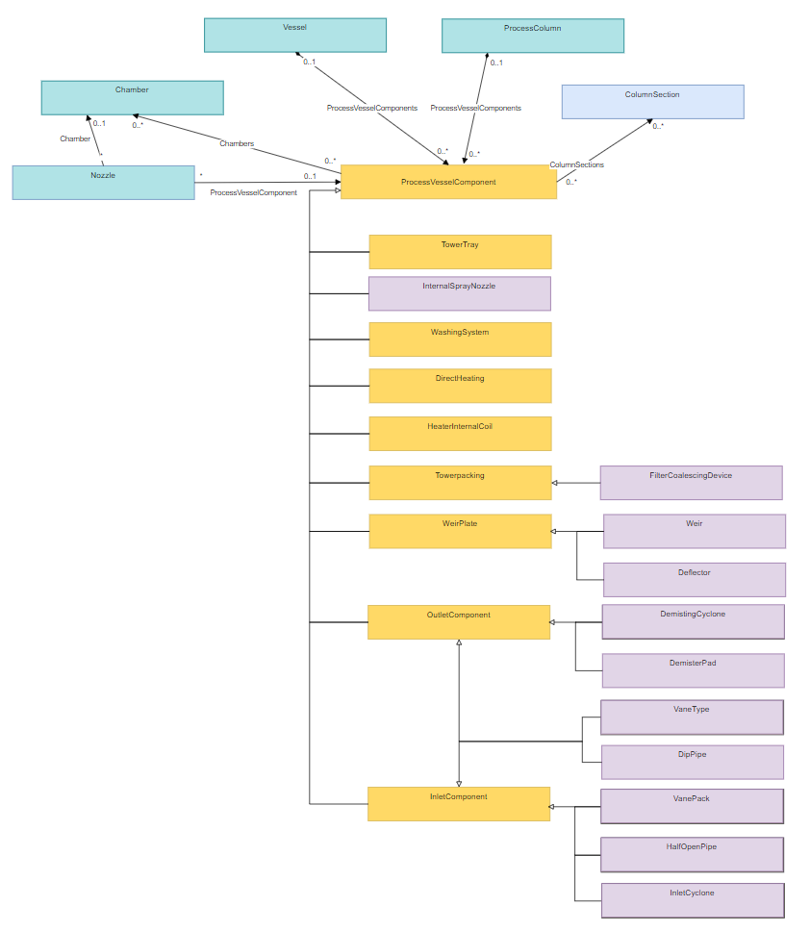
Proposal (DEXPI Information Model)
add new ProcessColumnComponent abstract class
add new sub-type classes for the different component types
Example: vortex breaker, vane pack, tower tray, tower packing, demister pad **Equinor symbol legend
** Yellow: indicates sub-types suggested for inclusion in DEXPI
**Purple: indicates addition custom sub-types identified by Equinor

Slide 4
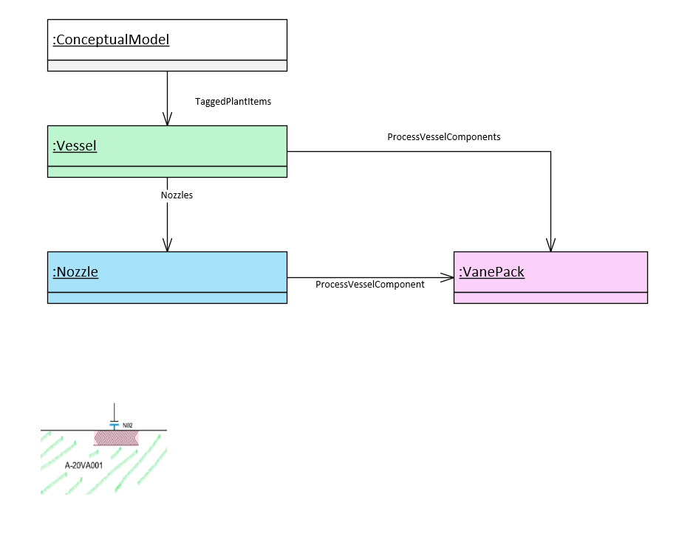
Modelled Example

