Slide 1
Use Cases
Base BluePrint File
Split DEXPI PipingNetworkSegment with a piping tee. E.g. split D-20L00004A DEXPI PipingNetworkSegment by placing a piping tee between the ESV0006 actuated valve and the FE0001 element and include an unnamed valve.
Rename TI0003/TIC0003/TV0003 to TI0013/TIC0013/TV0013 and update associated loop.
Retain the original PersistentID and change the name.
Remove the note and unused nozzle from 20VA001 and update elevation to EL. 400000
Change the type of actuator for HV0001 to a PA006A actuator type
Retain PersistentID of original actuator
Add heat tracing to PipingNetworkSegment D-20L A- PL-AS200-
Modify the heat trace attribute on the segment
Modify TI0007 combination -> TW/TT combination with Special Item on PipingNetworkSegment
** Use ND0037 ‘hidden’ in-line piping component to give location of special item.
Additional property break at one of the break
Add AreaBreak AP110 / AP310 need to associate these to the PipingNetworkSystems
Scale D-20HA001 symbol y-axis scaling 1.25
Modify pipe lines: D-20L00005A-1200PL-AS200- & D-20L00015A-0800PL-AD750- to test PipingNetworkSegment export variants

Slide 2
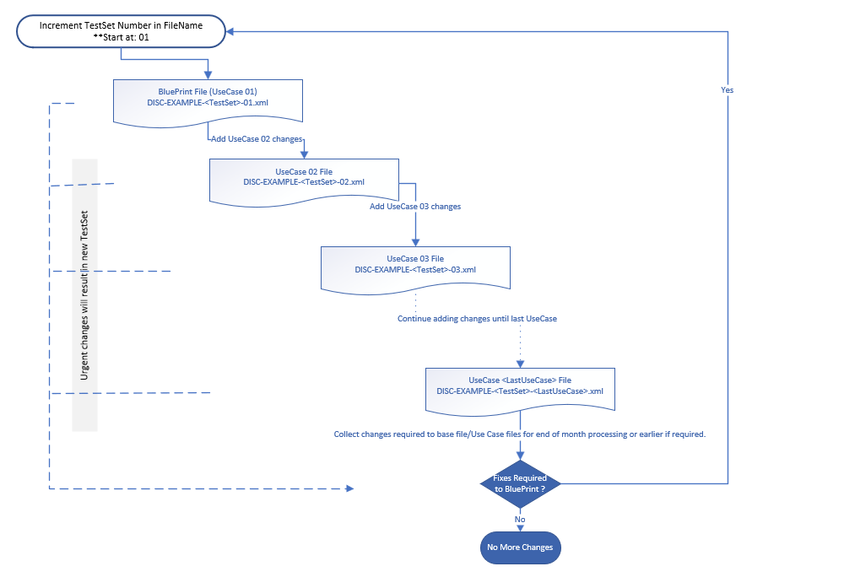
Use Case File Naming - Workflow

Slide 3
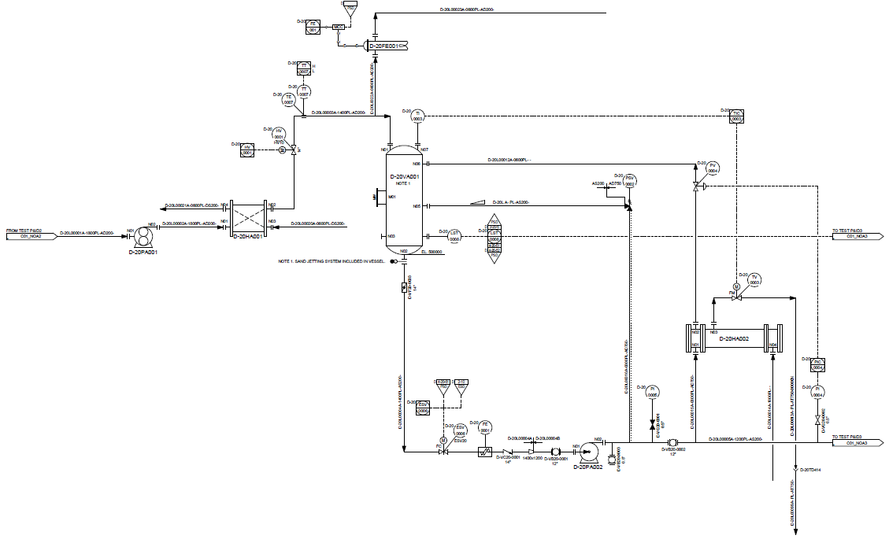
Base BluePrint File

Slide 4
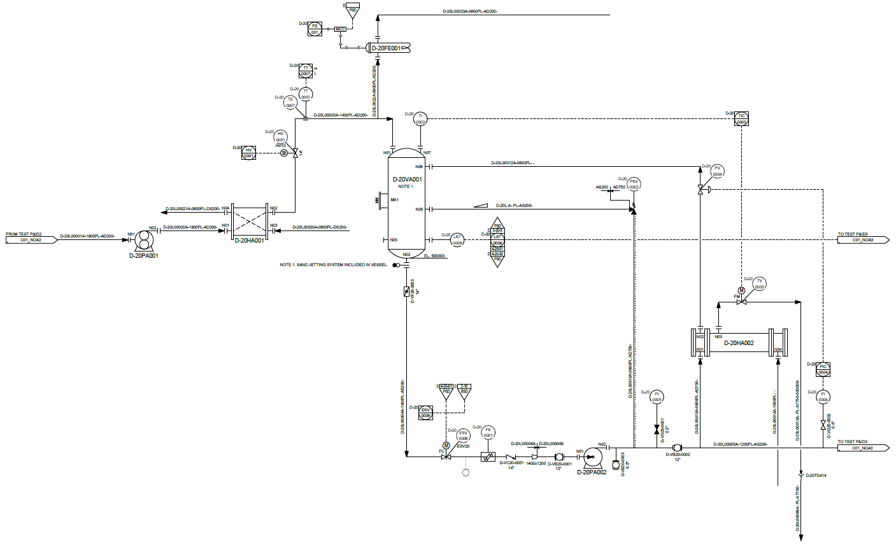
Split DEXPI PipingNetworkSegment with a piping tee. E.g. split D-20L00004A DEXPI PipingNetworkSegment by placing a piping tee between the ESV0006 actuated valve and the FE0001 element and include an unnamed valve.

Slide 5
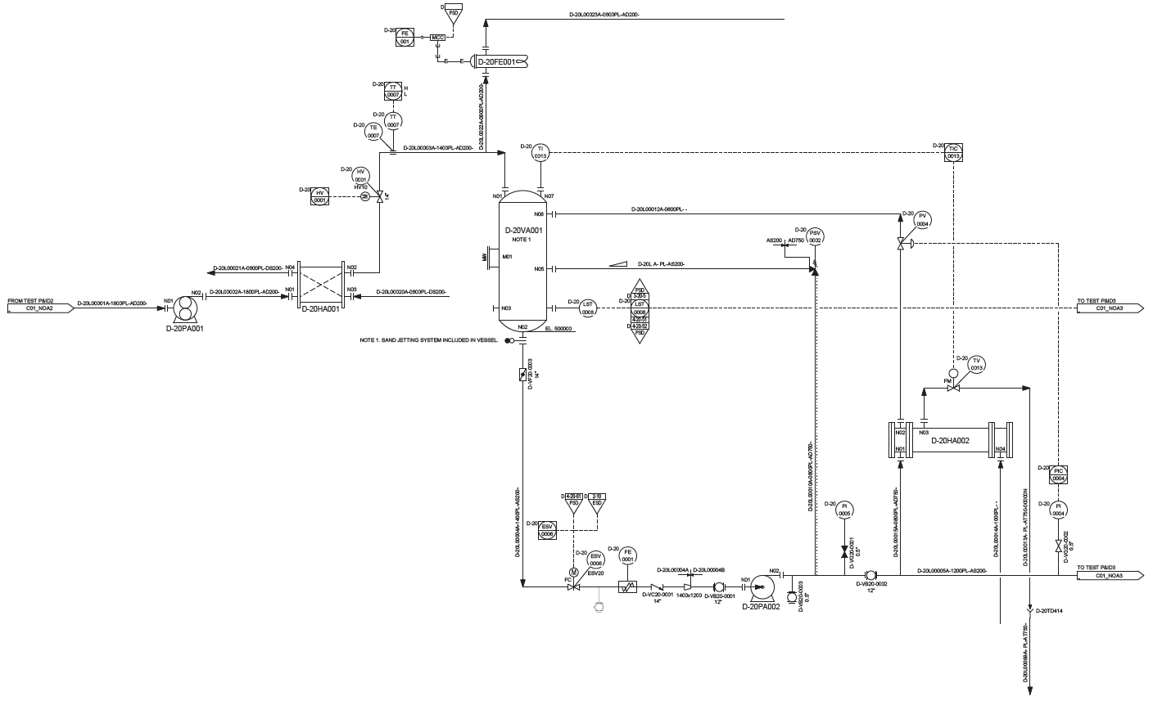
Rename TI0003/TIC0003/TV0003 to TI0013/TIC0013/TV0013 and update associated loop.
Retain the original PersistentID and change the name.

Slide 6
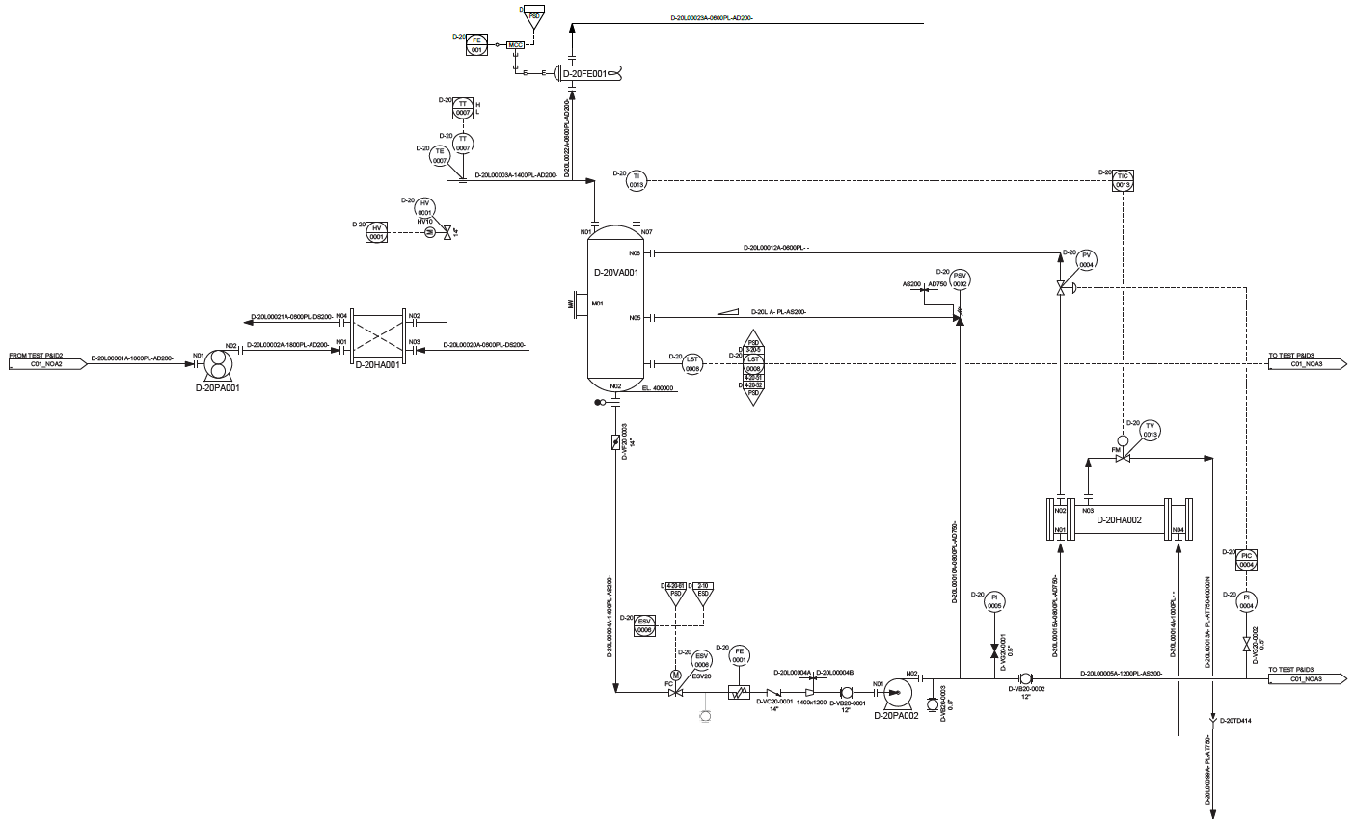
Remove the note and unused nozzle from 20VA001 and update elevation to EL. 400000

Slide 7
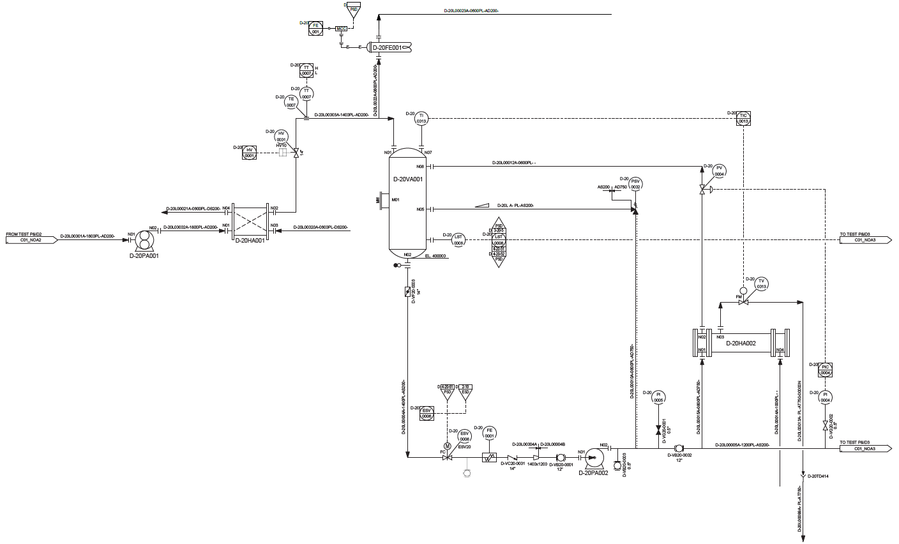
Change the type of actuator for HV0001 to a PA006A actuator type
Retain PersistentID of original actuator

Slide 8
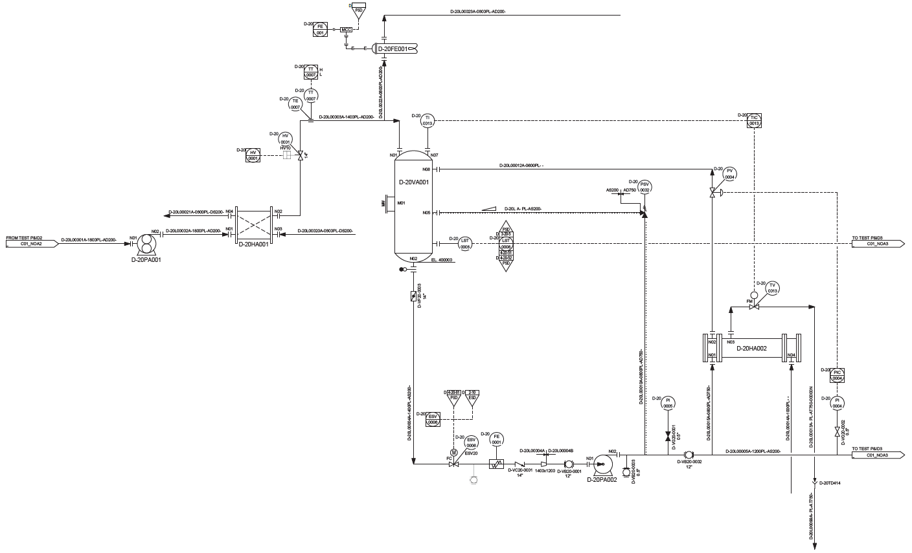
Add heat tracing to PipingNetworkSegment D-20L A- PL-AS200-
Modify the heat trace attribute on the segment

Slide 9
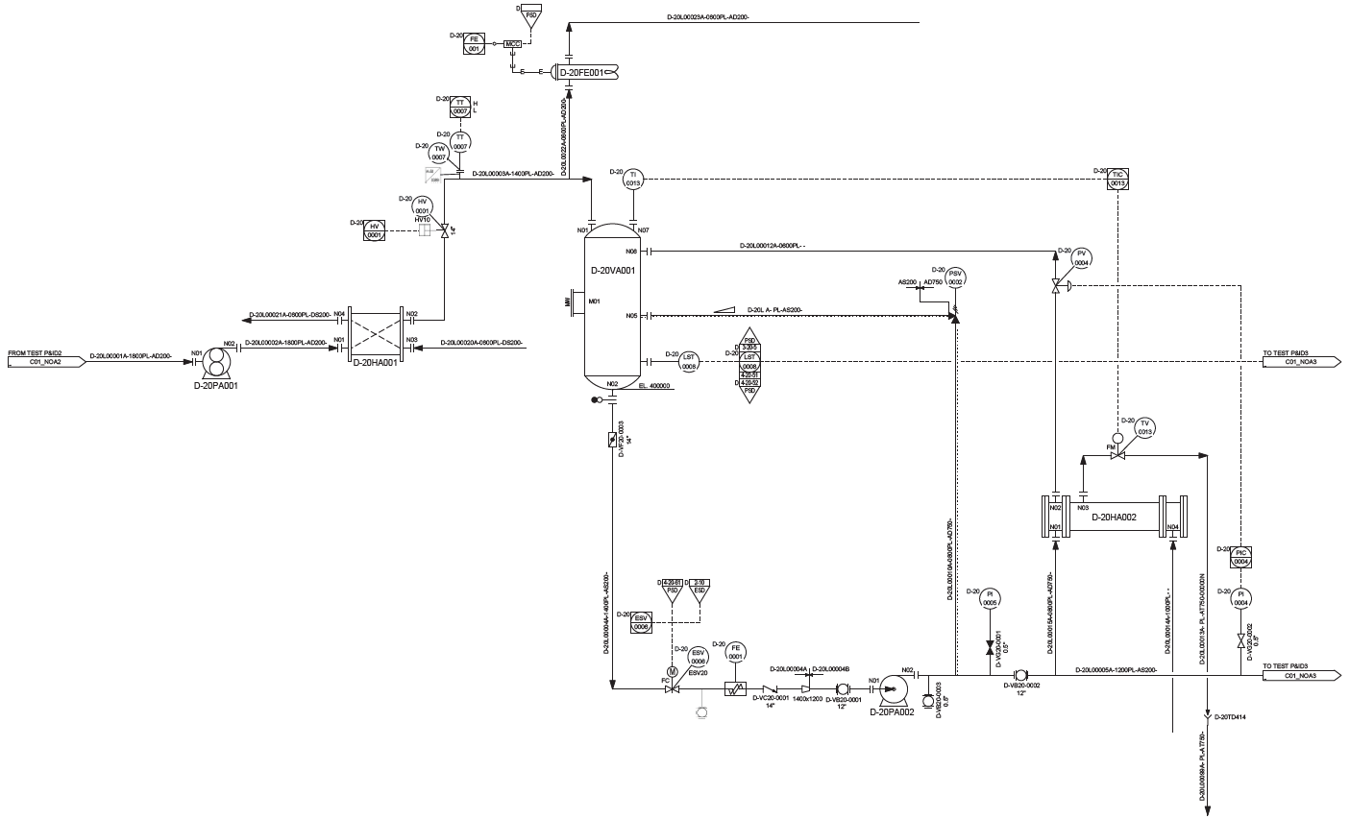
Modify TI0007 combination -> TW/TT combination with Special Item on PipingNetworkSegment
** Use ND0037 ‘hidden’ in-line piping component to give location of special item.

Slide 10
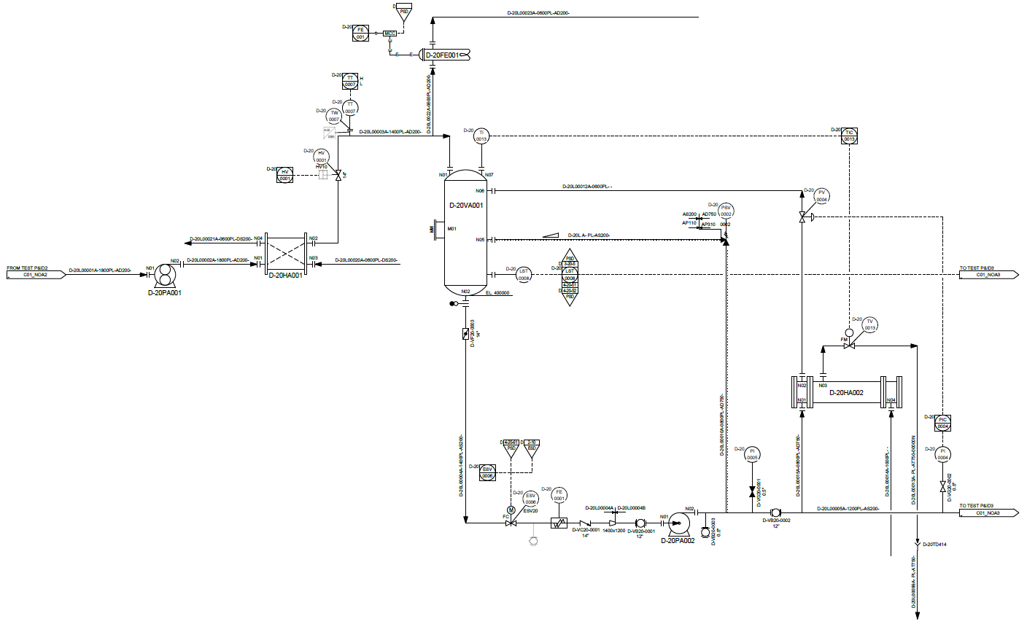
Additional property break to the existing breaks
Add AreaBreak AP110 / AP310 need to associate PlantArea these to the PipingNetworkSystems
** Test transfer of PropertyBreak:
Top break: use 2 PropertyBreak class elements 1 for each break type. 2 separate symbols placed up on each other.
Bottom break: use 1 PropertyBreak class element for both break types. 1 symbol used for the double break.
In each case the BreakValue1 attribute will be used to transfer the text shown on the left-hand side of the break, BreakValue2 will transfer the text on the right-hand side.
AP110
AP310

Slide 11
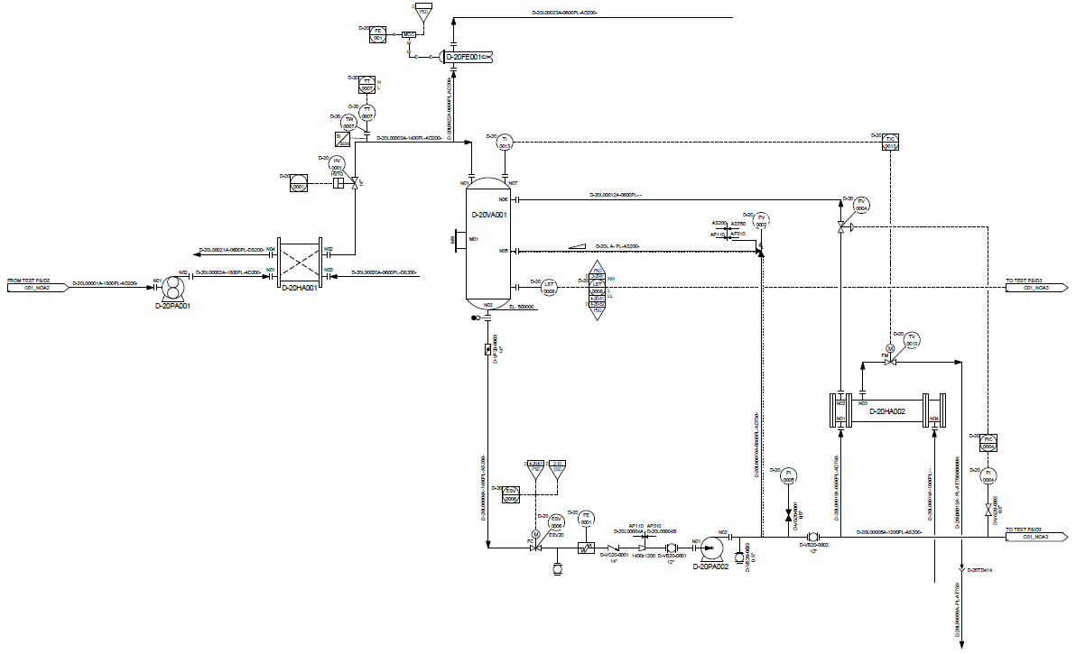
Scale D-20HA001 symbol y-axis scaling 1.25

Slide 12
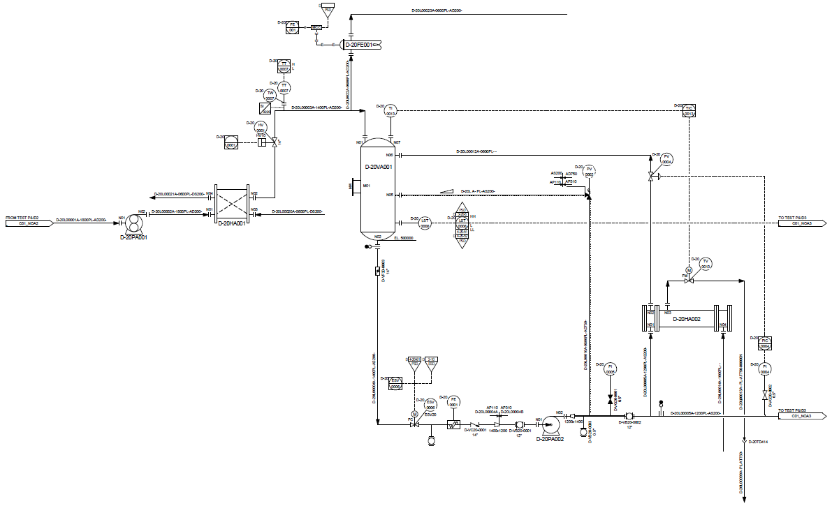
Modify pipe lines: D-20L00005A-1200PL-AS200- & D-20L00015A-0800PL-AD750- to test PipingNetworkSegment export variants
Add reducer to D-20L00005A-1200PL-AS200-
Convert D-20L00015A-0800PL-AD750- into a segment of D-20L00005A-1200PL-AS200- where all piping properties will be the same as D-20L00005A-1200PL-AS200- main pipe.
Add spectacle blind
Add physical piping tee near OPC.
2 PipingNetworkSegments will be created either side of the ball valve that is part of the main line.

