Slide 1
ProcessSafetyFunction – ProcessInstrumentationFunction subtype for safety elements.
2025-08-18 V1 Tonia Pedersen

Slide 2
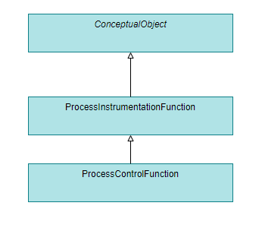
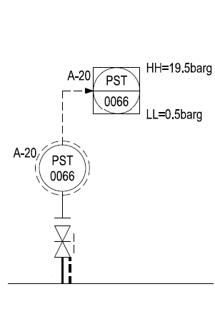
Motivation
Current DEXPI model:
ProcessInstrumentationFunction as a general class definition for instrumentation and/or control structures.
ProcessControlFunction for control structures specifically.
Example:
Unambiguous identification of import Process Safety Functions

Slide 3
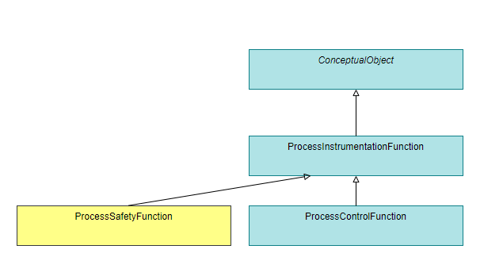
Proposal (DEXPI Information Model)
add new ProcessSafetyFunction class as new sub-type of ProcessInstrumentationFunction

Slide 4
Example
Example:

Slide 5
Proposal (DEXPI 2.0 Implementation)

Slide 6
Example (Proteus, simplified)
Notes:
<ProcessSignalGeneratingSystem ID = "ProcessSignalGeneratingSystem-1" ComponentClass = "ProcessSignalGeneratingSystem">
<ProcessSignalGeneratingSystemComponent ID = "SensorWellReference-1" ComponentClass = "SensorWellReference">
<Association Type = "refers to" ItemID = "SensorWell-1"/>
</ProcessSignalGeneratingSystemComponent>
</ProcessSignalGeneratingSystem>
<PipingNetworkSystem ID = "PipingNetworkSystem-1" ComponentClass = "PipingNetworkSystem">
<PipingNetworkSegment ID = "PipingNetworkSegment-1" ComponentClass = "PipingNetworkSegment">
<PipingComponent ID = "SensorWell-1" ComponentClass = "SensorWell">
<Association Type = "is referenced by" ItemID = "SensorWellReference-1"/>
</PipingComponent>
</PipingNetworkSegment>
</PipingNetworkSystem>

Slide 7
Questions, remarks, …?

