Slide 1
ProcessSafetyFunction – ProcessInstrumentationFunction subtype for safety elements.
2025-09-29 V1 Tonia Pedersen

Slide 2
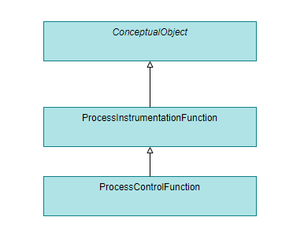
Motivation
Current DEXPI model:
ProcessInstrumentationFunction as a general class definition for instrumentation and/or control structures.
ProcessControlFunction for control structures specifically.
Gap:
Unambiguous identification of import Process Safety Functions
The safety system is an independent barrier against accidents and shall be separate from other systems.

Slide 3
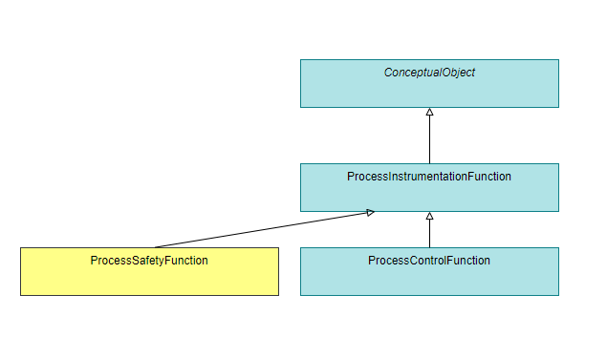
Proposal (DEXPI Information Model)
add new ProcessSafetyFunction class as new sub-type of ProcessInstrumentationFunction

