Slide 1
DEXPI Instrumentation for Norwegian Continental Shelf (NCS) P&IDs
2025-12-15 V1 Tonia Pedersen

Slide 2
Motivation
The current Instrumentation model has been defined based on IEC62424 whereby Process Control Engineering requests are represented on the P&ID as functional requirements (roles) and not the assembly of the equipment.
This is consistent with an approach of a functional / package requirement P&ID style: you can specify performance and constraints without committing to a very granular object model for every component and connection.
Norwegian P&ID approach expects a more equipment-level and connection-precise representation where representation and validation depends on:
having explicit components
explicit connectivity
explicit signal/actuation relationships
The P&IDs shall represent the basis for plant construction. Together with system descriptions and
system control diagrams (SCD), the P&IDs shall show means by which the plant is started up, operated,
controlled, safeguarded, shut down, depressurised and prepared for maintenance. The P&IDs shall show
control and shutdown inputs and outputs to the SAS system. The control and shutdown functions are further
described in the system control diagrams (SCD). *Ref: Equinor TR2339
Endeavouring to use the DEXPI instrumentation model for this level of detail results in:
Inability to represent the level of required detail without awkward workarounds
Possible use of DEXPI representation but loss of exchange consistency across vendors due to inconsistent workarounds

Slide 3
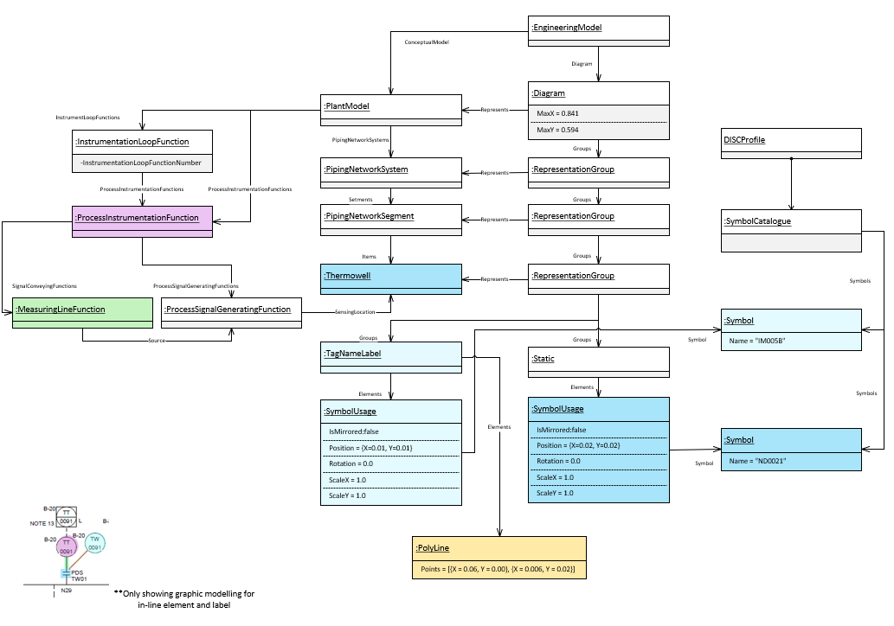
Motivation
Within the DISC DEXPI project a ‘simplified’ Instrumentation model has been used as a workaround to describe the level of detail for process control engineering shown on the Norwegian Continental Shelf (NCS) standard P&IDs.
This “simplified” model “overloads” the ProcessInstrumentationFunction class element as a pragmatic approach while still providing a DEXPI-compliant file. The approach is considered pragmatic because the rules required to generate this simplified model can be directly applied to the configuration used by CAD vendors for file export, without introducing unnecessary complexity or overly burdensome implementation requirements.
This is a workaround and requires the use of ‘custom’ attributes to identify types of process control engineering elements.

Slide 4
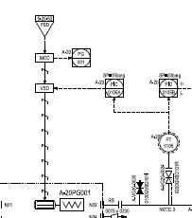
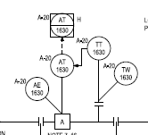
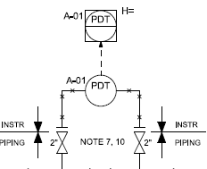
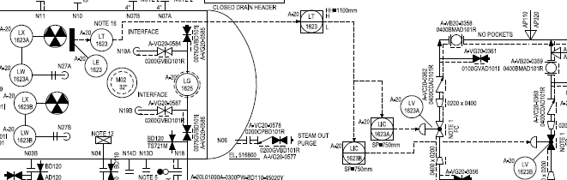
Motivation
Specific pain points related to this issue:
‘Signal’ line modelling:
Master/slave transmitter information flow
Measuring element to transmitter information flow
Multiple sensing locations for differential measurement
Electrical controller to electronic frequency converter (MCC -> VSD) information flow
Discrete source/target information for sensing location
Discrete source/target information for actuating electrical location

