Slide 1
Use Cases – DEXPI 2.0
Base BluePrint File
Safety elements ESV, PSD, ESD, LST mapped as ProcessSafetyFunction
Split DEXPI PipingNetworkSegment with a piping tee. E.g. split D-20L00004A DEXPI PipingNetworkSegment by placing a piping tee between the ESV0006 actuated valve and the FE0001 element and include an unnamed valve.
Rename TI0003/TIC0003/TV0003 to TI0013/TIC0013/TV0013 and update associated loop.
Retain the original PersistentID and change the name.
Remove the note and unused nozzle from 20VA001 and update elevation to EL. 400000
Change the type of actuator for HV0001 to a PA006A actuator type
Retain PersistentID of original actuator
Add heat tracing to PipingNetworkSegment D-20L A- PL-AS200-
Modify the heat trace attribute on the segment
Modify TI0007 combination -> TW/TT combination with Special Item on PipingNetworkSegment
** Use ND0037 ‘hidden’ in-line piping component to give location of special item.
Additional property break at one of the break
Add AreaBreak AP110 / AP310 need to associate these to the PipingNetworkSystems
Scale D-20HA001 symbol y-axis scaling 1.25
Modify pipe lines: D-20L00005A-1200PL-AS200- & D-20L00015A-0800PL-AD750- to test PipingNetworkSegment export variants

Slide 2
Use Cases - continuation
Add pump driver. Add VortexBreaker internal. Change NormalPosition for valve D-VG20-0001 to ‘NC’
Add Mount-on level element (Remove N04) & Add NOA3 continuation drawing
Add CustomEquipmentPackage and add MechanicalJoint

Slide 3
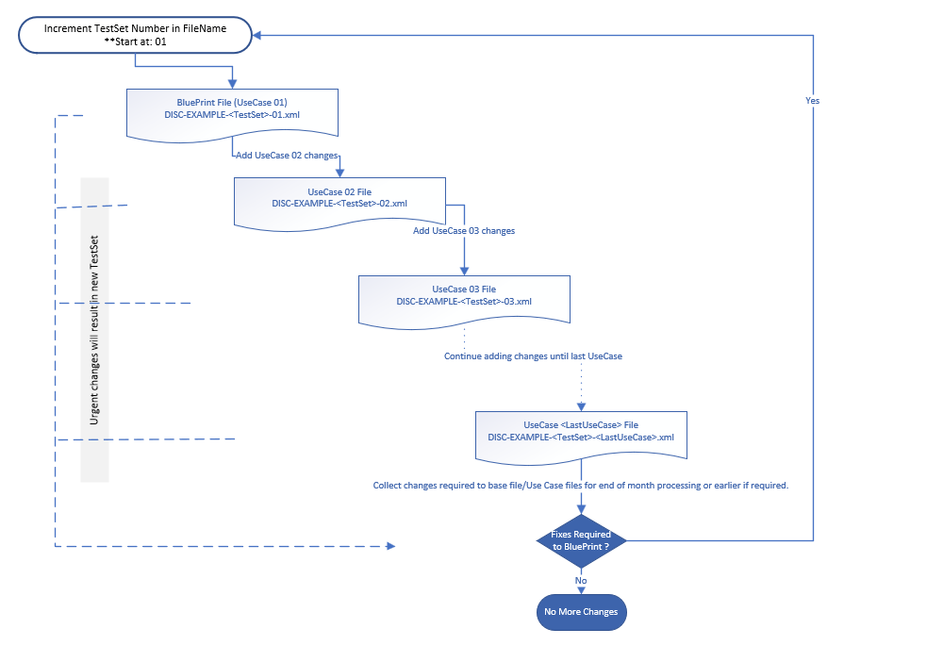
Use Case File Naming - Workflow

Slide 4
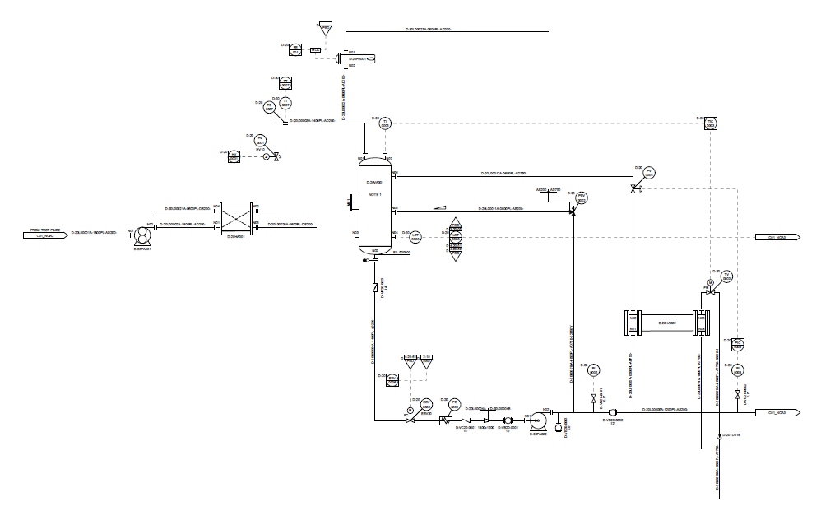
Base BluePrint File

Slide 5
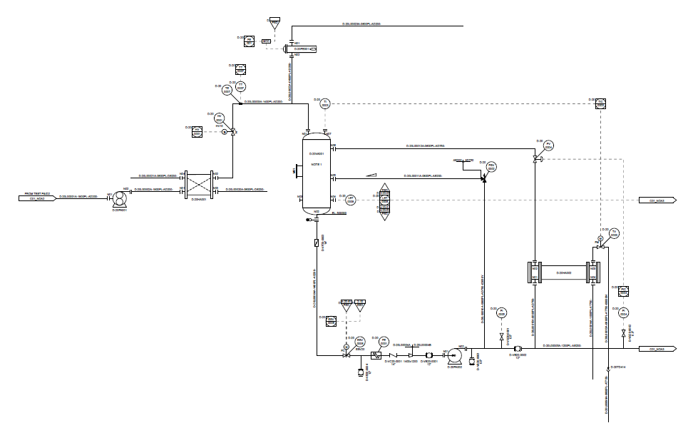
Split DEXPI PipingNetworkSegment with a piping tee. E.g. split D-20L00004A DEXPI PipingNetworkSegment by placing a piping tee between the ESV0006 actuated valve and the FE0001 element and include an unnamed valve.

Slide 6

Rename TI0003/TIC0003/TV0003 to TI0013/TIC0013/TV0013 and update associated loop.
Retain the original PersistentID and change the name.

Slide 7
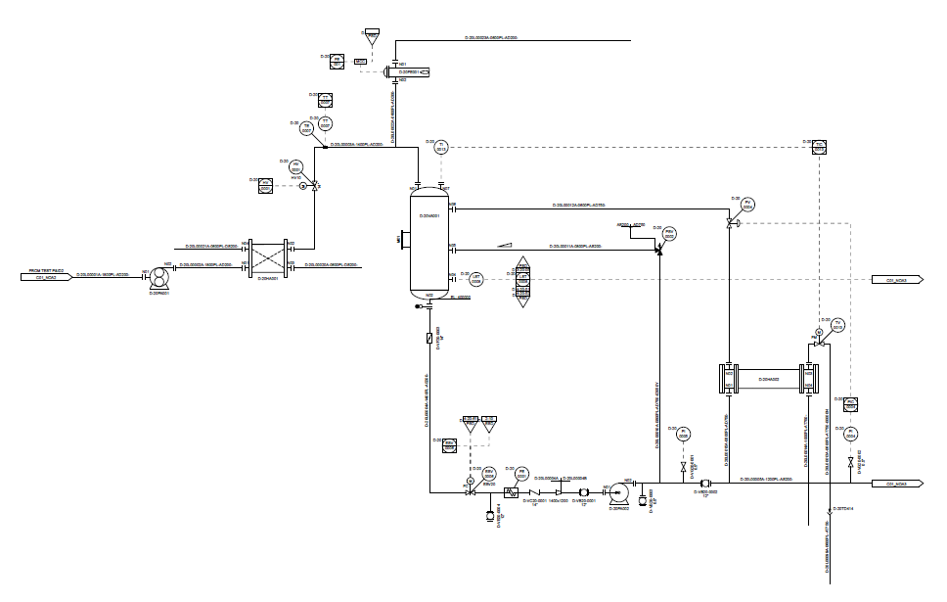
Remove the note and unused nozzle from 20VA001 and update elevation to EL. 400000

Slide 8
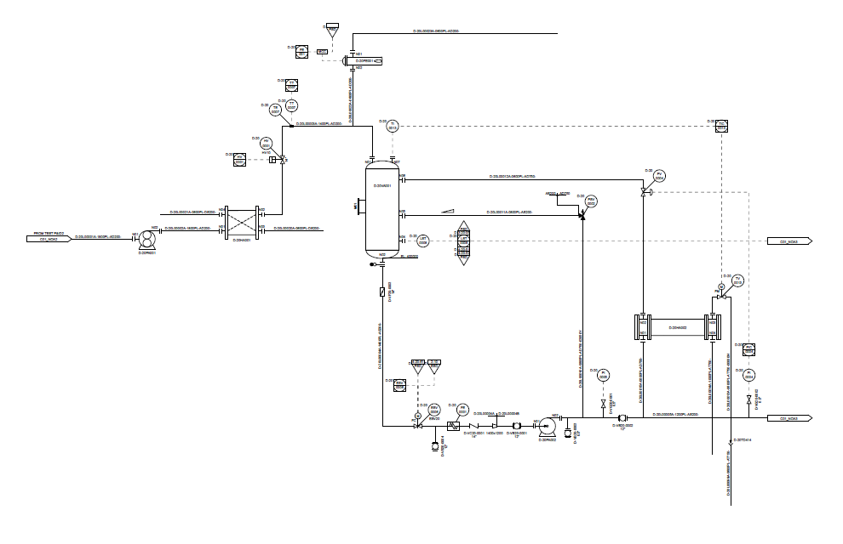
Change the type of actuator for HV0001 to a PA006A actuator type
Retain PersistentID of original actuator

Slide 9
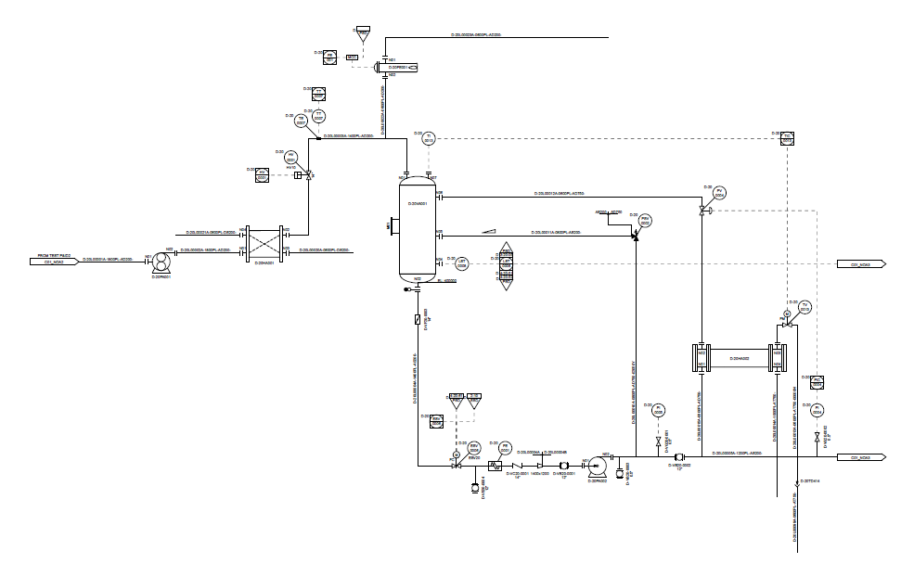
Add heat tracing to PipingNetworkSegment D-20L A- PL-AS200-
Modify the heat trace attribute on the segment

Slide 10

Modify TI0007 combination -> TW/TT combination with Special Item on PipingNetworkSegment
** Use ND0037 ‘hidden’ in-line piping component to give location of special item.

Slide 11

Additional property break to the existing breaks
Add AreaBreak AP110 / AP310 need to associate PlantArea these to the PipingNetworkSystems
** Test transfer of PropertyBreak:
Top break: use PropertyBreak class elements and separate LogicalBreak class elements for each break type.

Slide 12
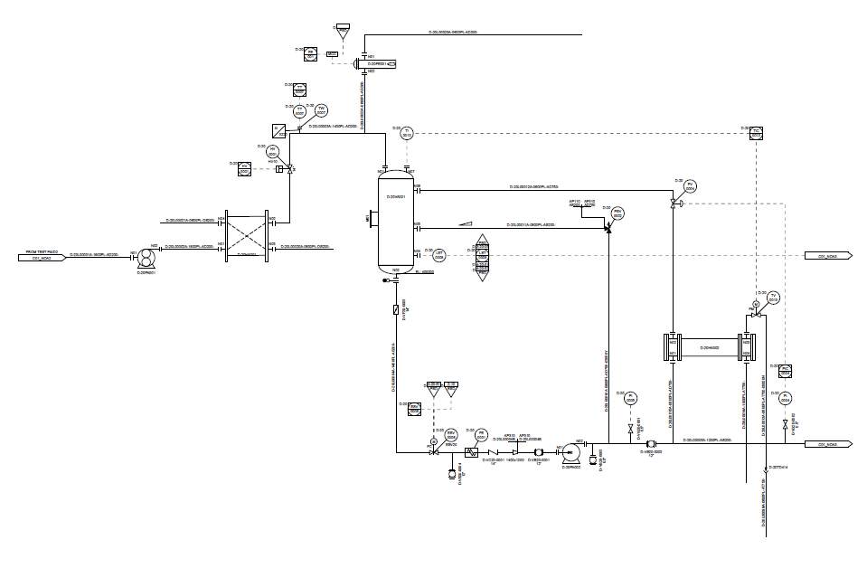
Scale D-20HA001 symbol y-axis scaling 1.25

Slide 13
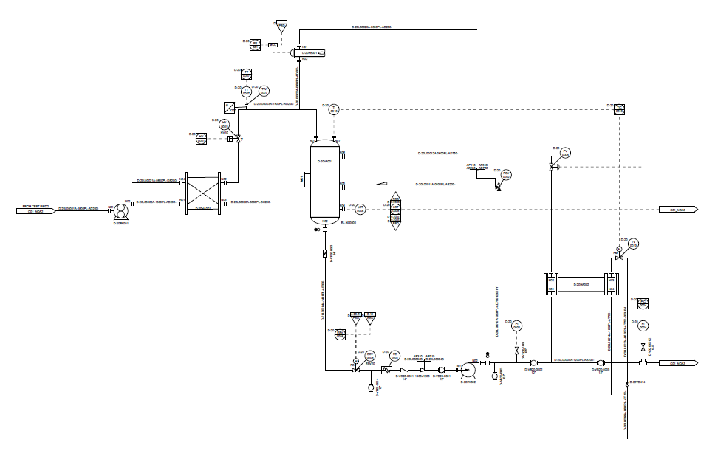
Modify pipe lines: D-20L00005A-1200PL-AS200- & D-20L00015A-0800PL-AD750- to test PipingNetworkSegment export variants
Convert D-20L00015A-0800PL-AD750- into a segment of D-20L00005A-1200PL-AS200- where all piping properties will be the same as D-20L00005A-1200PL-AS200- main pipe.
Add spectacle blind
Add physical piping tee near OPC.
Add ball valve D-VB20-0005
2 PipingNetworkSegments will be created either side of the ball valve D-VB20-0002 that is part of the main line.

Slide 14
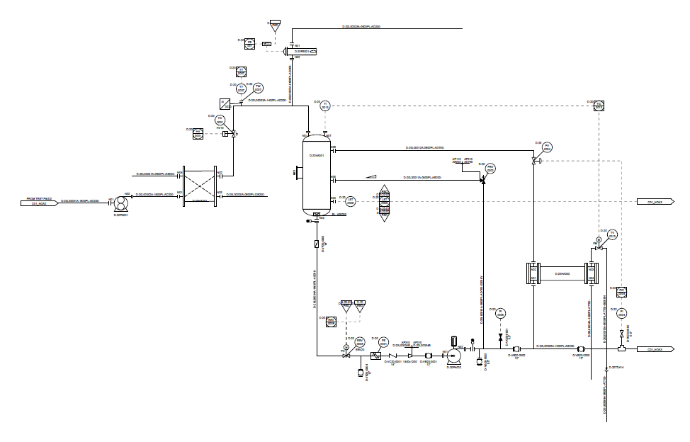
Add driver for pump. Add VortexBreaker internal.
Add pump driver.
Add VortexBreaker internal
Change NormalPosition for valve D-VG20-0001 to ‘NC’

Slide 15
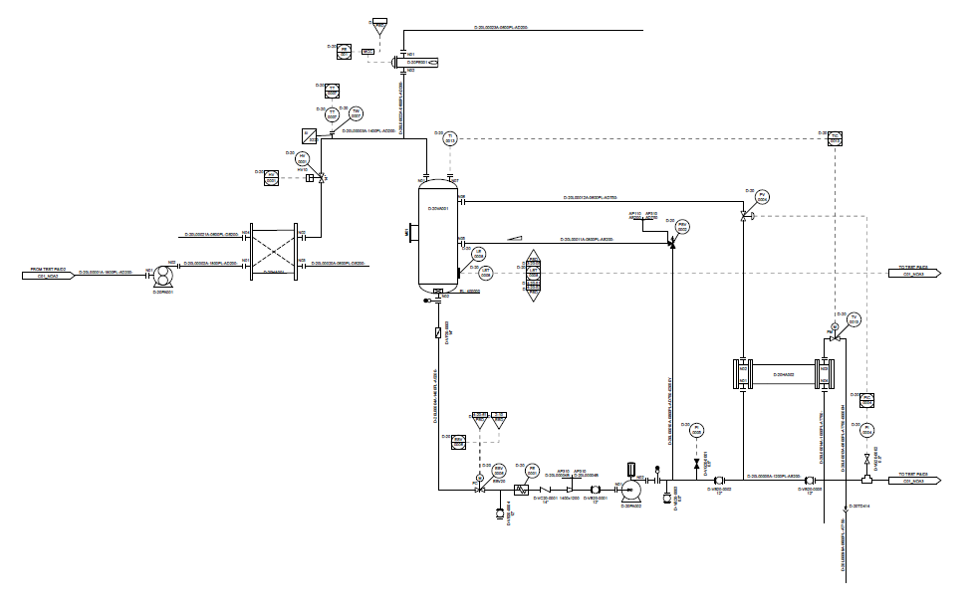
Mount-on & Off-Page Signal
Add Mount-on level element
Remove N04
Add NOA3 continuation drawing

Slide 16
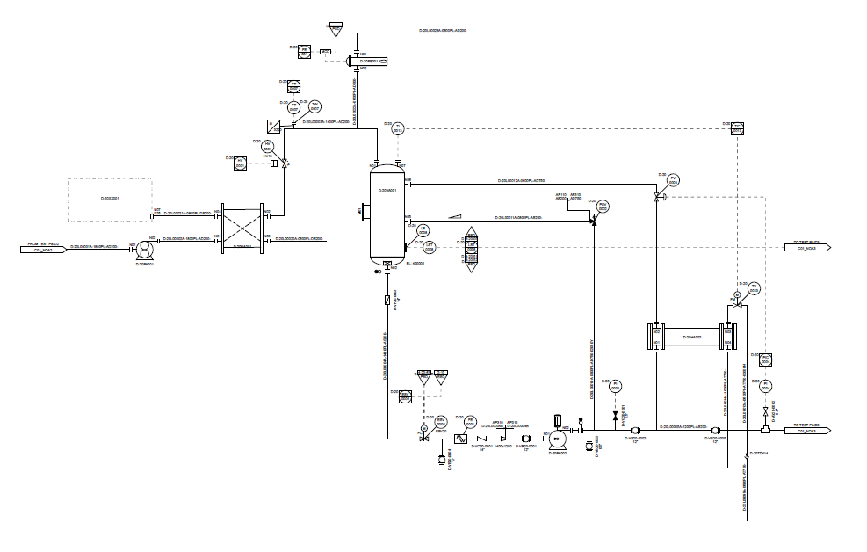
Add CustomEquipmentPackage
Add CustomEquipmentPackage
Add MechanicalJoint

