Slide 1

SyriaTel Customer Churn Prediction
Phase 3 Data Science Project
Presented by: CPA Anthony Njiru

Slide 2

Business Objectives
1. Identify behavior patterns linked to churn.
2. Predict at-risk customers with classification models.
3. Recommend data-driven retention strategies.

Slide 3
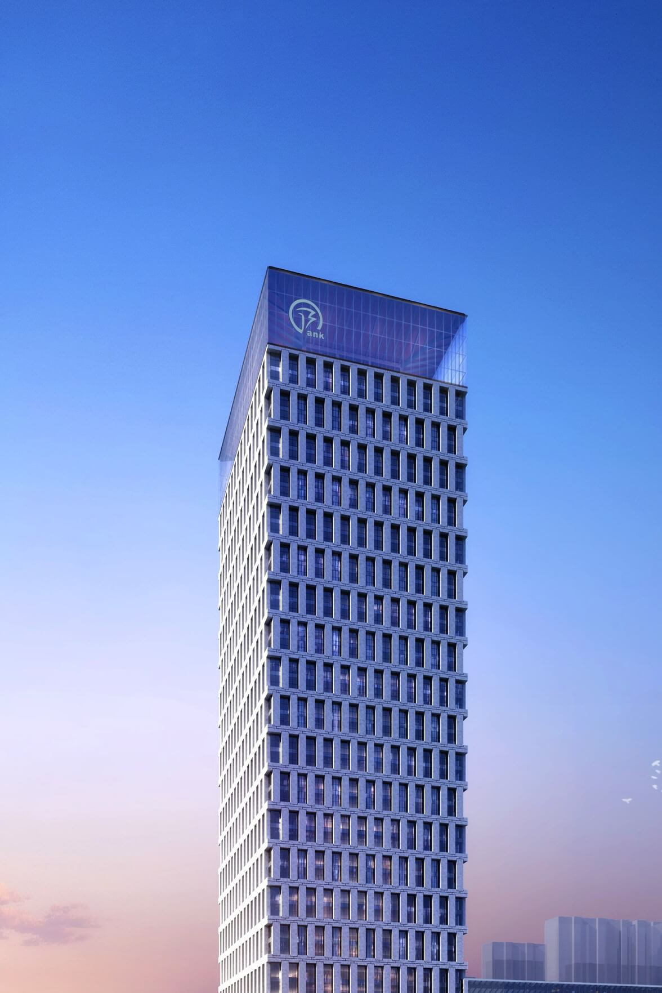
▰ Dataset Overview
3,333 customer records from SyriaTel telecom
Features include: usage stats, plans, support calls.
Target: churn (0 = No, 1 = Yes).

Slide 4
Churn Distribution
14%
Dataset is imbalanced: ~14% churn, 86% no churn.
Models must account for this imbalance.
86%

Slide 5
Data Preparation
Dropped identifiers like phone number.
Encoded categorical columns and split data.
Stratified 80/20 train-test split.

Slide 6
Correlation with Churn
Customer Service Calls
Customer Churn Indicators
Day Minutes/Charges
Voicemail Usage

Slide 7
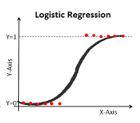
Baseline Model: Logistic Regression
Model failed to converge due to feature scale/complexity.
Performance was poor on churn recall (23%).
Shifted focus to tree-based models.

Slide 8
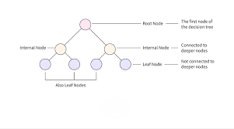
Model 2: Decision Tree
Improved recall (64%) and accuracy (92%).
Simple and interpretable, but still prone to overfitting.

Slide 9
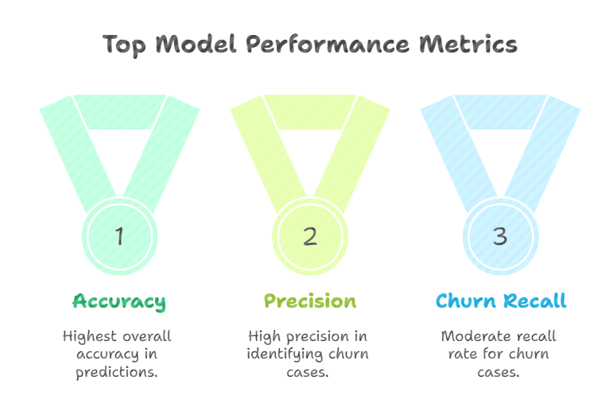
Final Model: Random Forest
Accuracy: 93%, Churn Recall: 60%, Precision: 89%.
Best balance of recall and precision.
Handles complex patterns and class imbalance well.

Slide 10
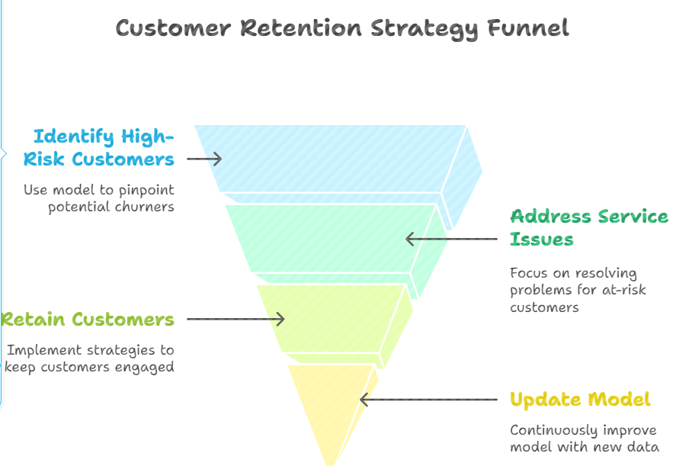
Recommendations
Use model to flag high-risk customers early.
Prioritize retention for those with service issues.
Retrain model regularly with new data.

Slide 11
Thank You
Questions?
https://github.com/TonieMuthee/Phase_3_Project.git

